Slide 1
Nuxtjs
December 24th

Slide 2

Nuxtjs
Nuxt.js is a frontend framework built upon Vue.js
Support server side rendering
Automatically generated routes
Vuex store
Improved meta tags managing and SEO improvement.

Slide 3
Directory Structure
Assets
Components
Layouts
Middleware
Page
Plugins
Static
Store
Util
nuxt.config.js

Slide 4




Syntax

Slide 5
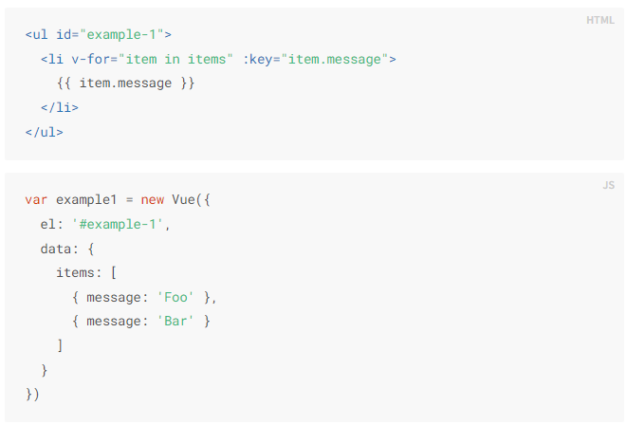
Syntax

Slide 6
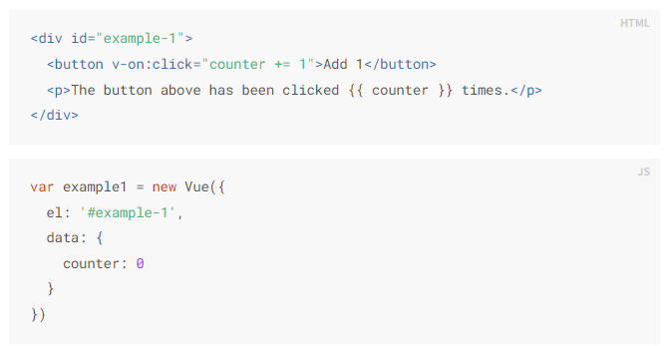
Syntax

Slide 7
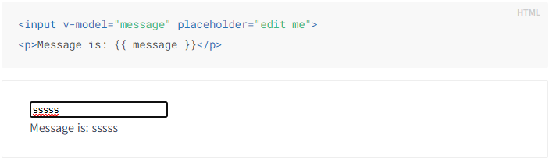
Syntax

Slide 8
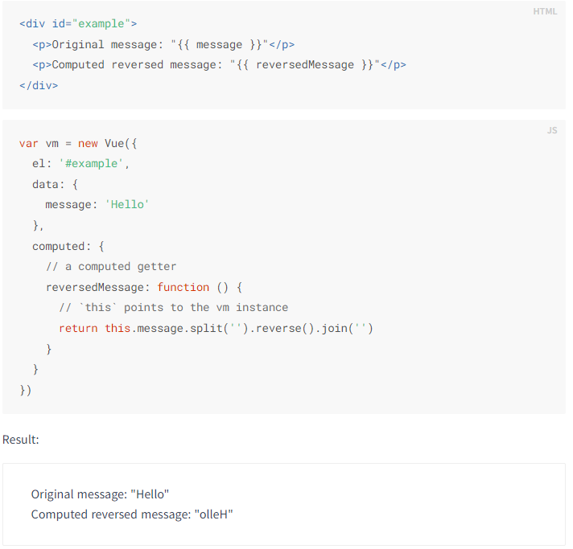
Computed

Slide 9
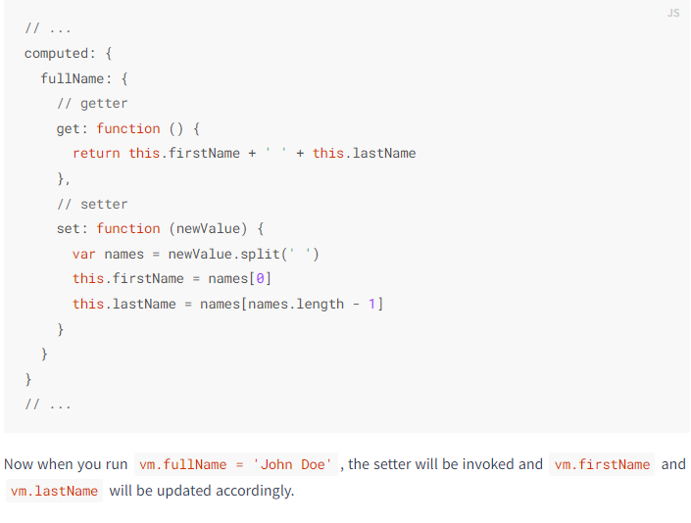
Computed

Slide 10
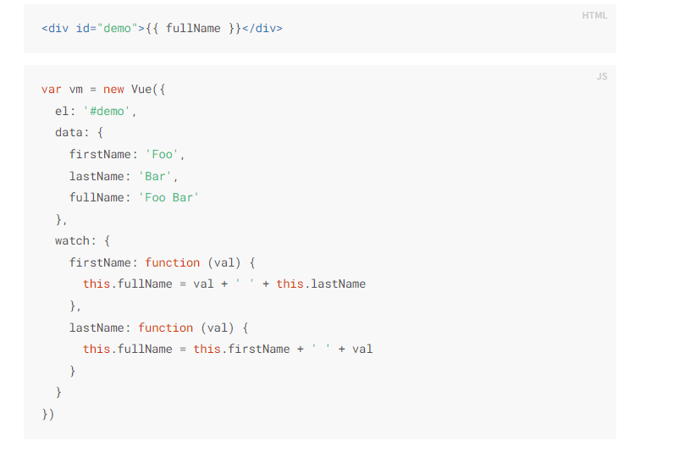
Watch

Slide 11
Life circle
Before create
Created
Before mount
Mounted
Before update
Updated
Before destroy
Destroyed

Slide 12
Nuxt config

Slide 13
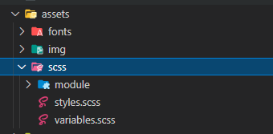
Assets
The assets directory contains assets such as Sass files, images, or fonts.
<img src="~/assets/your_image.png" />

Slide 14
Static
The static directory is directly mapped to the server root () and contains files that likely won't be changed
<img src="/my-image.png" />

Slide 15
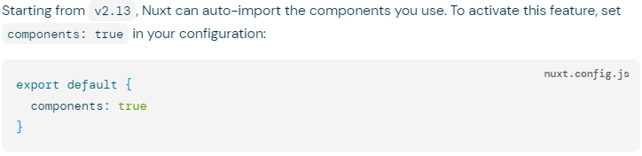
Components
The components directory contains your Vue.js Components

Slide 16
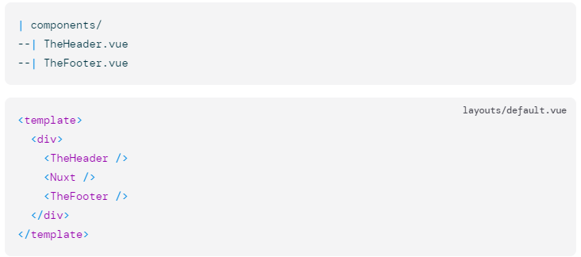
Components

Slide 17
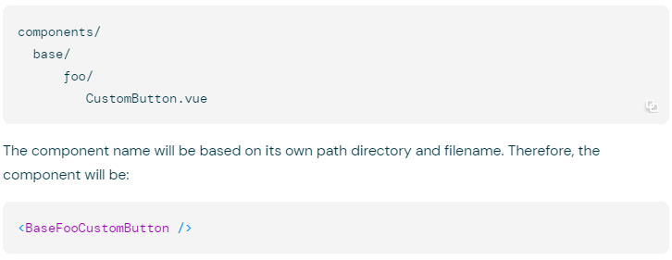
Components

Slide 18
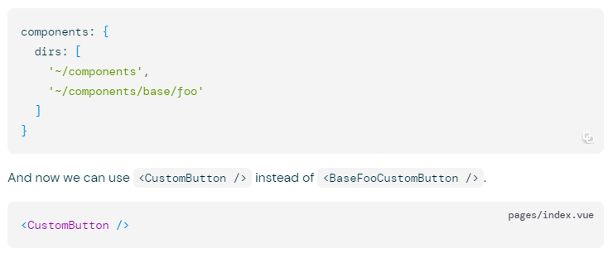
Components

Slide 19
Store
State: Store aplication state
-> this.$store.state.user
Getters: similar to computed
-> this.$store.getters.user
Mutations: change state in vuex store
-> this.$store.commit(‘user’, {})
Actions: Use to call mutation, can use async
-> this.$store.dispatch(‘user’, {})

Slide 20
Layout

Slide 21
Middleware

Slide 22
Pages
Middleware
Layout
Route

Slide 23
Plugin

Slide 24
Util
Used to store functions that are called many times, for example, format phone, format date ...

Slide 25
Vuetify

Slide 26
Working with list, create, update, delete

Slide 27
Any Questions?

Slide 28
Thanks!

