Slide 1


JavaScript
with

Slide 2

HTML/CSS
with

Slide 3

c++
with

Slide 4

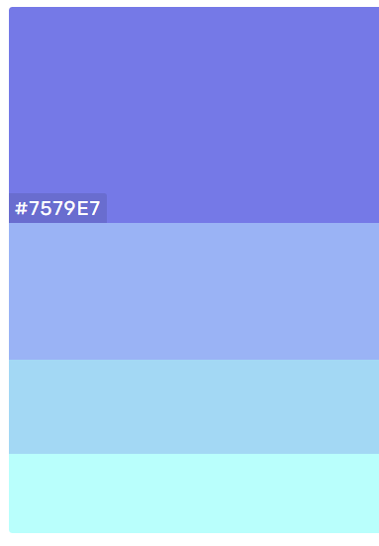
Python
with

Slide 5

AgularJs
with

Slide 6
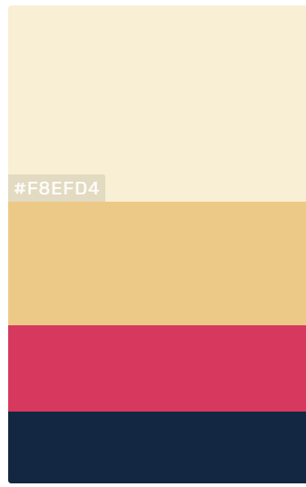
Ruby
with

Slide 7

Reponsive
with

Slide 8


Golang
Web Dev ?
with

Slide 9

.NET
Engineer ?
with

