Slide 1


JavaScript
Web Dev ?
with

Slide 2
For Newbie

Slide 3

HTML/CSS
Zero to Hero !!!
with

Slide 4

c++
Are you Beginer
with

Slide 5

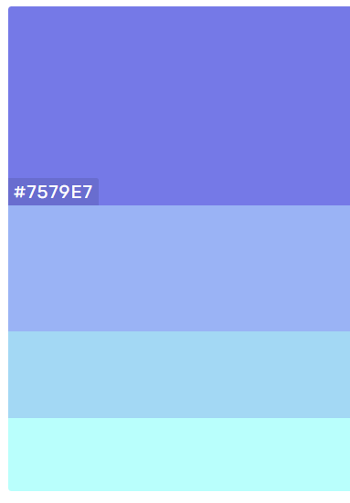
Python
For Beginer ?
with

Slide 6

AgularJs
Web Dev ?
with

Slide 7

Ruby
Are you Beginer
with

Slide 8

Reponsive
Web Dev ?
with

Slide 9


Golang
Web Dev ?
with

Slide 10

.NET
Engineer ?
with

Slide 11


Slide 12


Slide 13



Slide 14
C++

Slide 15
JS

Slide 16
HTML

Slide 17
PYTHON

Slide 18
JAVA

Slide 19
TEEN
CODE

Slide 20
PHP

Slide 21
CSS

Slide 22
C#

Slide 23
.NET

