Slide 1

SIML@B
JRC toolbox to perform Uncertainty and Sensitivity Analysis
12th Summer School on Sensitivity Analysis – SAMO
Parma, June 24th 2024

Slide 2
JRC SIML@B WebApp
It is a free online tool
Developed using RStudio and Shiny
Named after the previous SIMLAB (SIMulation LABoratory)
Provides a set of online user friendly tools (no need to code) to perform uncertainty analysis and sensitivity analysis (UASA) of model output
Notes:
A sostituita con @ per dare idea di qualcosa di web

Slide 3
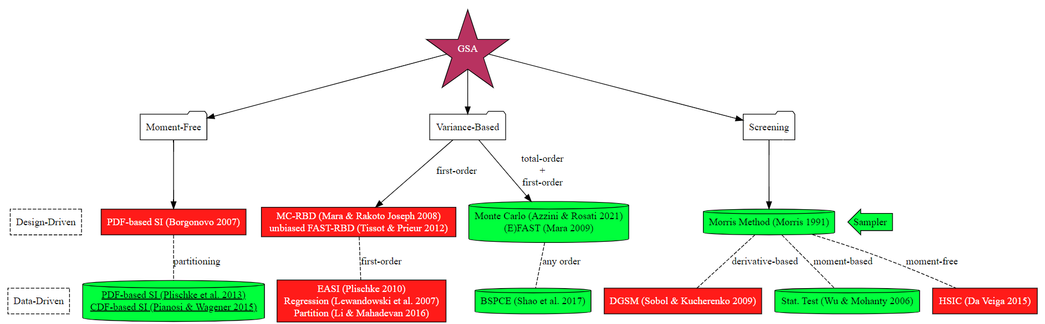
WebApp project structure
Design-Driven Methods: require specific design of experiments (sampler module)
Data-Driven Methods: only require an input/output Monte Carlo sample
Modules already active
Modules under development

Slide 4



SIML@B Global Sensitivity Analysis Methods
Moment Free Methods
They do not rely on any specific moment of the output
Screening Methods
They are used for factor fixing setting
Qualitative methods, they do not allow the ranking of the input variables by order of importance
Variance-based methods
Based on the analysis of the output variance (ANOVA decomposition)
Ilya M. Sobol’ (1993)

Slide 5
Sampler module

Slide 6
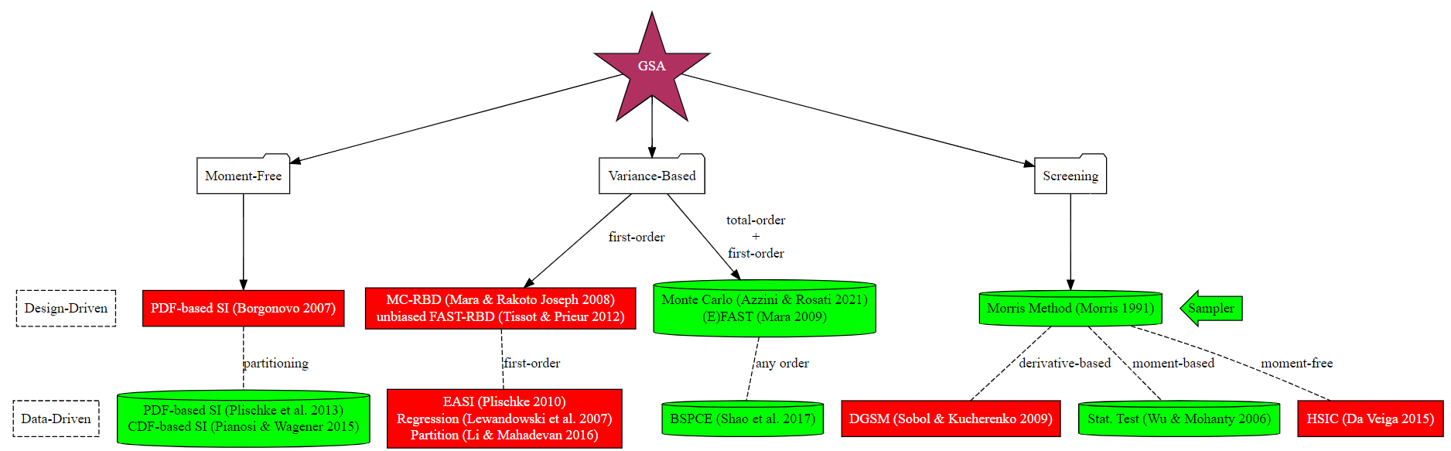
Open SIML@B
https://web.jrc.ec.europa.eu/rapps/pub/simlab/

Slide 7
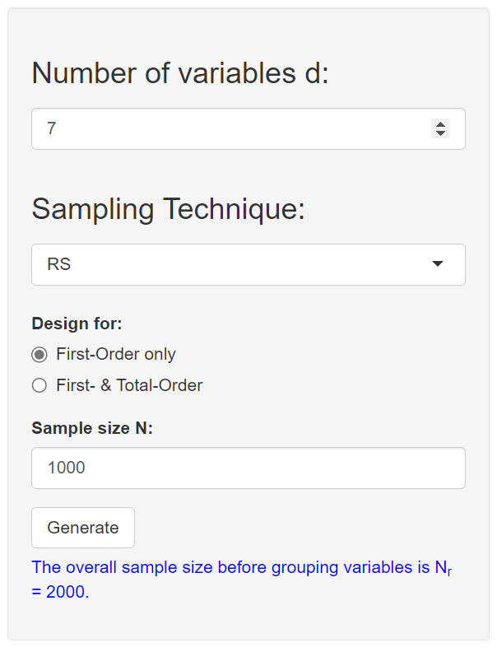
Generate the sample
Define the total number of input variables of the function
RS: Random sample
LHS: Latin Hypercube Sample (generating a near-random sample of parameter values from a multidimensional distribution)
QMC: Quasi-Monte Carlo sample (quasi-random sequences)
FAST: Fourier Amplitude Sensitivity Test method sampling
Morris: Morris Method sampling (varying one factor at a time)
First-Order Only (2N)
First- & Total-Order (N x d)
Define the sample size (N)
Notes:
Open Siml@b and do a couple of example together:
Random sampling and FAST
Uniform distribution
Uniform distribution + change the range
Normal distribution + change range

Slide 8
Piston Function

Slide 9

Piston Simulation function
The Piston Simulation function models the circular motion of a piston within a cylinder. It involves a chain of nonlinear functions
The response C is cycle time (the time it takes to complete one cycle), in seconds.
$$C\left(x\right)=2π\sqrt{\frac{M}{k+S^{2} \frac{P_{0} V_{0}}{T_{0}} \frac{T_{a}}{V^{2}}}}, where$$
$$V=\frac{S}{2 k}\left(\sqrt{A^{2}+4k\frac{P_{0} V_{0}}{T_{0}}T_{a}}−A\right)$$
$$A=P_{0}S+19.62 M −\frac{k V_{0}}{S}$$
https://www.sfu.ca/~ssurjano/piston.html

Slide 10
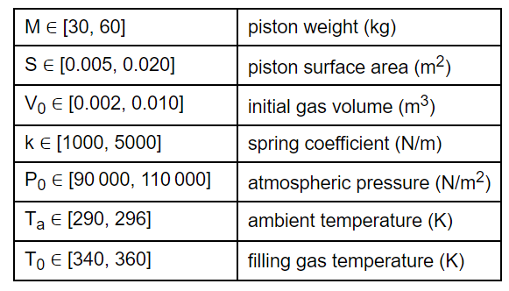
Piston Simulation function
The Piston Simulation function models the circular motion of a piston within a cylinder. It involves a chain of nonlinear functions
The response C is cycle time (the time it takes to complete one cycle), in seconds.
7 Input variables

Slide 11
Generate the sample
Define the total number of variables of the function
7 variables
RS: Random sample
LHS: Latin Hypercube Sample (generating a near-random sample of parameter values from a multidimensional distribution)
QMC: Quasi-Monte Carlo sample (quasi-random sequences)
FAST: Fourier Amplitude Sensitivity Test method sampling
Morris: Morris Method sampling (varying one factor at a time)
First-Order Only (A, B)
First- & Total-Order (A, B, Abi)
Define the sample size
1000

Slide 12
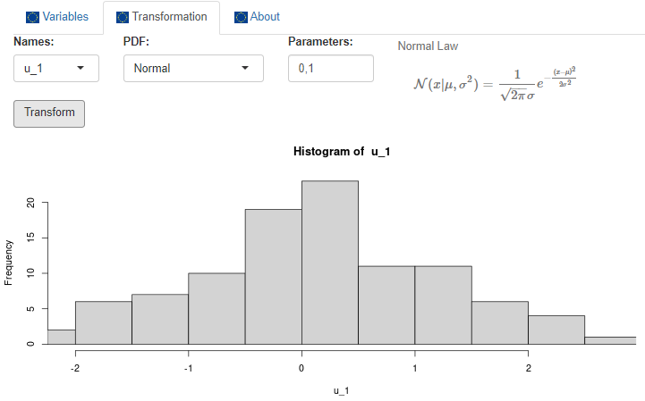
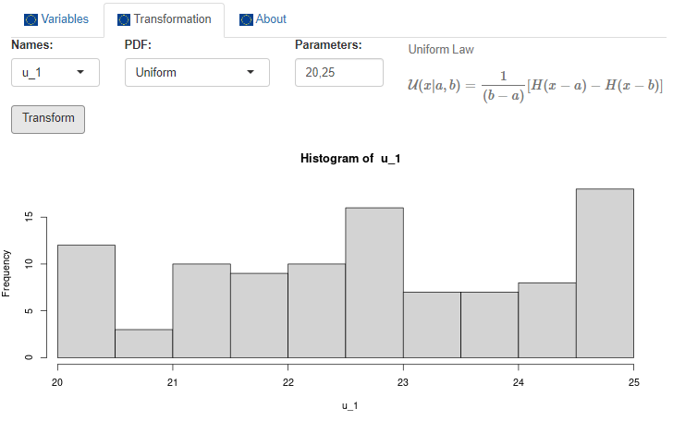
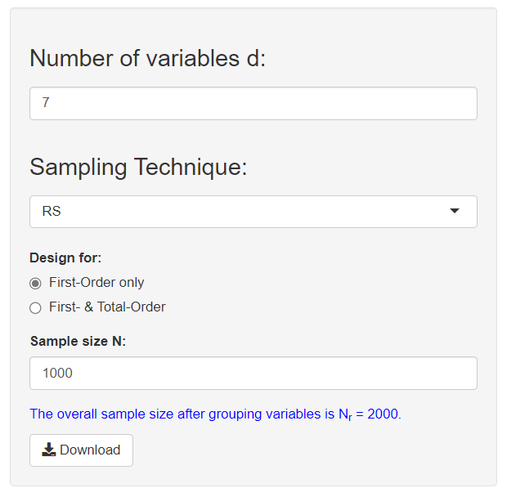
Define Input Variables
Notes:
Show an example on Simlab

Slide 13
Define Input Variables

Slide 14

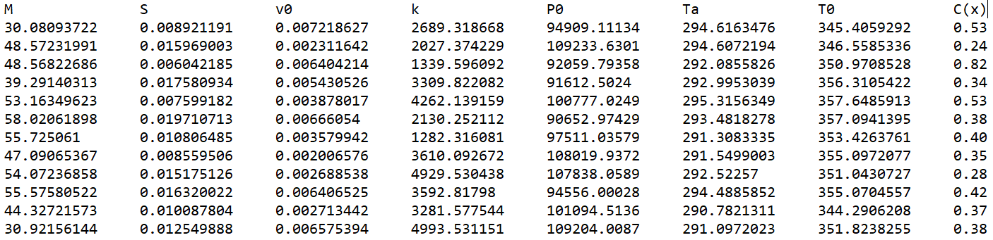


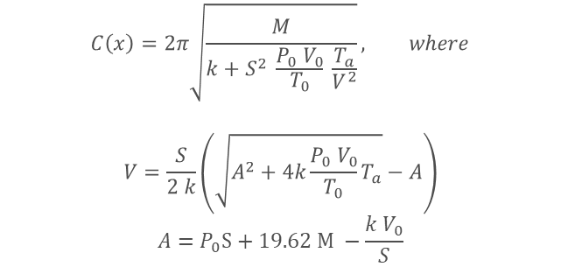
Download the input file and Run the model
Input
Run the model
$$C\left(x\right)=2π\sqrt{\frac{M}{k+S^{2} \frac{P_{0} V_{0}}{T_{0}} \frac{T_{a}}{V^{2}}}}, where$$
$$V=\frac{S}{2 k}\left(\sqrt{A^{2}+4k\frac{P_{0} V_{0}}{T_{0}}T_{a}}−A\right)$$
$$A=P_{0}S+19.62 M −\frac{k V_{0}}{S}$$
Output

Slide 15

Thank you
© European Union 2024
Unless otherwise noted the reuse of this presentation is authorised under the CC BY 4.0 license. For any use or reproduction of elements that are not owned by the EU, permission may need to be sought directly from the respective right holders.
Slide xx: element concerned, source: e.g. Fotolia.com; Slide xx: element concerned, source: e.g. iStock.com
Notes:
Update/add/delete parts of the copy right notice where appropriate.
More information: https://myintracomm.ec.europa.eu/corp/intellectual-property/Documents/2019_Reuse-guidelines%28CC-BY%29.pdf

