Slide 1

House prices in Perth
Thierry Zonneveld
Spiros basilakes

Slide 2
We will talk about:
What we set out to do
Tools
Data gathering
Methods
Results

Slide 3
What we set out to do
Dashboard to help user find location
Find relevant data
Build engine to train and predict based on user input

Slide 4
Which Perth suburb to buy a house in based on specific input parameters?

Slide 5
Tools
Python Pandas
Python Matplotlib / Seaborn
Python Scikit Learn
HTML/CSS/Bootstrap
JavaScript / Leaflet
SQL Database
Flask / Heroku app for deployment

Slide 6
Data gathering
Data gathering:
Kaggle – csv file on housing data
Github – geojson with suburb boundaries

Slide 7
Architecture
[Insert screenshot of file structure on Github]

Slide 8
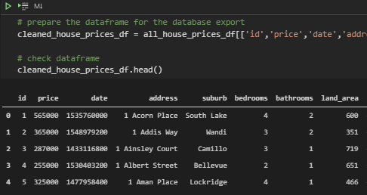
ETL.ipynb & db.sqlite
Extracting & cleaning relevant data
Transforming columns and headers
Loading to SQLite database using SQLalchemy

Slide 9
Methods
ETL

Slide 10

Machine Learning
Apply what we learned
Notes:
Looked at what we’ve been doing in class and figuring out which of the many varieties apply to our dataset and goal.

Slide 11
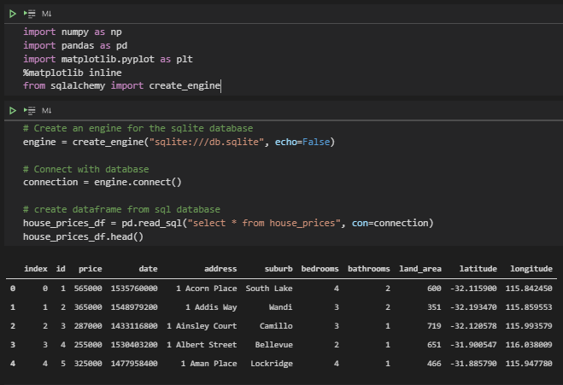
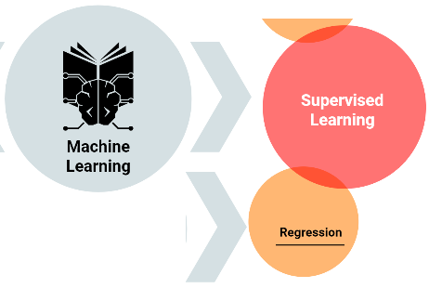
Machine Learning
Linear Regression
Boilerplate code!
Notes:
Supervised Learning => Linear regression
Of course boilerplate code!

Slide 12
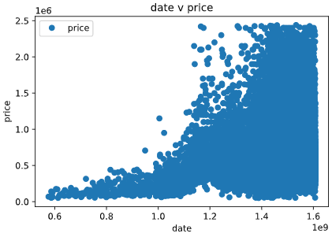


Machine Learning
Progress!
Notes:
Looking at data:
-Scatterplots indicate linearity

Slide 13
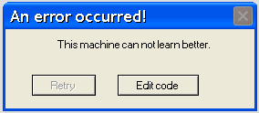
Machine Learning
Stuck ☹
Notes:
Couldn’t:
-Increase accuracy
-Export model
What can we do? What did others do?

Slide 14
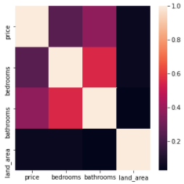

Machine Learning
Progress!
Notes:
Looking at other’s methods & data:
-Check for multicollinearity: None! - variables do not interfere with correlations
-Support for linear regression, on top of using numerical data to predict numerical data
-More models!

Slide 15
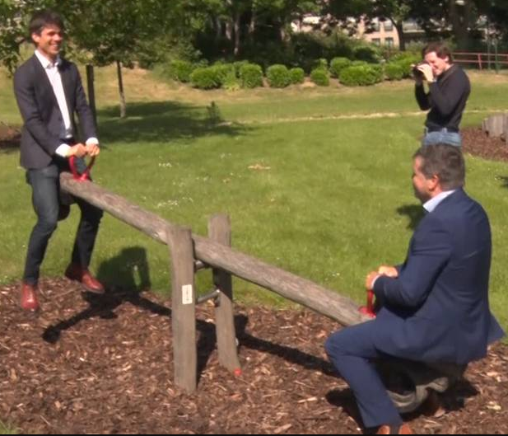
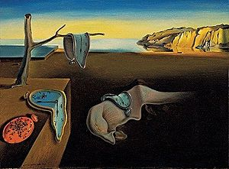

Machine Learning
Models work!
Notes:
Models work but huge trade off between quickness and complexity & accuracy

Slide 16
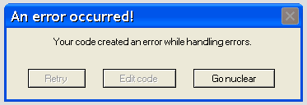
Machine Learning
Stuck ☹
Notes:
Could not progress from here.

Slide 17

Machine Learning
Stuck ☹
Notes:
Realised we needed to revise last few steps to better apply concept of ML:
-Further manipulate dataset to input expected outcomes LR, which improves training and testing
-Match predictions based on website input variables to allow for LR to give maximum # of hits

Slide 18
At least we didn’t use pie charts.
- Team two-beards

