Slide 1

House prices in Perth
Thierry Zonneveld
Spiros basilakes

Slide 2
We will talk about:
What we set out to do
Tools
Data gathering
Methods
Results

Slide 3
What we set out to do
Dashboard to help user find location
Find relevant data
Build engine to train and predict based on user input

Slide 4
Which Perth suburb to buy a house in based on specific input parameters?

Slide 5
Tools
Python Pandas
Python Matplotlib / Seaborn
Python Scikit Learn
HTML/CSS/Bootstrap
JavaScript / Leaflet
SQL Database
Flask / Heroku app for deployment

Slide 6
Data gathering
Data gathering:
Kaggle – csv file on housing data
Github – geojson with suburb boundaries

Slide 7
Architecture
[Insert screenshot of file structure on Github]

Slide 8
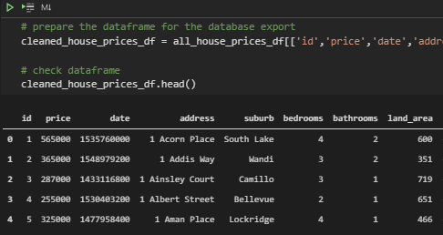
ETL.ipynb & db.sqlite
Extracting & cleaning relevant data
Transforming columns and headers
Loading to SQLite database using SQLalchemy

Slide 9
Methods
ETL

Slide 10
At least we didn’t use pie charts.
- Neil Armstrong

