Slide 1
Re-check Lot NG (Lot Out & Lot NG in process)
Day1: Incoming/Process NG
Day2: Sorting
Day3: Sorting
Kéo ra
500pcs
Kho NG
500pcs
NG Lot
Q’ty: 1000pcs
Kéo ra
400pcs
MCS lập “Recheck card”
Hiện trường phân biệt như thế nào lk OK/NG?
OK
200pcs
NG
300pcs
Trả lại NG
300pcs
OK
NG
Chưa
Kho NG
Q’ty: 1000pcs
E-Chop trên “Recheck card”
Hiện trường phân biệt như thế nào lk OK/NG?
Phân biệt như thế nào
Kho OK
300pcs
IQC proposal : Vẫn keep việc đóng dấu “re-check OK” như hiện tại, để MCS tiện phân biệt khi vợt OK

Slide 2
Re-check linh kiện quá hạn 1 năm
Day: 30-Aug-2024
Lo1: Date: 9-2023
MCS lập “Recheck card”
IQC E chop trên “Recheck card”
Lo2: Date: 10-2023
Lo3: Date: 9-2022
Re-check lo NG và Re-check hàng quá hạn 1 năm sử dụng chung format “Recheck card”
Phân biệtFIFO như thế nào
IQC proposal : ??

Slide 3
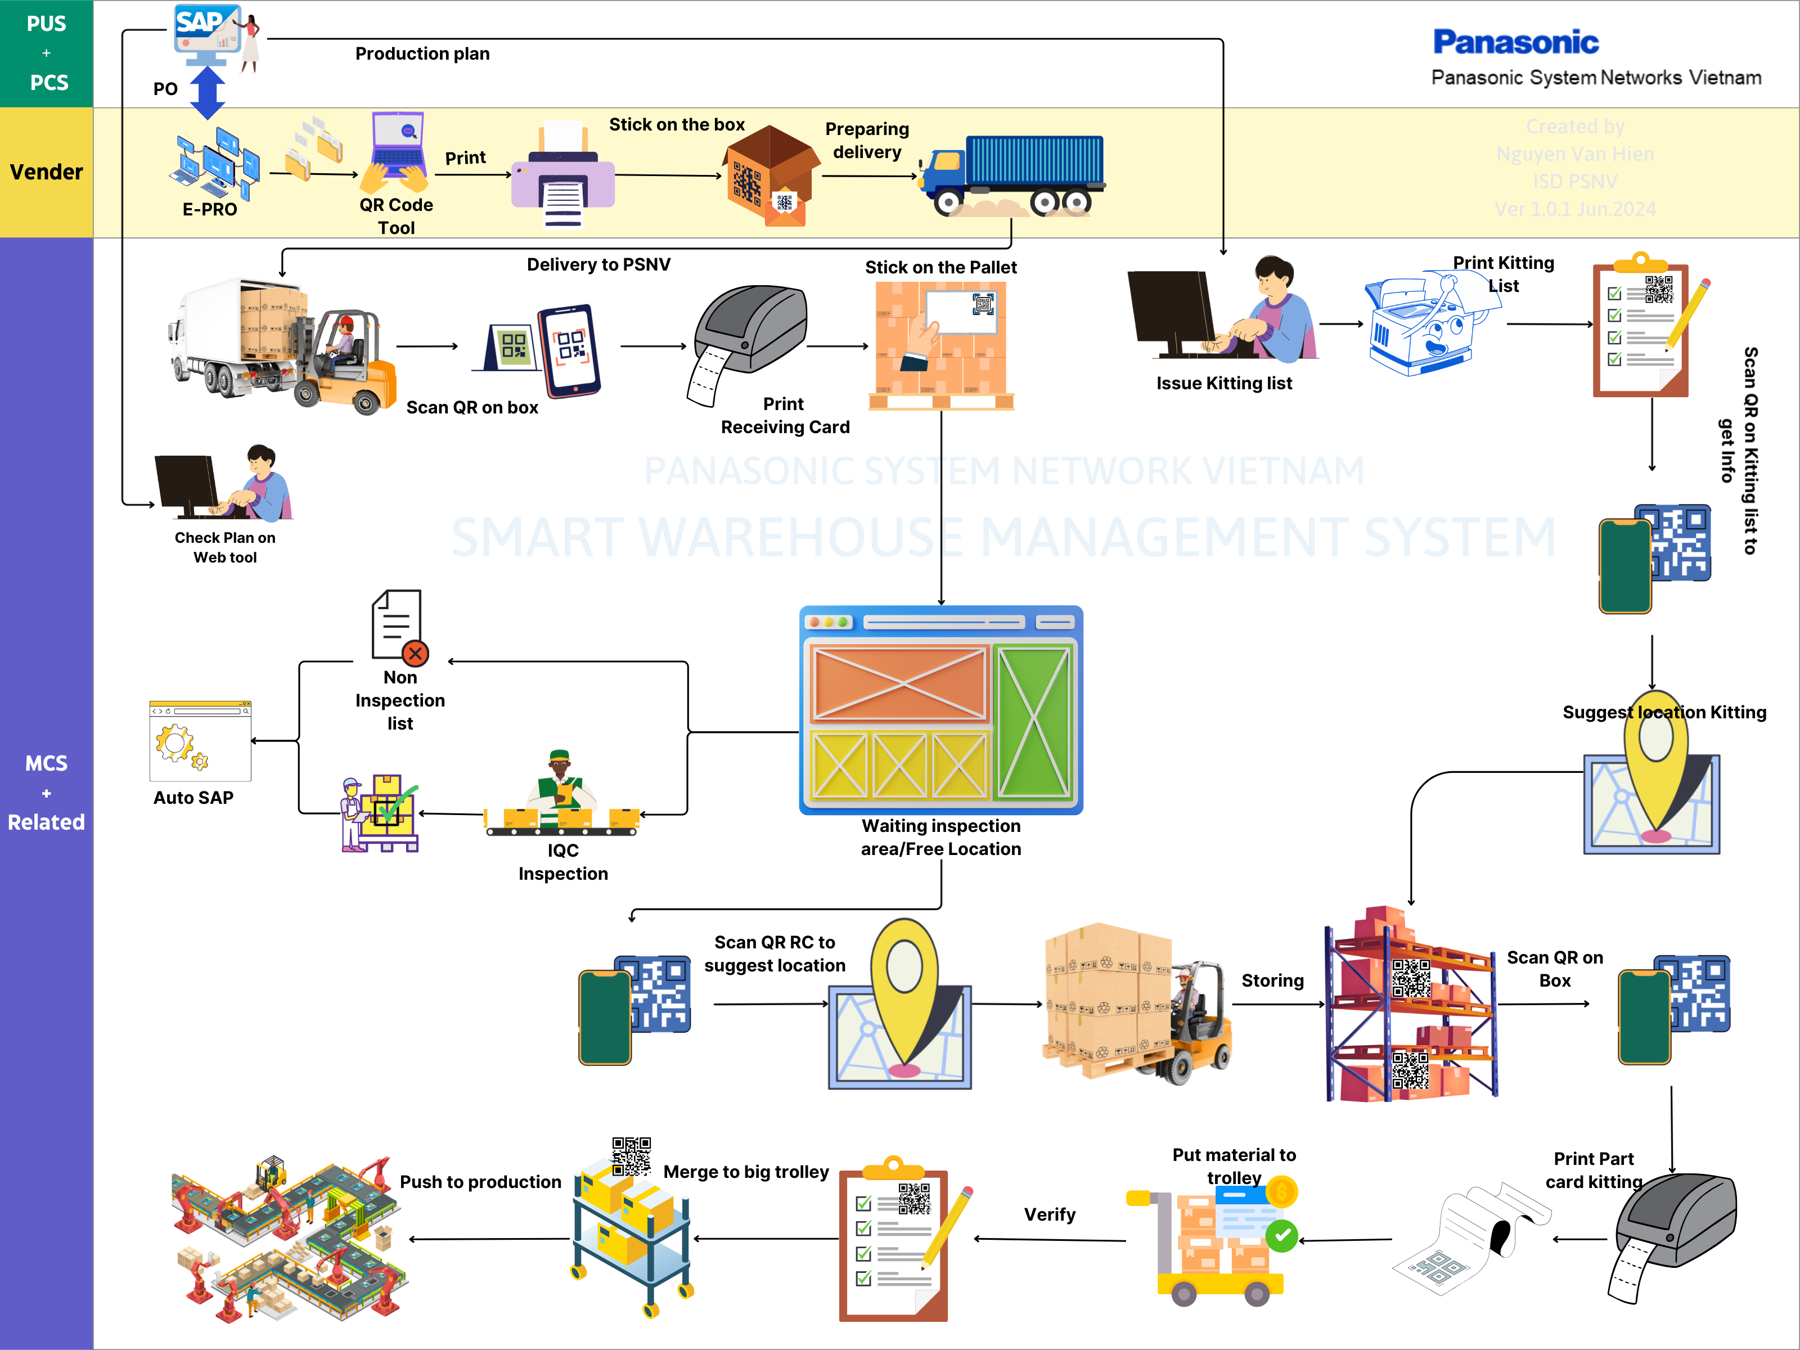
RECEIVING
GO-LIVE
TESTING
DEVELOPING

Slide 4


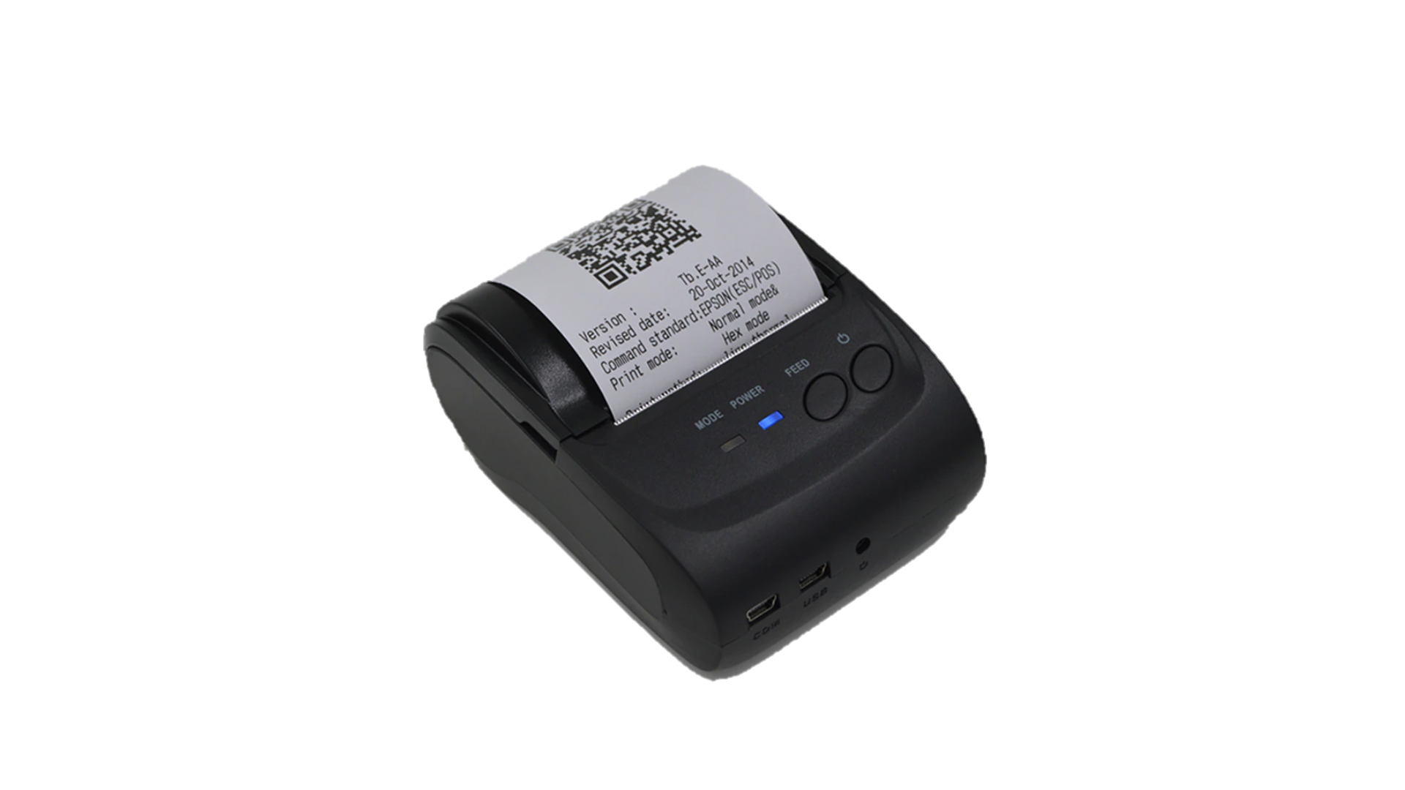

SWMS – E chop for IQC inspection
PROCEDURE
What kind of chop remove?
Inspection
OK
Good receipt
IQC check
Storing
Sampling box
All remain box
Receiving card
None inspection
Chop for
sampling box
➔ To record the box which is picked up
Chop for
All remain box
➔Approve indication
for all boxes.
To traceability
E-chop concept
Chop for
Receiving card
Approve
indication for lot.
To traceability
DETAIL OF PLAN
IQC Inspection function modify on website
IQC Inspection function add on PDA
E-Chop for IQC Inspection add on PDA + website
MCS
IQC inspection
Paste
OK
NG
Update
Not yet
PQC
Sampling
OK
Development time: 1 month(2pax)
Headcount reduce: 1pax
Day- Month- Year
Chop here
SWMS
PQC
Direct print stock card
Sampling chop
Inspection OK chop
Direction
Inspection OK
NG
location
E – chop cannot
replace
E – chop can replace
E – chop can replace
- Guideline store map
- Store function open
Store function close
Storing

Slide 5
SWMS – E chop for IQC inspection
PROCEDURE
What kind of chop remove?
Inspection
OK
Good receipt
IQC check
Storing
Sampling box
All remain box
Receiving card
None inspection
Chop for
sampling box
➔ To record the box which is picked up
Chop for
All remain box
➔Approve indication
for all boxes.
To traceability
E-chop concept
Chop for
Receiving card
Approve
indication for lot.
To traceability
MCS
IQC inspection
Paste
OK
NG
Update
Not yet
PQC
Sampling
OK
Day- Month- Year
Chop here
SWMS
PQC
Direct print stock card
Sampling chop
Inspection OK chop
Direction
Inspection OK
NG
location
E – chop cannot
replace
E – chop can replace
E – chop can replace
- Guideline store map
- Store function open
Store function close
Storing

Slide 6
IQC E-Chop
Non inspection
Part Incoming
inspection
Waiting Area
OK
SPL
NG
E-chop
E-chop
QT2
Kho SMT OK
Kho MCS OK
Kho NG
1 Year
Re-check
1 Year
Re-check
Re-check
E-chop
QT3
Manual Recheck OK
Sorting
Manual Recheck NG
E-chop
OK
NG
Grey
Manual Recheck OK
NG
Manual Recheck OK
OK
SPL
Manual Recheck NG
OK
SPL
QT4
NG
Manual Recheck NG

