Slide 1
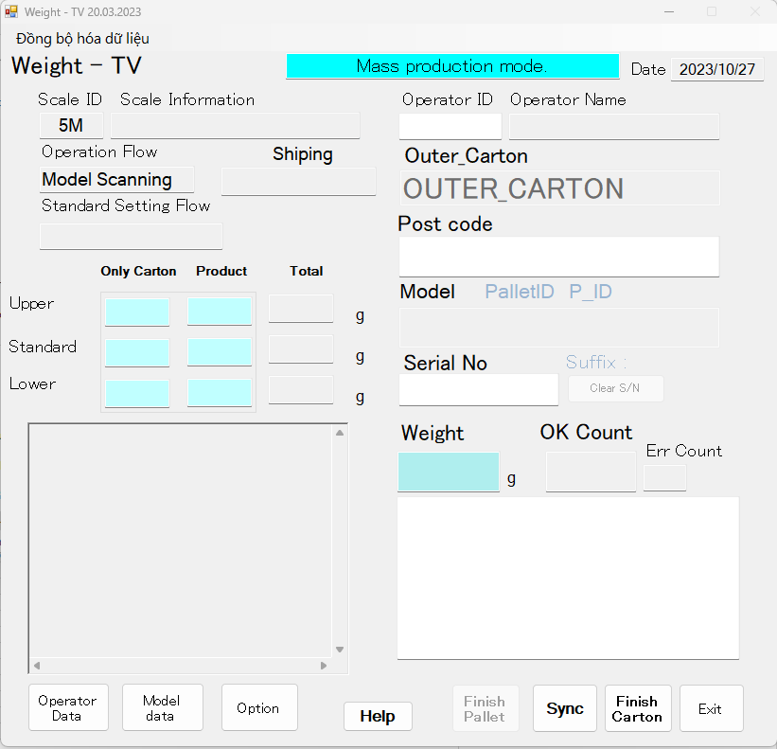
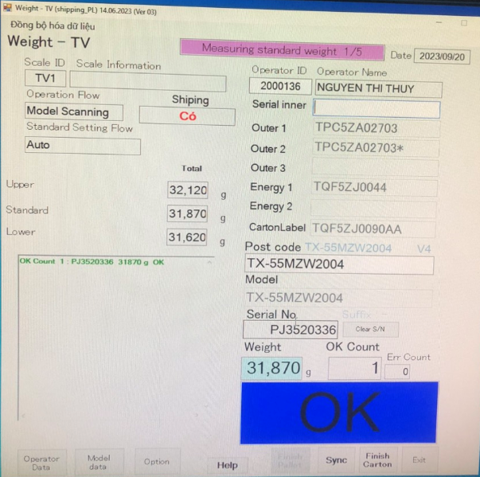
Edit weight check OleD TV
1/5
Make new function for weight check microwave scan serial product of supplier.
Developer: Nguyen Nhu Minh
Apply: Apr.2023
Expn: 0
Quality
◆Before
◆ After
New functions
Not time for manual control Serial label.
Not trace history.
Easy make mistake.
Not Ensure quality.
Easy manage operation and history
Reduce time to trace history.
Check function traceability and function PLC, Shipping of checker machine.
Notes:
HR other department training direct and paper for evulation .
For video training they need to make and edit about 20 hours
After anaylatis , we implement train online : learn by video, do exam one system , auto evulations…
About video training we using new technogy convert text for speech with many fomat : text or ppt ..
This activity help reduce more than 18k$

Slide 2

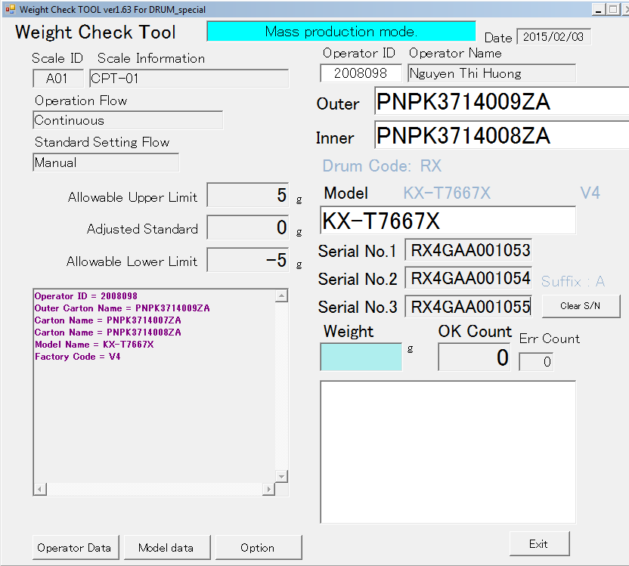
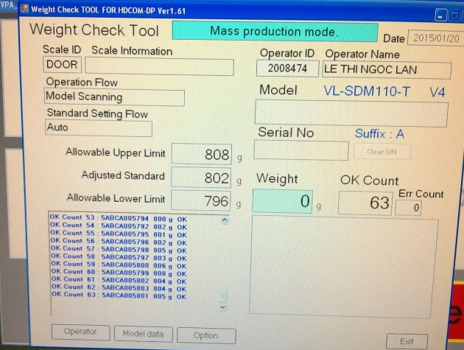
Enhanced Weight System
Week 2
Report items
Page 2/19
P.I.C: Hoang Viet Thien [AIO]
Developer: Nguyen Thi Huong [ISG]
Date: 4/Aug/2014
Expn: N/A
QUALITY
◆Before
◆ After
Have 3 S.No on carton
Only read 1 S.No
Add more fields Serial No.
No read postcode of Outer Carton
Old weight softwave only read 1 S.No on Carton ( One carton have 3 S.No )..
Old weight softwave don’t read postcode of outer carton. => Quality is affected
New weight-check softwave can read all S.No on carton , and read postcode of outer carton.
It help easy control S.No of products and prevent wrong part carton.

Slide 3
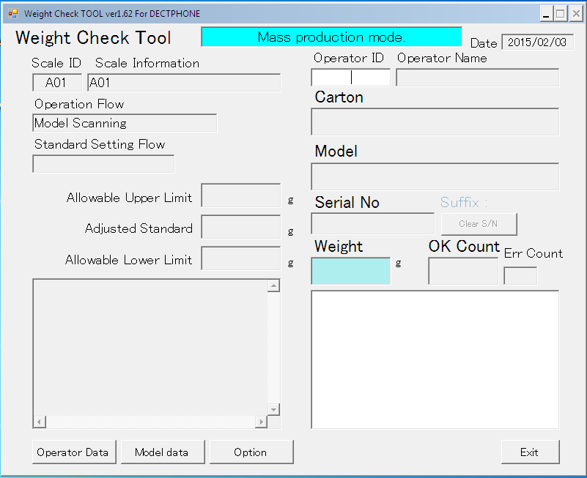
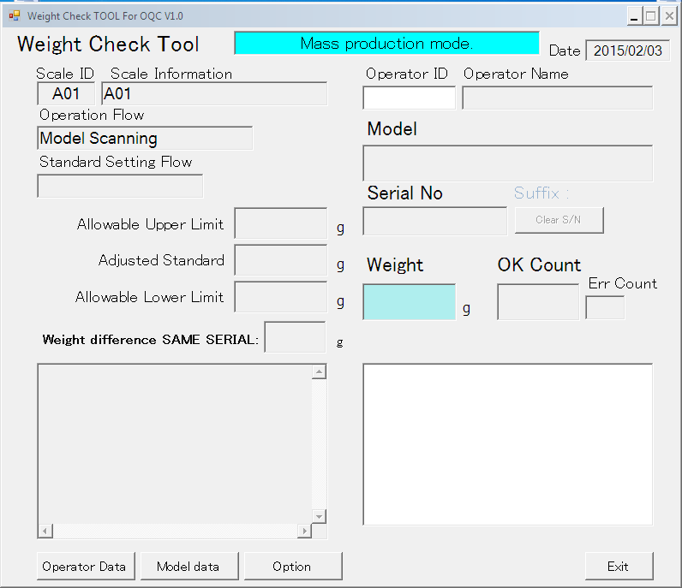
Enhanced Weight-Check System
Report items
Page 3/19
P.I.C: Hoang Viet Thien [AIO]
Developer: Nguyen Thi Huong [ISG]
Date: 08/Sep/2014
Expn: N/A
Save: 20$/month
◆Before
◆ After
Add 1 more field to Alert when change model / category
OQC check many model at same time And many time for change model, change category.
It takes long time for per checking time.
Reduction time : 16h/month
Cost reduction : 20$/month

Slide 4
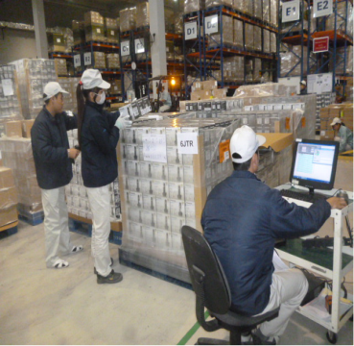
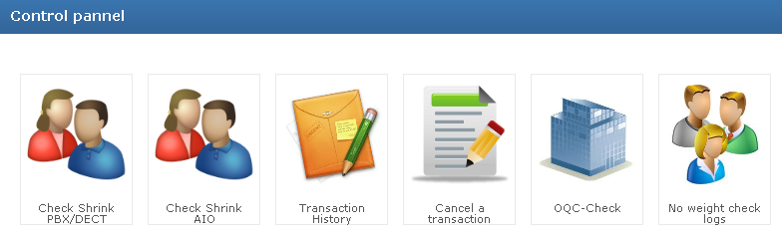
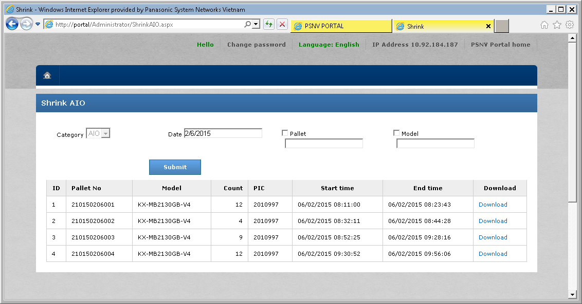
Packing Check System
Report items
Page 4/19
P.I.C: Nguyen Thu Phuong [SCM]
Developer: Nguyen Van Dung [ISG]
Date: 01/Sep/2014
Expn: N/A
Save: 180$ /month
■ Combine pallet un-full after Shrink process (Implement to DECT,PBX,AIO)
◆Before
After
Reading serial No at SCM WH For all pcs
Easy to control
Report issue automatically follow each pallet
Use 03 workers to read serail No ( 01 person directly read/ 01 person support arrange cargo/ 01 person check on computer)
Average takes: 200 hours/month
No need to scan serial (use only 1 person for checking again).Reduce 2 man power/process
Saving time:150 hours/month 180$/month

Slide 5
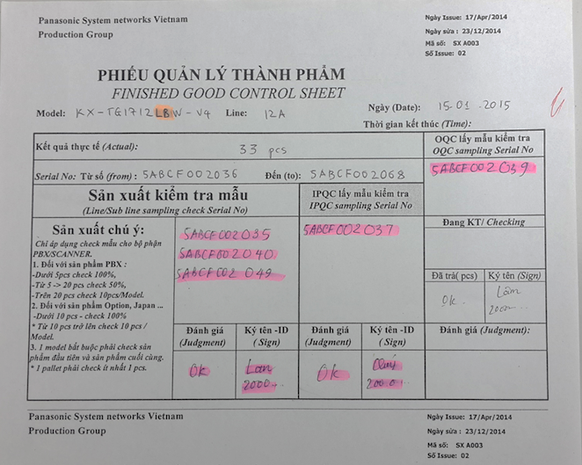


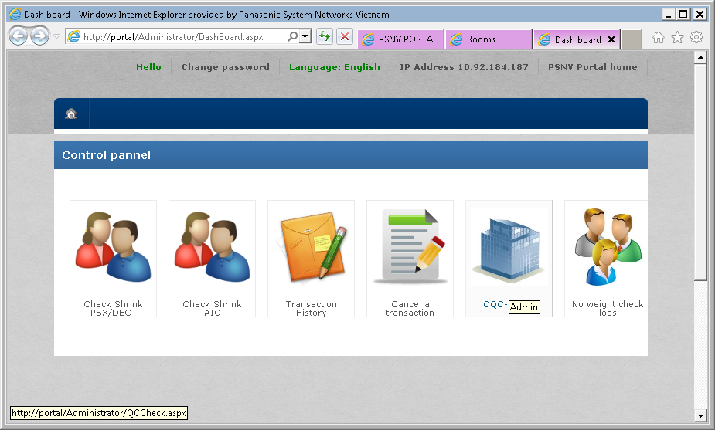
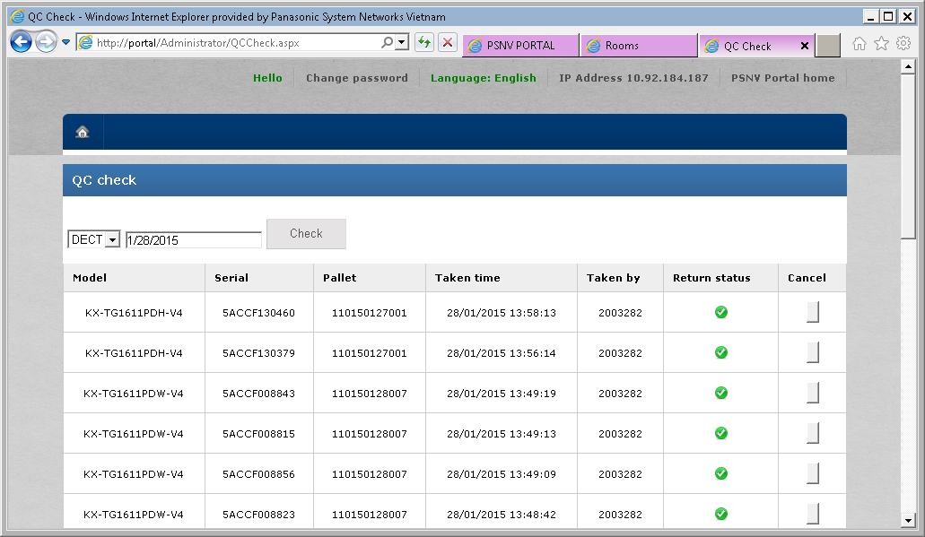
OQC Sampling Management
Report items
Page 5/19
Report items
P.I.C: Nguyen Thi Mung (OQC)
Developer: Nguyen Van Dung (ISG)
Date: 01/Nov/2014
Expn: N/A
QUALITY
■Control OQC sampling Serial No. after Shrink process
◆Before
After
Write down by Hand
Scan pallet,
Model, Serial
Packing system
automatically create daily report
When return sampling by visual checking
Easily make mistake
Difficult to control and check history
Easy to trace and create report
Avoid mistake (Data is control by server )

Slide 6
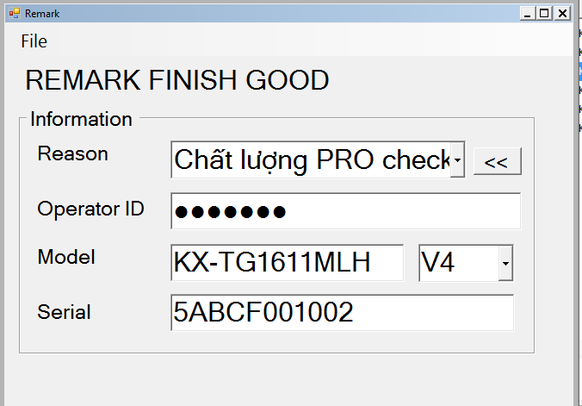
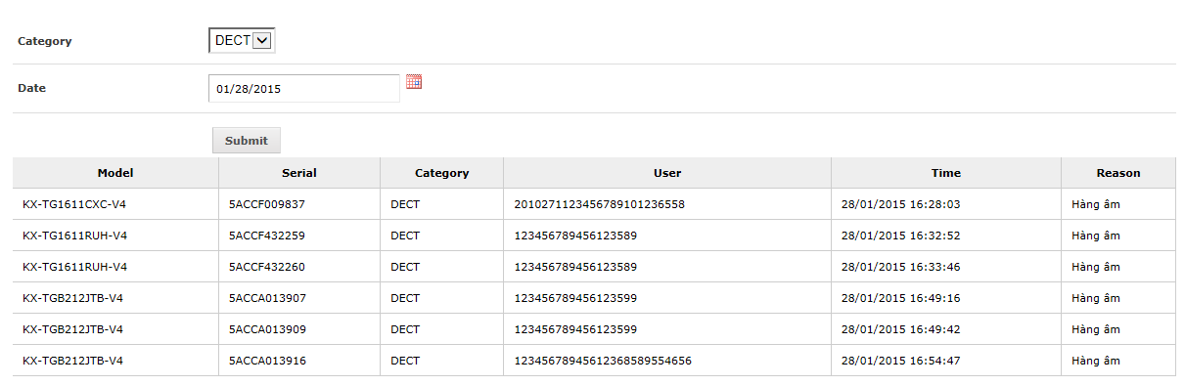
Remark Abnormal Serial
Report items
Page 6/19
Report items
P.I.C: Nguyen Thi Phuong (DECT)
Developer: Nguyen Van Dung (ISG)
Date: 03/Mar/2015
Expn: N/A
QUALITY
■Store sample product when being checked by QC, IPQC, Production
◆Before
After
Scan barcode of Model, Serial
Automatically summary daily report
Input remark manually
Use pen to write down on hard copy paper, easily make mistake by writing wrong information.
When problem happens, it’s difficult to search in check sheet
1. Scan model, serial of abnormal product on weight machine
To be easy for checking abnormal serial daily and category by category

Slide 7
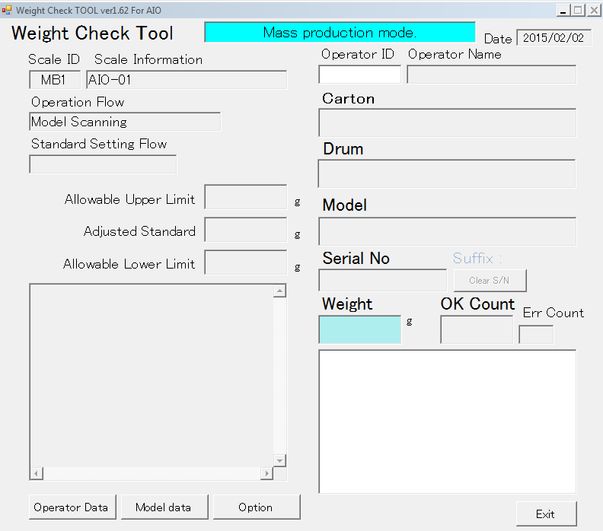
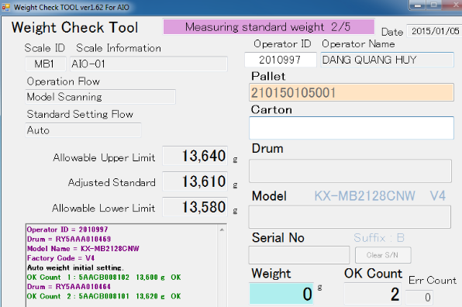

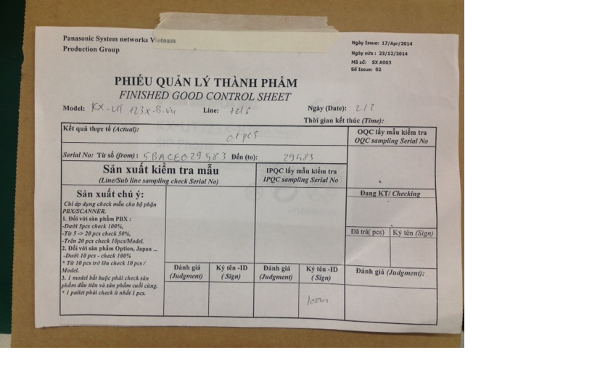
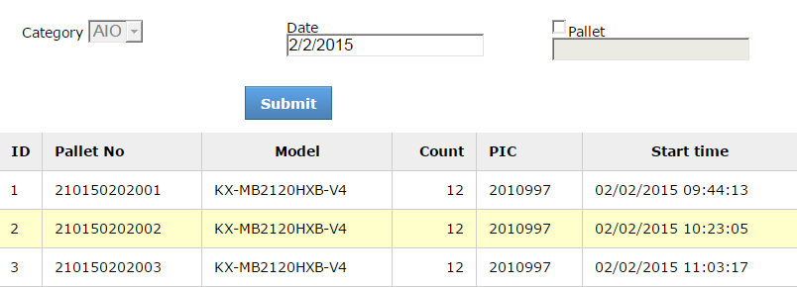
Enhanced Shrink System
Report items
Page 7/19
Report items
P.I.C: Hoang Viet Thien [AIO]
Developer: Nguyen Van Dung [ISG]
Date: 24/Nov/2014
Expn: N/A
QUALITY
■ Control AIO products by Pallet information on Weight system
◆Before
After
Place barcode field
No pallet information
Pallet information is store manually on check sheet paper
Check pallet no on WEB
Can’t control when pallet is enough
Storing PCSs information on check sheet takes much time and operator easily make mistake
When something happens, it’s difficult to find where is PCS
Place barcode field on Weight sys, auto remind when pallet is full
Access portal to check result daily(capacity, download PCSs on pallet),

Slide 8





Synchronize offline production result
Report items
Page 4
Report items
P.I.C: ISG
Developer: Develop team [ISG]
Date: 01/Aug/2015
Expn: N/A
480 $/year
■ Develop tool, set schedule daily run synchronize between client and Server
◆Before
After
Line 1
Result Line 1
Line 1
Auto synchronize
data daily
Result Line 1
Line 2
Result Line 2
Line 2
Result Line 2
Line 3
Result Line 3
Line 3
Result Line 3
Weight check data (.CSV)
ISG members have to data offline by USB
Result
Server
Server
when network problem, ISG takes long time
The result may be not correctly in some system.
No need to copy by USB
Result update automatically, data correct.
Saving : 20 hours/month ~ 40$*12 = 480$/year

Slide 9
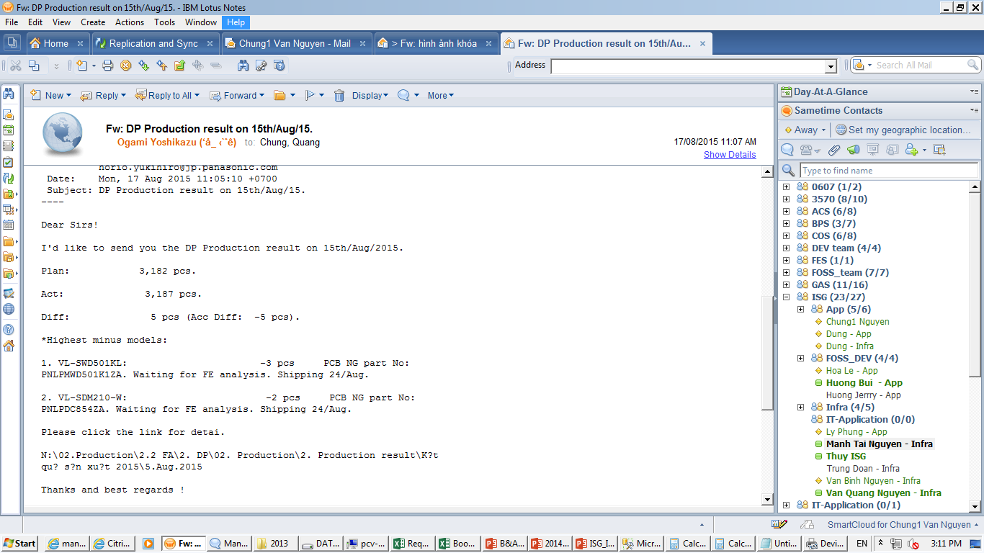
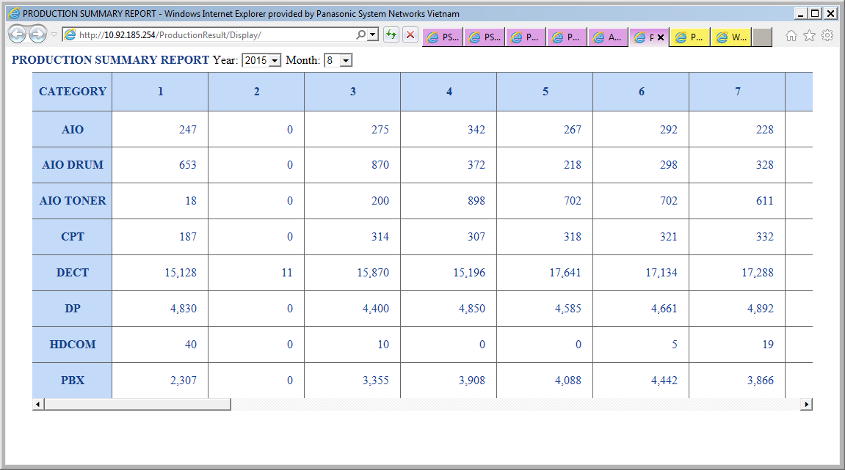
Production Progress Visualization
Report items
Page 6
Report items
P.I.C: ISG
Developer: Develop team [ISG]
Date: Dec/2015
Expn: N/A
71.6 hours/month
■ Auto get production result to show monthly production progress visualization
◆Before
After
Input Plan & production result by manual
Form
Input
Plan
Actual result
Weight
send email daily
SAP
Actual result
Actual result
Weight PCs
Takes time for summarize 30’/Category
There are 6 categories
Visualization , accuracy and necessary .
Just takes 10 seconds/Cat
Saving ~: 71.6 hours/month

