Slide 1

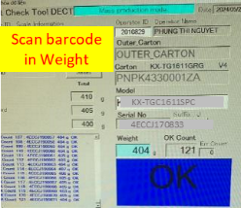
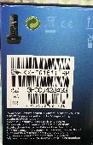
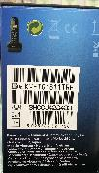


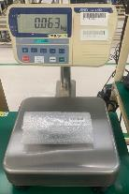
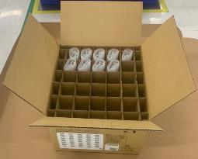

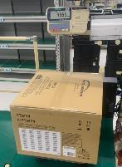
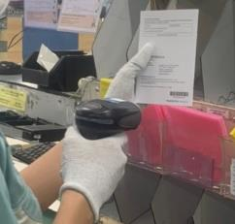
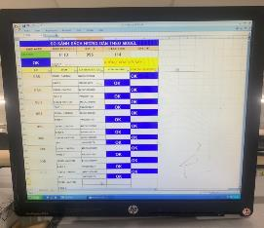
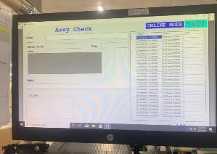
Request modify weight check system (DP, DECT, SB, Service)
BEFORE
AFTER
① No verify matching serial product & serial carton
① Add verify serial product & serial carton
Serial carton
Only scan serial No on Carton box
Scan all serial product & carton box
Merit: ensure inner & outer matching
Risk: Wrong mixing serial product & carton
Base
Remote
Carton
Apply: DP,DECT
② No verify weight of big carton box
② Add verify weight of big carton box
Only weight check single products
Verify weight of each products & total big carton
Merit: no missing products inside
Risk: Missing products inside big carton box
Weigh Product
No weigh total carton
Weigh Product
Weigh total carton
Apply: SB, Service
③ Manual confirm leaflet, book by excel file
③ Add software confirm – link to weight check
Only confirm by excel file
Confirm by software, link to weight check
Merit: traceability system
Risk: loss record file, can not traceability
Apply: DP, DECT, SB

Slide 2
Summary Weight check system all category
① Verify matching serial inner product & serial outer carton
 | TV | DP | DECT | SB | MW | PJ | Service
Weight check | O |  |  | O | O | O | Don’t have product serial
Excel file |  | O | O
Base
Remote
Carton
OK
Need Add
Need Add
OK
OK
OK
OK
② Verify weight of big carton [With many products inside]
 | TV | DP | DECT | SB | MW | PJ | Service
Big carton | None | Have | Have | Have | None | None | Have
Weight check |  | X | X | X |  |  | X
Pallet ID |  | O | O | X |  |  | X
Weigh Product
Weigh total carton
OK
Can control at Pallet ID
Need Add
OK
OK
Need Add
③ Confirm leaflet, manual book
 | TV | DP | DECT | SB | MW | PJ | Service
Leaflet, book | Have | Have | Have | Have | Have | Have | None
Software | O |  |  |  | O | O
Excel |  | O | O | O
Scan on software
OK
Need Soft
Need Soft
Need Soft
OK
OK
OK

Slide 3


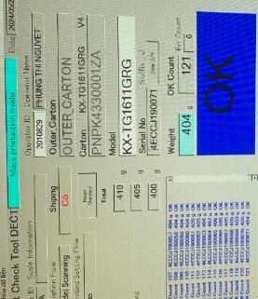
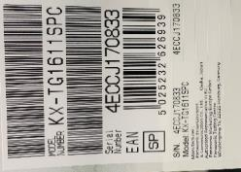



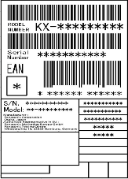
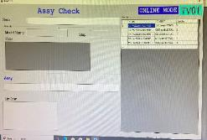



Activity 1 : Verify matching serial inner product & serial outer carton for weight DECT PHONE
【 Current Situation 】
No verify matching serial product & serial carton. Check compare serial by manual (Lost time : 3s/1pcs ~60min/day)
【Improvement 】
Add step verify serial product & serial carton (Reduce time : 20min/day ~ 5,760min/year -> Save : 132USD/year)
Current Issued
Stick serial no label in
Base & remote.
Only scan serial No on Carton box
FCT
Assemble
Auto Inspection
Auto
Shipping
PL check
Fold box
Packing
Serial Carton
Weight check
Base
Scan barcode in Weight
Compare serial carton with Base & remote
by manual. Because the serial no have barcode
Rick: Wrong mixing serial product & carton
Remote
Serial Base
No barcode
Serial remote
no barcode
KX-TGC1611SPC
4ECCJ170833
Ricky process: mixing serial base an remote
Improvement
Add barcode remote
Matching serial outer carton with serial base, handset.
Stick serial label in
Base & remote.
Add QR Base
3ABCB001005
3ABCB001005
3ABCB001005
Wrong serial
Ensure quality ( Prevent mixing inner & outer serial )
FCT
Assemble
Auto Inspection
Auto
Shipping
PL check
Fold box
Packing
3ABCB001005
3ABCB001005
3ABCB001005
Weight link to data base
Notes:
PART BODY WIP using for 18L Model need 6 process include 5 process using press machine & process number 5 using bending machine but THANHCONG don’t have bending machine so need to order outside bending maker & back to THANHCONG and complete process number 6
-> take time to movement and high cost, difficult control
After study design bending tooling can use in press machine to replace using bending machine

Slide 4
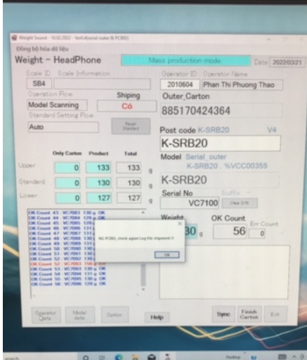

Activity 2 : Compare carton serial & product leaflet, book by Weight check for category DP, DECT, SOUND BIZ
【 Current Situation 】
Manual confirm leaflet, book by excel file -> can not traceability
【Improvement 】
Add software confirm – link to weight check
Current Issued
Risk: loss record file, can not traceability, mixing serial.
No Link
Scan serial leaflet , book
Only confirm by excel file
Weight check
Improvement
Detect wrong serial leaflet, book.
Can traceability system.
Database server
Scan serial leaflet , book
Software
Weight check
Notes:
PART BODY WIP using for 18L Model need 6 process include 5 process using press machine & process number 5 using bending machine but THANHCONG don’t have bending machine so need to order outside bending maker & back to THANHCONG and complete process number 6
-> take time to movement and high cost, difficult control
After study design bending tooling can use in press machine to replace using bending machine

Slide 5



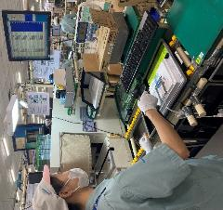
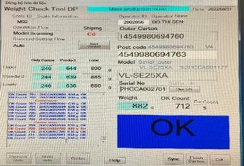
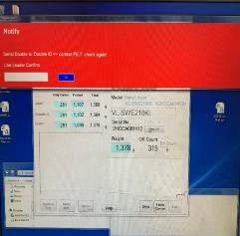
Activity 3 : Add step verify to check serials all of products for cate DP
Improvement Activity [Prevent Human mistake]
Passed
Automation line
Happened wrong s/n
Weight check
PL
F1
F2
F3
F4
F5
2,552g
Assemble
Pair S/N
Packing
Scan serial number by excel file
Problem
Don’t have item to check serial number all of products
Action
Make verify link with excel file to detect if wrong S/N
Scan S/N on product by manual
Weight check soft can detect if wrong serial no
Wrong serial camera, wireless, warranty card
3ABCB001005
3ABCB001005
3ABCB001005
Wrong serial
Link to weight check
3ABCB001005
3ABCB001005
3ABCB001005
Notify
Wrong serial number
Please, recheck again
Weight link to data base
Weight check did not detected
OK
Manual check S/N all of products
Alarm
Total: DP: 10 lines / 272 models, DECT: 8 lines / 340 models
MW: 3 lines / 110 models, PJ-SB: 8 lines / 200 models

Slide 6
Project: Link weight check system FA-SCM-OQC
1/2
9
◆Before
◆ After
FA
OQC
SCM
FA
Link
OQC
Link
SCM
No indicate shipment priority
No indicate result timely
Cannot use weight system → compare S/N by manual
Update OQC result not timely.
Loss time to come to SCM for chop stamp.
Loss time to confirm stamp by visual check
Indicate result timely
Indicate shipment priority
Use weight system → auto compare S/N
Online update OQC result & Save time to come to SCM for chop stamp
No need check stamp by visual
Confirm OQC result by system
Target improve:
Prevent wrong packing leakage out to market
△ 2pax for stamp by manual
2pax
OQC Issue
Risky point : Wrong packing pass to market by control offline
Loss time to confirm production result & Shipment schedule : 90sec*150 lots=3.75H/day.
2pax/ day need to follow chop stamp in warehouse.
Improvement: Link system from FA-OQC-SCM
Prevent wrong packing.
Save time : 3.75H/day ~ 990H/year
Save manpower : △ 2pax for stamp ~ 12K$/ year

Slide 7
Project: Link Weight Check System FA-SCM-OQC
2/2
9
FA
Pallet ID
SCM
Shipment
- Save Weight Check Date
on server : Production
Date/Model/Q’ty
- Issue Pallet ID: Model/Q’ty/SN
- Issue Movement slip <SAP>
- Read Pallet ID Model/Q’ty
- Compare FG & WMS
- Read Pallet: <Model/Q’ty>
- Compare FG & WMS
CURRENT SITUATION
OQC
- Pick up sampling
inspection
Additional
Additional
Additional
Additional
① Add OQC :
Input sampling plan
Input Sampling product & Serial No
② Indication OQC situation:
Input Checking result
Input Final judgment All lot.
→ Send result by Email auto
③ QC inspection result:
Reading Pallet ID to check OQC result
Indicate OK lot
④ Function: If OQC judgment NG or Not yet
Stop next step
< PSNV/ Jupiter >
Study to link weight check & WMS
REQUEST
MERIT
Save:
8,000min/month
Save:
Reduce 2pax
990H/year
Save:
4,000 min/month
Note: In case the model have not Serial Number → They should be controlled as current method

Slide 8
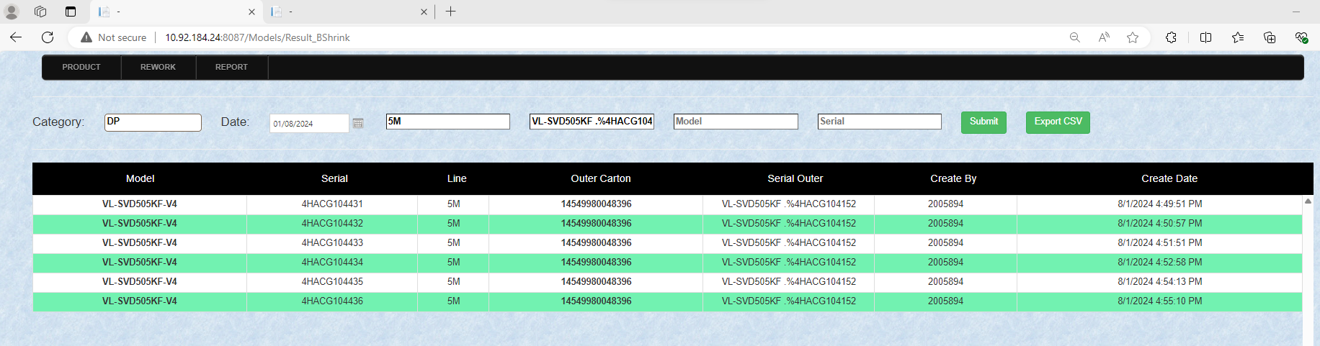
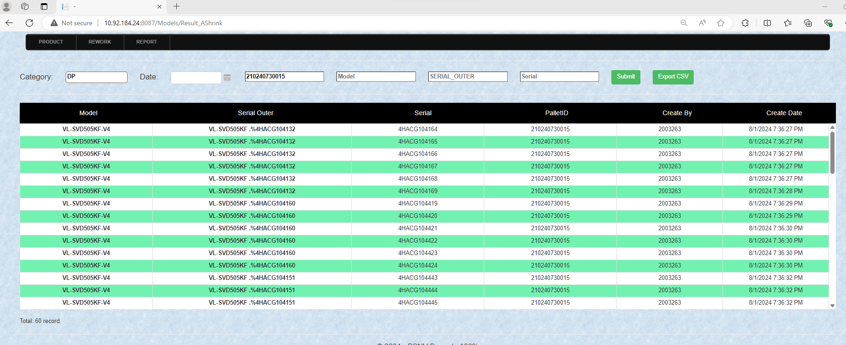
4HACG104436

