Slide 1



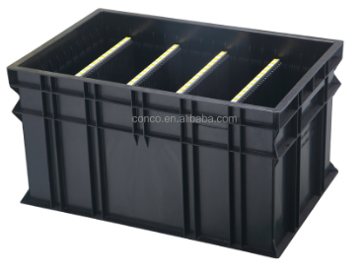
PEMS communicate current PSNV system (real time)
◆Before
◆ After
FLOW
PROBLEM ISSUE
PEMS Server
Server PSNV
WEB Visualization
data
SAP
SMT
Previous process not yet transfer SAP
Inform other process
1.Shortage material
MANUAL JOB
Communicate by API of PSNV
Other shortage
Check / re-backflush
BF/TF Files
DIP/FCT
1. Transfer information
Auto backflush
FCT => FA
2. Auto backflush SMT-> DIP/FCT
MANUAL JOB
2.ECN change
TF 309/ Open Bom list
Change / or part
2. Auto backflush FA-> SCM
1. Production result
FA
MANUAL JOB
FCT-01-IN-31
FCT-01-OUT-31
3.Block user
Inform to user to out
SMT/PCB F/G stock
FCT PCB F/G stock
SCS
Other user using
FA
SCM
Current method :
Loss time.
Use mistake
No Visualization of Production Results
Improvement method :
Auto Transfer and Backflush => Reduce 1pax.
Support PEMS => Reduce Costs: 3,790 USD.
Visualization of Production Results

