Slide 1



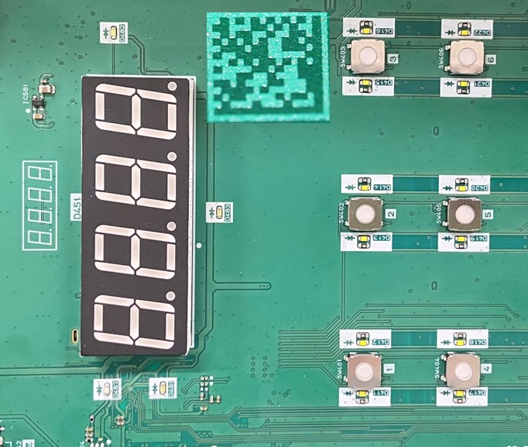

DP TRACEBILITY FOR NEW MODELS
SMT
DIP
FCT
FA – Assemble Block
Inspection
Packing
FCT 1
FCT 2
Assy 1
Assy 2
Assy 3
Assy 4
PL
Inspection 1
Inspection 2
Inspection 3
Packing
Weight check
Marking Laser
Scan QR code
Scan QR code
Scan QR code
Link
Link
Link
Log file
Verify
Scan manual books
Scan Serial number
Marking 1 face
<Can trace 2 face>
Trace SMT data
History production
Part list
Trace SMT/DIP data
History production
Part list
Stock
Trace SMT/DIP/FCT data
History production
Part list
Stock
Serial number
Verify by Weight check
P/N manual books
Serial number

