Slide 1


Panasonic System Networks Vietnam
Information Systems Group
QCC Team: EnIT
QCC REPORT
Reduce Network Response Time
Hanoi Dec 2018

Slide 2
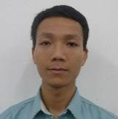
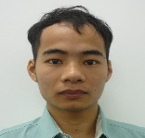

Team Group: EnIT
No | Họ và tên Full name | Ảnh Picture | Bộ phận Section | Chức vụ Position | Chức danh trong nhóm Position in Team
1 | Nguyễn Văn Quang |  | ISG | AM | Leader
2 | Trần Như Nam |  | ISG | Officer | Member
4 | Nghiêm Hiền Lâm |  | ISG | Officer | Member
5 | Lê Thu Hòa |  | ISG | Supervisor | Member

Slide 3

CONTENT
1.Select Theme
2.Observation & Setup Target
3.Make Schedule
4.Analysis Main Cause
5.Implement Solution
6.Confirm Effect
7.Standardization & Control
8.Review & New Course of Action

Slide 4

1. SELECT THEME
Weight check, PDA connect to database server slow , stop some times
Affect to production
Need Reduce Network connection Response between client & database Server

Slide 5
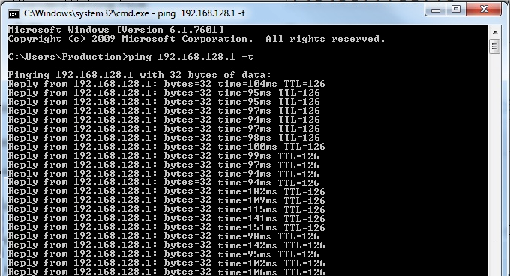
2.Observation & Setup Target
- Number of Downtime per month (FOSS, Weight check Slow):
110ms
Reduce Ping Response time to: <10ms
(what is ping response?: )

Slide 6





3.Make Schedule
 |  | What |  | When |  |  |  |  |  |  |  |  |  |  |  |  |  |  |  |  |  |  |  |  |  |  |  | Who | How
 |  | Content |  | Apr |  |  |  | May |  |  |  | Jun |  |  |  | Jul |  |  |  | Aug |  |  |  | Sep |  |  |  | PIC | Tools
 | 1 | Select Theme |  |  |  |  |  |  |  |  |  |  |  |  |  |  |  |  |  |  |  |  |  |  |  |  |  | All
 | 2 | Establishing Target |  |  |  |  |  |  |  |  |  |  |  |  |  |  |  |  |  |  |  |  |  |  |  |  |  | All
 | 3 | Action Plan |  |  |  |  |  |  |  |  |  |  |  |  |  |  |  |  |  |  |  |  |  |  |  |  |  | All
 | 4 | Analyses Cause |  |  |  |  |  |  |  |  |  |  |  |  |  |  |  |  |  |  |  |  |  |  |  |  |  | All
 | 5 | Countermeasure |  |  |  |  |  |  |  |  |  |  |  |  |  |  |  |  |  |  |  |  |  |  |  |  |  | All
 | 6 | Confirming Effect |  |  |  |  |  |  |  |  |  |  |  |  |  |  |  |  |  |  |  |  |  |  |  |  |  | All
 | 7 | Standardization |  |  |  |  |  |  |  |  |  |  |  |  |  |  |  |  |  |  |  |  |  |  |  |  |  | All
 | 8 | Review & Orientation |  |  |  |  |  |  |  |  |  |  |  |  |  |  |  |  |  |  |  |  |  |  |  |  |  | All
Where
No
Location
W1
W2
W3
W4
W1
W2
W3
W4
W1
W2
W3
W4
W1
W2
W3
W4
W1
W2
W3
W4
W1
W2
W3
W4
Plan
Actual

Slide 7



4.Analysis Main Cause
METHOD
MAN
Program
4
Software
Wifi
Network Design
Wrong Operation
3
Database
Network Setting
Configuration of
switch & Router
Reduce
Network
Response Time
Performance
Card
Reader
Switch, Router
CPU, RAM
1
Server
Barcode NG
2
Network Card
Performance
RAM
Access Point
PC
CPU
Network Card
MACHINE
MATERIAL

Slide 8
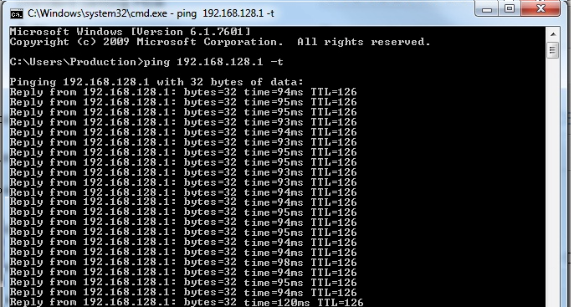
5.Implement Solution (action1)
Increase Ram & CPU for Server
94.3
Ping average :
Result: No Improve

Slide 9
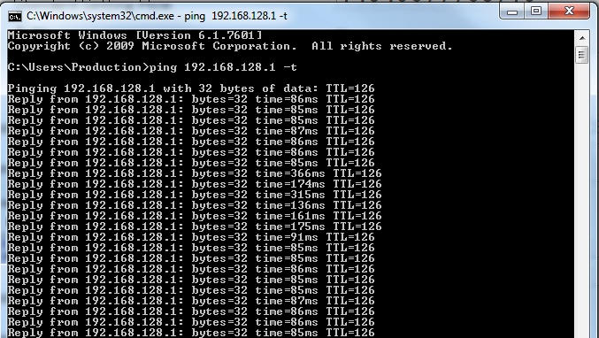
5.Implement Solution (action2)
Add more Access point
121ms
Ping average : 180ms
Result: No Improve

Slide 10
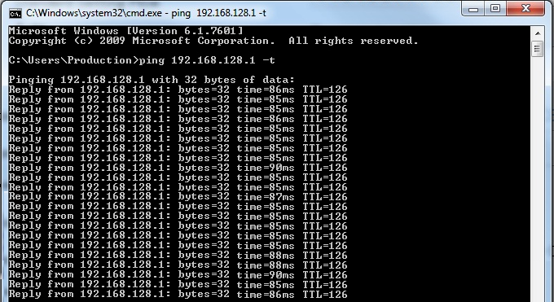
5.Implement Solution (action3)
Archive Database ( reduce Database size)
86ms
Result: Response reduce … %

Slide 11
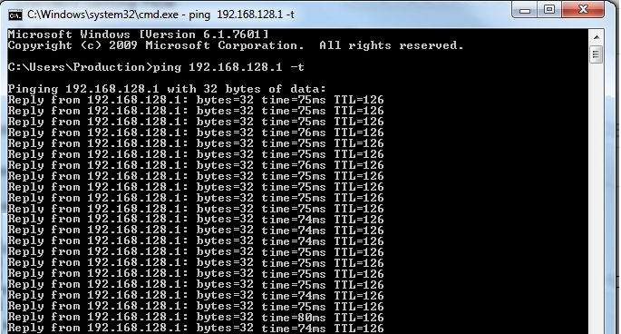
5.Implement Solution (action4)
Change to wifi to LAN cable
75ms
Result: Response reduce … %
Can not Apply for PDA
Still need to improve

Slide 12
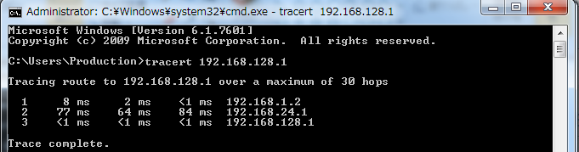



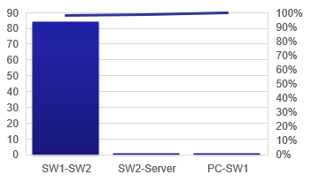

5.Implement Solution (action4)
Try another command: Tracert
Server
PC
Core Switch 1
Core Switch 1
Need Improve Firewall & core Switch

Slide 13

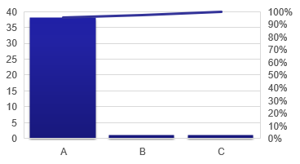
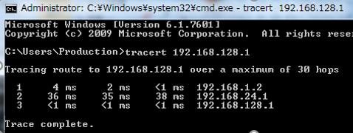
5.Implement Solution (action5)
Refine configuration of Core Switch
+ delete unnecessary config
46ms
Result: Response reduce 42 %

Slide 14

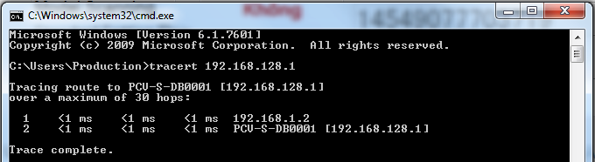
5.Implement Solution (action5)
Change Database location from Office to Production ( Separate Host)
2ms
Result: Response reduce … %
Ping Average:
Pareto: 0,1,1
=> Archive target

Slide 15
6.Confirm Effect

Slide 16
7.Standardization & Control

Slide 17
8.Review & New Course of Action
List up all the possibility of actual situation
Continuously Plan, Do, Check & Action to find the best improvement
Cooperation in Teamwork makes the strong effectiveness
Skill will be up surprisingly in challenges

Slide 18
Thank you for your time !

