Slide 1


Panasonic System Networks Vietnam
Information Systems Group
QCC Team: EnIT
QCC REPORT
Reduce Network Response Time
Hanoi Dec 2018

Slide 2








Member Introduction
1
5 members
4 members
Leader: Quang
Hoa
Lam
Duong
Tung
Nam
2
Register Date: 02/04/2018
3
Finish Date: 28/12/2018
4
Time activities: 9 months

Slide 3

CONTENT
1.Select Theme
2.Observation & Setup Target
3.Make Schedule
4.Analysis Main Cause
5.Implement Solution
6.Confirm Effect
7.Standardization & Control
8.Review & New Course of Action

Slide 4

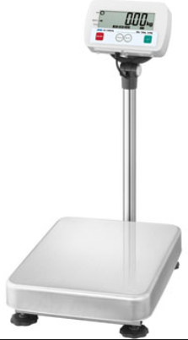





1. SELECT THEME
FOSS System
Weight check System
PDA
Database server
Production
System affect | Times/month | Related person | Lost time (h/year) | Cost($)
Weight check line | 51 | 1 | 102 | 255
FOSS system | 8 | 100 | 4,800 | 12,000
Total | 59 | 101 | 4,902 | 12,255
Reduce Network connection Response between client & database Server

Slide 5
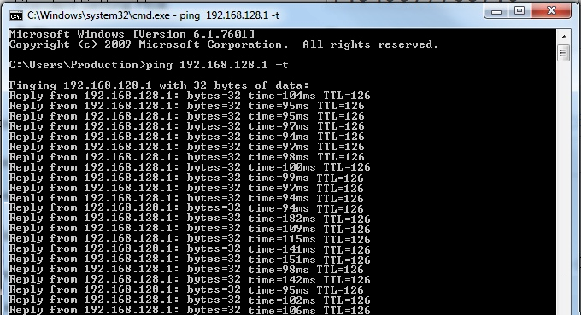

2.Observation & Setup Target
- How to measure network slowness?
Use PING command on Window
110ms
Reduce Ping Response time to: <10ms

Slide 6
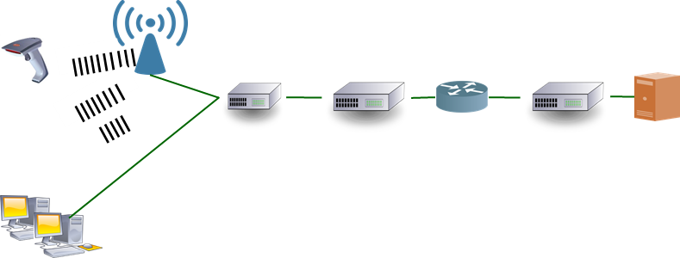
2.Observation & Setup Target
Current situation
Wifi
Firewall
Server
CAUSE
110ms
Reduce Ping Response time to: <10ms

Slide 7





3.Make Schedule
Action Plan
 |  | What |  | When |  |  |  |  |  |  |  |  |  | How
 |  |  |  | Apr | May | Jun | Jul | Aug | Sep | Oct | Nov | Dec | PIC | Tools
 | 1 | Select Theme | Factory |  |  |  |  |  |  |  |  |  | All
 | 2 | Establishing Target |  |  |  |  |  |  |  |  |  |  | All
 | 3 | Action Plan |  |  |  |  |  |  |  |  |  |  | All
 | 4 | Analyses Cause |  |  |  |  |  |  |  |  |  |  | All
 | 5 | Countermeasure |  |  |  |  |  |  |  |  |  |  | All
 | 6 | Confirming Effect |  |  |  |  |  |  |  |  |  |  | All
 | 7 | Standardization |  |  |  |  |  |  |  |  |  |  | All
 | 8 | Review & Orientation |  |  |  |  |  |  |  |  |  |  | All
Where
Who
No
Content
Location
Plan
Actual

Slide 8



4.Analysis Main Cause
METHOD
MAN
Program
4
Software
Wifi
Network Design
Wrong Operation
3
Database
Network Setting
Configuration of
switch & Router
Reduce
Network
Response Time
Performance
Card
Reader
Switch, Router
CPU, RAM
1
Server
Barcode NG
2
Network Card
Performance
RAM
Access Point
PC
CPU
Network Card
MACHINE
MATERIAL

Slide 9
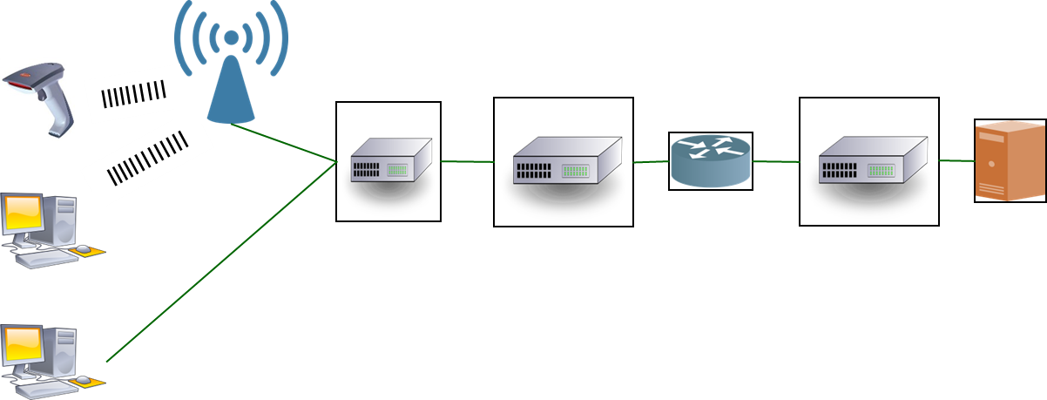
1. SELECT THEME
SLOW
Wifi
Firewall
Server
CAUSE
This Photo by Unknown Author is licensed under CC BY-SA

Slide 10
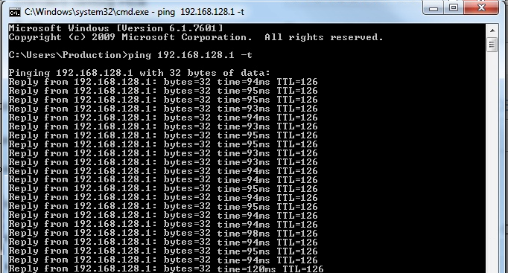
5.Implement Solution (action1)
Increase Ram & CPU for Server
94.3
Result: No Improve

Slide 11
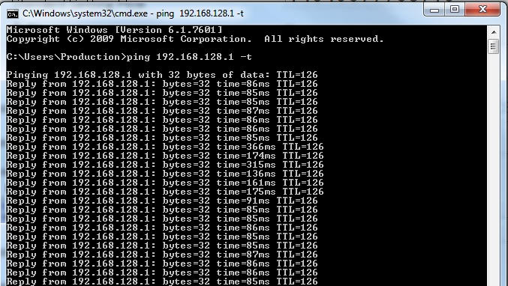
5.Implement Solution (action2)
Add more Access point
121ms
Ping average : 180ms
Result: No Improve

Slide 12
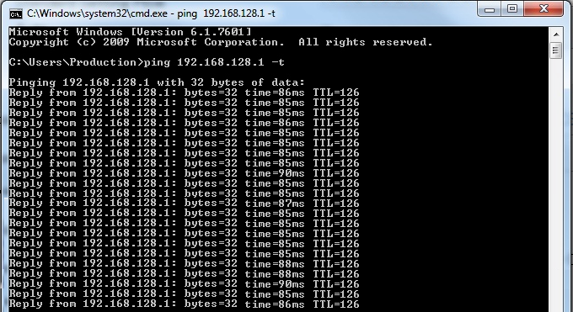
5.Implement Solution (action3)
Archive Database ( reduce Database size)
86ms
Result: Response reduce … %

Slide 13
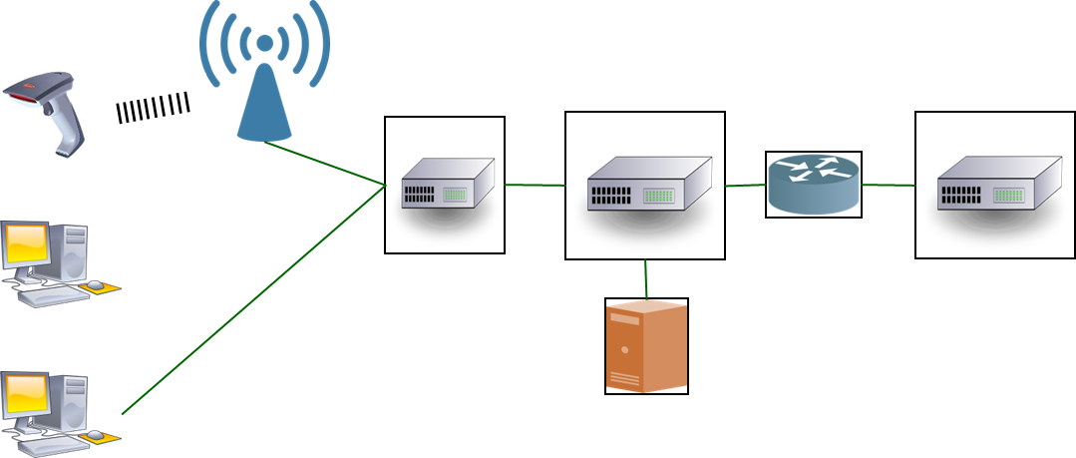
QUICK
Wifi
Firewall
Server
This Photo by Unknown Author is licensed under CC BY-SA

Slide 14
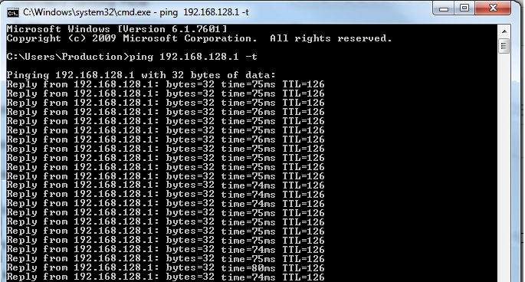
5.Implement Solution (action4)
Change to wifi to LAN cable
75ms
Result: Response reduce … %
Can not Apply for PDA
Still need to improve

Slide 15
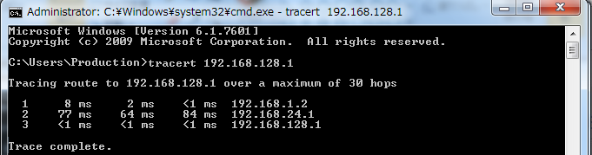



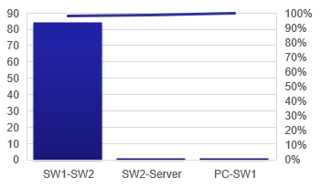

5.Implement Solution (action4)
Try another command: Tracert
Server
PC
Core Switch 1
Core Switch 1
Need Improve Firewall & core Switch

Slide 16

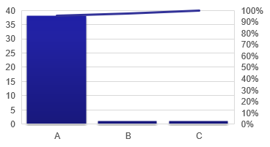
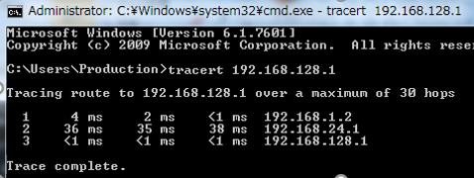
5.Implement Solution (action5)
Refine configuration of Core Switch
+ delete unnecessary config
46ms
Result: Response reduce 42 %

Slide 17

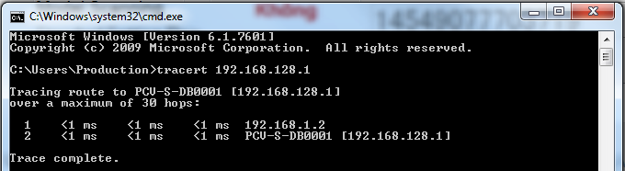
5.Implement Solution (action5)
Change Database location from Office to Production ( Separate Host)
2ms
Result: Response reduce … %
Ping Average:
Pareto: 0,1,1
=> Archive target

Slide 18
6.Confirm Effect

Slide 19
7.Standardization & Control

Slide 20
8.Review & New Course of Action
List up all the possibility of actual situation
Continuously Plan, Do, Check & Action to find the best improvement
Cooperation in Teamwork makes the strong effectiveness
Skill will be up surprisingly in challenges

Slide 21
Thank you for your time !

