Slide 1
QCC REPORT
Improve IT Equipment Monthly Inventory
Slogan
Stably IT Environment
Timely IT Respondent
Efficiency IT Application
Panasonic System Networks Vietnam
Information Systems Group
QCC Team: The Heroes

Slide 2
CONTENT
Theme Selection & Target
I
Action plan
II
Countermeasure implementation &Effect Confirmation
III
IV
Standardization & Review

Slide 3
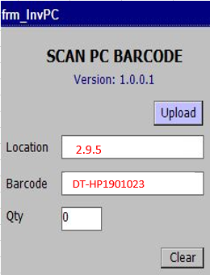



I. Theme Selection & Target
Not exactly position when manual by hand
Input data by hand
PC position
Not exactly
System affect | Times/month | Related person
Inventory PC | 35h | 1
Reduce inventory time
from average 35 h/1month to 5 h/month

Slide 4

II. Action plan
Who
 |  | What |  | When |  |  |  |  |  | Who | How
 |  |  |  | Oct.19 | Nov.19 | Dec.19 | Jan.19 | Feb.19 | Mar.19 | PIC | Tools
 | 1 | Select Theme | IT |  |  |  |  |  |  | Viet, Nam | Pareto
 | 2 | Establishing Target | QCC |  |  |  |  |  |  | Hien, Huong, Minh | Pareto Colum chart
 | 3 | Action Plan | QCC |  |  |  |  |  |  | All | Fish bone tree chart, 5W1H
 | 4 | Analyses Cause | IT |  |  |  |  |  |  | Hien, Huong, Minh
 | 5 | Countermeasure | IT |  |  |  |  |  |  | Minh,Hien, Nam | Actual
 | 6 | Confirming Effect | QCC |  |  |  |  |  |  | Hien, Minh | Data sheet
 | 7 | Standardization | QCC |  |  |  |  |  |  | Chung,Hien | WI/ Check sheet,Parato
 | 8 | Review & Orientation | IT |  |  |  |  |  |  | Chung,Viet, Nam
Where
No
Content
P
D
C
A
Plan
Actual

Slide 5
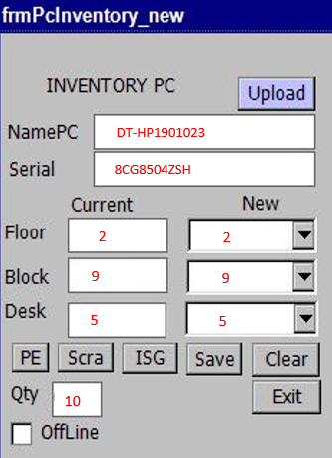


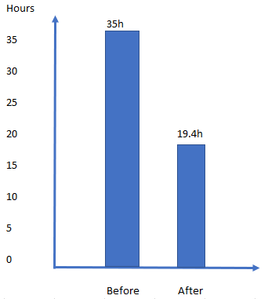
III. Countermeasure implementation &
Effect Confirmation
Who
Where
Database server
No
Content
Position computer and last time login
The position is auto load from database server
Before: 3’ x 700 pc = 2100’(35h)
After: 1.34’ x 700 pc =940’ (15.6h)
➔ Response reduce 55%

Slide 6
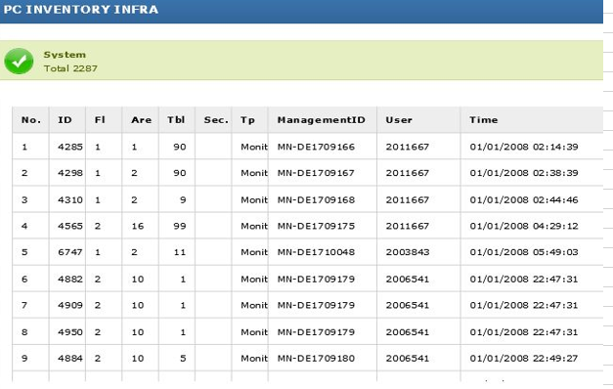
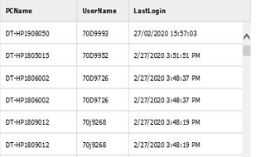

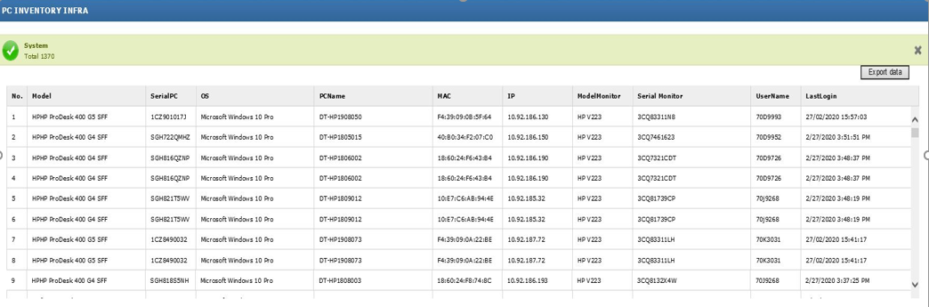
III. Countermeasure implementation &
Effect Confirmation
Who
Where
How to combine two reports ?
No
Content
View report easy & faster

Slide 7
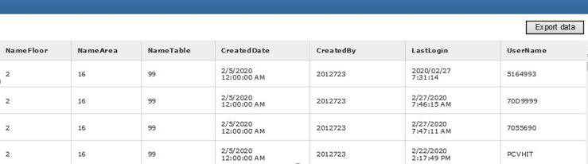
IV. Standardization & Review
2
1
Target:
35 h/1month to 5 h/month
Actual
➔35 h/1month to 15.6 h/month
1
+
2
Continue Improve IT Equipment system in next time

Slide 8

Thank you!

