Slide 1
PROMOTION REPORT
Upgrade Factory Operation Support System (Foss) &
Make Asset Life Cycle Management System
MAIN CONTENTS
1
Job History & Achievement
Page 1
2
Background Of Activities
Page 2~3
3
Total Improvement Schedule
Page 4
4
Detail Improvement Activity
Page 5~8
5
Confirm result & Next activities
Page 9~10
Presented by : Nguyen Nhu Minh
Join Date : 12-Feb-2019
Current Position : Officer (5 years)
New Position : Supervisor
Section : DEV
Notes:
Good morning/afternoon/evening everyone, My name is Minh ,member of IT section. Today, I am very honored to be here to present my promotion report. My topic is : “Upgrade Factory Operation Support System (Foss) & Make Asset Life Cycle Management System”
My presentation is split into 5 parts.
The beginning, I will start with job history & achievement. Then I mention background of activities. After that, I will talk about total improvement schedule. The next I talk about the detail of activities. And the last I confirm result and next activities.

Slide 2
Job History & Achievement (2109-2023)
2/10
1/10
1.Job History & Organization:
Time | Career History
Entrance | 12/02/2019
Apr 2022 | Rank up (V12-V13)
My Responsibilities | ✓Develop software. ✓Support users and all systems of IT.
ISD (GM. Matsushita)
M. (Chung/ Thuy/ Toan)
AM. Hien
Sup. Minh
4HC
4HC
6HC
2HC
Develop
Sap
Infra
Business Planning
2.New Assignment:
Analysis
✓ Current job : Maintain developed Systems, Analyse, Design & Develop new systems, study system of company production to make software. Share experience for other member in team.
✓ Change mindset : Lead team (2 officer) beside my current jobs. Study more new technologies to develop software.
3.My main achievements (2019 – 2023)
❖ Reduce HC
Auto transfer kitting to SAP (2pax)
QC & MCS Free Location (2pax)
PMD Warehouse management (2pax)
Auto print Part card and Reel Material by Mobile printer for MCS (2pax)
❖ Save cost
Sound Biz Adding Serial Outer & Shipping control (7.8K$)
Tally sheet for SCM (33.6K$)
Microwave Printing label (1.2K$)
Management sub-material (16.8K$)
❖ Ensure Quality
Develop weigh check system
Make label printing for all new category (MW, TV ,Sound…)
Check Double ID, PL, shipping for all production line
Modify shrink pallet ID
Notes:
Now, the first content. I introduce about my self.
I work here start February, 2019
As you see in the ISD Organization, I’m working in Develop team. There are 4 peoples in my team. I’m a in charge of Software development and support all system of IT.
There are some my achievement. I had done many project with achieve cost down, reduce HC, ensure quantity for production.

Slide 3
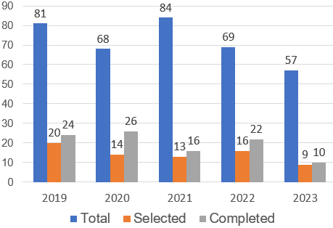




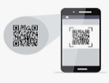




Background Of Activities
2/10
2/10
My Goal
Increase developing time, reduce time support to get more cost down
Select smart devices, new technology to upgrade win CE to Android
FY2023 PROJECTS SUMMARY
Development Activity
Target: Increase quantity Project
Actual: Development time is still not increase
Normal support is very height (45%)
45 % Normal support
55 % Development
END OF LIFE 2023
HANDY TERMINAL
OS/ PLATFORM
Scan
New technology ?
Theme 1: Upgrade Factory Operation Support System (FOSS)
Current System
OS is not update in the future.
Development Software is quite slow.
Not responsive to big data system.
The stable of the device is poor, often repaired.
New System
Development new Software.
New programming language (Flutter).
New development environment (Android).
Mission : Reduce support time, increase development time and comply policy
Notes:
The next, I talk about the background of activities.
Let's look at the 5-year chart (Project summary). The number of request IT received is very large. The litter small is selected.
Target : increase project but actual the develop time still not increate.
The main reason is the normal support is very high. Some are related to equipment, operators, or some requests related to quality.
As you know, all applications on Handy terminal of our company are running on the windows CE OS.
Difficult to develop soft on them. Take long time to modify and build program. Sometime repair and setup Operation system…
This is also one of the reasons why support time is so high.
my mission here How to reduce support time and increase software development time?
Let's find out the answer through the next slide

Slide 4

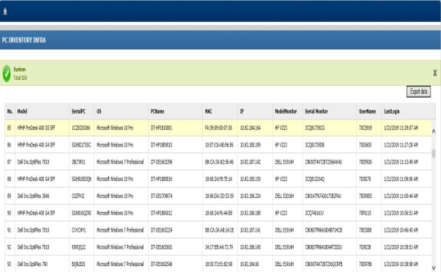

Auto Inventory PC
1/5
Using software inventory all PC
Developer: Tran Thi Thao
Apply: Nov 2018
Expn: N/A
Saving: 650 $/Y
◆Before
◆ After
Inventory collecting automatically software
Count Manual When PC Inventory Quarterly
Export and get all PC information
data exactly, anytime
Count and record PC information
Input information to Excel
Serial | OS | PC Name
FTVCHY1 | Win 7 Pro | DT-DE1602108
C00DHJ2 | Win10 Pro | DT-DE1709009
Take time : 650 Pcs * 0.1 hour =65 Hour
Save time and manpower: 65 * 2.5*4=650$/Year
Notes:
This is the fours improvement,
currently, Quaterly , we invertory Pc ,we go to section, count and write information to paper. After that input it to Excel when finish.
Now : we develop system allow get all information PC from Server. We will have information exactly and fast.
So we can save lot of time.

Slide 5

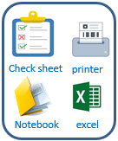

Background Of Activities
2/10
3/10
My Goal
Develop new system for IT department to manage equipment.
Analysis
Theme 2 :Asset Life Cycle Management System (ALCMS)
Current
Improve activities
Good receipt
- Manual job on excel, notebook, lost papers.
- Tack time to inventory, easy mistake.
- Difficult control in-out device, easy mistake.
- Not ensure quality.
Database Server
Scrap
Transfer
Use software
Save time management & ensure quality, reduce papers.
Reduce make mistake.
Easy manage operation and trace history.
Inventory
Maintenance
Notes:
We know the win CE operation system will be end of life 2023. so that we have to upgrade all software applications are running on win CE to Android. To compline policy of corporate. I have select new language programming, new platform. The advantage when develop time increase, suitable for big project. …
The issues 2. we mention to manage asset of IT room.
All IT department assets are managed manually through papers and tables, check sheet. It takes a lot of time to manage monthly inventory.
For this reason, I want to make an asset management software system for the department using by barcode.
A new system, using barcode technology with mobile device that connect database server via access point. Apply this system, you will control easy and specially we will save 40% time management and 50% print paper.

Slide 6




4. ACTION PLAN FY2016
6/10
Action 2 [TIME]: Apply web approve for all PSNV workflow Improve Indirect efficiency => Target: 100% IT Request no delay Reduce paperwork stack time => Target : IT request Time 1,200 hours
Biggest
Setup Target:
FY2016: Network Request
FY2017: SAP and
Develop
FY2018: Sections
Delay 1 day
Procedure Analysis
◆Fact
◆ Action
Web
Paper/2 hours
Section
Approve
confirmation
Section
Request
Section
Request
Section
Approve
Web
Cannot meet
1 hours
2 hours
Don’t know status
Don’t know status
IT
PIC
IT
Approve
IT
PIC
IT
Approve
Web
confirmation
Paper/1 hours
Notes:
Action 2: Reduce TIME. Long term target is apply web approve for all PSNV workflow.
Firstly improve IT request delay: this year we have more than 1000 it request, 15 % delay:
As you see Biggest quantity is network request with 90 cases delay up to 1 day.
So my target in 2016 is apply for network request. 2017 fro SAP and Develop, FY2018 I will introduce to other sections.
Now situation: section PIC input request in excel file then find his boss to get approve,
After that he pass to IT for approve.
There are 2 issues: first PIC cannot meet his boss any time, the second IT manger and section don’t know
Status of request completed or not.
If using web, section input request on web, system send email to his boss and IT for approve So manager can approve request any where have network, Such as meeting room or other locations have network. After that system send email confirm to section PIC.
So what I we can do by using this system? we move to next slide!

Slide 7
4. ACTION PLAN FY2016
7/10
Action 2 [TIME]: Apply web approve for all PSNV workflow Improve Indirect efficiency => Target: 100% IT Request no delay Reduce paperwork stack time => Target : IT request time 1,200 hours
Activities | Content: Web Approve System | Effective | Time
Evaluable IT Services |  | Quality: Improve efficiency | Jun.2016 Sep.2016
Change approve procedure |  | Approve Time: 1,200 hours/Y 2hours x 600 requests
Work status chasing |  | Delivery: Action Immediately No Paper
Database
Services KPI
Evaluation
Improvement
4 hours =>2hours
AM/MA
Parallel Approval
PIC
GM/DR
Section
PIC
Approval
PIC
Pending
=> See bottle-neck immediately
Notes:
By using web system, firstly I can evaluate IT service, from database i can create services KPI with information such as : response time of each IT request,
What is weakness skill. Base on such information i can evaluate and finally improve IT service quality, improve efficiency.
The second, we can change approve procedure, manager and GM can approve same time, no need to wait person by person.
One request can be reduced approve time from 4 hour to 2 hours, Totally save more then 1000 hours per year and speed up working.
The third, we can chase work status quickly, each step have email confirmation so we see bottle-neck immediately, no need to find paper request.
So we can take action immediately, no paperwork, Reduce management time
This model not only for IT request but we can apply for all indirect works such as uniform request in GAS, equipment request in production and PE, sanction in accounting and others. Finally factory productivity increase.
I have finish action 2, now I move to final action.

Slide 8
Total Improvement Schedule
1/10
4/10
Pending Issue | Pending Item | Activity Content | In charge (Main) | WHEN (Jul.2023) |  |  |  | TARGET
 |  |  |  | Q1 | Q2 | Q3 | Q4
Upgrade FOSS | [1] Upgrade Foss from wince to android Mobile for all devices. [2] Analyze & Optimize all process of FOSS [3] Develop all function of system. |  Select new language & new OS to develop.  Select smart device to scan barcode. | IT member |  |  |  |  | New Language (Flutter - Dart) Android new OS
 |  |  GR local  GR Oversea | IT member MCS Pic |  |  |  |  | Upgrade all function FOSS to new Devices
 |  |  Storing | IT & MCS
 |  |  Kitting & Supply | IT member MCS Pic
 |  |  Kitting Other  Temporary Location | IT member MCS Pic
Make Asset Life Cycle Management System | [1] Survey all process and build standard management. [2] Analysis system, design database [3] Develop, testing |  Borrow & return Equipment | IT member |  |  |  |  | Apply software to reduce time management, papers & manual jobs
 |  |  Manage stationery warehouse | IT member
 |  |  Good Receive | IT member
 |  |  Inventory, Transfer, Scrap, Maintenance | IT member
Issue ①
Issue ②
Plan:
Actual:
Notes:
Next slide, I talk about the total improvement schedule
the issue 1, how to upgrade to FOSS from win CE to android. we have to select new language to develop. the next work, we have analyze and optimize all process of Foss. at the end, I develop new soft on the new devices.
The issue 2, the begin to make software I survey all process and build standard management. After that I analysis system and design database. At the end I select the device and develop software.
Now I will explain for details of issue 1.

Slide 9
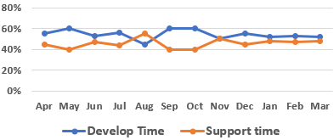
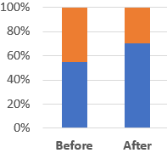

Detail Improvement Activity
1/10
5/10
Issue 1
Follow policy company FY23, OS Windown CE will be end of life 2023.
IT find new solution to upgrade old OS to smart device as mobile.
Main Issue
Improvement Actions
Result
[1] Upgrade to android Mobile
Select new language & new environment
Flutter develop applications for mobile devices runs on both Android and IOS. The Android OS is quite commonly and integrates many scanning devices
Total device need to Upgrade
- Foss is running on Windows CE &
Windows Embedded,
Can’t upgrade android OS
Activity Comparation
Improvement Result
MCS Dep:
FY2023
109 pcs
The disadvantage of wince:
- OS is not support in the future.
- Develop software slow, Not responsive to big data system.
- Regularly repair and setup window again.
Other Dep:
The Advantage use flutter
FY2024
6 pcs
Develop time
Support time
Efficiency
70%
30%
Follow company policy
Increase Develop time
 Reduce Support time
Make Faster, stable, smarter Software
 Upgrade FOSS on Android OS
Notes:
Flutter is used to develop applications for mobile devices. Runs on both Android and IOS platform, desktop applications and web applications.
The Android OS is quite commonly used and integrates many scanning devices. So that I have selected android platform.
The advantage when use flutter to develop software: make faster, stable software. So I can increase develop time, reduce support time.
Result : let look at total devices need to upgrade new software. MCS department : 140PCS, other department: 6 pcs
Now I go to the functions detail of FOSS.

Slide 10

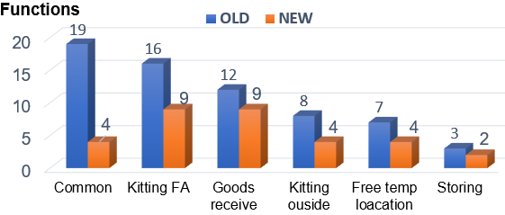
Detail Improvement Activity
1/10
6/10
Issue 1
Develop new software on new devices
Upgrade all function for FOSS system
Main Issue
Improvement Actions
Result
[2] Analyze & Optimist all process of FOSS
Material Control System Process
Apply:
Supplier
Receiving Area MCS
Warehouse MCS
Kitting by lines
Production Lines
GR local (Otc.2023)
GR Oversea (Dec.2023)
Storing
(Jan.2023)
Kitting FA,
Kitting Dip (Jan.2023)
Kitting Other
(Feb.2024)
Free temp location (Feb.2024)
G/R
Storing
Kitting
Supply
- Analyze Material control System.
- Improve & Optimize the process.
GR local
& Oversea
Temporary
Location
Kitting
FA
Kitting
Dip
Kitting
Others
Total Functions FOSS Upgrade
[3] Development software on Mobile
Result upgrade
 | Old | New
Total functions | 65 | 32
- Amount of working is big to develop.
- Research new technology to apply and own.
Merits : Coding time : 50% Support time : 30%
New software to run on mobile devices
Notes:
- Let's see the process of FOSS :
Firstly, Vender have to issue and paste barcode label on each box by our provided tool.
When G/R MCS Section will scan barcode label by HT device, result data will send automatically to FOSS Server.
When storing, you have to check validation between position barcode and a sample barcode label.
When kitting and supply, HT device will show a plan by time and by line on the screen to instruct you.
- We look at Total screen of old system is 65. the mount of working is big to develop new soft.
FOSS includes 4 stage. GR, storage, kitting and supply
Following schedule we will GR local in Oct.23, GR Oversea Dec.23,Free temp location Jan.24, Storing Feb.24, Kitting, supply FA Dec.23, Kitting other Feb.24 and so far ….. SMWS …is FOSS enhance.
This is all improvement activity 1. Now I move to next issue 2,

Slide 11


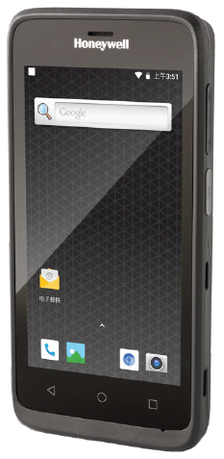
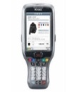

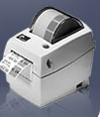



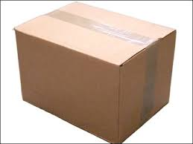
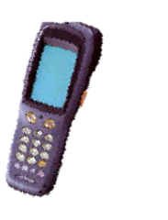



Detail Improvement Activity
1/10
7/10
Issue 2
Study about the department's asset management system of IT.
Provide a standard process to optimize the management system.
Main Issue
Improvement Actions
Result
[1] Survey all process and build standard management
Discuss, Q&A, find solution
List Job
Document, operators,
reports
System Solutions
Make documents & Design system
(Oct.23)
Study
Operating
system ?
IT
Part No :
A
Part card:
A
- Too much manual job ,use excel file, papers, check sheet to management.
- Take a long time to make report.
PIC, Leader
QTY:
30
Explain
new operations
Discuss
Create tool barcode (Nov.23)
Database
Process of ALCMS
Transfer
Inventory
Maintenance
Create tool Borrow & Return Equipment (Dec.23)
[2] Analysis system, design database
Issue Barcode
SQL Server
(ALCMS)
Scrap
- No barcode tool create & no scan device to manage.
- Not clear process.
Import stationery
Export stationery
Report
Equipment management by barcode
Notes:
Next, please look at the current issue and solution:
Currently, IT department has too much manual job ,use excel file, papers, check sheet to management. Take a long time to make report.
- All products do not have barcode for identification. The processes are not linked to each other. All operations are recorded on papers and note books. take a lot of time.
Solution: Discuss, Q&A and find solution with other members of IT. Build standard process of manage asset :
with the infra team: GR, Transfer, Maintenance, inventory, scrap. Borrow and return equipment by barcode.
With stationery team: input, output material and report.
After identify products by barcode and clear process. I started building the database. and select new device to develop software.
Next slide I will explain detail process of new system.

Slide 12




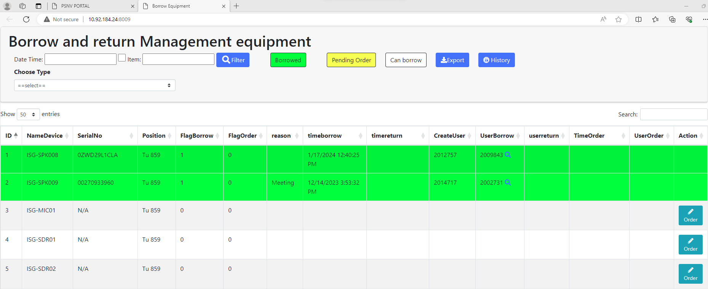
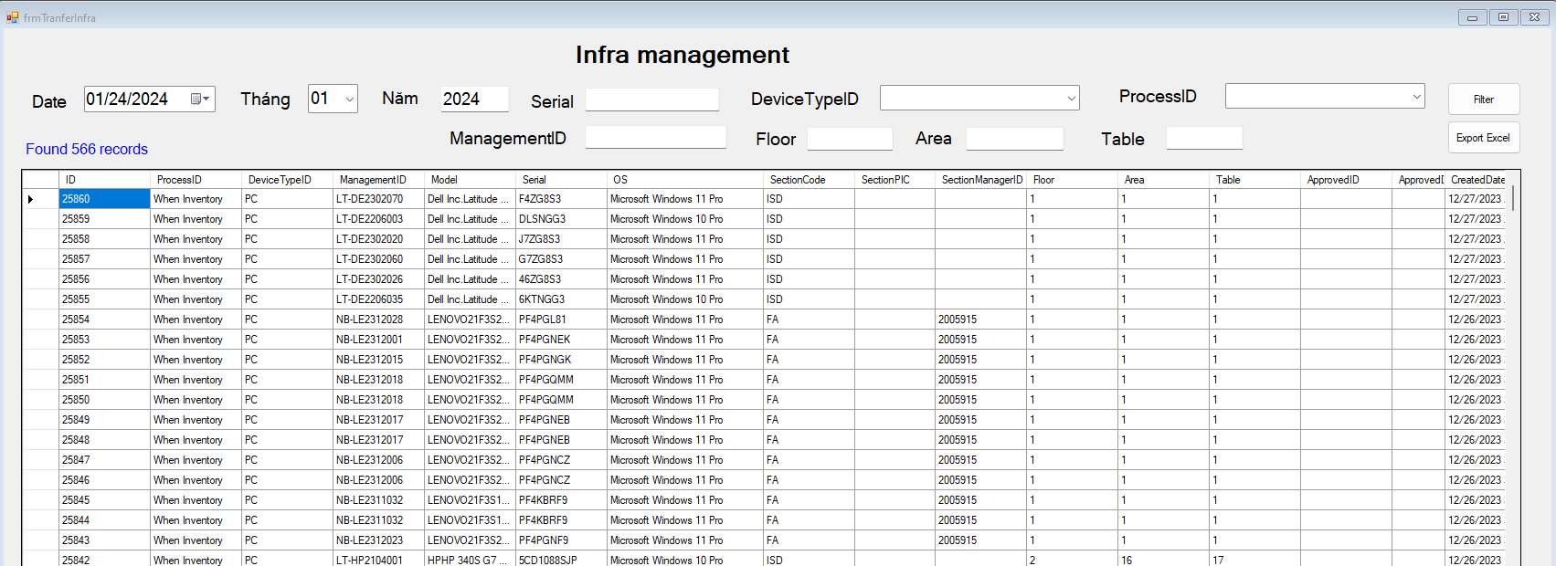

Detail Improvement Activity
1/10
8/10
Issue 2
Manage Asset of IT by barcode.
Optimize all manual jobs by using a management system.
Main Issue
Improvement Actions
Result
[3] Develop, testing
Standardization All manual operations
Apply:
Tick to check sheet
function
Action
Borrow & return (Dec.2023)
Manage stationery warehouse (Jan.2024)
GR, Transfer
& Inventory, Maintenance,
Scrap
(Feb.2024)
- Borrow & return
- Transfer, inventory
- Maintenance, scrap
- Stationery management
- Clear method
- Create barcode tool
- Build database
- Coding & Testing
Print report
Record Paper
software
Visualize
Auto Report
- Count and record PC, equipment information
- Manage stationery by excel, check sheet
- Lost time to inventory
- Lost papers to record, make report
Database
Merits
100%
Time
40%
100%
Paper
50%
50%
60%
time
Reduce paper: 50%
Save time inventory : 40%
Notes:
The Process of ALCMS split 3 stage : Borrow and return equipment, Manage stationery warehouse, GR, Transfer-inventory-maintenance-scrap, stationery warehouse management.
Action : I make tool barcode to identify equipment. I build functions for each process. Create tool scan barcode for operation borrow and return, assign position for equipment with function transfer and inventory, maintenance, scrap destroy, export and import stationery warehouse.
Result with new system, using barcode technology with new devices mobile that connect to database server via access point. Apply this system, you will control easy and specially we will save 40% time management and 50% print paper.
That all my improvement for each issue .and I move to next slide to confirm result.

Slide 13
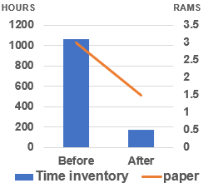
Confirm result
1/10
Before: Total time using: 3 min/60 * 20 * 1060 pcs = 1060 h/month
After: Total time using: 0.5 s/60 * 20 * 1060 pcs = 176 h/month
9/10
No | Action |  | Result | Time | Status
Issue 1: Upgrade FOSS
1 | Select new language & OS | Flutter & Android OS |  | 08/2023 | Complete
2 | GR local & GR Oversea | Finish Upgrade |  | 10/2023 | Complete
3 | Storing | Finish Upgrade |  | 01/2024 | Complete
4 | Kitting & Supply (FA,DIP) | Finish Upgrade |  | 01/2024 | Complete
5 | Kitting Other | Finish Upgrade |  | 02/2024 | Complete
6 | Temporary Free Location | Finish Upgrade |  | 02/2024 | Complete
Issue 2. Make Asset Life Cycle Management System
Inventory pc:
Before: Take time : 650 Pcs * 0.1 hour =65 Hour
After: Save time and manpower: 65 * 2.5*4=650$/Year
Time develop
: 1h * 4per = 4h/ day
Save time : 1h * 4per = 4hour / day
Save cost: 24 * 4 * 2.5 = 240$ / Y
Or
Save time : 0.5h * 4per = 2hour / day
Save cost: 12 * 4 * 2.5 = 120$ / Y
Function
Target
Result
Borrow & return Equipment
Use scan device & barcode to manage
Apply 12/2023
Manage stationery warehouse & GR, Transfer, Inventory, Scrap, Maintenance
Use scan device & barcode to manage
Apply 01/2024
Notes:
Before:
Take time: 120,000min/y (8min/PIC/m~1250 PIC)
Lost paper: 36RAM/y (~3RAM/m)
Lost cost: ~3,450 $/y (manpower + paper)
Lost pager make document & test exam
After:
Save time: 120,000min/y
Employees no need to tick to checksheet & print paper
Save cost: 3,450 $/y.
Reduce system development fee : 17k$

Slide 14
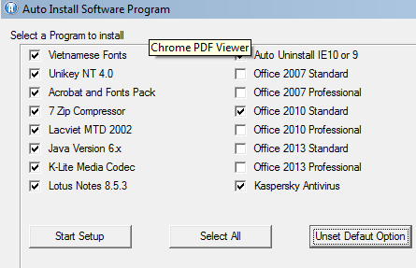
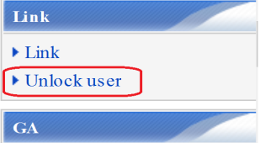

2. FY2015 ACHIEVEMENTS
14/10
2.2 Improve ISG Efficiency And Cost Down Reduce lead time of IT services: Time  1,460 hours Improve usage efficiency of server by new solution: Cost  $4,800
Activities | Content | Efficiency
Minimize delivery time of IT services | Setup PC: 80 pcs, setup all in 1 | Time:  20 hours/Y Speed up 4 x time => 15 minutes/PC x 80
 | Version-up Software: Auto 550 PCs Install IE 11 Change SAP server | Time:  360 hours/Y 20 minutes/PC x 550 x 2
 | Unlock user PC: for night shift, 0.5time/day | Time:  1080 hours/Y 12 hours / case x 90
Improve Server Efficiency | Save server space: combine same files | Data size:1,200GB = $4.8K
Software 1
Software 2
Software 3
1 Setup
Down Time
ZERO
Disk:
File A
Actual
-17%
-11%
+33%
display
display
Folder1:
File A
Store
Folder2:
File A
Notes:
This page I will show you my achievement to improve IT efficiency and cost down.
Firstly reduce delivery time of IT services, Setup PC: I combine all software setup into one setup, no need
To setup one by one, just one time click. so It speed up 4 times reduce 15 minutes in one PC.
Version up Software, To version up for more than 500 PC I create automatic software to deploy from server.
Avoid stop working of staff and reduce setup time 20 minutes in 1 PC.
Unlock user PC: I create this function for night shift, if user computer is lock, staff can ask other person access PSNV web to unlock for him.
Staff No need to wait until tomorrow, reduce 12 hours waiting.
The Second, to improve server efficiency, I study new function to reduce same files in server. You may see same file in deferent folders
But actually store only 1 on the disk, so space reduce 17% for file data, reduce 11 % for servers data. Finally free space increase 33%.
I finish achievement here and go to setup future Plan.

Slide 15
Confirm result
1/10
Before: Total time using: 3 min/60 * 20 * 1060 pcs = 1060 h/month
After: Total time using: 0.5 s/60 * 20 * 1060 pcs = 176 h/month
9/10
No | Action |  | Result | Time | Status
Issue 1: Upgrade FOSS
1 | Select new language & OS | Flutter & Android OS |  | 08/2023 | Complete
2 | GR local & GR Oversea | Finish Upgrade |  | 10/2023 | Complete
3 | Storing | Finish Upgrade |  | 01/2024 | Complete
4 | Kitting & Supply (FA,DIP) | Finish Upgrade |  | 01/2024 | Complete
5 | Kitting Other | Finish Upgrade |  | 02/2024 | Complete
6 | Temporary Free Location | Finish Upgrade |  | 02/2024 | Complete
Issue 2. Make Asset Life Cycle Management System
1 | Borrow & return Equipment | Use scan device & barcode to manage |  | 12/2023 | Complete
2 | Manage stationery warehouse | Use software to reduce papers & time inventory |  | 01/2024 | Complete
3 | Good Receive, Inventory, Transfer, Scrap, Maintenance | Use barcode to manage equipment |  | 02/2024 | Complete
Inventory pc:
Before: Take time : 650 Pcs * 0.1 hour =65 Hour
After: Save time and manpower: 65 * 2.5*4=650$/Year
Time develop
: 1h * 4per = 4h/ day
Save time : 1h * 4per = 4hour / day
Save cost: 24 * 4 * 2.5 = 240$ / Y
Or
Save time : 0.5h * 4per = 2hour / day
Save cost: 12 * 4 * 2.5 = 120$ / Y
Notes:
Before:
Take time: 120,000min/y (8min/PIC/m~1250 PIC)
Lost paper: 36RAM/y (~3RAM/m)
Lost cost: ~3,450 $/y (manpower + paper)
Lost pager make document & test exam
After:
Save time: 120,000min/y
Employees no need to tick to checksheet & print paper
Save cost: 3,450 $/y.
Reduce system development fee : 17k$

Slide 16
Next activities
1/10
10/10
For my team
For myself
- Tranning: Support skill, Training skill, coding skill, analysis skill
- Work team: Learn, sharing, knowledge, experience about new technical. Transfer some system to other member
- Goal: Building team work and improving spiritual
- Study: Method issue and solved problem, Level up Communication skill
- Job: Control schedule to keep on time support user, own new technology.
- Goal: Continuously to discuss find out best solution to save time & reduce human for production, ensure quality.
Next activities in 2024
NO | Action plan | FY23 |  |  | FY24
 |  | 1 | 2 | 3 | 4 | 5 | 6 | 7 | 8 | 9 | 10 | 11 | 12 | 1 | 2 | 3
1 | Complete FOSS system to a mobile application system
2 | Upgrade Fire extinguisher management
3 | Upgrade Stationery warehouse management GA
4 | Expand ALCMS to other department
THANK YOU FOR LISTENING!
Notes:
Develop Smart Warehouse management system, control schedule to keep on time.
And the last important thing is building team work and improving spiritual.
I expect my team reduces coding time: 50% and reduces support time 30% at the end of FY2024.
Thanks for your listening! If do you have any question, please let me know?

