Slide 1
PROMOTION REPORT
Upgrade Factory Operation Support System (Foss) &
Make Asset Life Cycle Management System
MAIN CONTENTS
1
Job History & Achievement
Page 1
2
Background Of Activities
Page 2~3
3
Total Improvement Schedule
Page 4
4
Detail Improvement Activity
Page 5~8
5
Confirm result & Next activities
Page 9~10
Presented by : Nguyen Nhu Minh
Join Date : 12-Feb-2019
Current Position : Officer (5 years)
New Position : Supervisor
Section : DEV
Notes:
Good morning/afternoon/evening everyone, My name is Minh ,member of IT section. Today, I am very honored to be here to present my promotion report. My topic is : “Upgrade Factory Operation Support System (Foss) & Make Asset Life Cycle Management System”
My presentation is split into 5 parts.
The beginning, I will start with job history & achievement. Then I mention background of activities. After that, I will talk about total improvement schedule. The next I talk about the detail of activities. And the last I confirm result and next activities.

Slide 2
Job History & Achievement (2109-2023)
2/10
1/10
1.Job History & Organization:
Time | Career History
Entrance | 12/02/2019
Apr 2022 | Rank up (V12-V13)
My Responsibilities | ✓Develop software. ✓Support users and all systems of IT.
ISD (GM. Matsushita)
M. (Chung/ Thuy/ Toan)
AM. Hien
Sup. Minh
4HC
4HC
2HC
6HC
Develop
Sap
Infra
Business Planning
2.New Assignment:
Analysis
✓ Current job : Maintain developed Systems, Analyse, Design & Develop new systems, study system of company production to make software.
✓ Change mindset : Lead team (2 officer) beside my current jobs. Study more new technologies to develop software.
3.My main achievements (2019 – 2023)
❖ Reduce HC
Auto transfer kitting to SAP(2pax)
QC & MCS Free Location(2pax)
Auto print Stock card by Mobile printer for MCS(2pax)
❖ Save cost
Tally sheet for SCM (33.6K$)
Manage sub-material(16.8K$)
Sound Biz Adding Serial Outer & Shipping control (7.8K$)
❖ Ensure Quality
Develop weigh check system
Modify printing label system
Check Double ID, PL, shipping for all production line
Notes:
Now, the first content. I introduce about my self.
I work here start February, 2019
As you see in the ISD Organization, I’m working in Develop team. There are 4 peoples in my team. I’m a in charge of Software development and support all system of IT.
There are some my achievement. I had done many project with achieve cost down, reduce HC, ensure quantity for production.

Slide 3
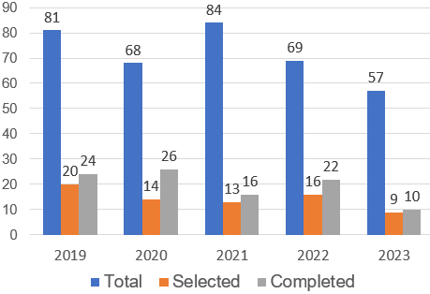




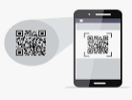




Background Of Activities
2/10
2/10
My Goal
Increase development time ratio, reduce time support to get more cost down.
Select smart devices, new technology to upgrade win CE.
FY2023 Project Summary
Development Activity
Target: Increase quantity Project
Actual: Development time is still not enough
OS/ PLATFORM
45 % Normal support
55 % Development
HANDY TERMINAL
END OF LIFE 2023
Scan
Normal support is very height (45%)
New technology ?
Issue 1: Upgrade Factory Operation Support System (FOSS)
Current System
OS is not update in the future
Development Software is quite slow
Not responsive to big data system
The stable of the device is poor, often repaired
New System
Development new Software
New programming language (Flutter)
New development environment(Android)
Mission: Make new software to reduce support time, save time inventory and comply policy
Notes:
The next, I talk about the background of activities.
Let's look at the 5-year chart (Project summary). IT received a lot of number request . There is small of request is selected..
Target : increase project but actual the develop time still not increate.
Normal support is very height, we are know all application running on Handy terminal. Difficult to develop soft on them. Take long time to modify and build program. Sometime repair and setup Operation system. This is also one of the reasons why support time is so high. (There are a lot of software need support during operation. human error, machine error, or system error. I need to solve it for the system running again..)
Win CE end of line 2023. to comply company policy I need to upgrade win CE to android Operation system.
Let's look at the details of development job….
my mission: Make new software to reduce support time, save time inventory and comply policy

Slide 4
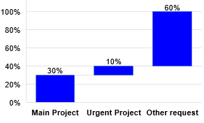

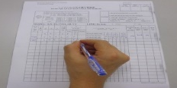

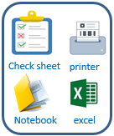
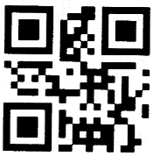
Background Of Activities
2/10
3/10
My Goal
Build standardization for asset management system.
Save time to inventory, reduce manual job, papers and ensure quality.
Ratio of development team projects
Current Asset Management IT
Solution
Other Request
Manual job
No software
Not clear process
Improve quality
Use Excel manage equipment
To Inventory PC by Paper
Manage Equipment by barcode
Analysis
Issue 2: Asset Life Cycle Management System (ALCMS)
Current process
 | Quantity | Time inventory / month (hours)
Stationery Item | 490 | 490
Infra Equipment | 652 | 652
Improve activities
Good receipt
Database Server
Use software
Scrap
Transfer
Manual job, lost papers.
Tack time to inventory.
Difficult control in-out.
Easy mistake.
Not ensure quality.
Save time management & ensure quality.
Reduce papers.
Easy manage operation and trace history.
Inventory
Maintenance
Notes:
We know the win CE operation system will be end of life 2023.
So that we have to upgrade all applications are running on win CE to Android. Most especially, Most especially I want to mention FOSS. This is a large system that needs to be upgraded.
The advantage of this action : reduce support time and increase develop time.
Let's look at issue 2. we mention to manage asset of IT room. GR, Transfer, inventory, stationery management.
All these activities are manual job through papers, check sheet and excel file. It takes a lot of time to manage monthly inventory.
For this reason, I want to make an asset management software system for the department using by barcode technology.
Apply new system, We save time management, reduce papers.

Slide 5
Total Improvement Schedule
1/10
4/10
Issue | Items | Activity Content | In charge (Main) | WHEN (Jul.2023) |  |  |  | TARGET
 |  |  |  | Q1 | Q2 | Q3 | Q4
Upgrade FOSS | [1] Upgrade Foss from wince to other OS. [2] Analyze & Optimize all process of FOSS |  Select new language & new OS to develop.  Select smart device to scan barcode. | IT member |  |  |  |  | Deciding on a new language
 |  |  GR local  GR Oversea | IT member MCS Pic |  |  |  |  | Upgrade all function FOSS to new software & install on new devices
 |  |  Storing | IT & MCS
 |  |  Kitting & Supply | IT member MCS Pic
 |  |  Kitting Other  Temporary Location | IT member MCS Pic
Make Asset Life Cycle Management System | [1] Study management asset of IT. [2] Develop software to manage asset |  Borrow & return Equipment | IT member |  |  |  |  | Apply software to reduce time management, papers & manual jobs
 |  |  Manage stationery warehouse | IT member
 |  |  Good Receive | IT member
 |  |  Inventory, Transfer, Scrap, Maintenance | IT member
Issue ①
Issue ②
Plan:
Actual:
Notes:
Next slide, I talk about the total improvement schedule
the issue 1, how to upgrade to FOSS from win CE to android. My action -> we have to select new language to develop.
[2] we have analyze and optimize all process of Foss and develop new soft on the new devices -> action: I split function GR, Store, kitting, supply -> the last : I develop on new device
The issue 2, I survey all process and build standard management. After that I analysis system and design database.
At the end I select the device and develop software.
Now I will explain for details of issue 1.

Slide 6

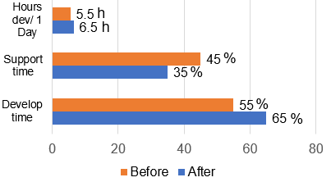
Detail Improvement Activity
1/10
5/10
Theme 1
Follow FY23 company policy, OS Windows CE will be end of life 2023.
IT find new solution to upgrade old OS to smart device as mobile.
Main Issue
Improvement Actions
Result
[1] Upgrade from Wince to other OS
Select new language & new OS
Upgrade FOSS on Android OS
➢ OS Win CE is not support in the future
➢ Upgrade from Wince to other OS
➢ Flutter develop applications for mobile devices runs on both Android and IOS.
➢ The Android OS is quite commonly and integrates many scanning devices
✓ Select Flutter language
✓ Select Android OS /Platform
The Advantage use flutter
Compliance
Efficiency
Develop time
Support time
Total device need to Upgrade
Limit windows CE
Follow company policy
➢ Difficult develop for big system.
➢ Tack a long time to support when error.
Increase Develop time
 Reduce Support time
Make Faster, stable, smarter Software
MCS Dep:
FY2023 109 pcs
Improvement Result
Other Dep:
Job request:
+ Select new language, new OS to develop
+ Comply company policy
FY2024 6 pcs
Notes:
I have choose Flutter language. Because it is used to develop applications for mobile devices. Runs on both Android and IOS platform, desktop applications and web applications. (Develop software slow, Not responsive to big data system, Regularly repair and setup window again)
The Android OS is quite commonly used and integrates many scanning devices. So that I have selected android platform.
The advantage when use flutter to develop software: make faster, stable software. So I can increase develop time, reduce support time.
Result : let look at total devices need to upgrade new software. MCS department : 140PCS, other department: 6 pcs
Now I go to the functions detail of FOSS.

Slide 7
Detail Improvement Activity
1/10
5/10
Issue 1
Follow FY23 company policy, OS Windows CE will be end of life 2023.
Upgrade Foss from Wince to new OS as mobile.
Current Situation
Solution
Applications are running on Wince.
Normal support is very height.
Select new language & new OS.
Make new software upgrade FOSS.
Select new language & new environment
➢ Flutter develop applications for mobile devices runs on both Android and IOS.
➢ The Android OS is quite commonly and integrates many scanning devices.
Limit Wince
Flutter Efficiency
❖ Difficult develop for big system.
❖ Tack a long time to support when error.
❖ Poor memory, catch poor signal WIFI.
 Increase Develop time.
 Reduce Support time.
 Make Faster, stable, smarter Software.
Compliance company policy
Improvement Result
Total devices need to Upgrade:
MCS Dep : 109 pcs
Other Dep: 6 pcs
Notes:
I have choose Flutter language. Because it is used to develop applications for mobile devices. Runs on both Android and IOS platform, desktop applications and web applications. (Develop software slow, Not responsive to big data system, Regularly repair and setup window again)
The Android OS is quite commonly used and integrates many scanning devices. So that I have selected android platform.
The advantage when use flutter to develop software: make faster, stable software. So I can increase develop time, reduce support time.
Result : let look at total devices need to upgrade new software. MCS department : 140PCS, other department: 6 pcs
Now I go to the functions detail of FOSS.

Slide 8


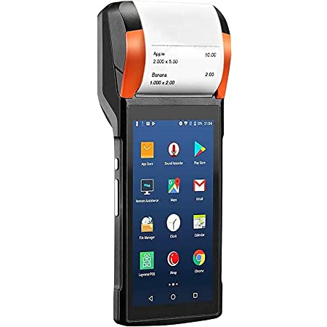
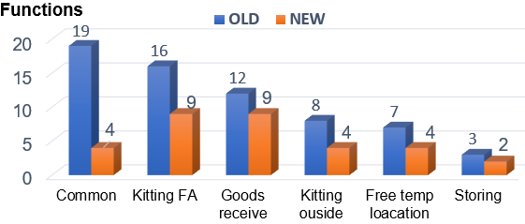
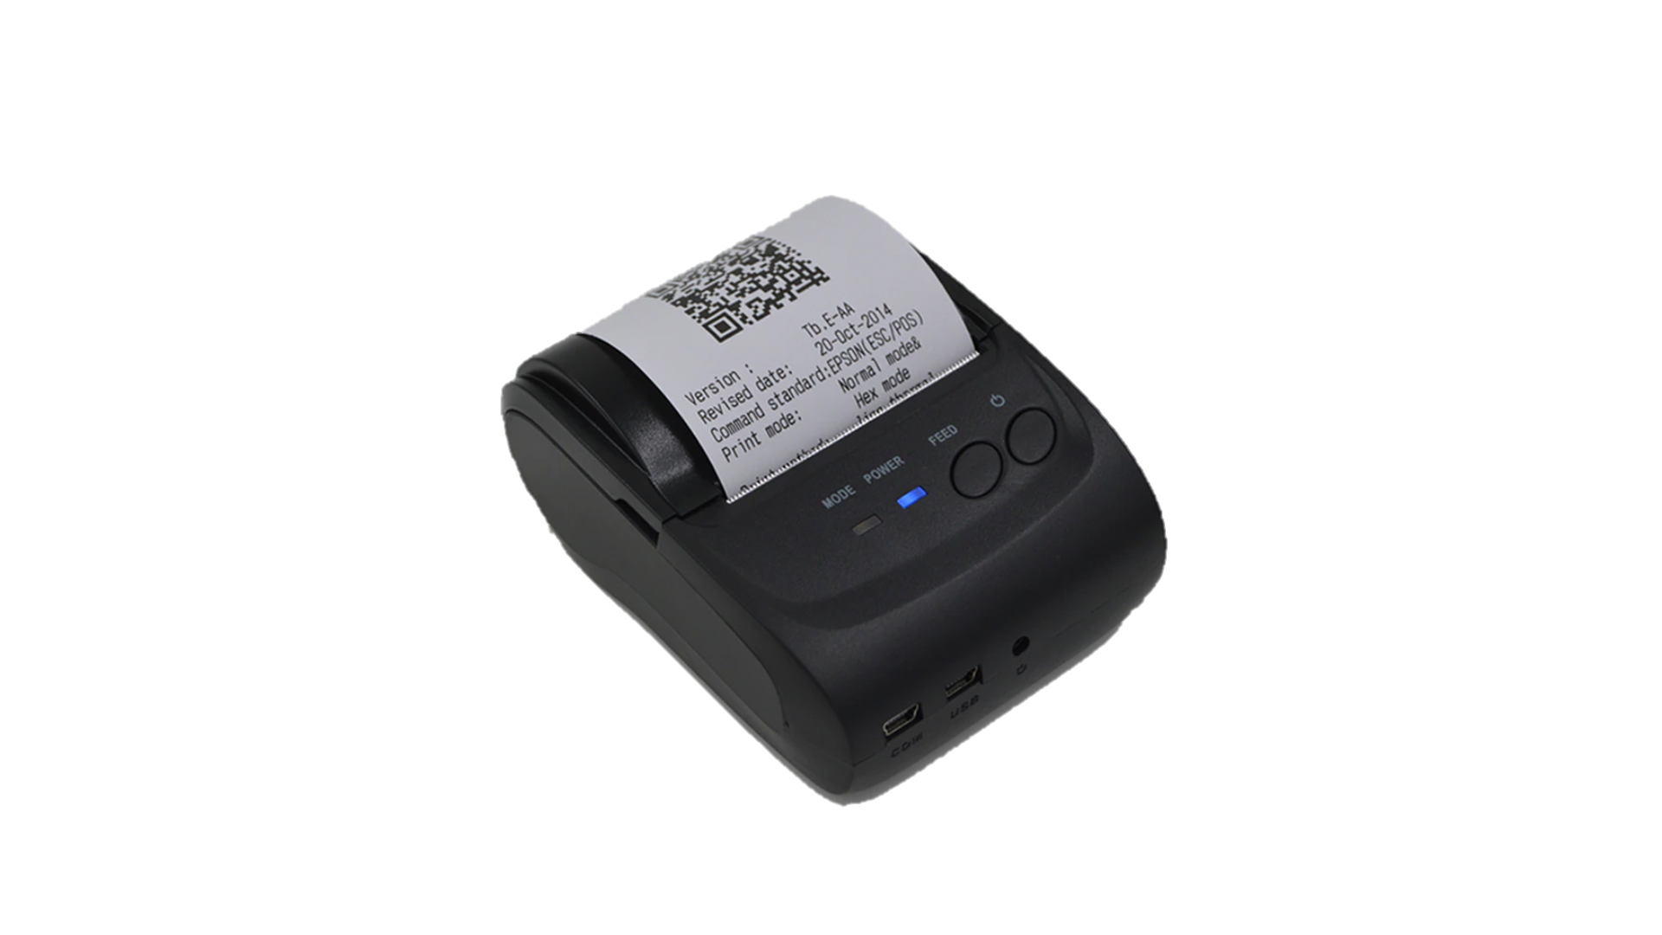
Detail Improvement Activity
1/10
6/10
Theme 1
Develop new software on new devices.
Upgrade all function for FOSS system.
Main Issue
Improvement Actions
Result
[2] Analyze & Optimize all process of FOSS
Material Control System Process
Apply:
Supplier
Receiving Area MCS
Warehouse MCS
Kitting by lines
Production Lines
GR local (Oct.2023)
GR Oversea (Dec.2023)
Storing
(Jan.2023)
Kitting FA,
Kitting Dip (Jan.2023)
Kitting Other
(Feb.2024)
Free temp location (Feb.2024)
➢ Analyze Material control System.
➢ Improve & Optimize the process Foss.
G/R
Storing
Kitting
Supply
GR local
& Oversea
Temporary
Location
Kitting
FA
Kitting
Dip
Kitting
Others
[3] Development software on Mobile
Total Functions FOSS Upgrade
Result upgrade
 | Old | New
Total functions | 65 | 32
Job request:
+ complete new software keep on time
+ upgrade all device
Merits : Coding time : 65% Support time : 35%
New software to run on mobile devices
Notes:
Let's see the process of FOSS :
FOSS includes 4 stage. GR, storage, kitting and supply
After analyze , discus with pic MCS we combine some the same function, reduce screen, optimize the process to reduce the operators.
Total function reduce 65 to 32. (-> Amount of working is big to develop. Research new technology to apply and own.)
Following schedule we will GR local in Oct.23, GR Oversea Dec.23,Free temp location Jan.24, Storing Feb.24, Kitting, supply FA Dec.23, Kitting other Feb.24 and so far ….. SMWS …is FOSS enhance.
This is all improvement activity 1. Now I move to next issue 2,

Slide 9

Detail Improvement Activity
1/10
6/10
Issue 1
Analyze & Optimize FOSS to develop new software on new devices.
There are a lot of function to develop and improve.
Current Situation
Solution
Analyze all Process of FOSS
There a lot of functions (65 screens)
There are many similar functions
Many request improvement quality activities from the department
❖ Improve & Optimize system
Analysis deeply and optimize process
combine some the same function
Discuss and clear process to develop software to ensure quality.
Develop Material Control System
G/R
Storing
Kitting
Supply
Apply new software
GR local
& Oversea
Temporary
Location
Kitting
FA
Kitting
Dip
Kitting
Others
Total Functions FOSS Upgrade
Result upgrade
 | Old | New
Total functions | 65 | 32
❖ Merits:
 Coding time: 65%
 Support time: 35%
Notes:
Let's see the process of FOSS :
FOSS includes 4 stage. GR, storage, kitting and supply
After analyze , discus with pic MCS we combine some the same function, reduce screen, optimize the process to reduce the operators.
Total function reduce 65 to 32. (-> Amount of working is big to develop. Research new technology to apply and own.)
Following schedule we will GR local in Oct.23, GR Oversea Dec.23,Free temp location Jan.24, Storing Feb.24, Kitting, supply FA Dec.23, Kitting other Feb.24 and so far ….. SMWS …is FOSS enhance.
This is all improvement activity 1. Now I move to next issue 2,

Slide 10




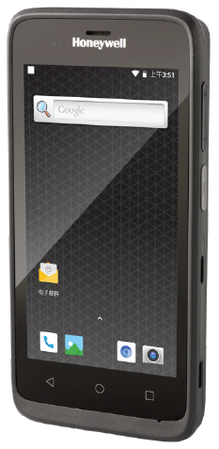
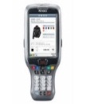



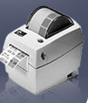



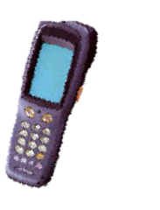
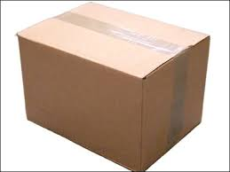



Detail Improvement Activity
1/10
7/10
Issue 2
Study about the department's asset management system of IT.
Provide a standard process to optimize the management system.
Main Issue
Improvement Actions
Result
[1] Survey all process and build standard management
Discuss, Q&A, find solution
List Job
Document, operators,
reports
System Solutions
Make documents & Design system
(Oct.23)
Tick to check sheet
Study
Operating
system ?
IT
Part No :
A
Part card:
A
PIC, Leader
QTY:
30
Explain
new operations
Discuss
Create tool barcode (Nov.23)
Print report
Database
Record Paper
Process of ALCMS
[2] Analysis system, design database
Transfer
Inventory
Maintenance
Create tool Borrow & Return Equipment (Dec.23)
➢ No barcode tool create.
➢ Not clear process.
Issue Barcode
SQL Server
(ALCMS)
Scrap
Job request:
+ Clear process
+ Issue barcode to identify equipment
+ Build database
Import stationery
Export stationery
Report
Equipment management by barcode
Notes:
This slide I talk about the asset management system of IT:
Currently, IT department has too much manual job ,use excel file, papers, check sheet to management. Take a long time to make report.
Solution: Discuss, Q&A and find solution with other members of IT. Apply barcode technology for each equipment.
Build standard process of manage asset
+ Borrow and return equipment by barcode
+ GR, Transfer, Maintenance, inventory, scrap.
+ input, output stationery.
After that, I build database. and select new device to develop software.
Next slide I will explain detail process of new system.

Slide 11






Detail Improvement Activity
1/10
7/10
Issue 2
Study about the department's asset management system of IT.
Provide a standard process to optimize the management system.
Current Situation
Solution
Too much manual job, papers, excel file.
Not clear process.
Survey all process, analysis and design.
Build standard process of manage asset.
Discuss, Q&A, find solution
Process of ALCMS
Issue Barcode
Transfer
Inventory
Maintenance
List Job
Document, operators,
reports
System Solutions
Study
Operating
system ?
IT
SQL Server
(ALCMS)
Scrap
Discuss
PIC, Leader
Explain
new operations
Import stationery
Export stationery
Report
Standardization All manual operations
Issue & Paste Barcode to each equipment
Scan barcode, user’s card & fix location
Data base Server
To Inventory, Make report by System
Notes:
This slide I talk about the asset management system of IT:
Currently, IT department has too much manual job ,use excel file, papers, check sheet to management. Take a long time to make report.
Solution: Discuss, Q&A and find solution with other members of IT. Apply barcode technology for each equipment.
Build standard process of manage asset
+ Borrow and return equipment by barcode
+ GR, Transfer, Maintenance, inventory, scrap.
+ input, output stationery.
After that, I build database. and select new device to develop software.
Next slide I will explain detail process of new system.

Slide 12






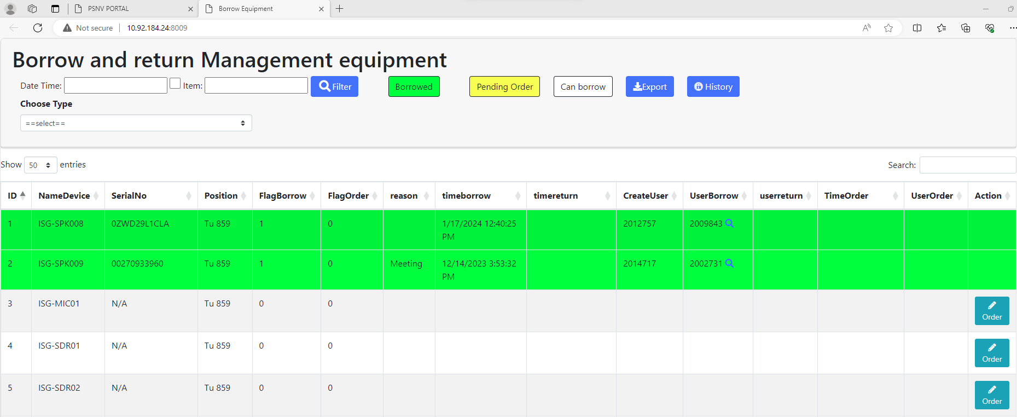
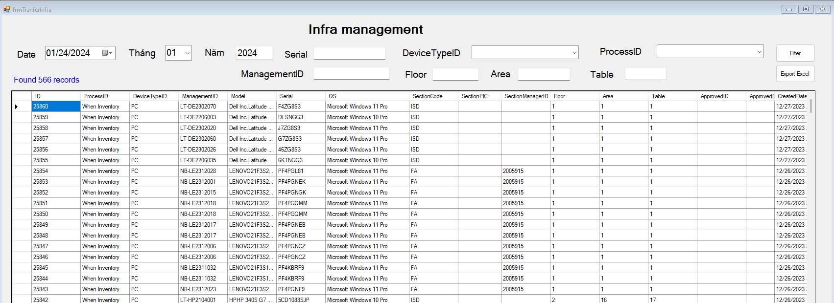

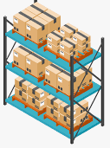



Detail Improvement Activity
1/10
8/10
Issue 2
Manage Asset of IT by barcode technology.
Optimize all manual jobs by using a management system.
Main Issue
Improvement Actions
Result
[3] Develop, testing
Standardization All manual operations
Apply:
➢ Borrow & return
Issue & Paste Barcode to each equipment
Scan barcode, user’s card & fix location
Borrow & return (Dec.2023)
Manage stationery warehouse (Jan.2024)
GR, Transfer
& Inventory, Maintenance,
Scrap
(Feb.2024)
IT
User
To Inventory PC by System
Data base Server
➢ Transfer & inventory
software
Visualize
Auto Report
Count Manual When PC Inventory Quarterly
➢ Stationery warehouse
Database
Manual check
Merits
80%
100%
Time
66,7%
IT
100%
Paper
Job request:
+ Training IT staff use new software.
33,3%
20%
Save time inventory : 60%
Reduce paper: 80%
Notes:
This slide I talk about detail actions:
For each step, I identify the device with a barcode. When transfer or inventory ,user scan the barcode equipment and user's card and fix location.
With stationery warehouses, input and output items, have to scan barcodes.
Data result auto save database server via access point. Reports auto show website.
Apply this system, you will control easy and specially we will save 60% time management and 80% print paper.
That all my improvement. The next slide to confirm result.

Slide 13

Detail Improvement Activity
1/10
8/10
Issue 2
Develop software to manage Asset of IT.
Optimize all manual jobs by using a management system.
Current Situation
Solution
The equipment is not barcoded.
Tack a long time to inventory, make report and trace history.
Issue barcode paste on equipment
Analyze system, design, build database, develop software.
Develop ALCMS
Borrow & return
Transfer & inventory
Stationery warehouse
Manual check
Count Manual When PC Inventory Quarterly
IT
User
IT
Auto report & visualization system
Merits
software
Visualize
Auto Report
100%
Paper
80%
100%
Time
66,7%
20%
33,3%
Database
Reduce paper: 80%
Save time inventory: 80%
Apply software to management asset, save time inventory and reduce papers
Notes:
This slide I talk about detail actions:
For each step, I identify the device with a barcode. When transfer or inventory ,user scan the barcode equipment and user's card and fix location.
With stationery warehouses, input and output items, have to scan barcodes.
Data result auto save database server via access point. Reports auto show website.
Apply this system, you will control easy and specially we will save 60% time management and 80% print paper.
That all my improvement. The next slide to confirm result.

Slide 14
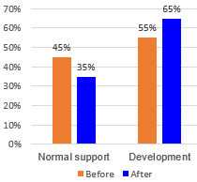
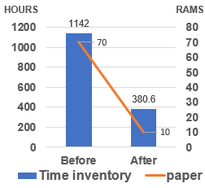
Confirm result
1/10
9/10
Issue 1: Upgrade Factory Operation Support System (FOSS)
Function
Target
Status
Result
Apply 08/2023
Apply 10/2023
Apply 01/2024
Apply 01/2024
Apply 02/2024
Apply 02/2024
Complete
Complete
Complete
Complete
Complete
Complete
Select new language & OS
GR local & GR Oversea
Storing
Kitting & Supply (FA,DIP)
Kitting Other
Temporary Free Location
35 % Normal support
65 % Development
Issue 2 :Asset Life Cycle Management System (ALCMS)
Function
Target
Status
Result
Borrow & return Equipment
Complete
Apply 12/2023
Apply 01/2024
Complete
Manage stationery warehouse
Good receive, Transfer, Inventory, Scrap, Maintenance
Apply 02/2024
Complete
Notes:
Save Time develop: 1h * 4per = 4hour / day
Save cost: 20 * 4 * 2.5 = 200$/ M ~ 2400$ /Y
Inventory pc:
Before: total time using: 3min/60*20*1142 pcs =1142 Hour / month
After: 1min/60*20*1142 pcs = 380.6 Hour /month
Total paper using : before = 70ram, after = 10ram

Slide 15
Next activities
1/10
10/10
For my team
For myself
- Tranning: Support skill, Training skill, coding skill, analysis skill
- Work team: Learn, sharing, knowledge, experience about new technical. Transfer some system to other member
- Goal: Building team work and improving spiritual
- Study: Method issue and solved problem, Level up Communication skill
- Job: Control schedule to keep on time support user, own new technology.
- Goal: Continuously to discuss find out best solution to save time & reduce human for production, ensure quality.
Next activities in 2024
NO | Action plan | FY23 |  |  | FY24
 |  | 1 | 2 | 3 | 4 | 5 | 6 | 7 | 8 | 9 | 10 | 11 | 12 | 1 | 2 | 3
1 | Complete FOSS to mobile application system.
2 | Upgrade Fire extinguisher management system to mobile.
3 | Upgrade Stationery warehouse management system GA.
4 | Expand ALCMS to other department.
THANK YOU FOR LISTENING!
Notes:
That all my report. Thanks for your listening!
If do you have any question, please let me know?

