Slide 1



Enhance Factory Quality by Standardize IT Systems & Deploy Smart Learning Solution
MAIN CONTENTS
1
New Assignment & Responsibilities
Page 1
2
Achievement
Page 2
3
Background and Improvement Activities (1)
Page 3 ~ 6
4
Background and Improvement Activities (2)
Page 7 ~ 9
5
Further Activities
Page 10
Presented by Joined in Department
Current position
New position
: Nguyen Van Hien
: 21st Jan 2019
: Information System
: Supervisor
: Assistant Manager
Notes:
(0.5m)
Good afternoon everyone,
My name is Hien, from ISD . I’m very delight to be here to tell you about my promotion report.
My topic is: “Enhance Factory Quality by Standardize IT systems & deploy smart learning solution”.
My presentation have to 5 parts.
Let’s start with part 1: New assignment & responsibilities.

Slide 2
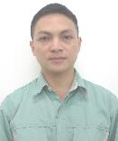
New Assignment and Responsibility
1/10
New Organization Chart after Assignment
Information Systems Department
My Responsibilities
GM Teramoto
Development
Leading all PSNV factory system
solution & development
Standardize & Centralize Company
systems, procedure
Negotiate , make the best solution
with all Department heads
Subordinate development
SAP
Project Management
AM
MG
AM(Hien)
Infra
ISM
2
Sup
Sup
Sup
2
Officer
Officer
Officer
Officer
Notes:
(0.5m)
Now I’m a supervisor of Project Management team.
In current position, I’m working as Assistant manager.
I’m leading all PSNV factory system solution,
standardize and centralize company system, procedure,
make the best solution with all department heads,
Subordinate development.

Slide 3


FY2019-2021 Main Achievement
2/10
We All Achievement Cost Deduction Target with BP
Summary Achievement
Saving Cost | FY2019 | FY2020 | FY2021
 | 91.2K$ (BP 77.6K$) | 111.5K$ (BP 68.2K$) | 93.58K$ (BP 79.83K$)
 | Project Management Leader Leading Research And Develop New Technology Proposal And Build IT Solution Work With Outside PSNV
Critical Systems Deployment
No | Items | Apply | Department | Effective
1 | E-Tally Sheet Management | FY19 | Production | 32.6K$
2 | Projector Traceability | FY20 | Production | 63.0K$
3 | Microwave Traceability | FY21 | Production | Quality
4 | Sound Business Traceability | FY21 | Production | 1pax
5 | QC - MCS Free Location | FY21 | QC-MCS | 2pax
6 | E–Approve Issue Material & Transfer | FY21 | All Dep't | 21.44K$
AP QCC Convention
Notes:
(0.5m)
Next I’d like to summary main achievement from FY2019 to 2021
We all achievement cost deduction target with BP
Besides a project management leader, I always work with all department heads and outside PSNV for building the best solution.
Here in the 6 critical system:
Biggest is “Projector Traceability system”.
Save 63K$. And joined AP QCC convention with Bronze Medal

Slide 4













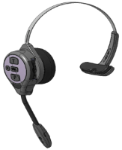

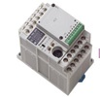


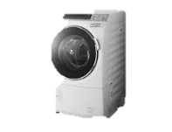








Background To Select Theme (1)
3/10
3/10
PSNV Products History
Current products
EOL products
Door
Phone
IP-Phone
HD-COM
Scanner
DECT
ODD
CPT
ITS
Display
Let’s
Note
PBX
Fax
Board
PCB
PAPVN
Projector
Micro
wave
Sound
Biz
PLC
MFP
PSNV grew up as Multi Product Factory
Problem:
Different System/Equipment/Procedure each Products
Very hard to standardize and control product quality
 Just received from BD/Factory
 Not strongly negotiate with BD
 Different system & format
Operation mistake
Not linkage all process
Just storing data
Issue 1
Not standardize and not strictly control Traceability System
Notes:
(0.45m)
Next I will say about Background to Select theme 1.
PSNV product history.
Currently we grew up as Multi product.
So We have problem is different system/ equipment and procedure each product.
Very hard to standardize and control product quantity.
When new product or new model come, we still not strongly to make suitable condition for our factory and Some special case System cannot detect Operation make mistake.
With problems, we select issue 1:
Not standardize and not strictly control Traceability System
Next slide, I will explain more detail for issue 1.

Slide 5
Improvement Activities (1)-1
4/10
Issue
1
Not standardize categories
No linkage to all process
Take time when expanding for new categories
Current Situation
Solution
Each transfer categories different format
Take much time for making new system
Have program but not linkage to once
Making standard process
Making prototype system
Linkage and strictly control system data
Create prototype system and making linkage for Traceability System

Organization and create Prototype System
New System Concept
Leader: Hien
Prototype System
New Products
Transfer
Prod Hai
(Sub leader)
PE Tan
(Sub leader)
Product
A
Template concept
Classify function
New
Singular module
Prototype System
Prototype
MCS
SMT
DIP
FA
PCS
FE
PE
QC
Module
combine
Common process
Build common function
Pickup new process
Module making
Negotiation and decision
System daily report sending
Product
B
System Go-live
Weekly meeting & review
Notes:
(2m)
About issue 1, Not categories standard, process by process not double and all process not yet linkage.
Current situation:
Each model and categories different process and format.
System not linkage to once and take time when making new system
Solution: Create prototype system and create system linkage
1st: I’d like to explain about: Organization & Create Prototype system.
For this Step :
1 – I made organization. I am a leader, 2 sub leader and all windows person of concerns department.
2- What’s prototype system? => Prototype is a system which combine common process and common function.
What’s is the benefit of prototype? => Reduce development time when make new system.
3- And for the new system concept We just focus into singular module only.

Slide 6
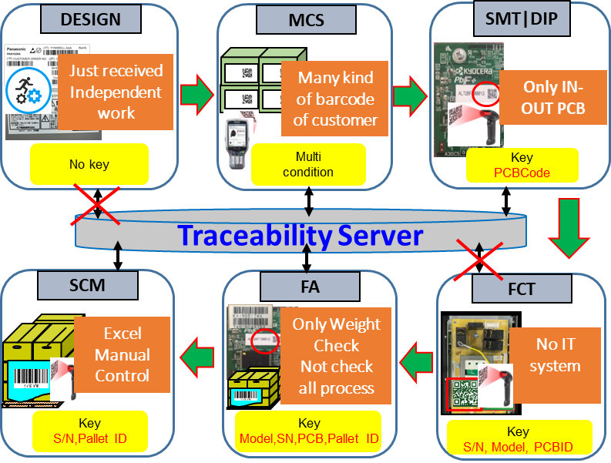
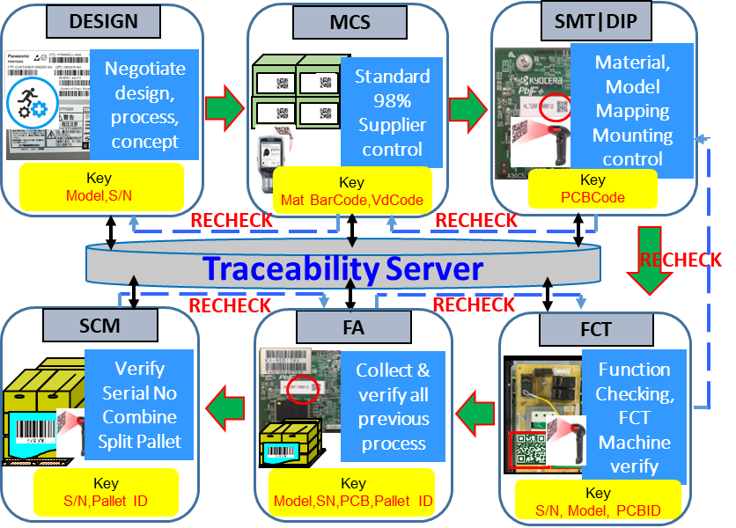
Improvement Activities (1)-2
5/10
Issue
1
Not standardize categories
No linkage to all process
Take time when expanding for new categories
Create Traceability System linkage

Traceability System linkage
Process Flow
Data
Prevent Skip
No link
No link
Each process independent work and not standard
Process by process not double check
All process not linkage and not verify
Make standard and apply for all process
Current process recheck previous process
All process linkage and verify
✵ We Can Adapt New Category By Common System
Save: 29.3K$
Notes:
(1.5m)
2nd : I’d like to introduce about: “Create System linkage”
Recently, We have 6 main process: from label design, transfer processing, concept making to SCM.
Almost process have some weakness point and some process don’t have any system for control (as I mention with arrogance color)
Following these point, I analyze system again and change:
Strongly negotiate, deeply checking condition of current system, create Linkage Key and new software, function also.
Make verify for all process (Current process check previous process)
And all process linkage
Through this project: We can adapt new category by common system. We saved: 29.3K$

Slide 7
Improvement Schedule & Result (1)
6/10
 | Items | Schedule |  |  |  |  |  |  |  | Target | Result
 |  | Aug | Sep | Oct | Nov | Dec | Jan | Feb | Mar
Traceability system Ensure quality |  Organize & create system prototype |  |  |  |  |  |  |  |  | Project organization Finish prototype system | Completed (11/2021)
 |  Create system linkage |  |  |  |  |  |  |  |  | All process linked Prevent skip process | Competed (01/2022)
Issue 1
Organization, research common function
Concept making, process making
Any category product can apply for PSNV.
All process linked and verified.
No happen quality issue by system.
Easy to management and analyze .
System making reduce from 6 months to 3 months.
Saving Cost
29.3K
Notes:
(0.5m)
Next, I review again for Schedule and Result of Issue 1.
System prototype I finished on Nov. 2021
System linkage I finished on Jan. 2022
And:
We can apply any product for PSNV
No happen quality issue by system
Easy to management and analyze
Development time reduce from 6months to 3 months.
----------------------------------------------------------------
Dev fee:
28.8 -> 14.4 (-14.4)
RW fee
FY20: 36.12K
FY21: 21.19K
(-14.93)
➔ total: 29.3K

Slide 8



Background To Select Theme (2)
7/10
PSNV Training Course holding status
Difficult open Face to Face training
COVID19 situation
Employee can not review the lesson
Training time was fixed
Trainer do repeated task
Reduce half FY2018 - FY2021
Develop people before making products
Problem:
Difficult to arrange training course and develop employees
under Covid19 situation
Issue 2
Employee not fully knowledge and skills
How to training & support for New Normal
How to increase chance to study
Notes:
(1.5m)
Next, We move to background to select theme 2:
On the Chart, We easy to see total training course reduce more than haft from 2018 to 2021.
Reason May we know is affected by Covid19
With current training method, we have many difficult point
Our policy is: Develop people before making products.
So our problems is difficult arrange training course and develop employees under covid19 situation.
I selected Issue 2: Employee not fully knowledge and skills.
How to training and support for new normal?
How to increase change to study?
I’ll explain in next slide.

Slide 9



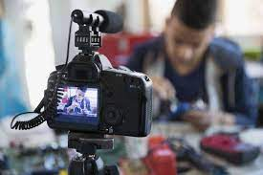


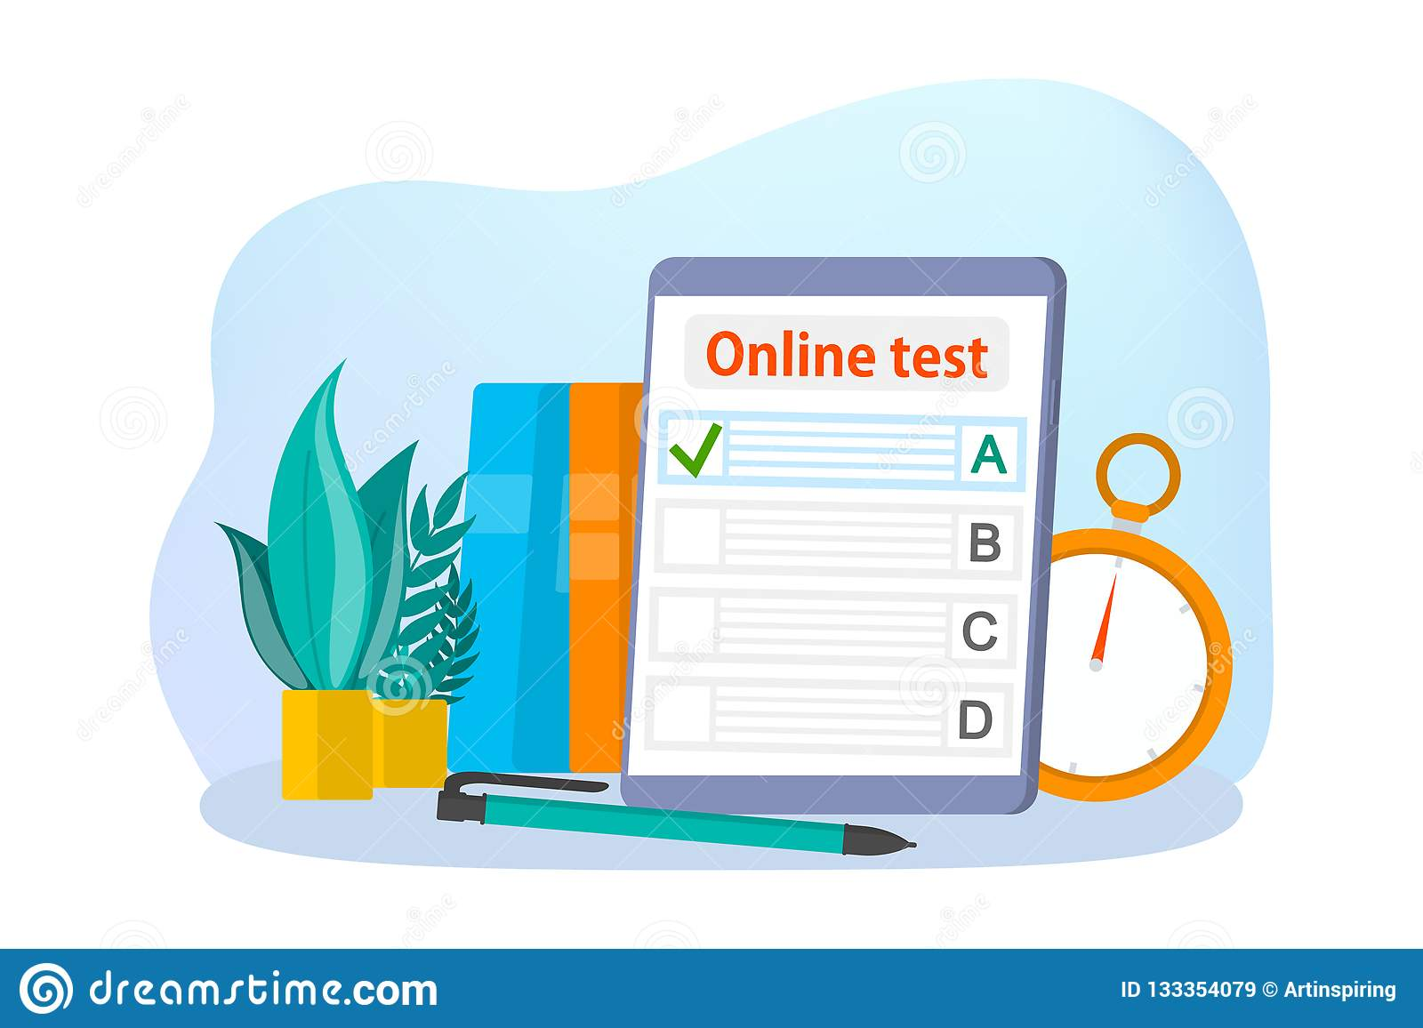
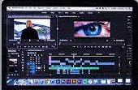

Improvement Activities (2)
8/10
Issue
2
Difficulty opening training course if long covid19
Employee not fully knowledge and skills
Lead to make a not good product and resignation increase
Current Situation
Solution
Covid19 training course opening ~50%
Not enough skill before start working
Easy make NG product & resignation
Opening online training course
Completed training & examination
Reduce NG ratio & job changing
Making E-learning system with AI technology


E-learning system making
Video making
Ex: 4h video making
New
Direct Training
Online Training
Video made by ②
8h
New
System
Recording
10min
Online Testing
Speech data
Paper Testing
Video
Editing
12h
Merge
PPT+ Speech
2h
Evaluation
Report
Manual Evaluation
Auto Evaluation
Total: 20h
Total: 2.2h
✵ We Can Reduce Covid19 Risky By E-learning System
Save: 29K$
Notes:
(2m)
The issue 2: Current situation:
Training course opening only ~ 50%. Employee not enough skill before start working And easy to make mistake & resignation
Our solution is Opening online training course, Support, reduce NG ratio & job changing.
So, I making E-learning system with AI technology.
1st: Website e-learning system
New website with video lesson and Examination also can do on the webpage
Because mainly of training system is content, so if following normal, we just use slide or image.
So I build new way with video training.
2nd : How to make video.
Normal way: People will be recording video base on content prepared . After that editing video.
Example: 4hour video take 20 hours.
My idea: Make new software for support: Auto Convert Text to Speech.
Next together merge with PPT file + speech data.
With E-learning system project, We can reduce Covid19 risky

Slide 10
Improvement Schedule & Result (2)
9/10
 | Items | Plan |  |  |  |  |  |  |  | Target | Result
 |  | Aug | Sep | Oct | Nov | Dec | Jan | Feb | Mar
E-learning system with AI technology |  Make lectures and E-Test |  |  |  |  |  |  |  |  | Completed 3 training courses | Completed (02/2022)
 |  Make video training |  |  |  |  |  |  |  |  | Completed Video Basic training | ISD Completed HRS finished 5/15 (02/2022) HRS finish 15/15 (04/2022)
Project management
Issue 2
Website training ver 1.0
Training, technical provider, Video support
ISD
HRS
Reduce covid19 risky.
Technical provide multiple languages: English, Vietnamese, Japanese etc.
Specially have Vietnamese language.
Employees can learning every time and every where.
Outside E-learning buying fee: 17K$ (Our development fee: 3.2K$)
Notes:
(0.5)
Next I review for improvement activity 2.
Make video: Our target: completed Basic training video. HR will be finish on Apr.
Make lecture & E-test. Finished on Feb.2022
I’ll introduce to others department for support and apply for other idea.
----------------------------------------------------------------------------------------
Dev fee:
17 -> 3.2 (-13.8)
Trainer time: 15.2
➔ total: 29K

Slide 11
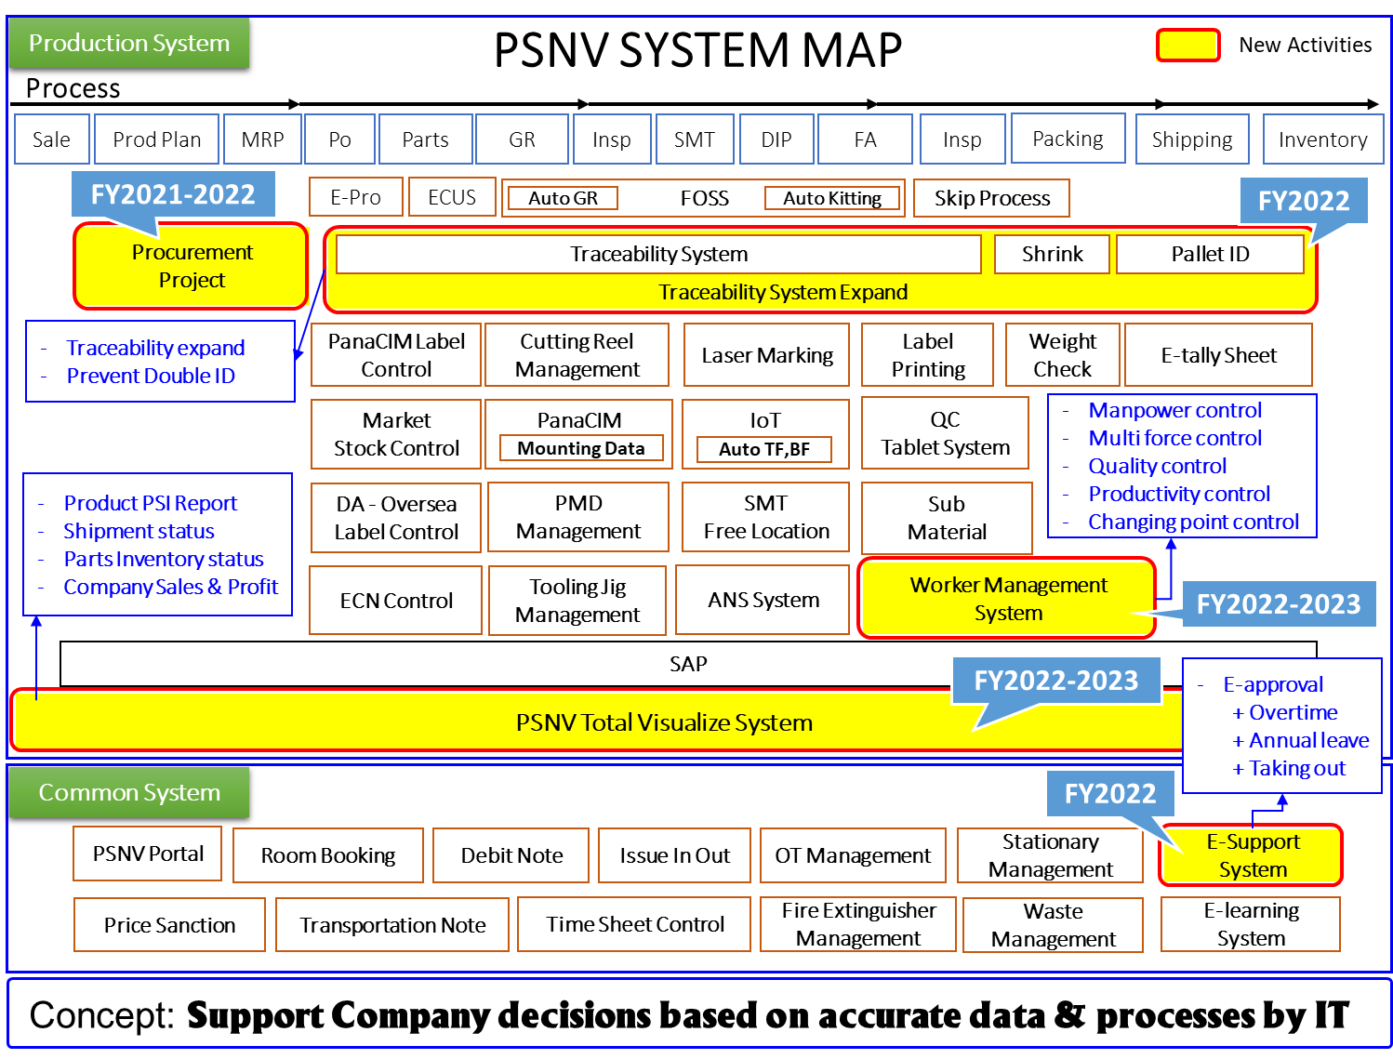
Further Plan
10/10
Notes:
(0.5m)
The last one I’d like to tell you about my further plan.
This is the PSNV system map with Production system and common system.
I have plan upgrade current and making some new system for support and improvement of total PSNV.
We continue with Procurement project and Traceability system expand.
Besides, PSNV total visualize system, Worker management system and E-support also considering.
That all my report! Thanks for your listening!
-----------------visualize--------------------------------------
PSI: procure sale inventory.
Reduce reporting(making ppt…)
Real time data.
-------------------Worker mgnt-------------------------------
What’s is the concept of ISD for company….! => 2022:

