Slide 1
PROMOTION REPORT
Upgrade Factory Operation Support System (Foss) &
Make Asset Life Cycle Management System
MAIN CONTENTS
1
Job History & Achievement
Page 1
2
Background Of Activities
Page 2~3
3
Total Improvement Schedule
Page 4
4
Detail Improvement Activity
Page 5~8
5
Confirm result & Next activities
Page 9~10
Presented by : Nguyen Nhu Minh
Join Date : 12-Feb-2019
Current Position : Officer (5 years)
New Position : Supervisor
Section : DEV
Notes:
Good morning/afternoon/evening everyone, My name is Minh ,member of IT section. Today, I am very honored to be here to present my promotion report. My topic is : “Upgrade Factory Operation Support System (Foss) & Make Asset Life Cycle Management System”
My presentation is split into 5 parts.
The beginning, I will start with job history & achievement. Then I mention background of activities. After that, I will talk about total improvement schedule. The next I talk about the detail of activities. And the last I confirm result and next activities.

Slide 2
Job History & Achievement (2109-2023)
2/10
1/10
1.Job History & Organization:
Time | Career History
Entrance | 12/02/2019
Apr 2022 | Rank up (V12-V13)
My Responsibilities | ✓Develop software. ✓Support users and all systems of IT.
ISD (GM. Matsushita)
M. (Chung/ Thuy/ Toan)
AM. Hien
Sup. Minh
4HC
4HC
2HC
6HC
Develop
Sap
Infra
Business Planning
2.New Assignment:
Analysis
✓ Current job : Maintain developed Systems, Analyse, Design & Develop new systems, study system of company production to make software.
✓ Change mindset : Lead team (2 officer) beside my current jobs. Study more new technologies to develop software.
3.My main achievements (2019 – 2023)
❖ Reduce HC
Auto transfer kitting to SAP(2pax)
QC & MCS Free Location(2pax)
Auto print Stock card by Mobile printer for MCS(2pax)
❖ Save cost
Tally sheet for SCM (33.6K$)
Manage sub-material(16.8K$)
Sound Biz Adding Serial Outer & Shipping control (7.8K$)
❖ Ensure Quality
Develop weigh check system
Modify printing label system
Check Double ID, PL, shipping for all production line
Notes:
Now, the first content. I introduce about my self.
I work here start February, 2019
As you see in the ISD Organization, I’m working in Develop team. There are 4 peoples in my team. I’m a in charge of Software development and support all system of IT.
There are some my achievement. I had done many project with achieve cost down, reduce HC, ensure quantity for production.

Slide 3
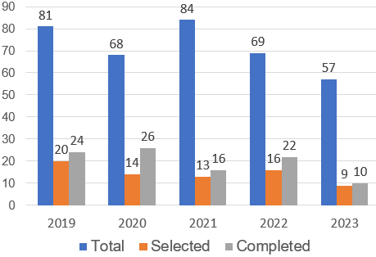




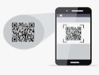




Background Of Activities
2/10
2/10
The reason normal support is very high : There are a lot of software need support during operation. human error, machine error, or system error. I need to solve it for the system running again..
My Goal
Increase developing time, reduce time support to get more cost down
Select smart devices, new technology to upgrade win CE to Android
FY2023 PROJECTS SUMMARY
Development Activity
Target: Increase quantity Project
Actual: Development time is still not increase
Normal support is very height (45%)
45 % Normal support
55 % Development
Win CE end of line 2023. to comply company policy I need to upgrade win CE to android OS.
END OF LIFE 2023
HANDY TERMINAL
OS/ PLATFORM
Scan
New technology ?
As you know, all applications on Handy terminal of our company are running on the windows CE OS.
Difficult to develop soft on them. Take long time to modify and build program. Sometime repair and setup Operation system…
This is also one of the reasons why support time is so high
Theme 1: Upgrade Factory Operation Support System (FOSS)
Current System
OS is not update in the future
Development Software is quite slow
Not responsive to big data system
The stable of the device is poor, often repaired
New System
Development new Software
New programming language (Flutter)
New development environment(Android)
Mission: Reduce support time, increase development time and comply policy
Notes:
The next, I talk about the background of activities.
Let's look at the 5-year chart (Project summary). IT received a lot of number request . There is small of request is selected..
Target : increase project but actual the develop time still not increate.
…..
I select the new smart device, new programming language to make new software to running Android.
my mission of this action: reduce support time, increase develop time and comply policy.

Slide 4

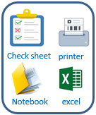
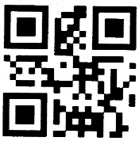
Background Of Activities
2/10
3/10
My Goal
Develop new system for IT department to manage equipment
Save time to inventory, reduce manual job, papers and ensure quality
Current status system:
GR -> Transfer -> Maintenance -> Inventory -> scrap.
Action borrow, return equipment or
Stationery warehouse manage always use paper, check sheet record file.
Current Process Analysis
Good receipt
Transfer
Maintenance
Inventory
Scrap
Stationery
Borrow & Return
Purchase a new one
Approve
Report
Transfer to section
Approve
Report
Update information
Update Serial
Approve
Report
Inventory checking
Approve
Report
When Scrapping
Approve
Report
Import
Export
Report
Borrow
Return
Report
For this reason I want to Make new system use barcode technology to identify equipment. Use mobile device scan barcode and result data auto save database server via access point.
Analysis
Theme 2 :Asset Life Cycle Management System (ALCMS)
Current
Improve activities
Good receipt
- Manual job on excel, notebook, lost papers.
- Tack time to inventory, easy mistake.
- Difficult control in-out device, easy mistake.
- Not ensure quality.
Database Server
All report an history is visualize not to check paper
Scrap
Transfer
Use software
Save time management & ensure quality, reduce papers.
Reduce make mistake.
Easy manage operation and trace history.
Inventory
Maintenance
Mission: Build standardization for asset management system
Notes:
The issues 2. we mention to manage asset of IT room.
…...
effective of this activity, all asset is control easy and specially we will save 40% time management and reduce 50% print paper.

Slide 5
Background Of Activities
2/10
2/10
The reason normal support is very high : There are a lot of software need support during operation. human error, machine error, or system error. I need to solve it for the system running again..
My Goal
Increase developing time, reduce time support to get more cost down
Select smart devices, new technology to upgrade win CE to Android
FY2023 PROJECTS SUMMARY
Development Activity
Target: Increase quantity Project
Actual: Development time is still not increase
OS/ PLATFORM
45 % Normal support
55 % Development
Win CE end of line 2023. to comply company policy I need to upgrade win CE to android OS.
END OF LIFE 2023
HANDY TERMINAL
Scan
Normal support is very height (45%)
New technology ?
As you know, all applications on Handy terminal of our company are running on the windows CE OS.
Difficult to develop soft on them. Take long time to modify and build program. Sometime repair and setup Operation system…
This is also one of the reasons why support time is so high
Old device
Develop Job
Mission: Reduce support time, increase development time and comply policy
Notes:
The next, I talk about the background of activities.
Let's look at the 5-year chart (Project summary). IT received a lot of number request . There is small of request is selected..
Target : increase project but actual the develop time still not increate.
…..
I select the new smart device, new programming language to make new software to running Android.
my mission of this action: reduce support time, increase develop time and comply policy.

Slide 6
Background Of Activities
2/10
3/10
My Goal
Develop new system for IT department to manage equipment
Save time to inventory, reduce manual job, papers and ensure quality
Current status system:
GR -> Transfer -> Maintenance -> Inventory -> scrap.
Action borrow, return equipment or
Stationery warehouse manage always use paper, check sheet record file.
Current Process Analysis
Good receipt
Transfer
Maintenance
Inventory
Scrap
Stationery
Borrow & Return
Purchase a new one
Approve
Report
Transfer to section
Approve
Report
Update information
Update Serial
Approve
Report
Inventory checking
Approve
Report
When Scrapping
Approve
Report
Import
Export
Report
Borrow
Return
Report
For this reason I want to Make new system use barcode technology to identify equipment. Use mobile device scan barcode and result data auto save database server via access point.
Analysis
Theme 2 :Asset Life Cycle Management System (ALCMS)
Current
Improve activities
Good receipt
- Manual job on excel, notebook, lost papers.
- Tack time to inventory, easy mistake.
- Difficult control in-out device, easy mistake.
- Not ensure quality.
Database Server
All report an history is visualize not to check paper
Scrap
Transfer
Use software
Save time management & ensure quality, reduce papers.
Reduce make mistake.
Easy manage operation and trace history.
Inventory
Maintenance
Mission: Build standardization for asset management system
Notes:
The issues 2. we mention to manage asset of IT room.
…...
effective of this activity, all asset is control easy and specially we will save 40% time management and reduce 50% print paper.

Slide 7
Total Improvement Schedule
1/10
4/10
Pending Issue | Pending Item | Activity Content | In charge (Main) | WHEN (Jul.2023) |  |  |  | TARGET
 |  |  |  | Q1 | Q2 | Q3 | Q4
Upgrade FOSS | [1] Upgrade Foss from wince to android Mobile for all devices. [2] Analyze & Optimize all process of FOSS [3] Develop all function of system. |  Select new language & new OS to develop.  Select smart device to scan barcode. | IT member |  |  |  |  | New Language (Flutter - Dart) Android new OS
 |  |  GR local  GR Oversea | IT member MCS Pic |  |  |  |  | Upgrade all function FOSS to new Devices
 |  |  Storing | IT & MCS
 |  |  Kitting & Supply | IT member MCS Pic
 |  |  Kitting Other  Temporary Location | IT member MCS Pic
Make Asset Life Cycle Management System | [1] Survey all process and build standard management. [2] Analysis system, design database [3] Develop, testing |  Borrow & return Equipment | IT member |  |  |  |  | Apply software to reduce time management, papers & manual jobs
 |  |  Manage stationery warehouse | IT member
 |  |  Good Receive | IT member
 |  |  Inventory, Transfer, Scrap, Maintenance | IT member
Issue ①
Issue ②
Plan:
Actual:
Notes:
Next slide, I talk about the total improvement schedule
the issue 1, how to upgrade to FOSS from win CE to android. My action -> we have to select new language to develop.
[2] we have analyze and optimize all process of Foss and develop new soft on the new devices -> action: I split function GR, Store, kitting, supply
The issue 2, I survey all process and build standard management. After that I analysis system and design database.
At the end I select the device and develop software.
Now I will explain for details of issue 1.

Slide 8
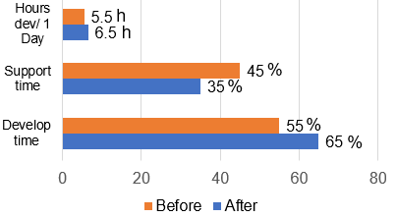
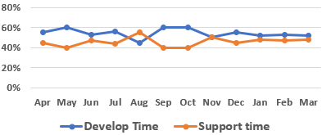
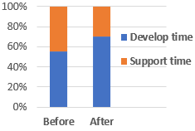

Detail Improvement Activity
1/10
5/10
- Issue: Foss is running on Windows CE Can’t upgrade android OS
- Follow policy company FY2023 I develop new soft ware to upgrade Foss to android OS.
-Action :Development time is only larger than support time a litter.
- I have flutter language to develop new software on mobile device.
Issue 1
Follow policy company FY23, OS Windown CE will be end of life 2023.
IT find new solution to upgrade old OS to smart device as mobile.
Main Issue
Improvement Actions
Result
[1] Upgrade to android Mobile
Select new language & new environment
Flutter develop applications for mobile devices runs on both Android and IOS. The Android OS is quite commonly and integrates many scanning devices
- Foss is running on Windows CE
-OS Win CE is not support in the future
Total device need to Upgrade
Activity Comparation
-The advantage when use flutter to develop soft ware: make faster, stable software. So I can increase develop time, reduce support time
Improvement Result
The disadvantage of Wince
MCS Dep:
- Develop software slow, Not responsive to big data system
- Regularly repair and setup window again
FY2023
109 pcs
-follow the policy MCS department : 140PCS, other department: 6 pcs
Other Dep:
The Advantage use flutter
FY2024
6 pcs
Improvement Result
Develop time
Support time
Efficiency
Follow company policy
Job request:
+ Select new language, new OS to develop
+ Comply company policy
Increase Develop time
 Reduce Support time
Have more time develop
1h * 4per = 4h/ day
Save time : 2h * 4per = 8hour / day
Save cost: 24 * 8 * 2.5 = 480$ / Y
Make Faster, stable, smarter Software
 Upgrade FOSS on Android OS
Notes:
Flutter is used to develop applications for mobile devices. Runs on both Android and IOS platform, desktop applications and web applications.
The Android OS is quite commonly used and integrates many scanning devices. So that I have selected android platform.
The advantage when use flutter to develop software: make faster, stable software. So I can increase develop time, reduce support time.
Result : let look at total devices need to upgrade new software. MCS department : 140PCS, other department: 6 pcs
Now I go to the functions detail of FOSS.

Slide 9

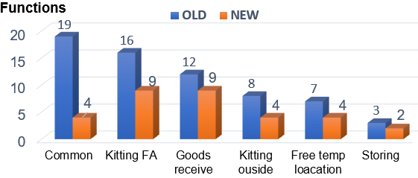
Detail Improvement Activity
1/10
6/10
Issue 1
Develop new software on new devices
Upgrade all function for FOSS system
Main Issue
Improvement Actions
Result
-FOSS includes 4 stage. GR, storage, kitting and supply
[2] Analyze & Optimist all process of FOSS
Material Control System Process
Apply:
Supplier
Receiving Area MCS
Warehouse MCS
Kitting by lines
Production Lines
-after analyze , discus with pic MCS we combine some the same function, reduce screen, optimize the process to reduce the operators.
- Analyze Material control System
- Improve & Optimize the process Foss
GR local (Oct.2023)
GR Oversea (Dec.2023)
Storing
(Jan.2023)
Kitting FA,
Kitting Dip (Jan.2023)
Kitting Other
(Feb.2024)
Free temp location (Feb.2024)
G/R
Storing
Kitting
Supply
GR local
& Oversea
Temporary
Location
Kitting
FA
Kitting
Dip
Kitting
Others
-Total function reduce 65 to 32
[3] Development software on Mobile
Total Functions FOSS Upgrade
- Amount of working is big to develop.
- Research new technology to apply and own.
Result upgrade
 | Old | New
Total functions | 65 | 32
Job request:
+ complete new software keep on time
+ upgrade all device
Merits : Coding time : 65% Support time : 35%
New software to run on mobile devices
Notes:
- Let's see the process of FOSS :
Firstly, Vender have to issue and paste barcode label on each box by our provided tool.
When G/R MCS Section will scan barcode label by HT device, result data will send automatically to FOSS Server.
When storing, you have to check validation between position barcode and a sample barcode label.
When kitting and supply, HT device will show a plan by time and by line on the screen to instruct you.
….
Following schedule we will GR local in Oct.23, GR Oversea Dec.23,Free temp location Jan.24, Storing Feb.24, Kitting, supply FA Dec.23, Kitting other Feb.24 and so far ….. SMWS …is FOSS enhance.
This is all improvement activity 1. Now I move to next issue 2,

Slide 10




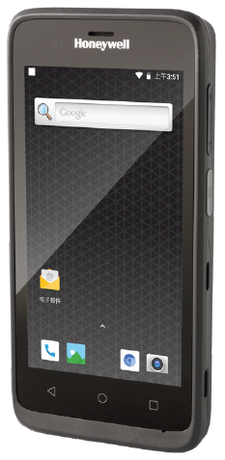
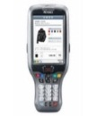



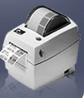



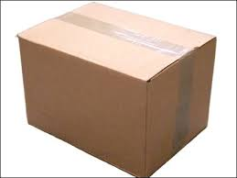
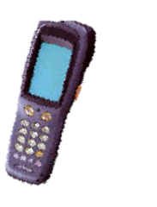



Detail Improvement Activity
1/10
7/10
Issue 2
Study about the department's asset management system of IT.
Provide a standard process to optimize the management system.
- Too much manual job ,use excel file, papers, check sheet to management.
- Take a long time to make report.
Main Issue
Improvement Actions
Result
[1] Survey all process and build standard management
Discuss, Q&A, find solution
List Job
Document, operators,
reports
System Solutions
Make documents & Design system
(Oct.23)
Tick to check sheet
Study
Operating
system ?
- No barcode tool create & no scan device to manage.
- Not clear process.
IT
Part No :
A
Part card:
A
PIC, Leader
QTY:
30
Explain
new operations
Discuss
Create tool barcode (Nov.23)
Print report
Database
Record Paper
Process of ALCMS
Transfer
Inventory
Maintenance
[2] Analysis system, design database
Create tool Borrow & Return Equipment (Dec.23)
- No barcode tool create
- Not clear process.
Issue Barcode
SQL Server
(ALCMS)
Scrap
Job request:
+ Clear process
+ Issue barcode to identify equipment
+ Build database
Import stationery
Export stationery
Report
Equipment management by barcode
Notes:
Next, please look at the current issue and solution:
Currently, IT department has too much manual job ,use excel file, papers, check sheet to management. Take a long time to make report.
- All products do not have barcode for identification. The processes are not linked to each other. All operations are recorded on papers and note books. take a lot of time.
Solution: Discuss, Q&A and find solution with other members of IT. Build standard process of manage asset :
After identify products by barcode and clear process. I started building the database. and select new device to develop software.
Next slide I will explain detail process of new system.

Slide 11



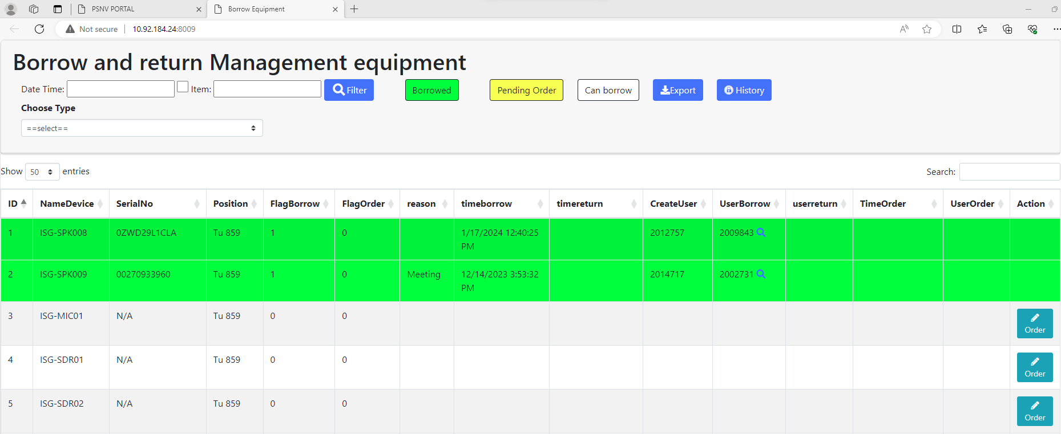
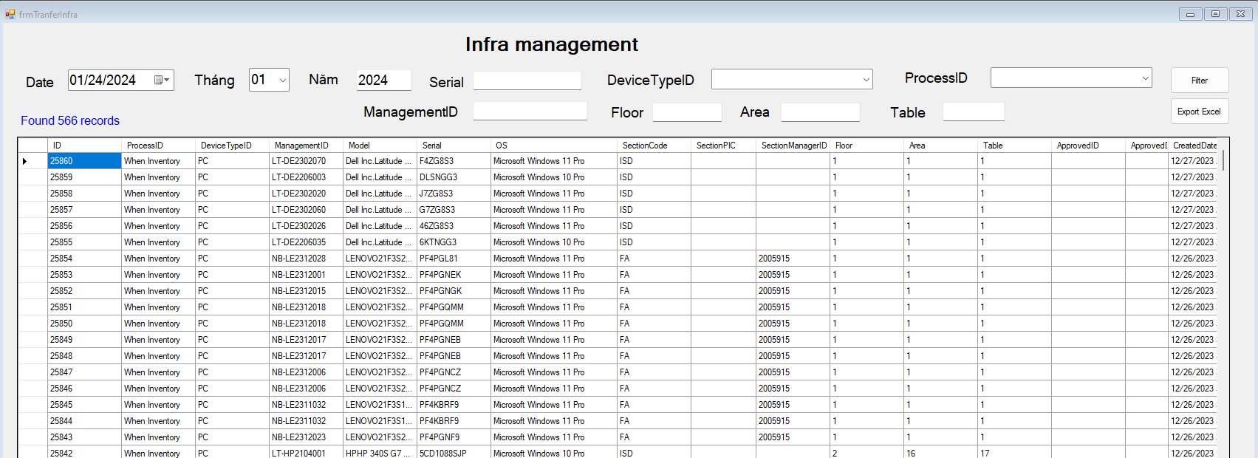

Detail Improvement Activity
1/10
8/10
Issue 2
Manage Asset of IT by barcode.
Optimize all manual jobs by using a management system.
- Borrowing and returning equipment is manual jobs on paper. Lost time to check and inventory.
Main Issue
Improvement Actions
Result
[3] Develop, testing
Standardization All manual operations
Apply:
➢ Borrow & return
- Issue barcode
- Scan card identify user
Issue & Paste Barcode to each equipment
PIC go to PC to scan barcode
Borrow & return (Dec.2023)
Manage stationery warehouse (Jan.2024)
GR, Transfer
& Inventory, Maintenance,
Scrap
(Feb.2024)
- Count and record PC, equipment information
- Manage stationery by excel, check sheet
- Lost time to inventory
- Lost papers to record, make report
-Export and get all PC information
data exactly, anytime
➢ Transfer & inventory
- Read barcode of Serial
- Select function
- Select Device type
- Fix location
- Read barcode of Serial
To Inventory PC by System
Data base Server
software
Visualize
Auto Report
➢ Stationery warehouse
- Import equipment
- Export equipment
- Report monthly
Database
- Stationery warehouse is control by excel data, lost time to inventory, easy mistake.
- The Process good receive, transfer, maintenance, scrap is manual difficult to manage and easy mistake.
Merits
Job request:
+ Apply barcode for all operating
+ Training staff use soft
100%
Time
40%
100%
Paper
50%
50%
60%
time
Reduce paper: 50%
Save time inventory : 40%
Notes:
The Process of ALCMS split 3 stage : Borrow and return equipment, Manage stationery warehouse, GR, Transfer-inventory-maintenance-scrap, stationery warehouse management.
Action :
with the infra team: GR, Transfer, Maintenance, inventory, scrap. Borrow and return equipment by barcode.
With stationery team: input, output material and report.
Result with new system, using barcode technology with new devices mobile that connect to database server via access point. Apply this system, you will control easy and specially we will save 40% time management and 50% print paper.
That all my improvement for each issue .and I move to next slide to confirm result.

Slide 12
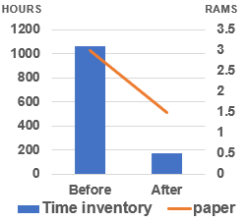
Confirm result
1/10
Before: Total time using: 3 min/60 * 20 * 1060 pcs = 1060 h/month
After: Total time using: 0.5 s/60 * 20 * 1060 pcs = 176 h/month
9/10
Issue 1: Upgrade Factory Operation Support System (FOSS)
Function
Target
Status
Result
Apply 08/2023
Apply 10/2023
Apply 01/2024
Apply 01/2024
Apply 02/2024
Apply 02/2024
Complete
Complete
Complete
Complete
Complete
Complete
Select new language & OS
GR local & GR Oversea
Storing
Kitting & Supply (FA,DIP)
Kitting Other
Temporary Free Location
45 % Normal support
65 % Development
Inventory pc:
Before: Take time : 650 Pcs * 0.1 hour =65 Hour
After: Save time and manpower: 65 * 2.5*4=650$/Year
Issue 2 :Asset Life Cycle Management System (ALCMS)
Time develop
: 1h * 4per = 4h/ day
Save time : 1h * 4per = 4hour / day
Save cost: 24 * 4 * 2.5 = 240$ / Y
Or
Save time : 0.5h * 4per = 2hour / day
Save cost: 12 * 4 * 2.5 = 120$ / Y
Function
Target
Status
Result
Borrow & return Equipment
Complete
Apply 12/2023
Apply 01/2024
Complete
Manage stationery warehouse
Good receive, Transfer, Inventory, Scrap, Maintenance
Apply 02/2024
Complete
Notes:
Before:
Take time: 120,000min/y (8min/PIC/m~1250 PIC)
Lost paper: 36RAM/y (~3RAM/m)
Lost cost: ~3,450 $/y (manpower + paper)
Lost pager make document

Slide 13
Next activities
1/10
10/10
For my team
For myself
- Tranning: Support skill, Training skill, coding skill, analysis skill
- Work team: Learn, sharing, knowledge, experience about new technical. Transfer some system to other member
- Goal: Building team work and improving spiritual
- Study: Method issue and solved problem, Level up Communication skill
- Job: Control schedule to keep on time support user, own new technology.
- Goal: Continuously to discuss find out best solution to save time & reduce human for production, ensure quality.
Next activities in 2024
NO | Action plan | FY23 |  |  | FY24
 |  | 1 | 2 | 3 | 4 | 5 | 6 | 7 | 8 | 9 | 10 | 11 | 12 | 1 | 2 | 3
1 | Complete FOSS system to a mobile application system
2 | Upgrade Fire extinguisher management
3 | Upgrade Stationery warehouse management GA
4 | Expand ALCMS to other department
THANK YOU FOR LISTENING!
Notes:
Develop Smart Warehouse management system, control schedule to keep on time.
And the last important thing is building team work and improving spiritual.
I expect my team reduces coding time: 50% and reduces support time 30% at the end of FY2024.
Thanks for your listening! If do you have any question, please let me know?

Slide 14

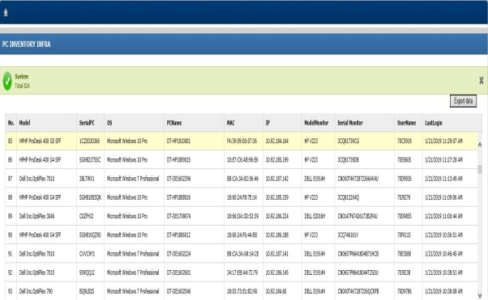

Auto Inventory PC (khong dung)
1/5
Using software inventory all PC
Developer: Tran Thi Thao
Apply: Nov 2018
Expn: N/A
Saving: 650 $/Y
◆Before
◆ After
Inventory collecting automatically software
Count Manual When PC Inventory Quarterly
Export and get all PC information
data exactly, anytime
Count and record PC information
Input information to Excel
Serial | OS | PC Name
FTVCHY1 | Win 7 Pro | DT-DE1602108
C00DHJ2 | Win10 Pro | DT-DE1709009
Take time : 650 Pcs * 0.1 hour =65 Hour
Save time and manpower: 65 * 2.5*4=650$/Year
Notes:
This is the fours improvement,
currently, Quaterly , we invertory Pc ,we go to section, count and write information to paper. After that input it to Excel when finish.
Now : we develop system allow get all information PC from Server. We will have information exactly and fast.
So we can save lot of time.

Slide 15
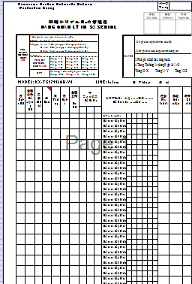
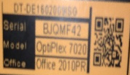

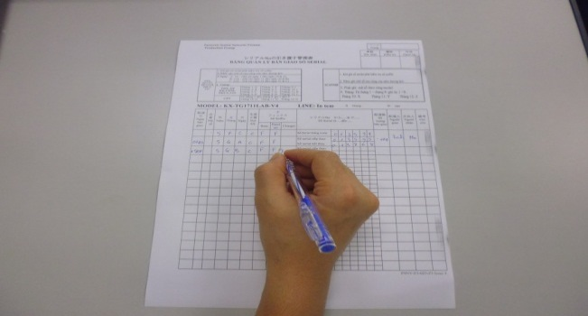
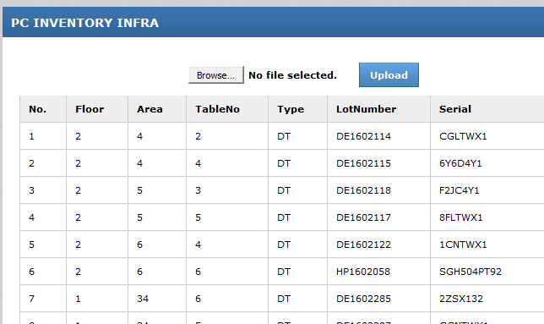
Inventory pc BY SYSTEM (khong dung)
Report item:11
Time saving, Accuracy , Speed by using Inventory System
P.I.C: ISG I team
Developer: Nguyen Thai Thinh
Date: May/2016
Expn: N/A
Save: 176h/year
◆Before
◆ After
P.I.C go to PC to collect information of PC
Issue & Paste Barcode to each PC
PIC go to PC to scan barcode
To Inventory PC by Paper
To Inventory PC by System
Total time using:
3 min/60 * 20 * 1060 pcs = 1060 h/month
Total time using:
0.5 s/60 * 20 * 1060 pcs = 176 h/month

