Slide 1
IMPROVEMENT RESULT REPORT JULY 2019
Information System Group
Total themes : 7 themes
5S, ISM : 3 themes
Cost saving : 69,058 USD/Year
Presented by: Nguyen Van Hien

Slide 2
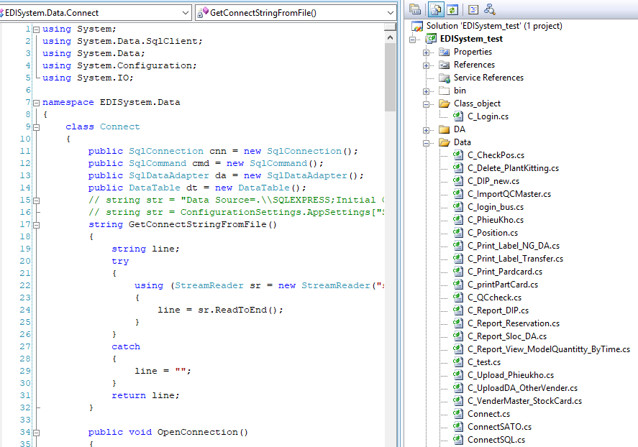
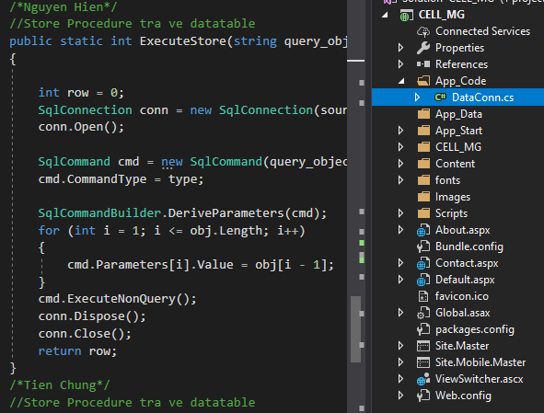
SMART CLASS IN PROGRAM
1/7
Make one standard class for all project
Developer: Nguyen Van Hien
Apply: Feb
Expn: N/A
Saving: 240 $/Y
◆Before
◆ After
Build and use many class
Make once class only
Take time for making related class
Difficult for other members debug
Lost time: 60’ / person/ day
Use standard class for all
Save time
Lost time: 1h * 4per = 4h/ day
Save time : 1h * 4per = 4hour / day
Save cost: 24 * 4 * 2.5 = 240$ / Y

Slide 3
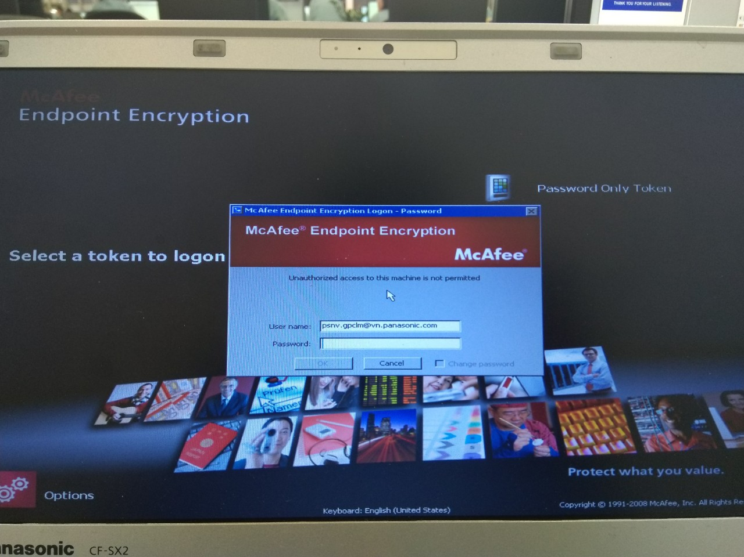

EXPAND encryption HDD method TO REDUCE COST
2/7
Replace Safeboot license (Encryption HDD) by new encryption method for all laptop Windows 10 Pro
Developer: Infra Team
Apply: Mar
Expn: N/A
Saving: 2,280 $/Y
◆Before
◆ After
Study and install encryption HDD free tool (for local managers above)
Buy license Safe boot McAfee for Encryption HDD for all laptop
Easily control ,free and
follow ISM Rule.
Pay license and service fee every year
Take 2 hours when upgrade OS
Fee: 90$/license/Year
24 laptop ~ 90*24= 2,160 $/Year
When upgrade OS need reinstall Safeboot and install after upgrade finish➔Take times
Save fee: 2,160 $/Year
Save time: 2*24*2.5=120$/Year
➔Total save: 2,280$/Year
Notes:
Before if we need encryption HDD we must buy license McAfee for it .
And we pay fee service every year . It no cheap about 90 $ per one license . But when we upgrate window , we must reintall McAfee and intall it after upgrate finish.
It take times.
Now we using encryption method of win 10 .This is Bitlocker win. This is tool integrated in win 10 . And no pay fee

Slide 4
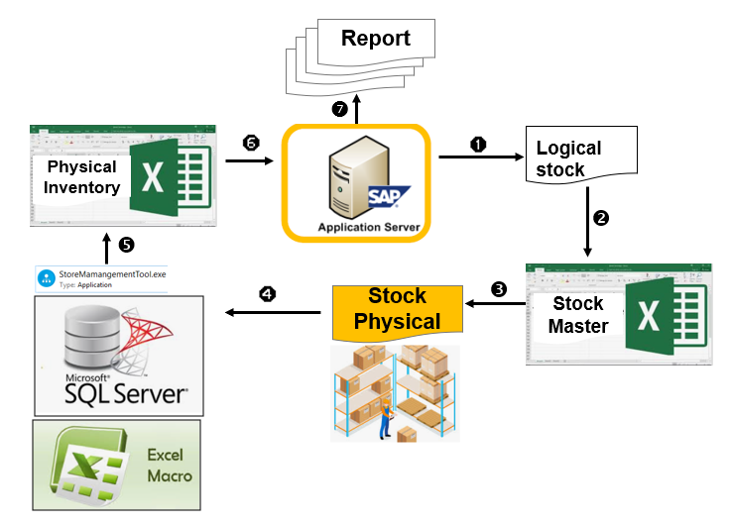
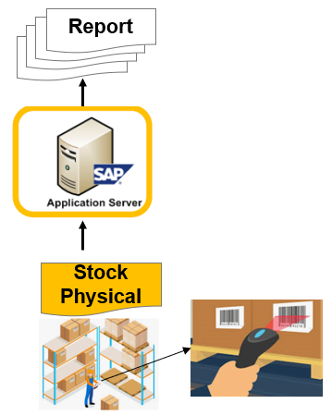
New End of Month Process Physical Inventory
3/7
Apply new Inventory operation flow
Developer: SAP Team
Apply: Apr
Expn: N/A
Saving: 4,320 $/Y
◆Before
◆ After
SAP System synchronization
Cut down data storing on Server
Eliminate human mistake
Shorten Inventory time
Many steps (8 steps)
Many operations for 27 users with 300 S.loc
80% error come out monthly with other software
Total time saving: ~ 90 h/month
Shorten: from 7 steps to 1 Step
Release memories (Server + PC): cut down 49.28MB
Take times: 300h/month
Automatic, Accuracy data
Reduce: 90h*4$*12m = 4,320$

Slide 5
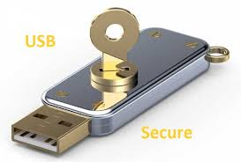
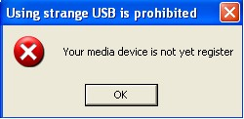


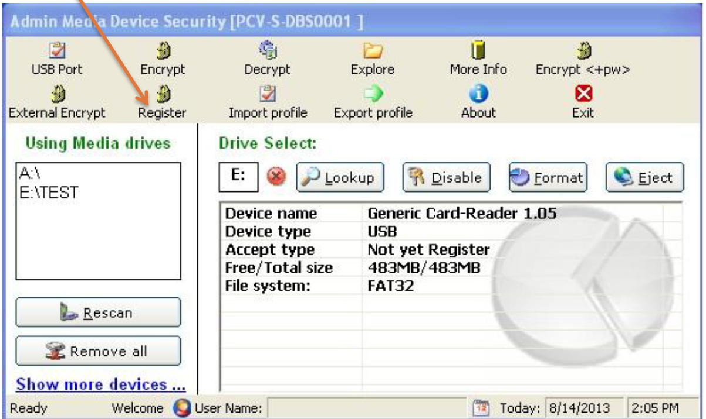
Prevent USB STORAGE Plug IN to FACTORY PC
4/7
Create new software for using in PSNV Factory PC
Developer: Nguyen Van Chung
Apply: May
Expn: N/A
Saving: 61,500$/Y
◆Before
◆ After
Buying “Device protector” Software to prevent USB Storage connecting to PC
Develop Media Device Security Software to prevent USB Storage Plug-in Voluntarily
50 KUSD/1,000 PC/Y
(PSNV Factory PC total: ~ 65 K$/1,303 F. PC)
Too expensive!
Need to buy Software to control , cost: 65 K$/Y
Set default Disable USB Storage Ports, control Strictly USB Storage Registration
Labour cost: 3h*24d*6m*8$= 3,456$
=> Saving: 65K$ - 3.5K$ = 61.5K$

Slide 6

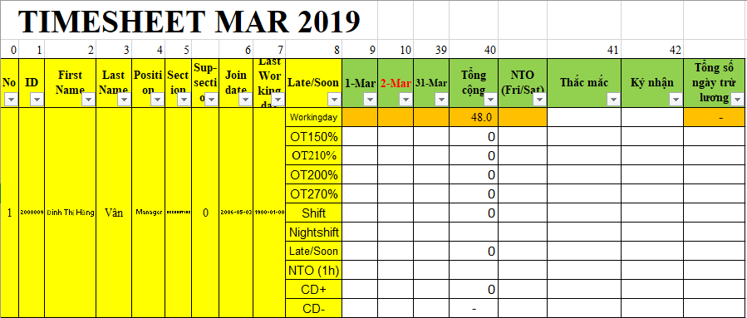
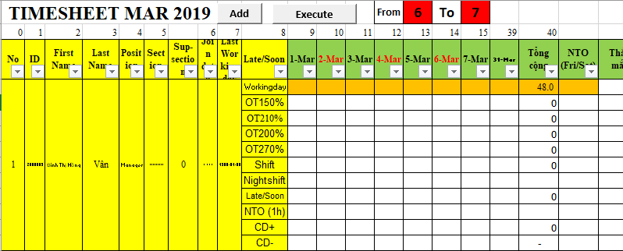
TIMESHEET CHECK SHEET
5/7
Using function making timesheet check sheet for all employee with one click
Developer: Nguyen Van Hien
Apply: May
Expn: N/A
Saving: 478$/Y
◆Before
◆ After
Copy and Paste format for all employee list
Make function with just 1 click
Take time: 15.9h/ month
Make mistake
Receive claim from related department
Take time: 5min/ month
No mistake
No claim
Lost time: 15.9h/ month
Save time : 15.9h * 12 month = 191 hour
Save cost: 191 * 2.5 = 478 $/ Year

Slide 7
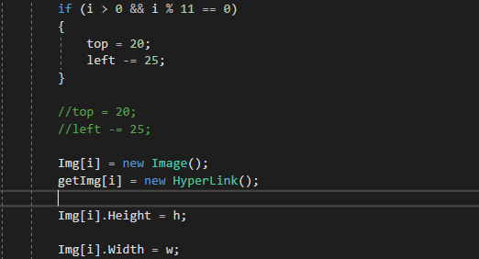
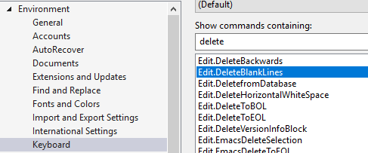
5S .NET CODING
6/7
Make function for remove blank rows
Developer: Nguyen Van Hien
Apply: May
Expn: N/A
Saving: 240 $/Y
◆Before
◆ After
Removal once by once
Make function to remove blank with just 1 click
Take time for duplicate operation
Lost time: 30’ / person/ day
Reduce operation to 2 second
Save time
Lost time: 0.5h * 4per * 2 = 4h/ day
Save time : 0.5h * 4per * 2 = 4hour / day
Save cost: 12 * 4 * 2.5 * 2 = 240$ / Y

Slide 8
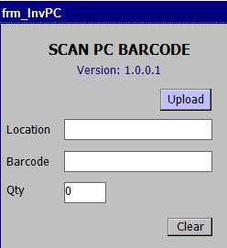
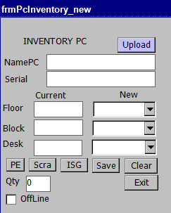
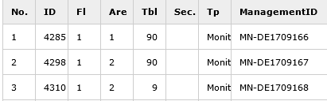
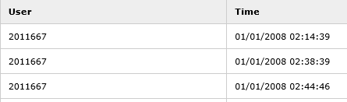

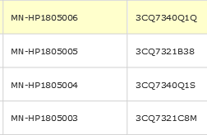
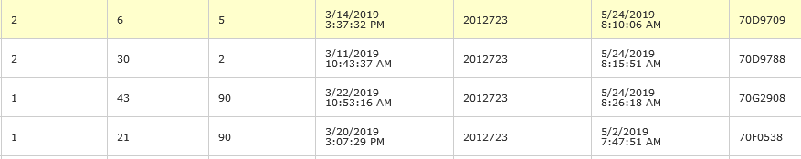
UPGRADE PC INVENTORY
7/7
Improve quality for PC inventory software
Developer: Nguyen Nhu Minh
Apply: Jun
Expn: N/A
Quality
◆Before
◆ After
User manual input location information
Make mistake when inputting
Must to view on 2 report separate
Easily to check latest PC’s information
No mistake
Button transfer to famous department
One report with full information available

Slide 9
Thank you for your listening.

