Slide 1
IMPROVEMENT RESULT REPORT JUN 2020
Information System Group
Total themes : 5 themes
5S, ISM : 2 themes
Cost saving : NMK USD/Year
Presented by: Vu Ngoc Dai
Notes:
Good morning everyone, My name is Dai, I come from ISG department, I’m very happy when stay here for explaining about ISG improvement result from Jan to now.
Today, I would like to share 5 themes. With total cost saved about …

Slide 2


IMPLEMENT server file backup at HCM CITY SIDE
1/7
Migration data from intermediate server to High Availability Server
Developer: PISCVN & PSNV Infra Team
Apply: 11/2019
Expn: N/A
QUALITY
◆Before
◆ After
CURRENT
TO BE
Users
File server at HN
Users
Load balancing
DFS server
Backup
Backup
NAS
Mirroring
NAS
File server at HCM
(Standby)
File server at HN
(Active)
Low availability, Long time to recover server
High availability
Disaster recovery server & backup in HCM
Currently, file server is backup in only PV’s server room
Enhancement File Server – Improve Quality
Reduce downtime service if happened
Notes:
DFS: Distributed File System
Firstly, I would like to show you about implement server file backup at HCM city side

Slide 3

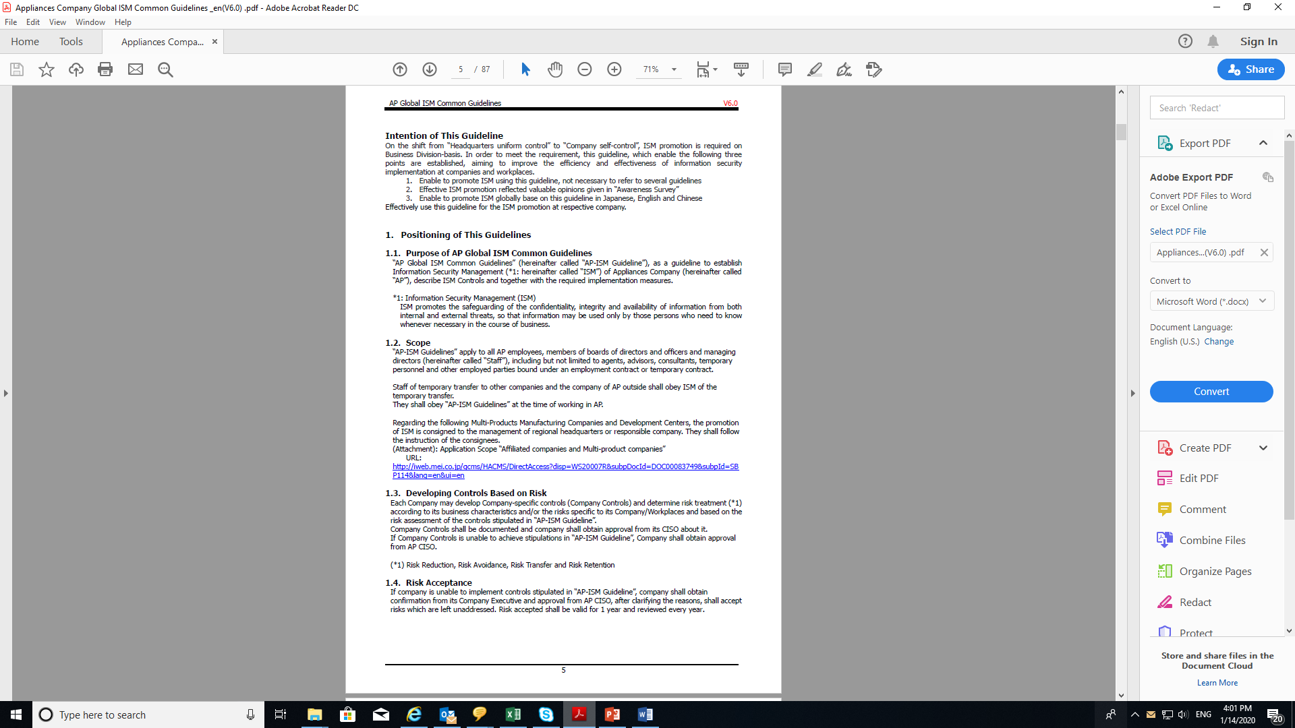

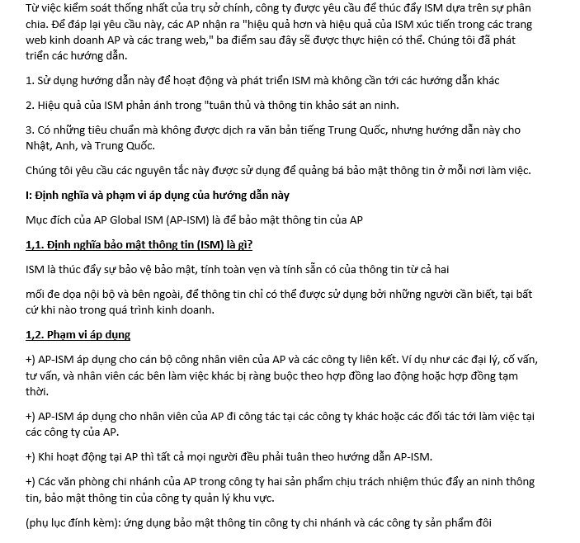
ISM AWARENESS IMPROVEMENT
2/7
Translate AP ISM Guidelines English Documents to Vietnamese
Developer: ISG ISM Team
Apply: 08/2020
Expn: N/A
QUALITY
◆Before
◆ After
ISM Guide Line Standard English Version
ISM Guide Line Vietnamese version
Easy Understand, more clearly
Some Vietnamese mis-understand about the meaning.
- Improve ISM awareness for all employee
Notes:
Secondly, That is ISM awareness impovement

Slide 4
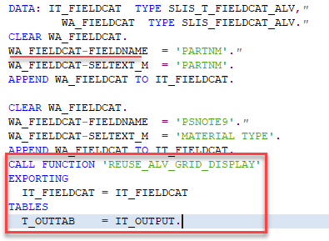
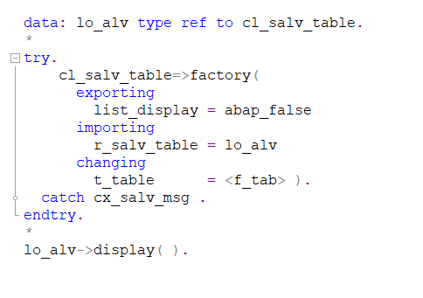
Display ALV report using class CL_SALV_TABLE
Time
3/7
Developer: Khuong san
Apply: Jul/2020
Expn: 9.5K$
IMPROVE TIME
◆Before
◆ After
Display ALV using REUSE_ALV_GRID_DISPLAY function
Display ALV using CL_SALV_TABLE class
Current condition:
Need to declare all the header of display report
Take many time if the report has many column.
Slowly while coding and running.
Solution
New display ALV method: 1. Automation getting column’s header.
2. Faster while coding and running report.
3. Easy to use.
4. Cost down: (7min * 90user x 30day x 12month) / 60 * 2.5 = 9450USD
5. Reduce coding time: (10min * 30program)/ 60 * 2.5 = 12.5USD
Notes:
Thirdly, This is improvement from Khuong san, SAP team.

Slide 5
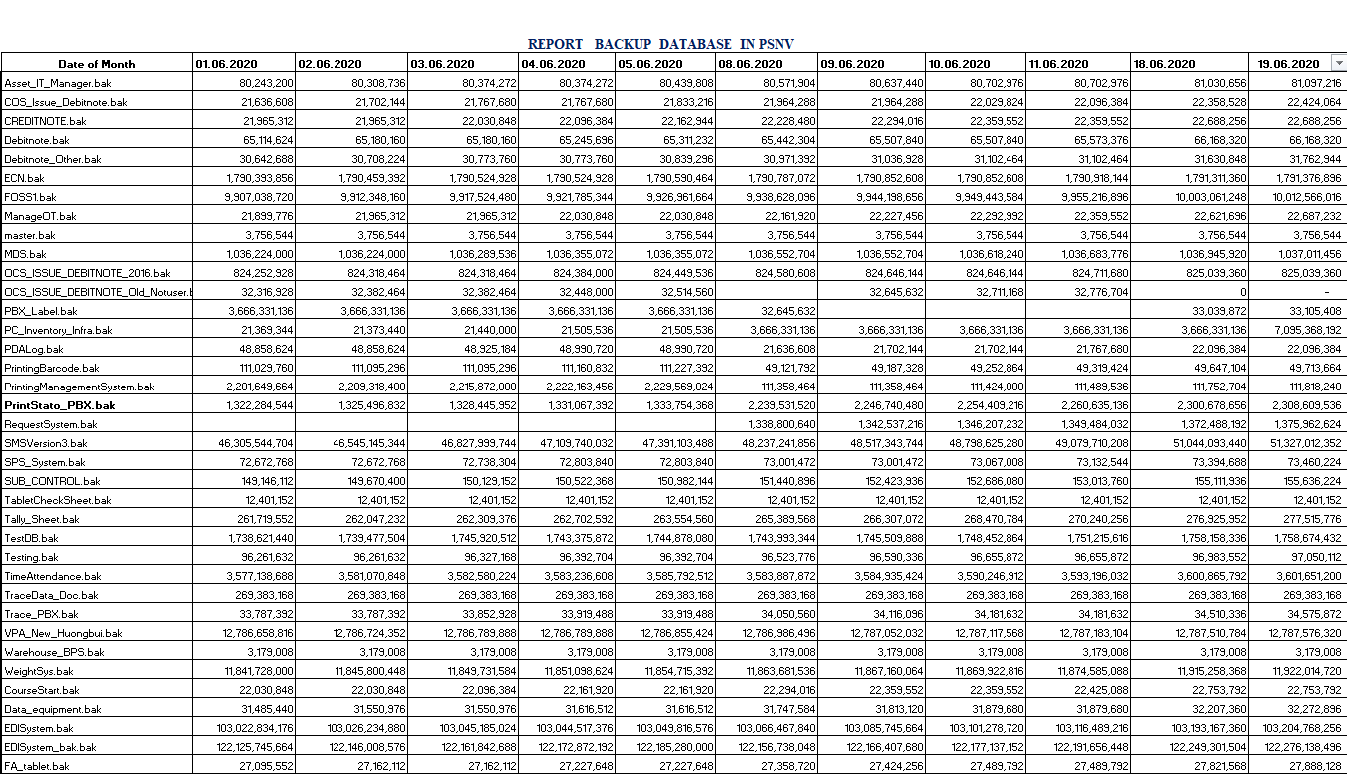
MAKE FUNTION DAILY CHECKING DATABASE IN PSNV
4/7
Making morning checking Database using excel VBA
Developer: Development team
Apply:
Expn:
Saving: 1411.3 $/Y
◆Before
◆ After
Step | Task | Duration
1 | Login Server | 20s
2 | Check DB capacity | 35s
3 | Input Excel File | 5s
4 | Report Sum DB | 2 min
5 | Check DB | 3 min
Total time repeat |  | 60s
Step | Task | Duration
1 | Open file Macro | 15s
2 | Run file & wait report | 2 min
3 | Check DB | 3 min
Total Time |  | 5m15s
Lost Time: (60s x 61 DB)x 2 Servers + 5’ = 123’ ( 2hours 3’)/ 1 day
Save time : 1.96 h * 24 days * 12 months = 564.5 hour
Save cost: 564.5 * 2.5 = 1411.3 $/ Year
Notes:
Next theme, this is database daily checking improved by development team.

Slide 6
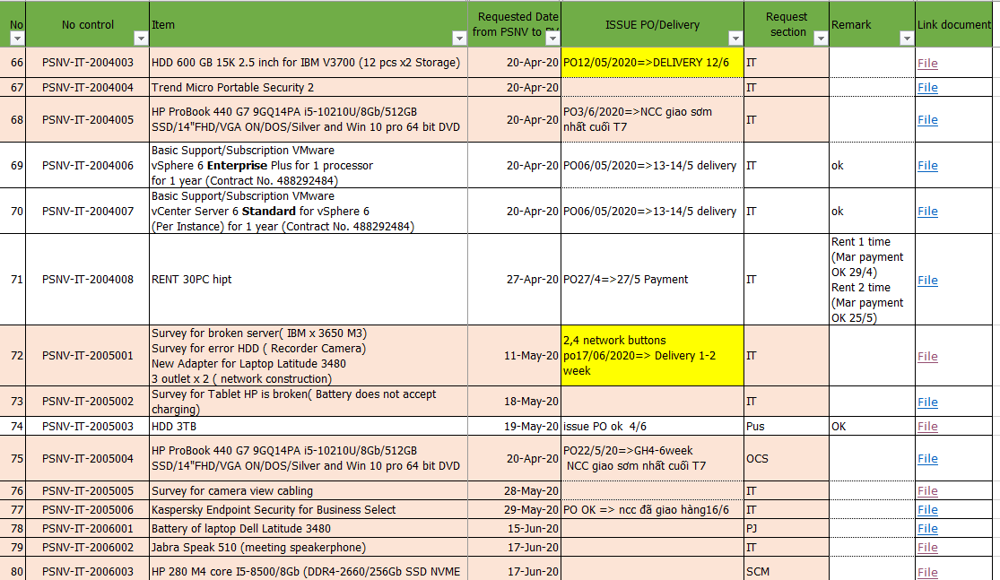
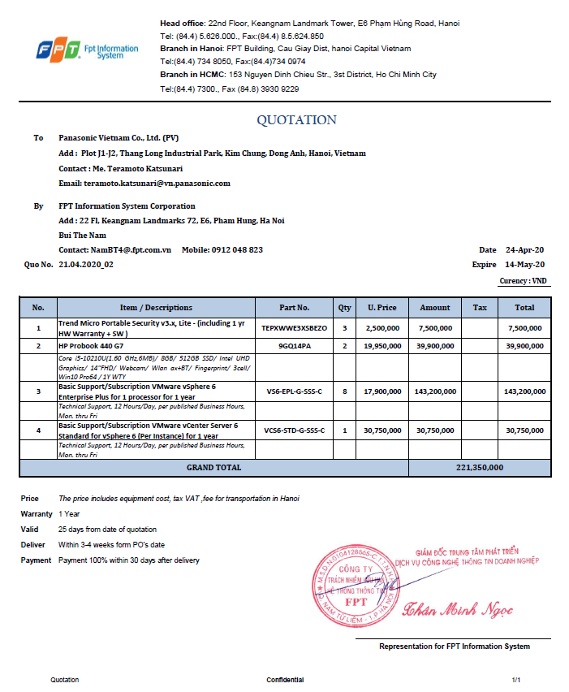
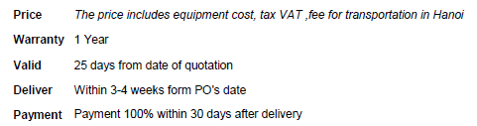

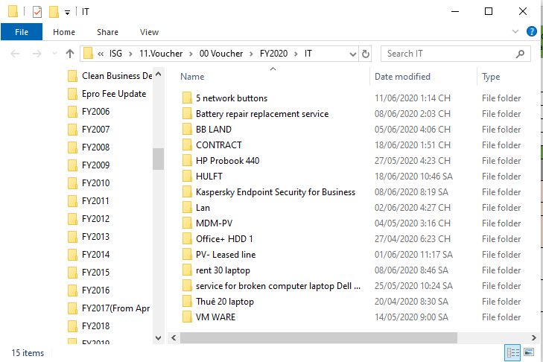
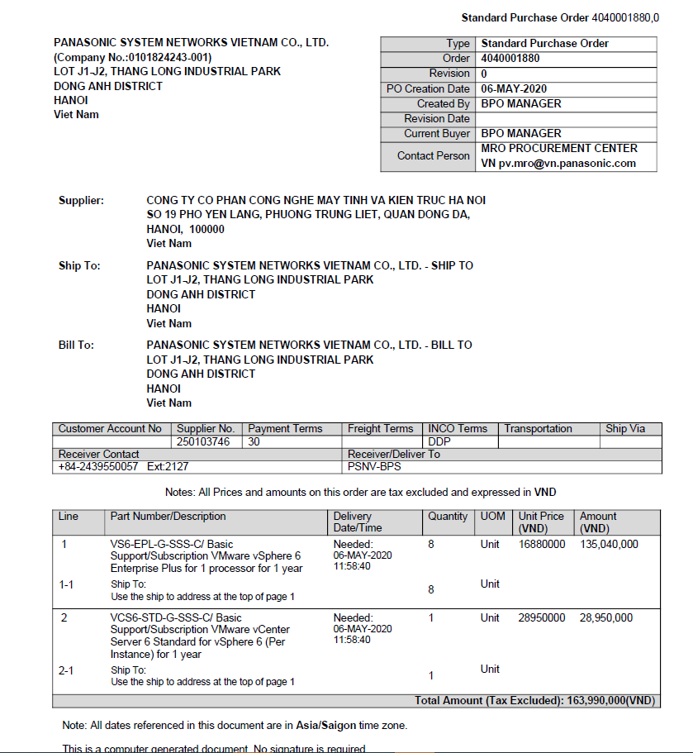

CheckING PURCHASE PROCESS it DEVICES FOR ALL OF GROUPS
5/7
Check information by soft documents
Developer: LE THI HAI
Apply:01/06/2020
Expn:
Saving: /Y
◆Before
◆ After
Manage data by soft copy (enter information into the file to manage request items with MRO)
Find and check data PO and delivery with hard copies / PDF files in a shared drive
Use hyperlinks to automatically update the storage path for files, and with just one click, you can access the files of each item in the shared drive.
Step by step the path W: \ 11.Voucher \ 00 Voucher \ FY2020 / go to the file to save data if need to find information / print data
Lost time:
-hard copy check: 8 item*15 page* 30s *24 day =86.400s(24h/month)
-check PDF file: 8 item* 10 file* 15s *24 day=28.800s (8h/month)
Save time:
hard copy check:0
Check file control information:10 time*15s* 24 day=3600s (1h/m)
check PDF file: 8 item* 10 file*5s*24 day=9.600s(~2,6h/m)
Notes:
Last theme, that is ISG member checking purchase process IT devices for all of groups.

Slide 7
Thank you for your listening.

