Slide 1
IMPROVEMENT RESULT REPORT
DEC.2021
Department : Information System
Presenter : Nguyen Nhu Nam
Total topics : 5 topics
Save cost : 80K$/year
Notes:
Good morning, everyone.
My name is Nam.
I would like to explain ISD improvement activity.
We have 4 topics and save cost about 79K USD/year
Let’s start.

Slide 2








APPLY SVN SERVER FOR DEVELOP SOFTWARE
1/5
TOOL CONTROL SOURCES CODE OF PROJECT BETWEEN CLIENT AND SERVER.
Developer: Nguyen Thi Dao
Apply: Jul.2021
Expn: 0
Save: 7.1K$
◆Before
◆ After
Each members working independent
Can not develop together on a project
Each members working together on a project.
No using data storage
on file server.
X
Consumes data
storage space
on file server.
Can control revision of projects
Lost time find when support.
Can not control revision of projects
Take time collect project :
36 project x 0.5hour/month x 5pax =1,080 h/year.
Take time to find
70 project code x 10 min x 5pax = 700 h/year).
All member working group together on project better.
Save time: 1,780 hours/ year -> 7.1K$
Notes:
First activity is improvement of ISD develop software source code management.
Before,
Software development working is each member by member.
And developed software store in file server.
So other developer difficult to check & support other member's project and
Lost time for finding exact latest version of source code
After,
We made source code control SNV server and check in to the server.
Then, each member easy to find all project source code.
And store & control software version history.
This activity improved our software development environment. And save excess time 1,780 hours/year

Slide 3











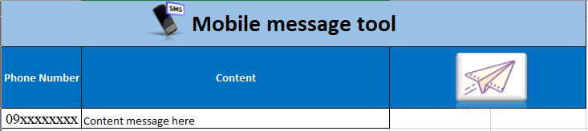
Mobile auto send message tool
2/5
USING EXCEL MAKE FUNTION MACRO
Developer: Nguyen Nhu Minh
Apply: Jul.2021
Expn: 0
Saving: 0.5K$
◆Before
◆ After
User
IT
User
IT
Excel tool
Message server
Database
Manual check faulty of data which send by user
Check latest data from server
Prepare data with user’s data
Input into server
Receive data from user
Paste into Excel Tool
Lost time for many step
Easy to make mistake
Lost time: 120 hour/year
Just using Excel Tool
Save time: 120 hour/year -> 0.5K$
Notes:
Next activity, making function macro for supporting auto message tool.
We have auto message tool and message data need input database.
Current COVID situation, HR need to sent many email and recipient is case by case.
Before,
ISD receive request with recipient list each format and need check & input to database manually.
This method is easy to make mistake and take time for setting.
After,
We made support tool by Excel Macro tool.
Requester only paste recipient list into the Excel.
ISD also just push import button in Macro then automatically e-mail address check with database and register.
This activity save time 120 hour/year with no mistake.

Slide 4
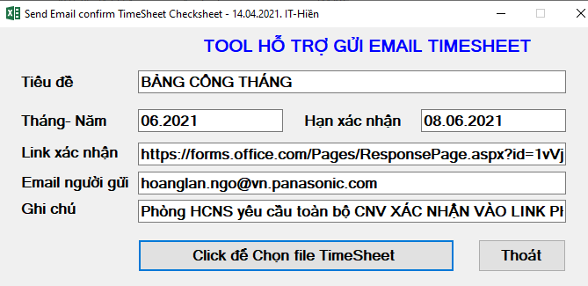
EMAIL SENDING TIMESHEET CHECKSHEET
3/5
TOOL FOR AUTOMATIC EMAIL SENDING TIMESHEET CHECKSHEET
Developer: Nguyen Van Hien
Apply: Aug.2021
Expn: 0
Save: 2.3K$
◆Before
◆ After
1. Send Timesheet for employees by email (auto)
1. Send Timesheet for section to check (14 PIC)
2. Employees check & response to HR
1 days for final data
3 days
For
final
data
2. Section print Timesheet for employees check
3. HR compare hard copy & adjust Timesheet
3. Sections collect, check and send to HR
4. HR compare hard copy & adjust Timesheet
Send TS to section to print for employees to check:
Take time: 1,008 h/y (6h/PIC/m~14 PIC)
Lost paper: 2,400 pcs/y (200pcs/m)
Lost cost: ~2,308 $/y (manpower + paper)
Send Timesheet to employees by email for checking:
Save time: 1,008 h/y Section no need to check & print paper
Save cost: 2,308 $/y.
Notes:
Third activity is auto email system for time sheet check sheet.
Before,
HR need send timesheet check sheet to each section’s HR support member.
Then each section print hard copy for employees check and collecting result.
After that send back to HR hard copy.
So HR need compare this hard copy and HR data.
This operation take 3 days for finalization and lost paper.
After,
HR send Timesheet check to all employee using ISD auto email system.
Employee can be easy to response by Forms.
And HR also easy to compare employee response result and HR data.
This activity save time for HR & each section’s HR support member’s excess job
And reduce paper, too.

Slide 5




IMPROVE WFH ENVIRONMENT BY OPENVPN
4/5
RESUMPTION OF USE OPENVPN (PISCVN SERVICE) FOR PV GROUP
Developer: Tran Nhu Nam
Apply: Jul.2021
Expn: 0
Save: 69K$
◆Before
◆ After
Vietnam
Internet
Singapore
Japan
Vietnam
Singapore
Japan
Home
SMART RAS
Home
Internet
Take time
Access to PSNV
Quick
Access
OPEN VPN
PSNV
PSNV
ECUS
File server
PSNV System
Company Network
ECUS
File server
PSNV System
Company Network
Operation | Time / 1 ope. | Total Time/day
Custom declaration | 20 min | 11.7 hour (7 ope., 5 pax)
File server operation | 70s per file | 97.2 hour (50 file, 100 pax)
Operation | Time / 1 ope. | Total Time/day
Custom declaration | 4 min | 2.3 hour (7 ope., 5 pax)
File server open | 25s per file | 34.7 hour (50 file, 100 pax)
Estimate loss time for network VPN issue
Custom declaration : 2,808 hour / year
File server operation : 23,328 hour / year
Efficiency of Improvement WFH Environment
Custom declaration : 552 hour / year
File server operation : 8,328 hour / year
◇Save time : 17,256 hour / year -> 69K$
Notes:
Last activity is improvement WFH environment.
From this fiscal year, Panasonic HQ request using VPN provided by each region HQ.
PSNV start to use SMART RAS by Singapore.
But accessing to PSNV system is very slow because need through Singapore to Vietnam
Each connection.
So after, we negotiated with HQ,PV and re-use OpenVPN by PISCVN.
We can direct access to PSNV from Home so very quick access to PSNV system same as office.
This activity reduce network access time loss and WFH environment become better.
That’s all my presentation.
Thank you so much for listening.

Slide 6
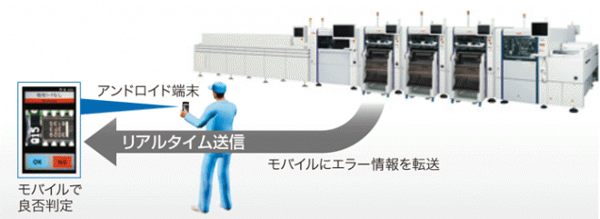





IOT - AUTOMATIC TRANSFER AND BACKFLUSH
5/5
AUTO TRANSFER AND BACKFLUSH FROM IOT TO SAP
Developer: Nguyen Van Hien
Apply: Nov.2021
Expn: 0
Saving: 0.8K$
◆Before
◆ After
Production network
Production network
Office network
Office network
Auto
Manual operation, no history, easy mistake
Lost file, easy make mistake
Auto transfer and backflush
Auto send and receive error record
Lost time for export and input into SAP
Easy to make mistake
Lost time: 192 hour/year
Background job running
Save time: 192 hour/year -> 0.8K$
Notes:
Next theme, this is database daily checking improved by development team.

