Slide 1
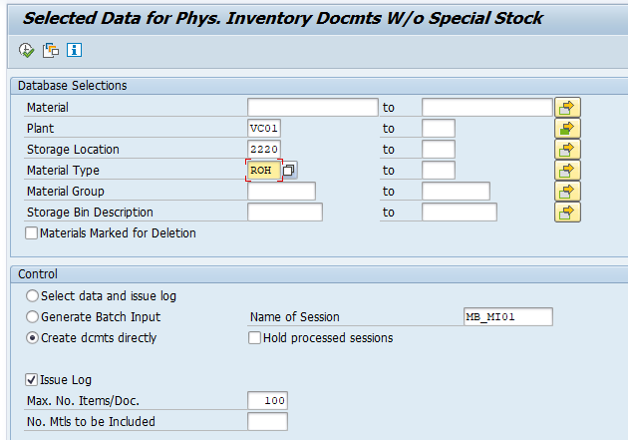
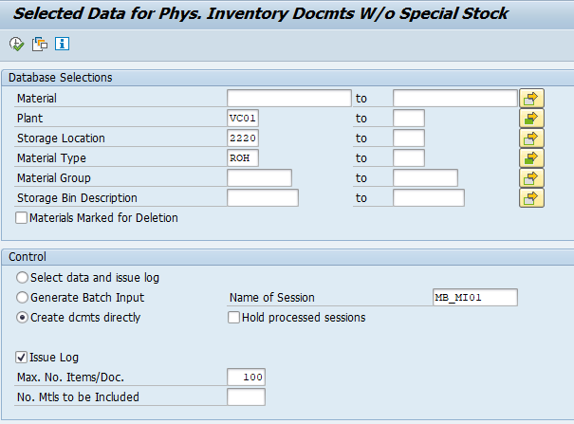
Reduce time to support user inventory
1/1
Reduce time to create physical inventory number for user monthly
Developer: SAP team
Apply: Apr.2022
Expn: 0
Save time: 56h/y
◆Before
◆ After
~ 900 storage location in SAP
Input each material type each time → 3 type = 3 execution time
Input all material type one time
Take time to execute for each material type
Reduce time to execute for all material type
Execution no. time: ~ 200 time (each type)
For all type = 200 time x 3 = 600 time
→ Take time: 600 time x 0.7 min = 420min
Execution no. time: ~ 200 time
For all type = 200 time x 1 = 200 time
Take time: 200 time x 0.7 min = 140 min
Save time: 280 min/month = 56h/y

