Slide 1






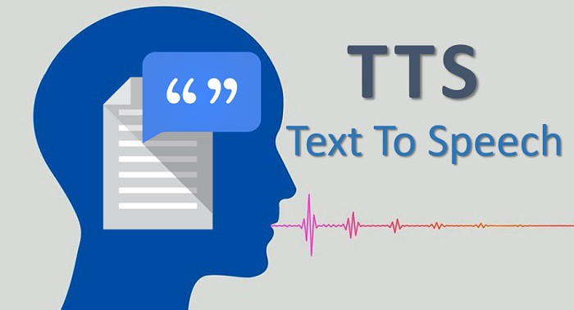


E-LEARNING SYSTEM
2/3
E-LEARNING SYSTEM WITH AI TECHNOLOGY.APPLY FOR ALL COUSE IN PSNV
Developer: Nguyen Thi Dao
Apply: Sep.2022
Expn: 0
Save cost & time
◆Before
◆ After

Training offline
Direct Training
Online Training
Using
System
Video made by ②
Online Testing
Report
Manual Evaluation
Auto Evaluation
8h
New
Technology
10’
Total: 20h
Speech data
Video
Editing
Merge
PPT+ Speech
2h
Video making
12h

Total: 2.2h
Not enough skill before start working
Easy make NG product & resignation
Lost pager make document & test exam.
Take time make video: ~ 20h/1Course (manpower + paper)
Opening online training course for 5 course Sept.2022
Further apply to all course in PSNV
Reduce system development fee : 17k$
Cost down for all cost 20*23* 4 = 1.8K
Notes:
HR other department training direct and paper for evulation .
For video training they need to make and edit about 20 hours
After anaylatis , we implement train online : learn by video, do exam one system , auto evulations…
About video training we using new technogy convert text for speech with many fomat : text or ppt ..
This activity help reduce more than 18k$

