Slide 1
IMPROVEMENT RESULT REPORT
DEC.2022
Department : Information System
Presenter : Nguyen Thi Dao
Total topics : 5 topics
Save cost : 20.1K$
Notes:
Good morning, everyone.
My name is Dao. I am from Information System department.
I am very happy to be here , introduce about improvement result report.
We have 5 topics and save cost about 19K dollar

Slide 2









E-LEARNING SYSTEM
1/5
Training and Exam with AI Technology apply for all course in PSNV.
Developer: Nguyen Thi Dao
Apply: Sep.2022
Expn: 0
Save cost: 18,6K
◆Before
◆ After



Video making
Training online

Training offline
Video making
New
Online Training
[10’]
Direct Training
Video made by ②
Video made by ②
Recording
New
System
Speech data
Paper Testing
Online Testing
[2h]
Evaluation
Report
Manual Evaluation
Video
Editing
Auto Evaluation
Merge PPT+Speech
[Total: 20h]
[Total: 2.2h]
Not enough skill before start working
Easy make NG product & resignation
Lost pager make document & test exam.
Take time video: ~ 20h/1Course (manpower + paper)
Opening online training course for 5 course Sep.2022
Further apply to all course in PSNV
Reduce system development fee : 17K$
Cost down for al 17.8hour*23courses* 4$ = 1.6K$ ➔18.6K$
Notes:
The First , I will introduce about E-Learning system.
Before Kaizen
We direct training using video => paper testing and manual evaluation.
Specially, video recoding and video editing we spend 20h.
After kaizen
We develop E-Learning system. All user can online training, online testing and auto evaluation.
Beside, For support video making.
we develop software with new technology is text to speech.
After that, Merge PowerPoint and speech data.
only use more than 2 hour.
Total save cost about 18K $ per year.

Slide 3
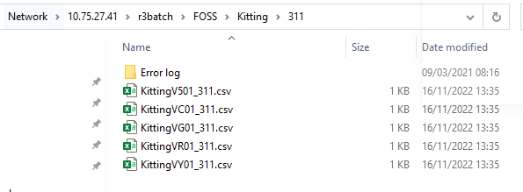
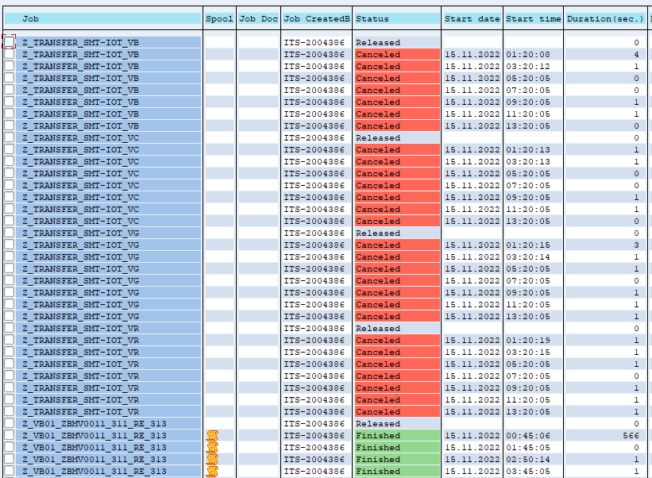
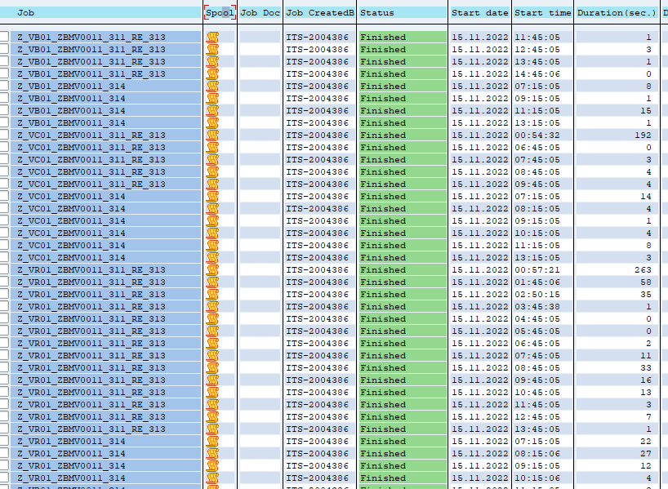
REDUCE SERVER CAPACITY BY USING HULFT JOB
2/5
Stop useless auto-job by using Hulft ID event.
Developer: SAP team
Apply: Sep.2022
Expr: 0
Quality
◆Before
◆ After
SAP Job only execute
once exist data on server.
File has no data, job still execute.
No more useless auto job
Many useless auto job
Exist data file on server, SAP Job will be executed (on scheduled time) – even the file has no data.
➔ Lose the unnecessary bandwidth.
(might effect other SAP Job)
Only if the file has data.
➔ SAP job will execute.
➔ Don’t lose the unnecessary bandwidth.
Notes:
The second topic is reduce server capacity by using Hufft job.
Before kaizen
We have to many application communicate with SAP
Event though, No file or no data still job running
After kaizen
We using Hulft ID event , SAP background job only run when exits data on server.
So, reduce capacity on server.

Slide 4




upgrade new version FOR Windows
3/5
Download package new latest version 21H2 to upgrade windows on first time.
Developer: Mai Ngọc Trinh
Apply: Oct.2022
Expn: 0
Save cost : 0.84 K$
◆Before
◆ After
Prevent outside attacks from old version
Headquarters request upgrade new version for Window
Version 20H2 EOS
210 hours /700 pcs
THE LASTEST VERSION
210 hours /700 pcs
Version 21H1 EOS
2 times upgrade => 2 times = 420h
Waste time for install
Lost cost time: 420 hours
Only once time OT to install
Save time: 210 hours ->210 * 4$ = 0.84K$
Notes:
The next topic is Upgrade new version for windows
Before
Following compliant, we need to install and update / new windows version.
One version we spend 46 hours overtime
Some time we need to install one by one version.
After kaizen
We update the latest version.
So reduce 1 times for windows update.

Slide 5
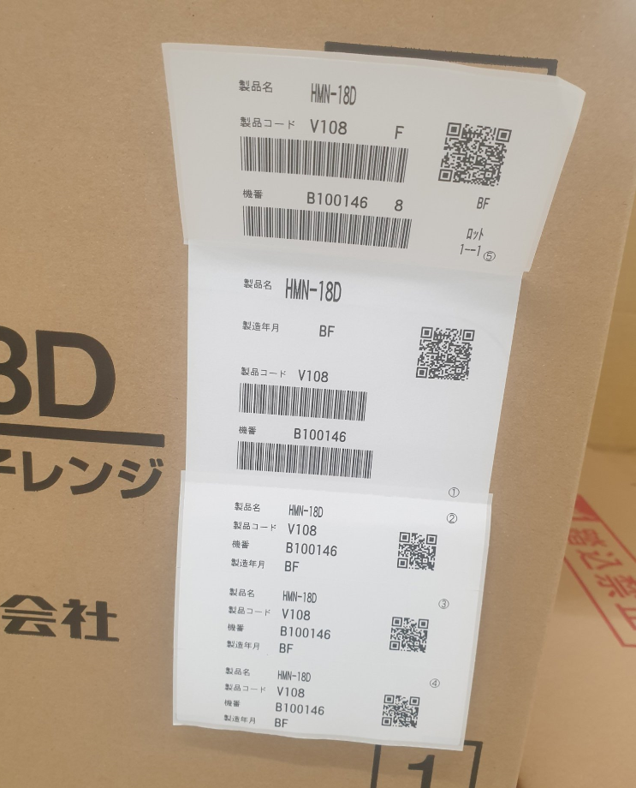
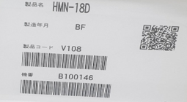

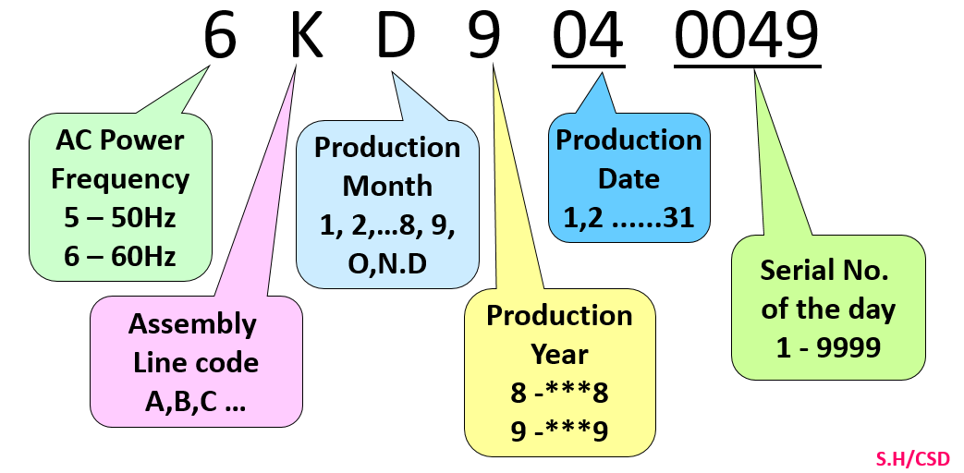
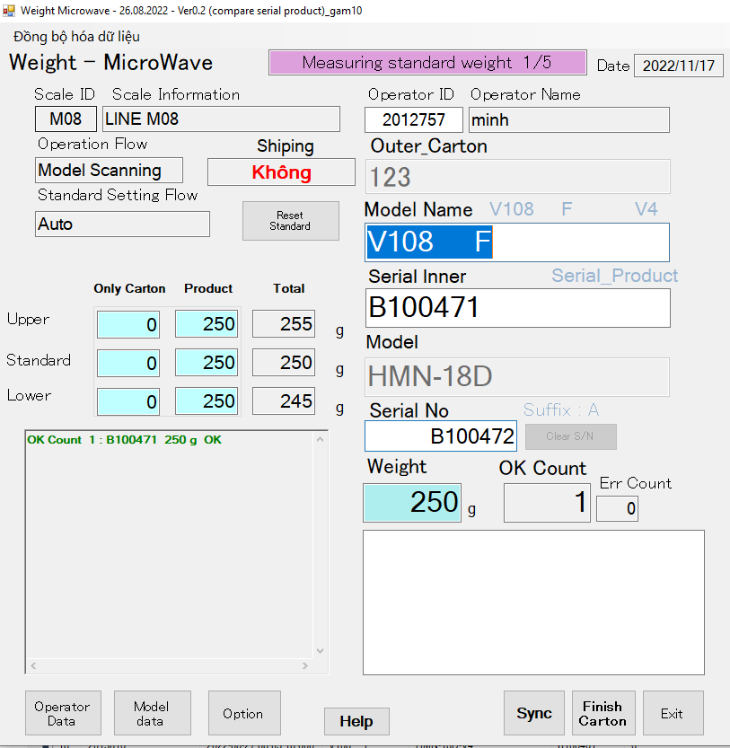
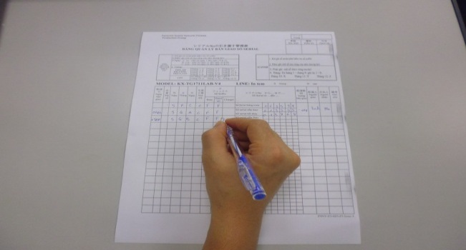
NEW VERSION OF weight check FOR MICROWAVE OCS MODEL
4/5
Make new function for weight check microwave scan serial product of supplier.
Developer: Nguyen Nhu Minh
Apply: Oct.2022
Expn: 0
Save cost: 0.4 K$
◆Before
◆ After
Not format standard
New serial of supplier
Format serial is not standard of PSNV .
Not trace history.
Lost time for manual control and risk quality
Easy manage operation and history
Reduce time:300pcs x 3 min= 900min/month
~180 hours/1year ~ 0.4K$/1year
Can check traceability and PLC of checker machine.
Notes:
The next topic is: new version of weight check for microware outsourcing model
Before kaizen,
Following outsourcing model, label of product not follow PSNV standard.
So we control manual by paper check sheet. Lost time and risk quality.
After kaizen,
We make new version of software
We easy to control operation and product traceability.

Slide 6




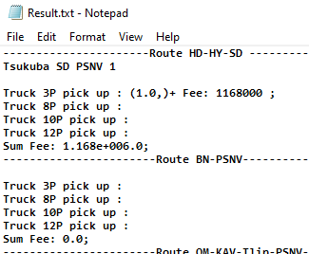
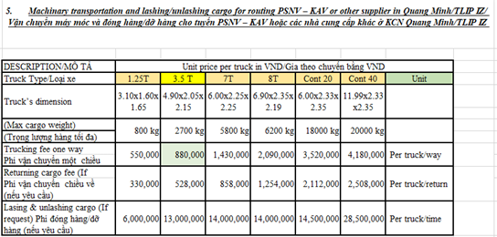
Pick up goods from vendor by truck (milk run)
5/5
Chose the best and cheapest truck fee.
Developer: DO MINH TOAN
Apply:Oct.2022
Expn: 0
Quality
◆Before
◆ After
QUANG MINH AREA
QUANG MINH AREA
Vender 1
Vender 2
Vender 1
Vender 2
Vender 3
Vender 3
TLIP AREA
Macro Program
TLIP AREA
Excel File
BAC NINH AREA
BAC NINH AREA
Vender 3
Vender 2
Vender 3
Vender 2
Vender 3
Vender 1
Vender 1
Vender 1
Vender 1
Vender 2
Manual pick up
Auto pick up
HAI DUONG AREA
HAI DUONG AREA
Vender 1
Vender 1
Vender 1
Vender 2
Manual pick up truck ➔ Loss time : 45 min/day
Easy to make mistake , high truck fee
Automation pick up truck : 5 min/ day
Save time : 40 min/ day
~ (40min*247days*2$)/60 ~ 0.3K $/year)
Ensure quality, reduce truck fee
Notes:
The last topic Pick up goods from vendor by truck.
Before kaizen,
When / outsourcing inform / PSNV pick up goods.
We arrange car / by manual
So easy to mistake and high truck fee.
After kaizen,
We develop software / to find the best / and cheapest truck fee
That’s all my presentation.
Thank you so much for listening.

Slide 7
THANK YOU FOR YOUR ATTENTION

