Slide 1
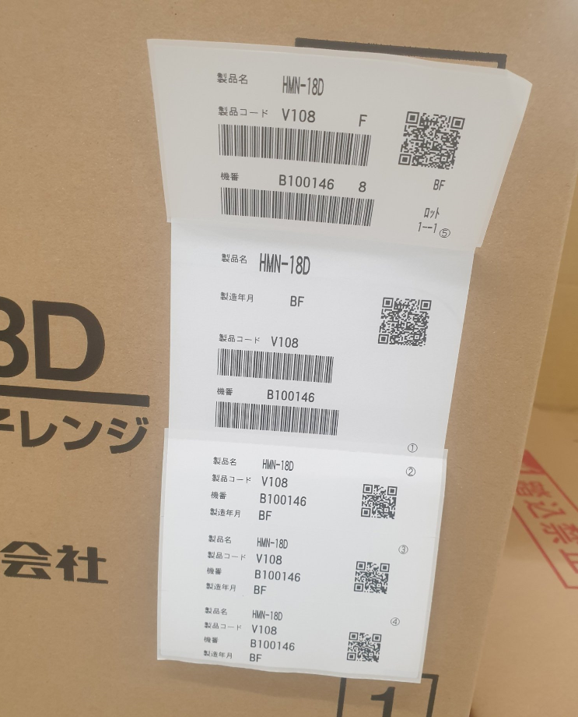
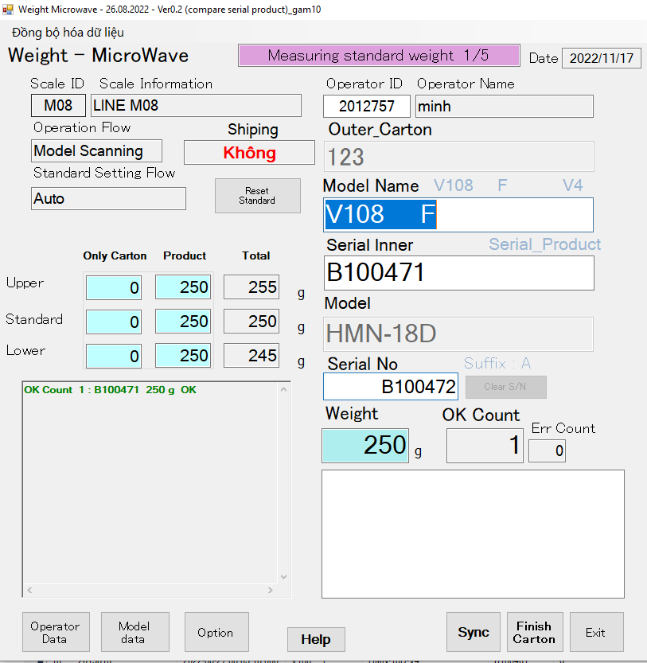
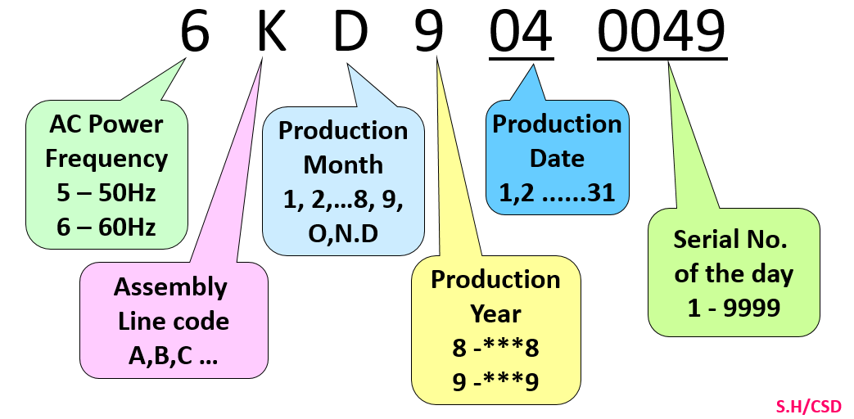
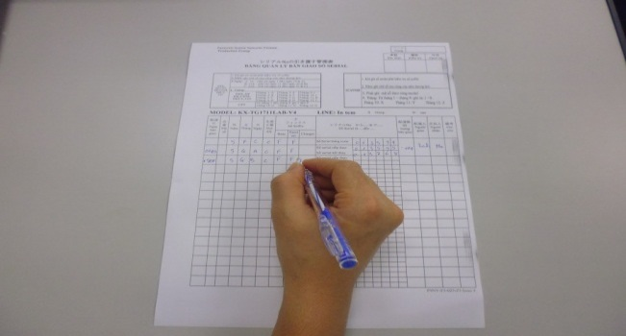
Edit weight check Microwave for new Model HMN-18D
2/5
Make new function for weight check microwave scan serial product of supplier.
Developer: Nguyen Nhu Minh
Apply: Aug.2022
Expn: 0
Save time & Quality
◆Before
◆ After
Not format standard
New serial of supplier
Format serial is not standard of PSNV .
Not trace history.
Lost time for manual control.
Not Ensure quality.
Easy manage operation and history
Reduce time to trace history.
Check function traceability and function PLC of checker machine.
Notes:
HR other department training direct and paper for evulation .
For video training they need to make and edit about 20 hours
After anaylatis , we implement train online : learn by video, do exam one system , auto evulations…
About video training we using new technogy convert text for speech with many fomat : text or ppt ..
This activity help reduce more than 18k$

