Slide 1
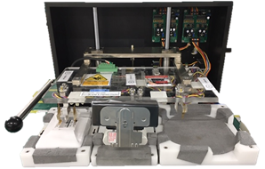
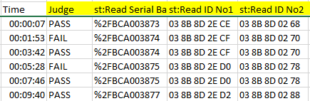


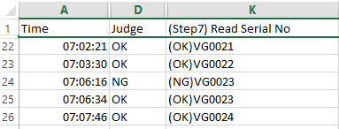
Check double ID for category Door phone
1/1
Make new software auto upload and function check double ID ,Mac ,Vid , Private key of log shipment checker.
Developer: Nguyen Nhu Minh
Apply: Aug.2022
Expn: 0
Ensure quality
◆Before
◆ After
New log file shipment
5KG
Weight check
Checker machine
Shipping set up
Only check NG/OK of product
NG Double ID1
Auto upload log file shipment
Check double ID /Mac/Vid/Private key
Data server
Old log file shipment
Weight check
Current :
Product has trouble when Re-writing ID/MAC/VID/ private key. Not detect double ID/Mac/vid/private key.
Weight check only check log file and return OK/NG of product, not save history check functions.
Improve :
Weight check detect double ID/Mac/Vid/Private Key.
Ensure check all function of checker machine.
Easily trace functions checker history.

