Slide 1
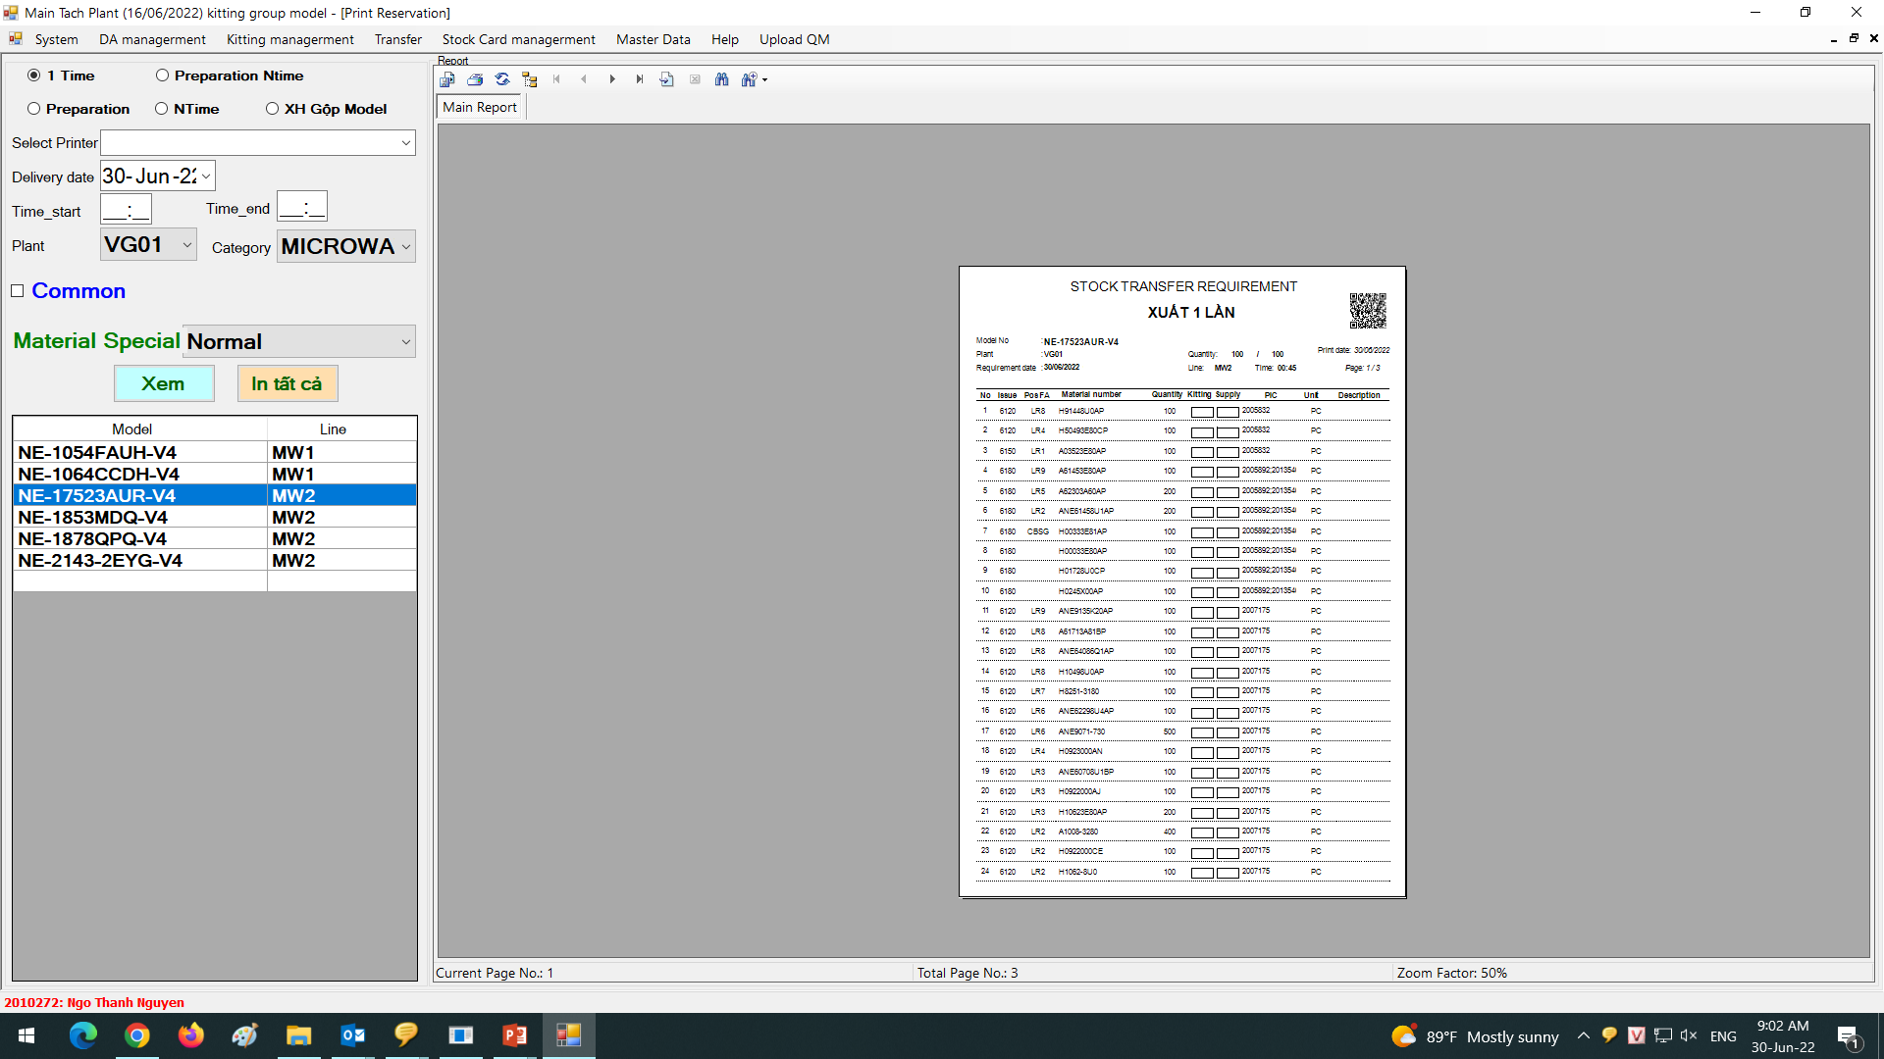
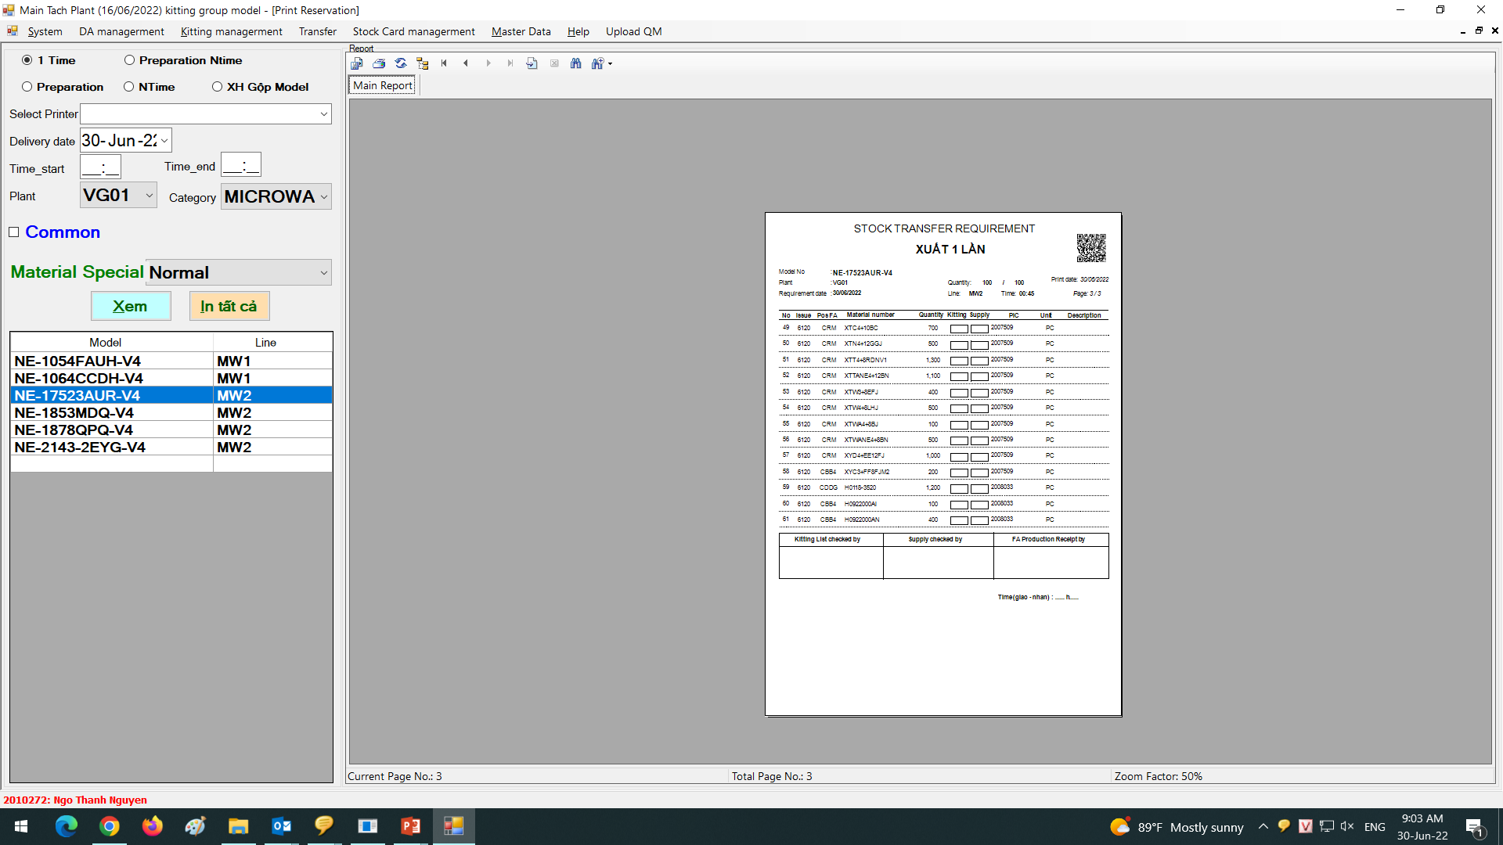
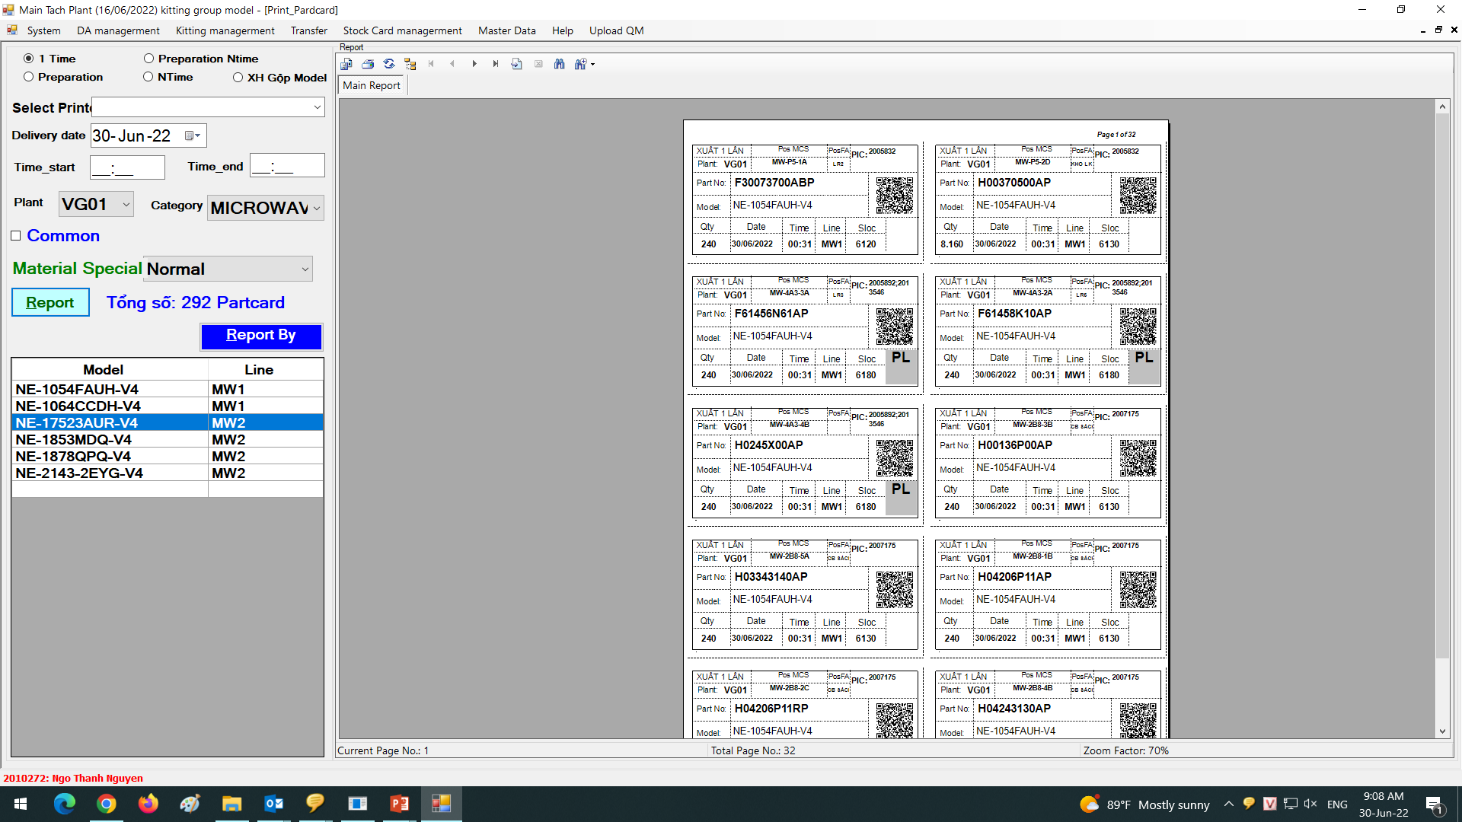
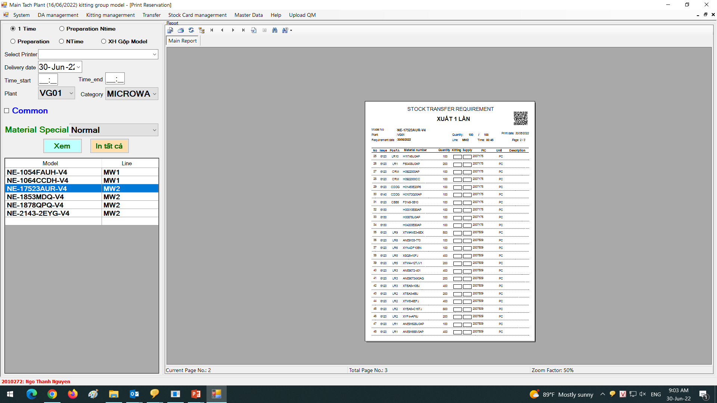

Improver printing list & part card by model & table assemble (MW &PJ)
1/1
Edit function print part card by group model and table assemble.
Developer: Nguyen Nhu Minh
Apply: Aug.2022
Expn: 0
Save time
◆Before
◆ After
List by table
1/3
Table 1
Table 2
Table 1
Table 3
Table 1
Table 2
Table 3
Table 2
Table 1
Table 4
Table 1
Table 5
Table 1
Table 6
Table 6
Table 6
Table 6
Table 6
Table 6
Table 6
Table 6
Table 6
Table 6
Table 6
Table 6
2/3
-One list control many trolley supply
-1 trolley many part supply for many table assemble
=>Loss time supply for FA
3/3
-Easy control part on trolley supply
=>save time supply for FA
FA Line
( separate part by table assemble)
Table 1
Table 2
Table 1
Table 2
Table 1
Table 2
Table 1
Table 2
Table 3
Table 3
Table 4
Table 3
Table 4
Table 3
Table 4
Lost time supply
Table 1
Table 2
Table 3
Table 5
Table 6
Table 5
Table 6
Table 5
Table 6
Table 4
Table 5
Table 6
List and part card group by table assemble
Save time supply
Current :
-Microwave & Projector print List & part card group model by model by 1 list have many part 60 -120 parts
on the list => 1 list have many trolley supply
-At FA line request MCS must separate part by table assembly
=> MCS loss time for find part and location when supply
Improve:
-Microwave & Projector print List & part card group model by model and table assemble. Trolley supply have part list group by table assemble
Easy control part on trolley table assemble , save time supply.
Reduce tack time : 1.5 min/trolley
MW 150 trolleys supply to FA,PJ 80 trolleys supply to FA (1 trolley reduce 0.5 min) Save : (150+80) x 0.5 = 115 min/day

