Slide 1
ISG ITAKONA ACTIVITY
NOV 2021

Slide 3
ISD ACTIVITIY LIST OCT.2021-MAR.2022
No | Items | Department | PIC | Efficiency | Dev (Month) | Oct | Nov | Dec | Jan | Feb | Mar
1 | QC-MCS Free location | Procurement | Minh | 2pax | 4.0
2 | Auto compare BOM/ECN btw SAP & Excel file | Procurement | Dong | 1.8k$ | 2.0
3 | Freight Management(Custom INV vs DA/EDI INV) | Procurement, PSCD | Lam | 3pax | 8.0
4 | Sound Business-Microwave label printing | Manufacturing | Dev | Quality | 5.0
5 | Extend function Auto convert BOM PAPVN/BCBU/SCBU/MEBD | Procurement, FE | Lam | 2pax | 5.0
6 | Add text when issue out/scrap for Accounting | Procurement, Accounting | Hoa | 0.4k$ | 0.3
7 | NG list (include ECN) | PSCD, Procurement | Dong | 0.8k$ | 0.3
8 | Add house bank determination account | Accounting | Hoa | Compliance | 0.5
9 | Addition VAT control for verify material IPC | Procurement, Accounting | Hoa | Compliance | 1.5
10 | Tool for Inv Forecast, SA analysis and critical material report | Procurement | Dong | 50.0k$ | 4.0
11 | Tooling control sheet | Procurement | Hien | 2.8k$ | 1.0
12 | Tool for issue Commercial Invoice return auto | Procurement | Dao | 0.6k$ | 0.2
13 | Sound Business Adding Serial Outer Weight Check & Shrink system | Manufacturing | Minh | 3.9k$ | 1.0
14 | Auto Material Master | Procurement | Dao | 16.4k$ | 3.0
15 | DP, Sound Business Prevent Double ID & Serial No | Manufacturing | Dao | Quality | 1.0
16 | Sound Business shipping control | PSCD | Minh | 3.9k$ | 0.5
90%
Testing
100%
Go-Live
90%
100%
Go-Live
20%
1st Ver(Jan)
2nd Ver (Mar)
100%
Go-Live
75%
Developing
100%
Go-live
70%
40%
Testing

Slide 4

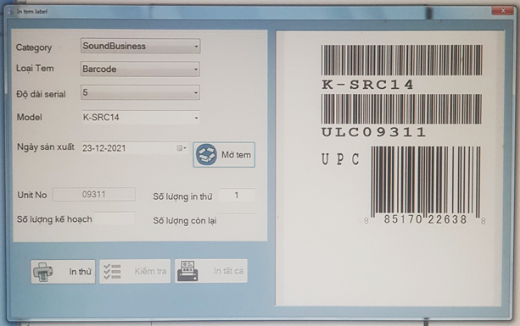

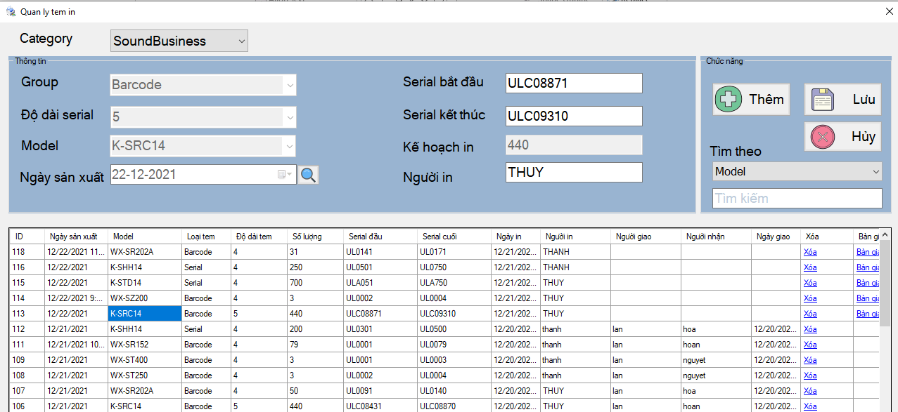

LABEL PRINTING SOFTWARE FOR SB & MCW
1/4
Making Software control Label Serial of Sound Business and Microwave
Developer: Dev
Apply: Dec.2021
Expn: 2.8K$
Ensure quality
◆Before
◆ After
Open Check sheet
Checking last Serial
Auto select model
& open label design
Auto generate
serial number
Open label design
Input variable
Hand over control
Re-print control
Error-print control
Record on check sheet
Using paper for manual control.
Manual calculating serial number cycle time
Using system for all information control
Other section can check supply status
Lost time for manual control
Easy make mistake
Automatic generate and control
Ensure quality
Easy manage operation and history
Notes:
Next theme, this is database daily checking improved by development team.

Slide 5




BOM PROCESS FLOW Systemization
2/4
Saving time to compare BOM by systemization
Developer: SAP
Apply: Nov.2021
Expn: 2.2K$
Saving: time
◆Before
◆ After
All jobs are processed manually
Co-operate with IT to reduce processing time by IT tool
FES/PMS
FES/PMS
1. Part list all Cate
PDM/ PAPVN
1. Part list all Cate
PDM/ PAPVN
COS
COS
2.Check/choose OR part
OR Part
Price?
Stock?
Used?
Part A
2.Check/choose OR part
OR Part
Price?
Stock?
Used?
Part A
Part B
Part B
PMS
Part n
PMS
Part n
3. Making data upload files
manual
3. Making data upload files
manual
4. SAP registration
4. SAP registration
5. Double check
5. Double check by SAP
Lost time for manual double check
Easy to mistake
Lost time: 50 hours/month
Double check by new function into SAP
No mistake
Save time: 50 hours/monthly => 600 hours/year

Slide 6
ADD TEXT WHEN ISSUE OUT/SCRAP
3/4
Upload file for issue out/Scrap material
Developer: Nguyen Thi Thuy
Apply: Nov.2021
Expn: 0.5K$
Saving: time
◆Before
◆ After
Excel file
Accounting
Excel file
Manual input
Issue out
Accounting
Hardcopy
Debit Note
Upload
SAP
Manual input
Check
SAP
Section manual input into Excel file
Accounting double check on Debit note and SAP
Using upload function
Accounting re-check only
Lost time for manual control
Take time: 6hour/month = 72 hour/year
Reduce make mistake
Save time: 72 hour/year
Notes:
Next theme, this is database daily checking improved by development team.

Slide 7
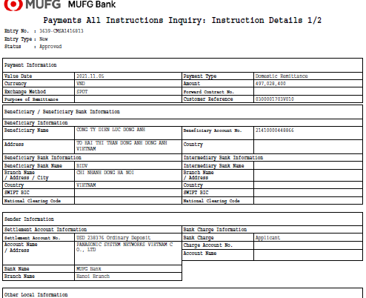
Add house bank in payment of accounting
4/4
Setup House Bank for automatic payment account ID 405 (VND) following compliance
Developer: Le Thu Hoa
Apply: Nov
Expn: 0.35K$
Saving: time
◆Before
◆ After
SAP
SAP
Tokyo Bank system
Tokyo Bank system
VND
VND
VND
Manual
Automatic
USD 238376
VND 143405
VND 143405
For payment currency in VND
Manual adjust settlement Account No from USD 238376 to VND 143405
Accounting Master vendor in SAP 1 time
System automatic use bank account VND 143405
Manual adjust House bank in remittance .
Easy mistake, take time 1min/remittance
Time: 300 remittance/month*1min*12month=60hour/year
Set up 1 time in SAP for automatic
No mistake. Following compliance
Time: 2 hour => Save time 58hour/year
Notes:
Next theme, this is database daily checking improved by development team.

