Slide 1
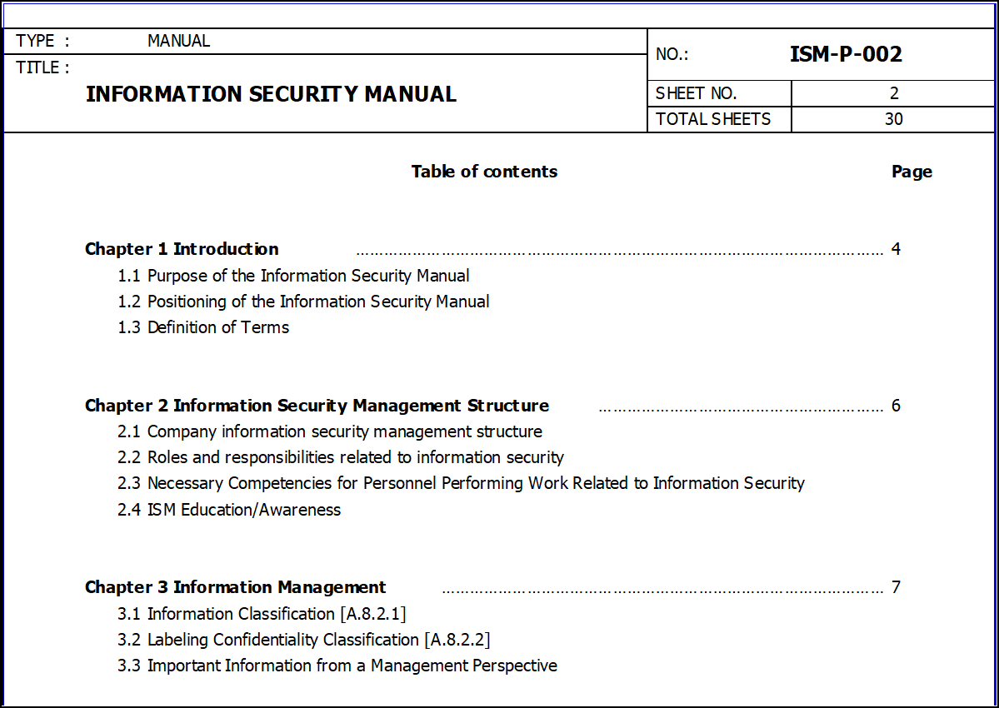
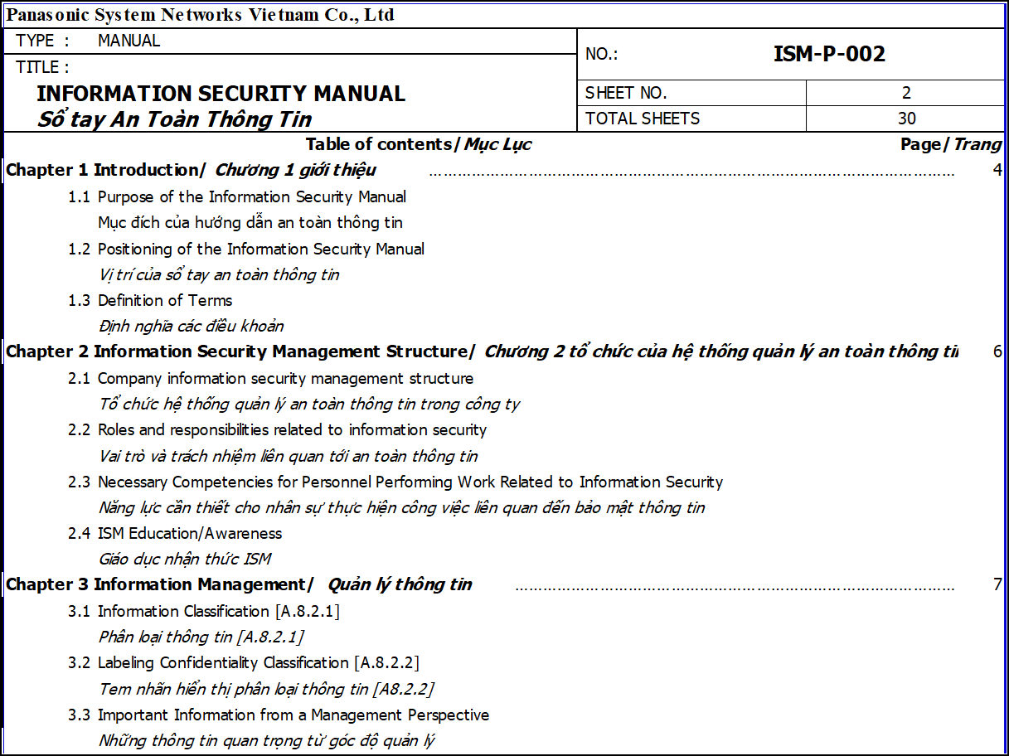
reduce unclear understanding error iSM-P
1/1
Add Vietnamese for ISM-P
Developer: ISM team
Apply: 12,2021
Expense: 0
Save : 0 $/Y
◆Before
◆ After
Issue
Delete manually
English only
English & Vietnamese
Problem: Misunderstanding or incomplete understanding of the requirements of ISM-P
Benefit: Easy to understand and easy to promote to each employee. Completed 9/37 ISM-P
Notes:
,

