Slide 1
IMPROVEMENT RESULT REPORT
DEC.2021
Department : Information System
Presenter :
Total topics : 6 topics
Save cost : /year
Notes:
Good morning everyone.

Slide 2











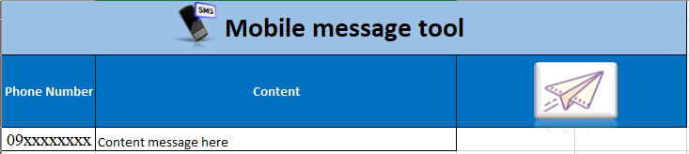
Mobile auto send message tool
1/3
USING EXCEL MAKE FUNTION MACRO
Developer: Nguyen Nhu Minh
Apply: Sep, 2020
Expn: 0
Saving: 480$/Y
◆Before
◆ After
User
IT
User
IT
Excel tool
Message server
Database
Manual check faulty of data which send by user
Check latest data from server
Prepare data with user’s data
Input into server
Receive data from user
Paste into Excel Tool
Lost time for many step
Easy to make mistake
Lost time: 240 hour/year
Just using Excel Tool
Save time: 240 hour/year
Notes:
Next theme, this is database daily checking improved by development team.

Slide 3
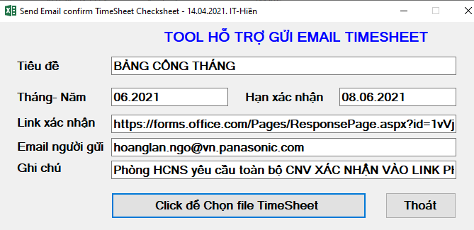
EMAIL SENDING TIMESHEET CHECKSHEET
2/3
TOOL FOR AUTOMATIC EMAIL SENDING TIMESHEET CHECKSHEET
Developer: Nguyen Van Hien
Apply: May.2021
Expn: 0
Save cost & time
◆Before
◆ After
1. Send Timesheet for employees by email (auto)
1. Send Timesheet for section to check (14 PIC)
2. Employees check & response to HR
1 days for final data
3 days
For
final
data
2. Section print Timesheet for employees check
3. HR compare hard copy & adjust Timesheet
3. Sections collect, check and send to HR
4. HR compare hard copy & adjust Timesheet
Send TS to section to print for employees to check:
Take time: 1,008 h/y (6h/PIC/m~14 PIC)
Lost paper: 2,400 pcs/y (200pcs/m)
Lost cost: ~2,308 $/y (manpower + paper)
Send Timesheet to employees by email for checking:
Save time: 1,008 h/y Section no need to check & print paper
Save cost: 2,308 $/y.

Slide 4
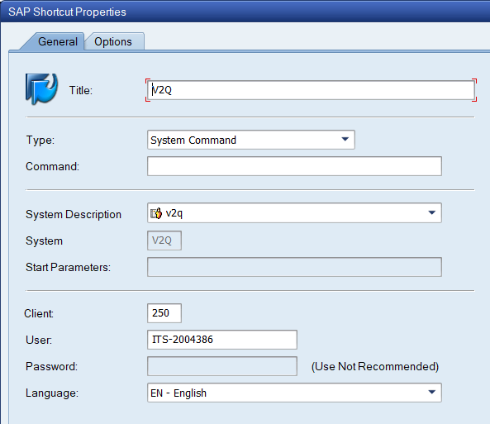
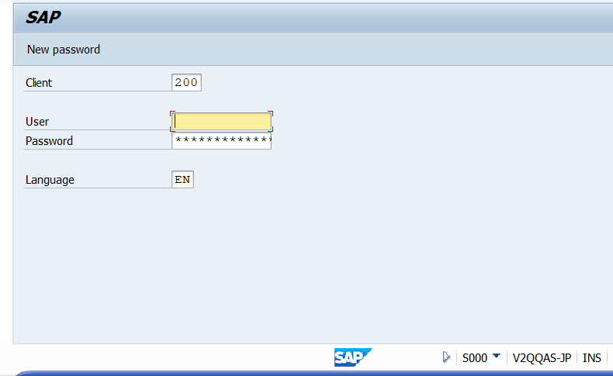

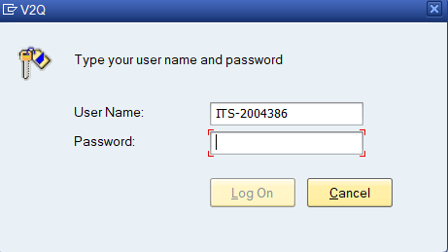
More convenient while Log in to v2q
1
Setting client & account one time only in testing system (V2Q)
Developer: Nghiem Hien Lam
Apply: Nov 2021
Expense: 0
Save time:
◆Before
◆ After
Fill and log in V2Q system daily
Setting one time only
No need filling
client & account
Change to 250
Account
password
Fill Password only
Take time: 30s/day
Save time: 25s/day
Notes:
The first item is: delete printed job automatically
All job will exist in system within 30days.
sometime memory is over, user can not print. We must check and delete printed job by manual.
After, we set background job to auto delete daily, we keep data 3 recent days.
From now system delete print job automatically and user always print ok and not effect to their work.
We no need to to anything, so we can save all time.

Slide 5








APPLY SVN SERVER FOR DEVELOP SOFTWARE
3/2
TOOL CONTROL SOURCES CODE OF PROJECT BETWEEN CLIENT AND SERVER.
Developer: Nguyen Thi Dao
Apply: Jan.2021
Expn: 0
Save time
◆Before
◆ After
Each members working independent
Can not develop together on a project
Each members working together on a project.
No using data storage
on file server.
X
Consumes data
storage space
on file server.
Can control revision of projects
Lost time find when support.
Can not control revision of projects
Take time collect project :
36 project x 30 Min/year = ~16 hours/year.
Take time find
70 project code x 5 min = ~ 6 hours/ year).
All member working group together on project better.
Save time: 22hours / year.

Slide 6
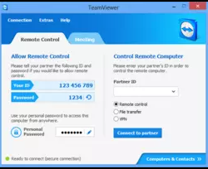
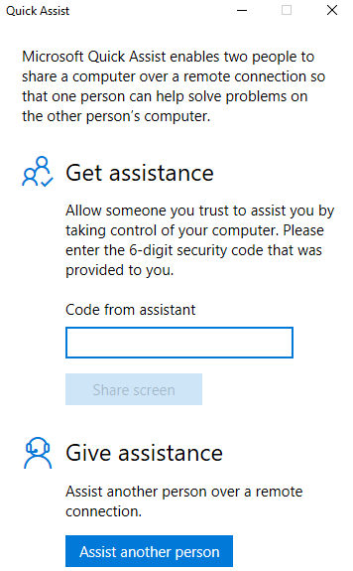
Replace support user tool by Quick Assist
1/1
Change tool teamviewer by quick assist
Developer: Infra team
Apply: Jan,2021
Expense: 0
Save :20400 $/Y
◆Before
◆ After
Issue
Use tool TeamViewer, cost for use:35$ x 50pcs = 1700$/ month
We use tool Quick Assist of Window 10, replace for TeamViewer
=> Lost cost and not safe for ISM rule
Save Cost: △1700$/month, safe for ISM rule
Notes:
,

