Slide 1
IMPROVEMENT RESULT REPORT
DEC.2021
Department : Information System
Presenter : Tran Nhu Nam
Total topics : 5 topics
Save cost : 80K$/year
Notes:
Good morning everyone.

Slide 2








APPLY SVN SERVER FOR DEVELOP SOFTWARE
1/5
TOOL CONTROL SOURCES CODE OF PROJECT BETWEEN CLIENT AND SERVER.
Developer: Nguyen Thi Dao
Apply: Jul.2021
Expn: 0
Save: 7.1K$
◆Before
◆ After
Each members working independent
Can not develop together on a project
Each members working together on a project.
No using data storage
on file server.
X
Consumes data
storage space
on file server.
Can control revision of projects
Lost time find when support.
Can not control revision of projects
Take time collect project :
36 project x 0.5hour/month x 5pax =1,080 h/year.
Take time to find
70 project code x 10 min x 5pax = 700 h/year).
All member working group together on project better.
Save time: 1,780 hours/ year -> 7.1K$

Slide 3











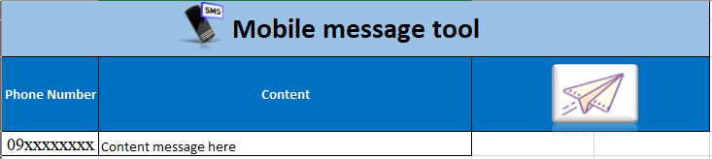
Mobile auto send message tool
2/5
USING EXCEL MAKE FUNTION MACRO
Developer: Nguyen Nhu Minh
Apply: Jul.2021
Expn: 12$ (Develop 2h)
Saving: 0.5K$
◆Before
◆ After
User
IT
User
IT
Excel tool
Message server
Database
Manual check faulty of data which send by user
Check latest data from server
Prepare data with user’s data
Input into server
Receive data from user
Paste into Excel Tool
Lost time for many step
Easy to make mistake
Lost time: 120 hour/year
Just using Excel Tool
Save time: 120 hour/year -> 0.5K$
Notes:
Next theme, this is database daily checking improved by development team.

Slide 4
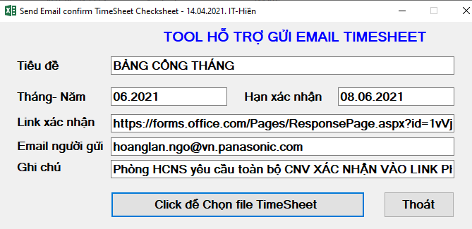
EMAIL SENDING TIMESHEET CHECKSHEET
3/5
TOOL FOR AUTOMATIC EMAIL SENDING TIMESHEET CHECKSHEET
Developer: Nguyen Van Hien
Apply: Aug.2021
Expn: 23$ (Develop 3h)
Save: 2.3K$
◆Before
◆ After
1. Send Timesheet for employees by email (auto)
1. Send Timesheet for section to check (14 PIC)
2. Employees check & response to HR
1 days for final data
3 days
For
final
data
2. Section print Timesheet for employees check
3. HR compare response data & adjust Timesheet
3. Sections collect, check and send to HR
4. HR compare hard copy & adjust Timesheet
Send TS to section to print for employees to check:
Take time: 1,008 h/y (6h/PIC/m~14 PIC)
Lost paper: 2,400 pcs/y (200pcs/m)
Lost cost: ~2,308 $/y (manpower + paper)
Send Timesheet to employees by email for checking:
Save time: 1,008 h/y Section no need to check & print paper
Save cost: 2,308 $/y.

Slide 5




IMPROVE WFH ENVIRONMENT BY OPENVPN
4/5
RESUMPTION OF USE OPENVPN (PISCVN SERVICE) FOR PV GROUP
Developer: Tran Nhu Nam
Apply: Jul.2021
Expn: 0
Save: 69K$
◆Before
◆ After
Vietnam
Internet
Singapore
Japan
Vietnam
Singapore
Japan
Home
SMART RAS
Home
Internet
Take time
Access to PSNV
Quick
Access
OPEN VPN
PSNV
PSNV
ECUS
File server
PSNV System
Company Network
ECUS
File server
PSNV System
Company Network
Operation | Time / 1 ope. | Total Time/day
Custom declaration | 20 min | 11.7 hour (7 ope., 5 pax)
File server operation | 70s per file | 97.2 hour (50 file, 100 pax)
Operation | Time / 1 ope. | Total Time/day
Custom declaration | 4 min | 2.3 hour (7 ope., 5 pax)
File server open | 25s per file | 34.7 hour (50 file, 100 pax)
Estimate loss time for network VPN issue
Custom declaration : 2,808 hour / year
File server operation : 23,328 hour / year
Efficiency of Improvement WFH Environment
Custom declaration : 552 hour / year
File server operation : 8,328 hour / year
◇Save time : 17,256 hour / year -> 69K$

Slide 6
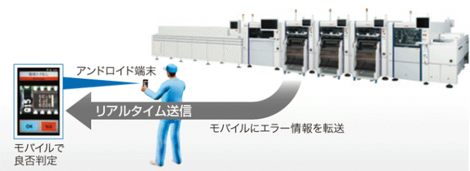





IOT - AUTOMATIC TRANSFER AND BACKFLUSH TO SAP
5/5
AUTO TRANSFER AND BACKFLUSH FROM IOT TO SAP
Developer: Nguyen Van Hien
Apply: Nov.2021
Expn: 210$ (Develop 3 days)
Saving: 0.8K$
◆Before
◆ After
Production network
Production network
Real-time Link
Real-time Link
Office network
Office network
Auto
Manual operation, no history
Lost file, easy make mistake
Auto transfer and backflush
Auto send and receive error record
Lost time for export and input into SAP
Easy to make mistake
Lost time: 192 hour/year
Background job running
Save time: 192 hour/year -> 0.8K$
Notes:
Next theme, this is database daily checking improved by development team.

