Slide 1
IMPROVEMENT RESULT REPORT
JUN.2021
Department : Information System
Presenter : Nguyen Van Hien
Total topics : 5 topics
Save cost : 5.3K$/Year
Notes:
Good morning everyone.

Slide 2
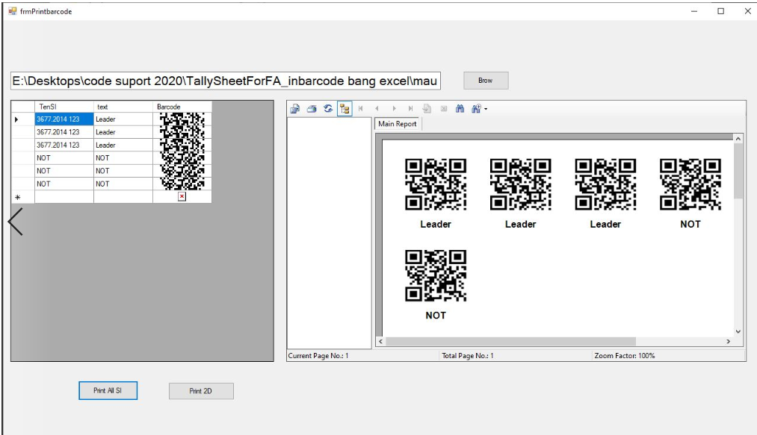











Barcode Printing SOFTWARE
1/5
Make a new program for barcode generator
Developer: Dev team
Apply: Mar,2021
Expense: 0
Save : $0.5K/Y
◆Before
◆ After
Issue
User
IT
Database
User finding barcode item then send IT for error check
Prepare data on excel and print barcode
Can not make QR Code
Receive user information
Using program for barcode generator
Take time to find and print barcode
Lost time: 120h/ Year
Quick response and easy to use
Save time: 115h/Year. (0.5K/Year)
Notes:
,

Slide 3
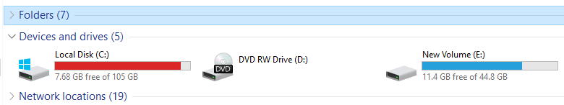
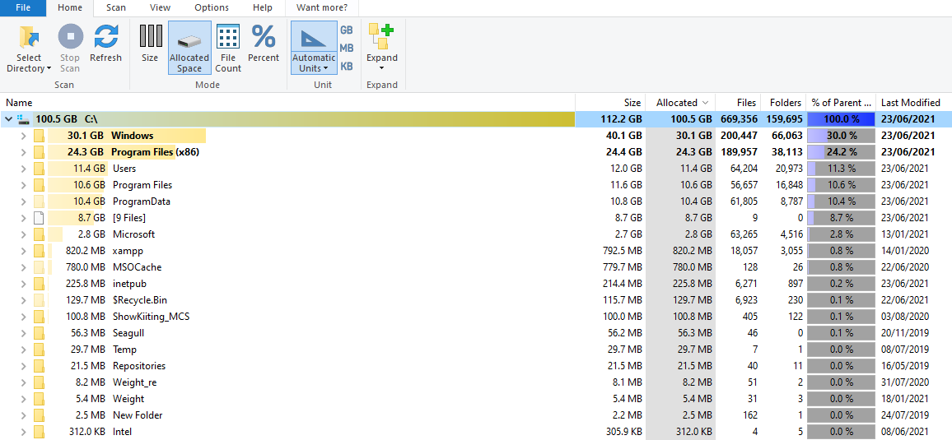
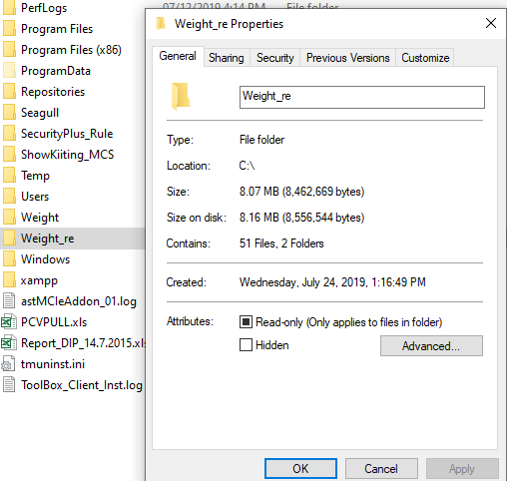
FILE CONTROL & disk space CHECKING
2/5
Check the hard drives and all you see
Developer: Dev Team
Apply: Apr,2021
Expense: 0
Save : $0.8K/Y
◆Before
◆ After
Issue
Manual
Check by software
Manual checking disk space
Manual finding no use file, largest file
Easy to check disk space & capacity folder
Easy to find no use file, largest file, temp file
Easy to server clean, space release
Check manually
Delete manually
Manual checking
Can not find huge file, folder
Software using
Save time: 200h/Year(0.8K/Year)
Notes:
,

Slide 4
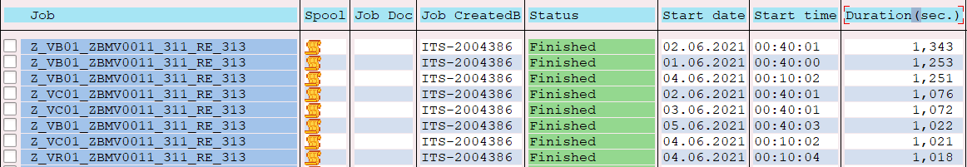
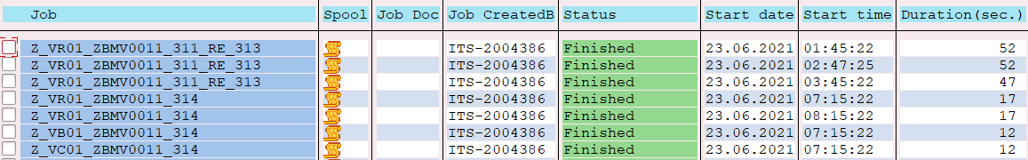
prevent cancel status of kitting job
3/5
Improve auto kitting program to reduce runtime of auto kitting job → no cancel job
Developer: Nguyen Thi Thuy
Apply: May,2021
Expense: 0
Save time: 0.8K$/Y
◆Before
◆ After
Auto kitting job’s runtime is take time
Improve program → reduce runtime
~13k item/day – 13h daily finish
~13k item/day – 04h daily finish
Sometime: runtime error
Job cancelled
IT&Section check and transfer manually.
Take time: 16h/month
Delay goods → Claim from Prod dept
No runtime error.
No job cancelled
No more check
Take time: 0h
No more claim due to delay
Delete manually
In time
Human take time: 16h/month
Job take time: 240h/month
Human take time: 0h ⬄ 0.8K$/Year
Job take time: 80h/month
Notes:
,

Slide 5
change the process of transferring pc layout
4/5
Transfer password security for ISM leader of each department & change procedure for change PC layout
Developer: ISM team
Apply: Jun,2021
Expense: 0
Save : $2.9K$/Y
◆Before
◆ After
Issue
Delete manually
Problem: Lost time from step 1 ~ 5, 8
Take time: 0.6h/request ⬄ 6h/ month
Cost: 120rq x 6h x 4$ = 2.9K$
Benefit: Reduce time for change PC layout
Save time: 0.6h/year
Cost: 2.9K$/Y
Notes:
,

Slide 6
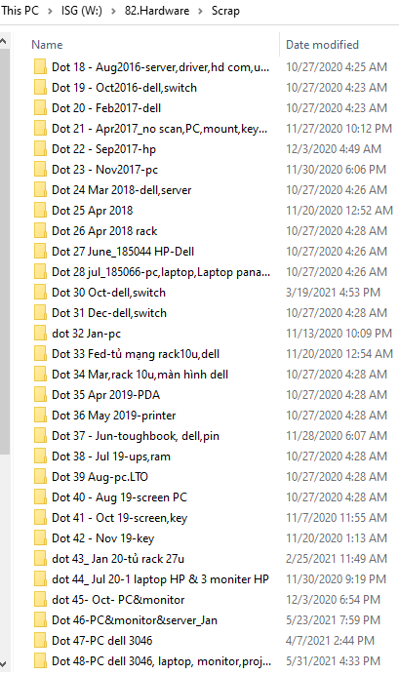
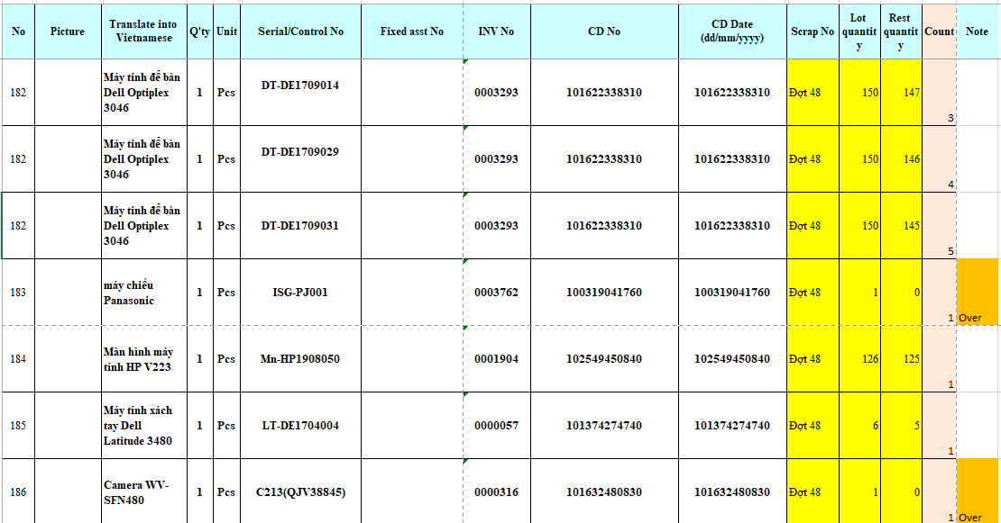
Control of SCRAPS & LOT NO
5/5
Check information by excel file=> when need scrap the devices
Developer: LE THI HAI
Apply: Jun, 2021
Expn:
Saving: 0.3K$/Y
◆Before
◆ After
- Not control Lot No of scrap, control scrap list by scan document.
- Control by database
Lost time: 3 day*3h*12time = 108h/Y
Save time: 3 day*2h*12time = 72h/Y = 0.3K$/Y
Notes:
Last theme, that is ISG member checking purchase process IT devices for all of groups.

