Slide 1

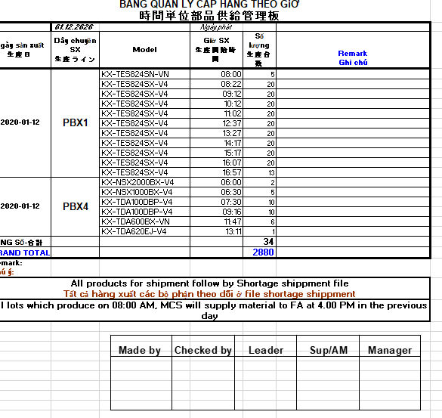
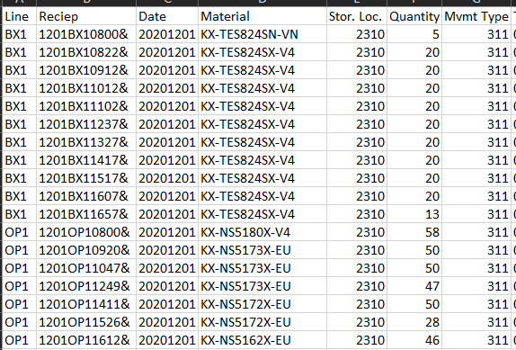
AUTOMATIC MAKING JUST TRANSFER FILES
1/1
Generate just transfer file upload automatically.
Developer: Ha Minh Khuong
Apply: Oct.2020
Expn: 0
Reduce 2pax
◆Before
◆ After
PCS collect data , analyse & adjust
AUTOMATIC OUTPUT
PE
Machine
SCM
Actual ETD
Collect data
Upload
Process
Export
1. Internal Daily Plan
FA
Shift arrange
RF
SP order
2. Production Model/Line
PCS
Model
/Line
Standard packing
Capacity
FE
ECN, New model, trial schedule
PMS
BOM change/revise
3. Working Time
PUS
NG material schedule
COS
LCD dummy/leaflet stock
Shift
/Standard
Start/End
Breaking time
Get approval
❶ Update Sub-model list
❷ Input models into correct lines
❸ Divide into hour capacity in lines
❹ Arrange production order based on information from
FA,FE.PUS,COS,PMS,RF,SCM,PE
4. Special setting
Special Model
Special Line
Special Time
Priority:
1. Required model
(running 1st, 2nd …)
2. Last model
3. Next model
Duplicate Line, Merge Line,
Service Part
Cut off time,
Change model,
Add time/lot
Record data
MAKE JUST TRANSFER EXCEL/CSV FILE TO SECTIONS/SAP
Daily 4 PIC PCS manually make JT file for all categories
PCS just need input data, output just transfer file automatically by SAP.
➔ Reduce 2 PIC

