Slide 1
IMPROVEMENT RESULT REPORT JAN 2019
Information SystemS Group
Total themes : 5 themes
Save time : 1 theme
Cost saving : 14,841 USD/Year
Presented by: Nghiem Hien Lam

Slide 2

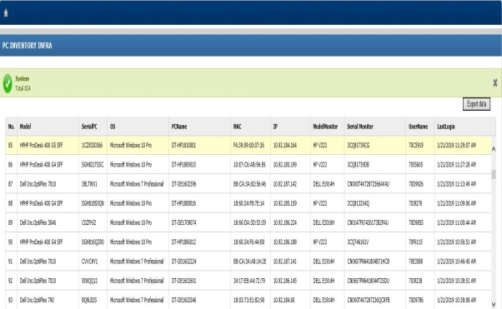

Auto Inventory PC
1/5
Using software inventory all PC
Developer: Tran Thi Thao
Apply: Nov 2018
Expn: N/A
Saving: 650 $/Y
◆Before
◆ After
Inventory collecting automatically software
Count Manual When PC Inventory Quarterly
Export and get all PC information
data exactly, anytime
Count and record PC information
Input information to Excel
Serial | OS | PC Name
FTVCHY1 | Win 7 Pro | DT-DE1602108
C00DHJ2 | Win10 Pro | DT-DE1709009
Take time : 650 Pcs * 0.1 hour =65 Hour
Save time and manpower: 65 * 2.5*4=650$/Year
Notes:
This is the fours improvement,
currently, Quaterly , we invertory Pc ,we go to section, count and write information to paper. After that input it to Excel when finish.
Now : we develop system allow get all information PC from Server. We will have information exactly and fast.
So we can save lot of time.

Slide 3
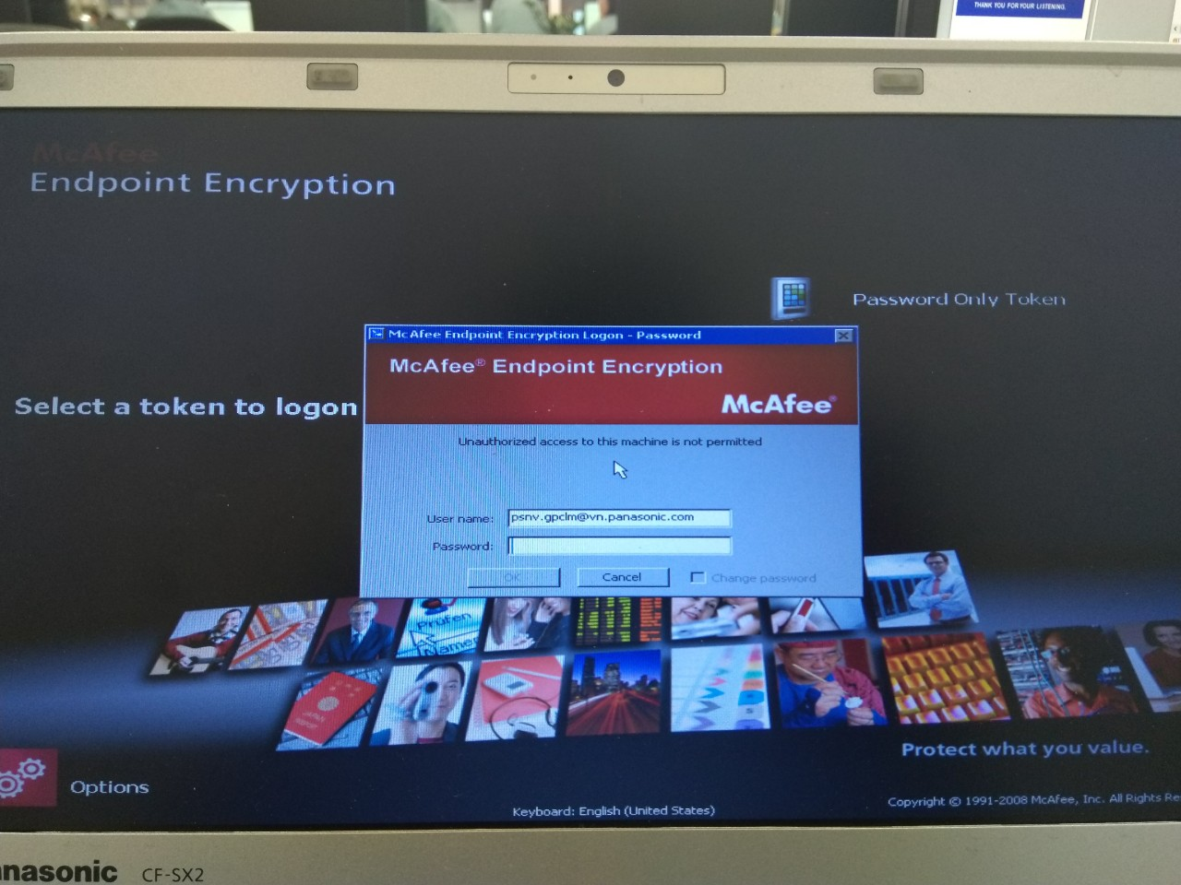

Change encryption HDD method
2/5
Replace Safeboot (Encryption HDD) by new encryption method for all Tablet Windows 10
Developer: Nguyen Van Chung
Apply: Nov/18 – Jan/19
Expn: N/A
Saving: 5,035 $/Y
◆Before
◆ After
Buy license Safeboot McAfee for Encryption HDD
Using encryption HDD tool of win 10
Easily control ,free and
follow ISM Rule
Pay license and service fee every year
Take 2 hours when upgrade OS
Fee: 90$/license/Year
53 pcs tablet: 90*53=4.77K $/Year
When upgrade OS need reinstall Safeboot and install after upgrade finish➔Take times
Save fee: 4,770 $/Year
Save time: 2*53*2.5=265$/Year
➔Total save: 5,035$/Year
Notes:
Before if we need encryption HDD we must buy license McAfee for it .
And we pay fee service every year . It no cheap about 90 $ per one license . But when we upgrate window , we must reintall McAfee and intall it after upgrate finish.
It take times.
Now we using encryption method of win 10 .This is Bitlocker win. This is tool integrated in win 10 . And no pay fee

Slide 4
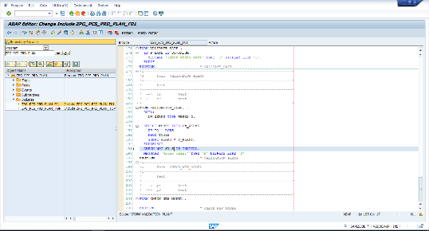
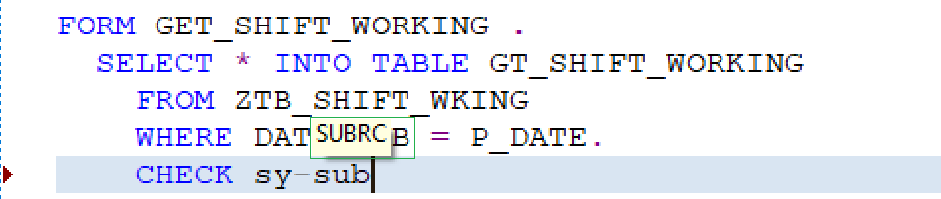
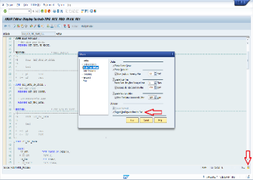
5S coding abap
3/5
Change Configuration in editor to get the suggestion code
Developer: Dang Thanh Dung
Apply: Jan 2019
Expn: N/A
Quality
◆Before
◆ After
Change Configuration in editor
Not suggestion code
Easily coding, save time
Lost about 15min/day for find object and uncomfortable to coding
Lost time for find and check object coding
Easily coding
Find object more quickly
Notes:
Before config tool ,it doesn’t have suggest . we must copy variable name , structure name , internal table name … to text field after that copy it to new program ➔ Lost many time, difficult to control and using
After config tool develop ,when we coding the object name will appear and we push tab and using it .

Slide 5
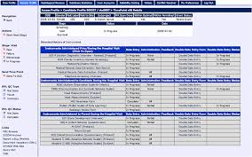

Resign employee in web
4/5
Delete information of resign employee in all system
Developer: Nghiem Hien Lam
Apply: Feb 2019
Expn: N/A
Saving: 156 $/Y
◆Before
◆ After
Build function all in one in web
Remove information of resign employee manual
Very fast and high performance
Delete employee account step by step
(About 15 systems)
Take 5minutes * 15systems *50acc / 60 = 62.5 Hour
(about 50 employee resign per year)
Save time ➔ Cost down : 62.5*2.5=156$/Year
Notes:
Before when employee resign .We need login all system with admin authentication and delete inform this employee
Now we are building a function in web allow .We can delete all information with only one push.

Slide 6
New End of Month Process Physical Inventory by SAP
5/5
Apply new function in SAP to reduce Processing when all section Enter count End of month
Developer: Nguyen Thi Thuy
Apply: Feb 2019
Expn: N/A
Saving: 9,000 $/Y
◆Before
◆ After
1
PI creation (SAP)
2
Download current stock (SAP)
3
Download & Upload Physical SAP
7
4
5
6
Download PI list (SAP)
Save Stock Master (SAP and Excel)
Input Stock Physical (Excel)
Running Store Management System (SQL server, Excel)
1
PI creation (SAP)
2
Download current stock (SAP)
3
Download & Upload Physical SAP
7
4
5
6
All Section (Total: 300 SLocs, 25 Users, 27 PCs)
Many step and lost time when enter count.
SAP System synchronization
Shorten Inventory time : 300h/Month~9,000$/Year

Slide 7
Thank you for your listening.

