Slide 1
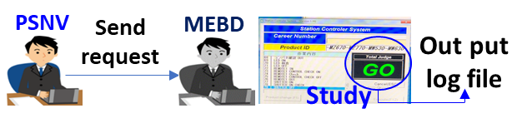
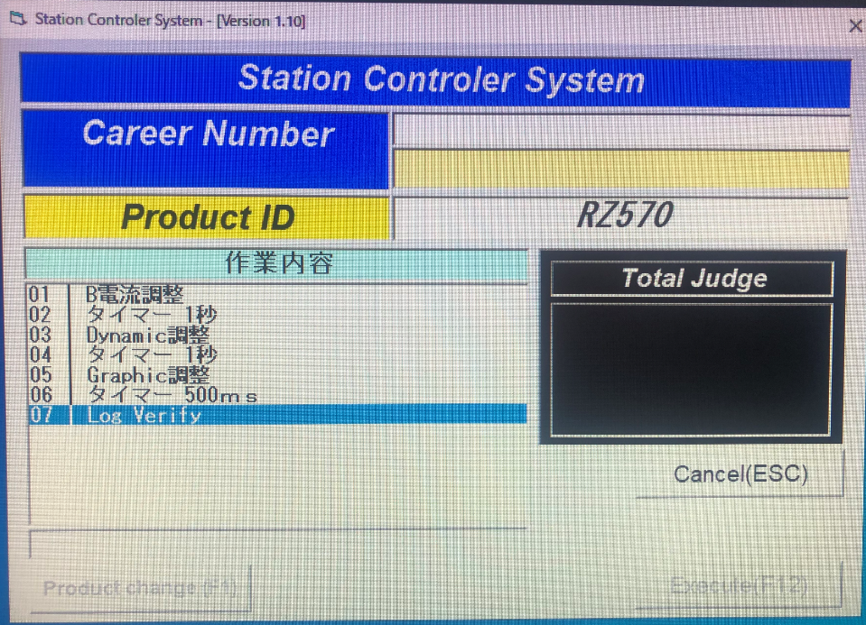
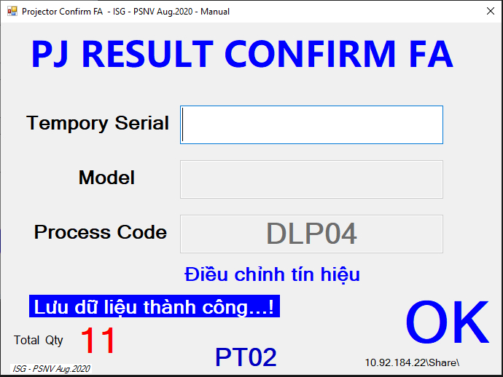
PROJECTOR MEBD QUALITY IMPROVEMENT
2/4
Make system for improve quality
Developer: Nguyen Van Hien
Apply: Sep.2020
Expn: 0
Quality
◆Before
◆ After
Verify
68. Log verify
Record serial check OK
Can not get data from Checker
Depend on MEBD software
Make new software and running on checker
Loss time for waiting: request from Apr’20 until Sept’20 not yet complete)
Investment 20.000USD
Make new software by ourselves
Investment is zero

Slide 2
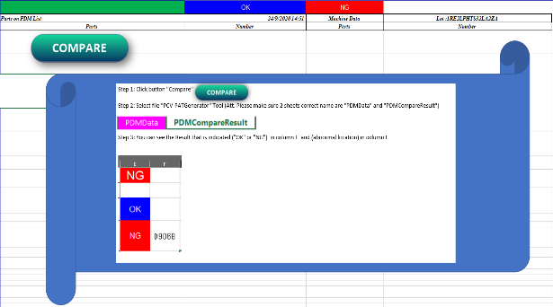




Compare pdm machine data tool
3/4
Automatic comparing data between PDM and Machine data
Developer: Vu Ngoc Dai
Apply: Sep.2020
Expn: 0
$15.57K
◆Before
◆ After
Worker using their eyes for checking paper.
Comparing by their hands
Automatic comparing
Auto Export report after compared
Spending many time and easy mistake.
Taking many manpower.
Control data by system, easy checking and searching history information.
16min/1model x 1,300 model/month = 20,800 min/month
Save: 4,152 min / month (519 hour/ Year)

Slide 3




Microwave traceability
1/5
Microwave traceability system
Developer: Nguyen Thi Dao
Apply: Jan.2020
Expn: 0
Quality
◆Before
◆ After
Manual control
System Control
MCS
Reel ID
Panacim
Label
Printing
Weight
Traceability System
PLC
Shrink
DIP
FCT
FA
Manual control
Make function for all process
Prevent human mistake
Prevent skip process

