Slide 1
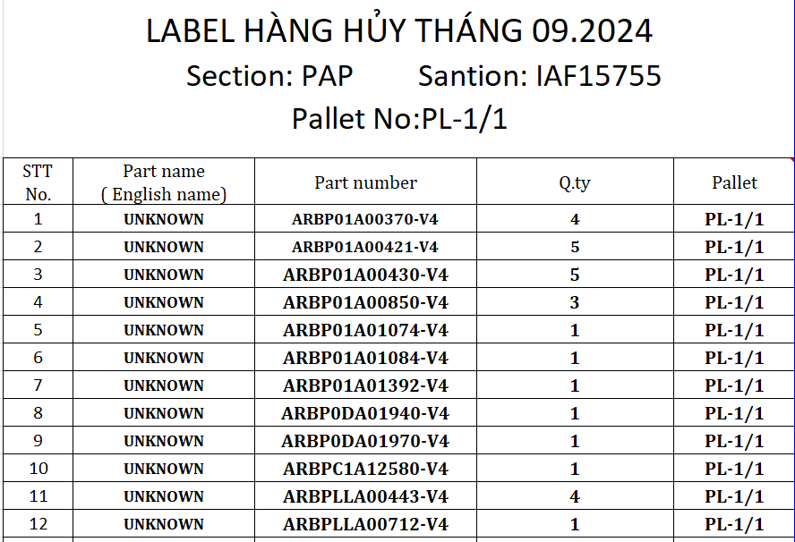
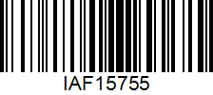




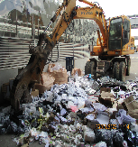
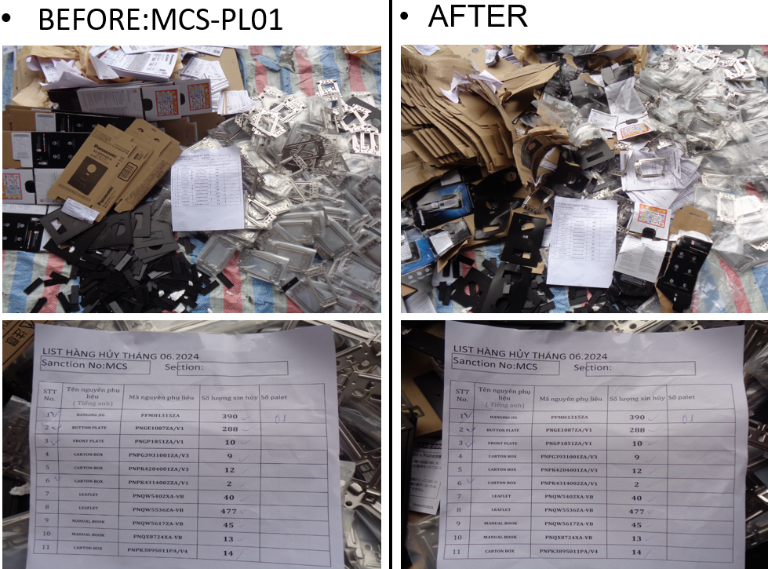
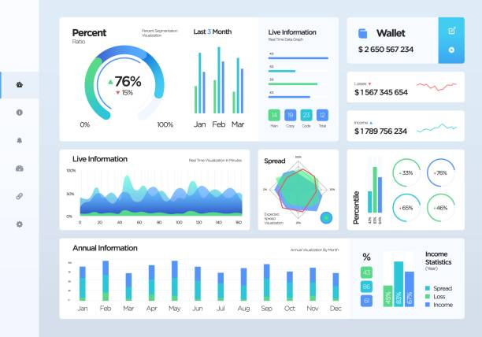

1
Plan
Note:
Improve
No change
2
Submit document
3
3
Re-arrange goods
4
Receive goods
Import data
Add Barcode
5
Scrap operation Notice
6
Verify customs data
Scrap System
7
Compare SAP
8
OK
NG
11
9
Approve data
10
Submit Customs
11
Process scrap
Scan the barcode created in step 3
Take photo before & after scrap
12
Transfer Waste
15
13
Issue out SAP
14
Customs Declaration
15
Follow
Report
Manage photos and attachments

Slide 2
QC EXPAND APPLY

