Slide 1
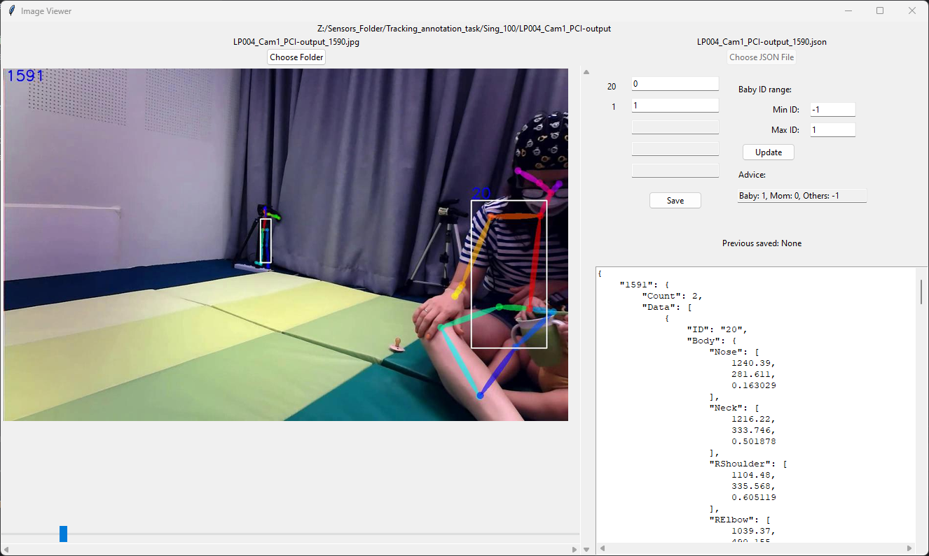
Current folder
START HERE
Current files
Is baby?
-
IDs of poses
Save to JSON
Name of previous JSON saved
JSON viewer
image viewer
image slider

