Slide 1
BINARY SEARCH TREE

Slide 2
01
BINARY SEARCH TREE DEFINITION
BST DEMO APLLICATION
02
TABLE OF CONTENTS
04
IMPLEMENTS IN PROGRAM
EXPLAIN SOME MAIN FUNCTIONS
03
CONCLUSION
05
SNEAK PEEK
06
Here you could describe the topic of the section

Slide 3
01
Binary search tree
Definition

Slide 4
Binary Search Tree is a node-based binary tree data structure which has the following properties:
-The left subtree of a node contains only nodes with keys lesser than the node’s key.
-The right subtree of a node contains only nodes with keys greater than the node’s key.
-The left and right subtree each must also be a binary search tree.

Slide 5
Basic Operations
Add
Search
Delete
Binary search tree
Pre-order Traversal
In-order Traversal
Post-order Traversal

Slide 6
02
Binary search tree demo application

Slide 7
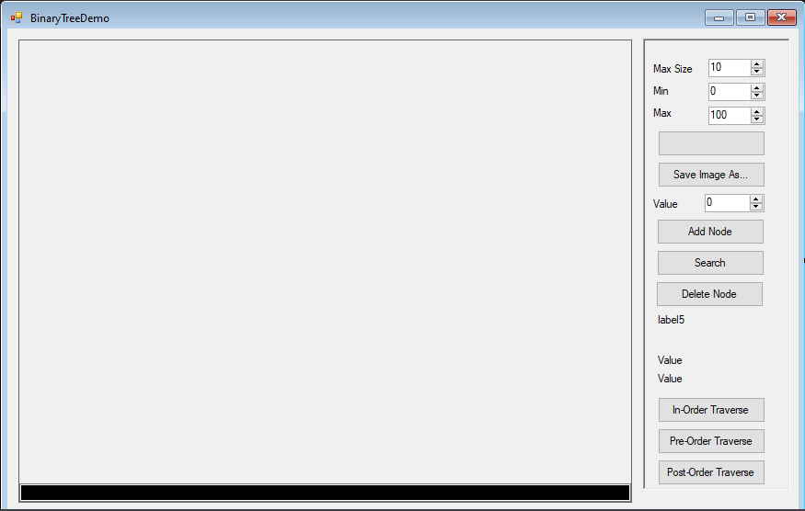
Design form
MERCURY

Slide 8
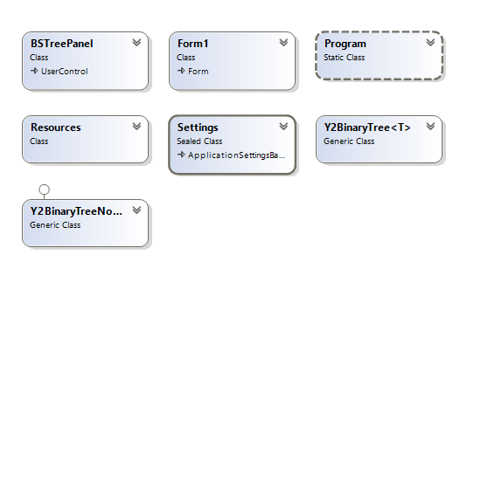
CLASS DIAGRAM

Slide 9
03
Explain some main functions

Slide 10
Pre-post traversal
A
B
C
D
E
F
G
Visit the root.
Traverse the left subtree
Traverse the right subtree

Slide 11
In-order traversal
A
B
C
D
E
F
G
Traverse the left subtree
Visit the root.
Traverse the right subtree

Slide 12
Post-order traversal
A
B
C
D
E
F
G
Traverse the left subtree
Traverse the right subtree
Visit the root.

Slide 13
04
Implements in program

Slide 14
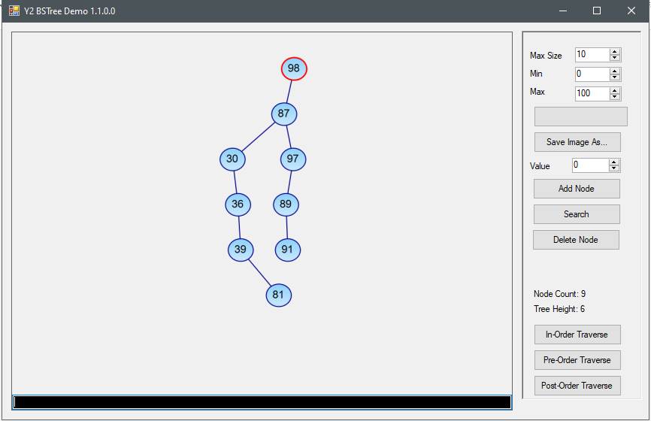
GENERATE RANDOM TREE

Slide 15
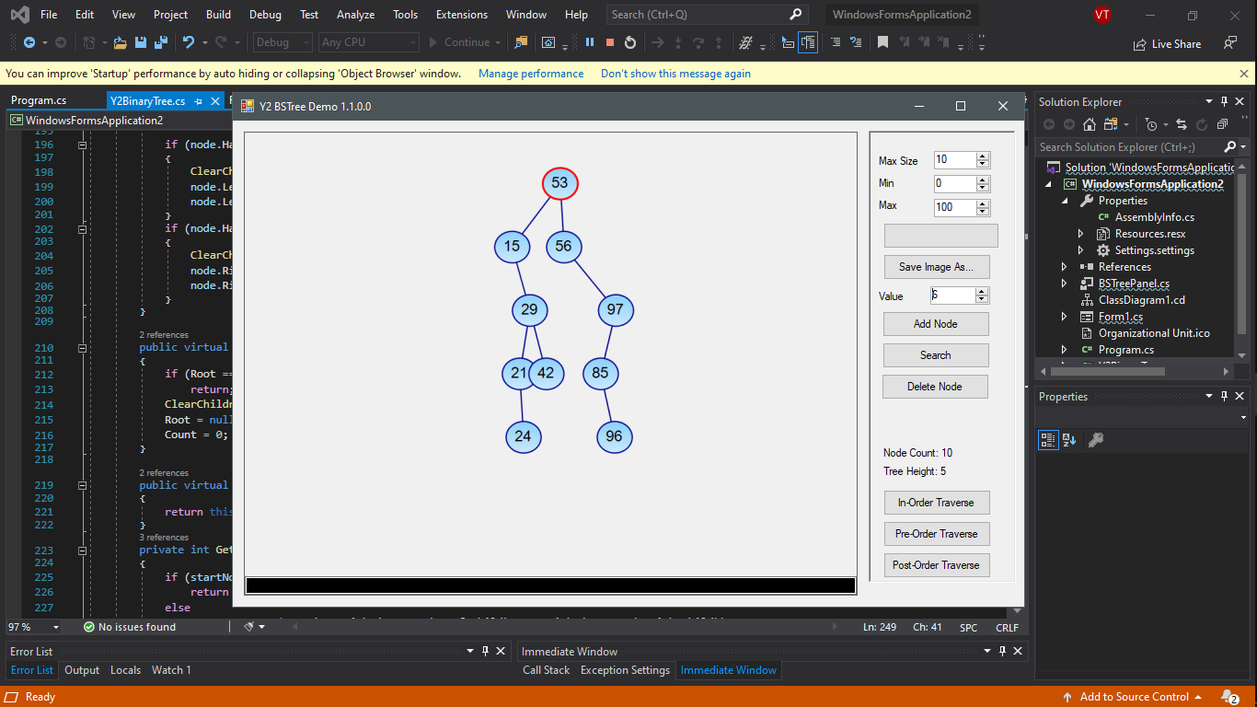
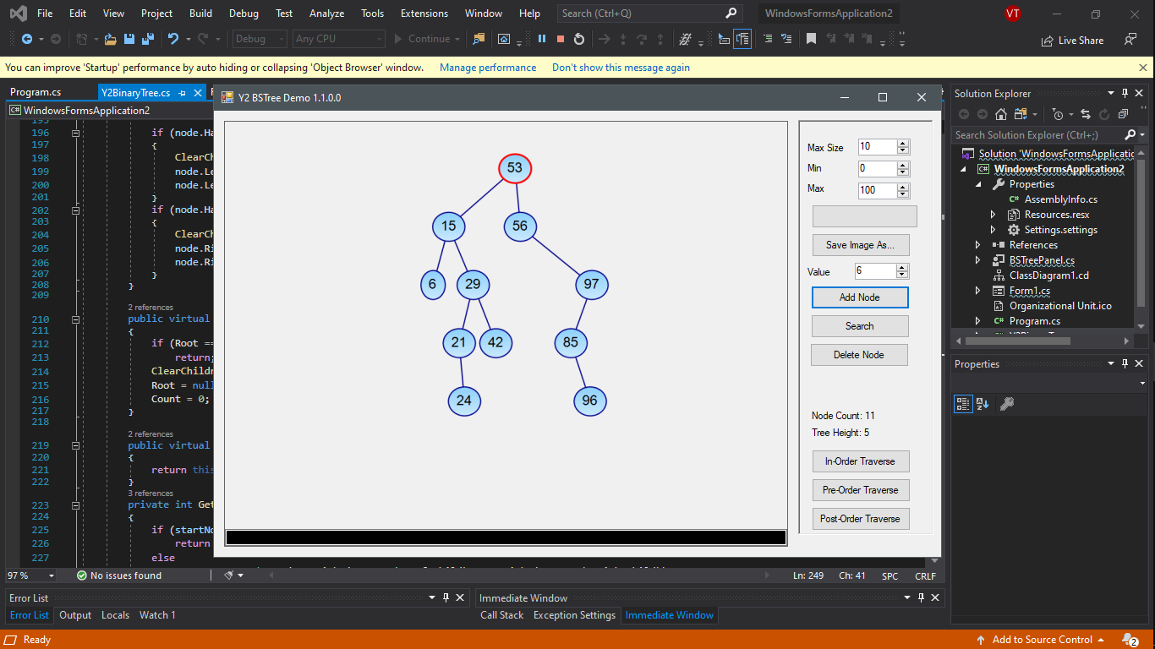
Add node
Before add a note 6 value
After add a note 6 value

Slide 16
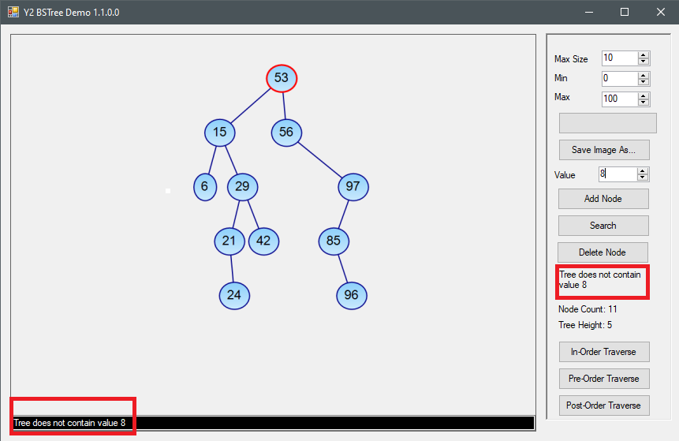
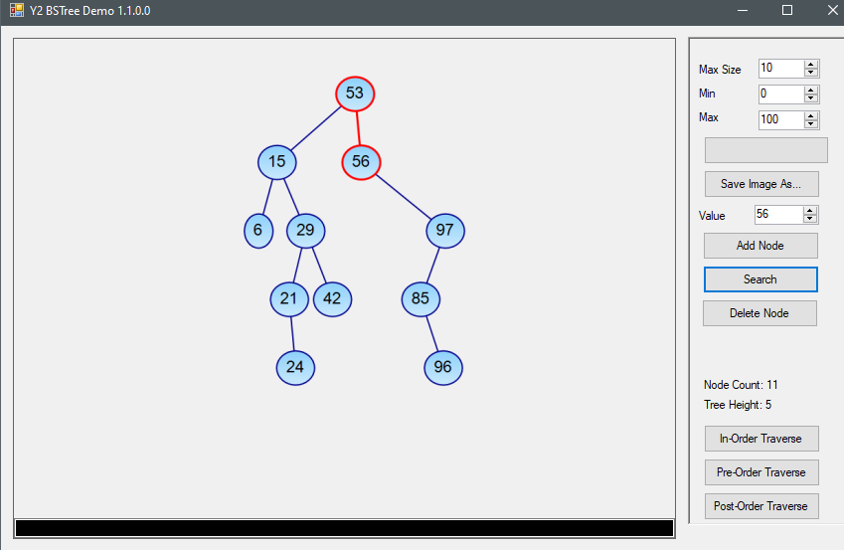
Search note
Result of searching a node 8 value
Result of searching a node 56 value

Slide 17

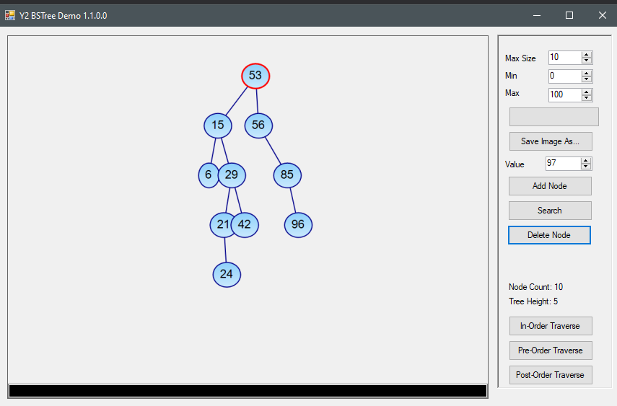
Delete node
Before deleting a node 97 value
After deleting a node 97 value

Slide 18
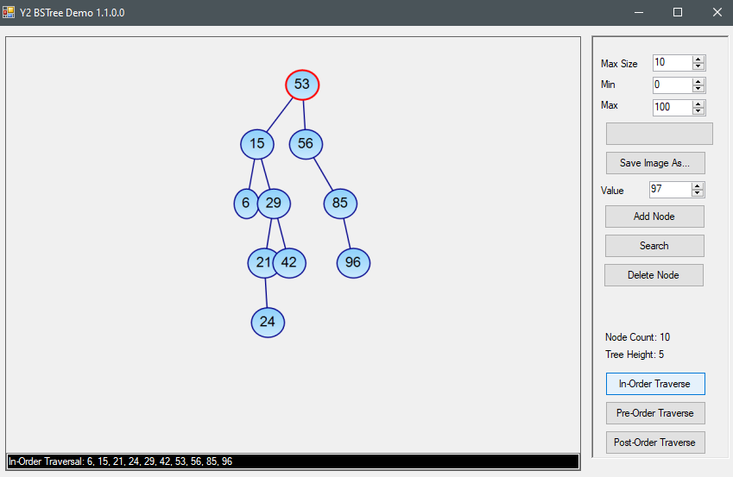
In-order traversal

Slide 19
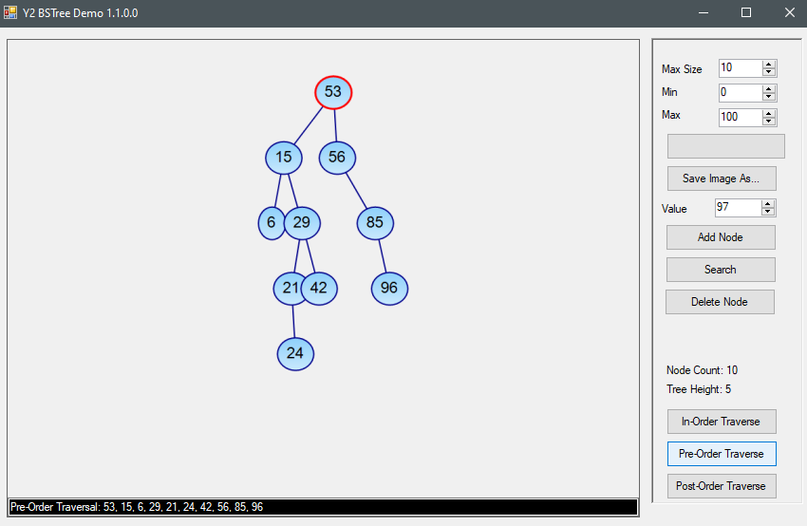
Pre-order traversal

Slide 20
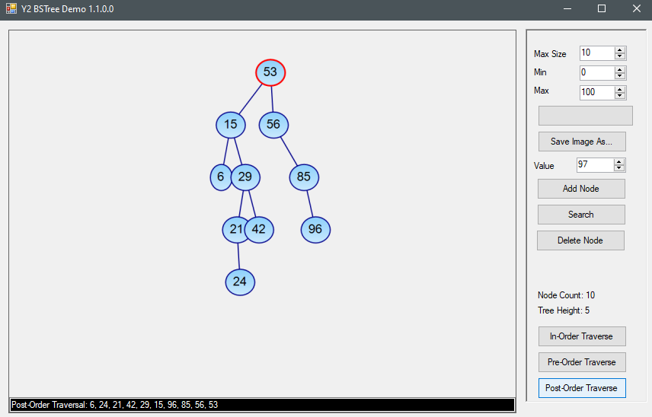
Post-order traversal

Slide 21
05
CONCLUSION

Slide 22
ADVANTAGES
The program runs stably, no errors or crashes occur during use.
Many useful features
2
4
1
3
5
The interface is neat, elegant and accessible.
Capacity quite light.
Do not heat the appliance.

Slide 23
DISADVANTAGES
1
Cannot open a tree from an image
.

Slide 24
THANKS

