Slide 1


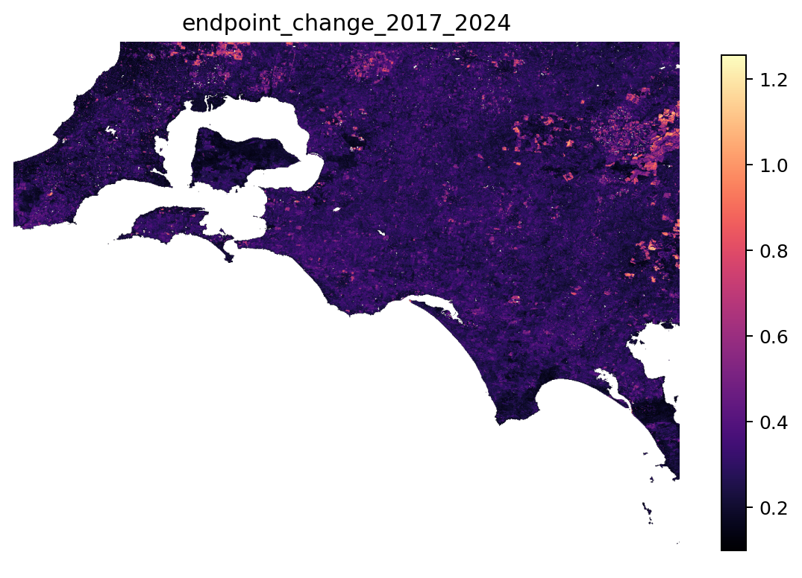
AusHabitat
AI-Powered Monitoring of Landscape Change
From AI-derived satellite signals to explorable land-cover and vegetation evidence
Bass Coast prototype · 2017–2024
CURRENT CHECKPOINT
Notes:
PURPOSE
Open with the project in one sentence: AusHabitat is a workflow that turns annual AI-derived satellite signals into locations people can investigate with land-cover, vegetation and map-based evidence.
HOW TO PRESENT
Introduce yourself as Paul Phan. Explain that the current demonstration covers the Bass Coast study rectangle from 2017 to 2024. Tell the audience that the presentation follows a simple journey: detect unusual landscape-signal change, describe how it unfolded, add independent context, and make the result explorable.
Set the interpretation boundary immediately: this is not an automated system that declares why a place changed. It is an evidence and prioritisation system that helps people find and inspect candidate changes consistently.
TRANSITION
Ask: why is a new workflow needed when satellite maps already exist?
SUGGESTED TIME: 45-60 seconds.
[Sources]
- Local: AusHabitat_Latex/fig8.png
- Local: bass-coast-change-map/public/assets/cnps-logo.jpeg

Slide 2
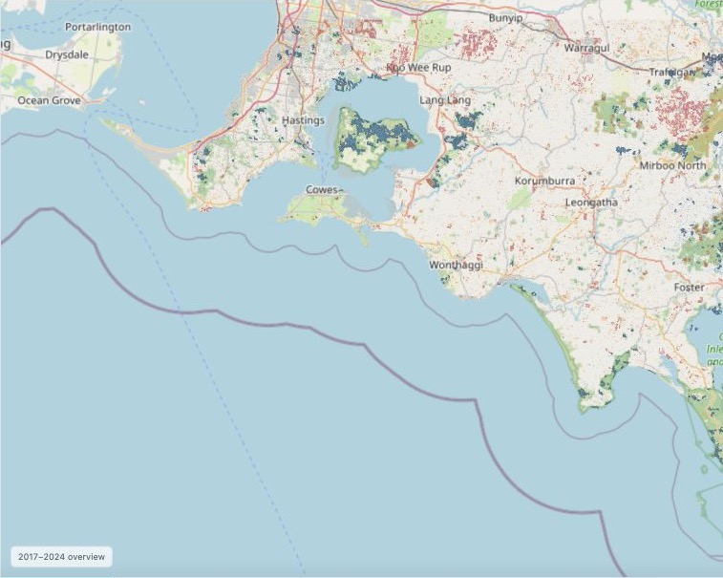
PROBLEM
Landscape change is continuous; evidence is fragmented
THE MONITORING CHALLENGE
Change may be abrupt, gradual, repeated or temporary.
The strongest signals are scattered across a very large map grid.
Detection alone does not explain the land-cover or vegetation context.
Manual review does not scale from Bass Coast to Australia.
The opportunity is to connect these separate clues into one repeatable evidence workflow.
02
Notes:
PURPOSE
Create the monitoring problem that the rest of the deck solves.
HOW TO PRESENT
Start with the map, then move to the four challenges. Landscape change is not one pattern: it can be abrupt, gradual, repeated, or temporary. Across a large map grid, the strongest signals are scattered and difficult to review manually. Even when a numerical method identifies a strong change, that number does not explain whether vegetation, land cover, or a built surface changed. Finally, a workflow that depends on manually checking every location cannot scale to Australia.
KEY TAKEAWAY
The problem is not simply detecting change. The problem is connecting detection, interpretation and communication in a repeatable workflow.
TRANSITION
The next slide explains why one type of map cannot answer all three needs.
SUGGESTED TIME: 60-75 seconds.
[Sources]
- Local: BassCoast_Phase9_Map_Data_Preparation_outputs
- Basemap: © OpenStreetMap contributors

Slide 3
MOTIVATION
A single map rarely explains both where and what changed
Traditional imagery
AI change signal
Context layers
Rich visual detail
But expensive to inspect consistently over years and large areas.
Highlights unusual landscape-signal change
But the 64 learned dimensions are not semantic labels.
Provides land-cover classes and vegetation direction
But may miss subtler structural or textural change.
AusHabitat combines them so that detection, interpretation and communication reinforce one another.
03
Notes:
PURPOSE
Explain why the project combines complementary evidence rather than searching for one perfect dataset.
HOW TO PRESENT
Walk from left to right. Traditional imagery is visually rich but expensive to compare consistently over many years. The AI embedding gives a sensitive numerical change signal, but its 64 dimensions do not have human-readable class names. Context layers such as DEA Land Cover and NDVI provide interpretable labels or vegetation direction, but they may not capture every structural or textural change that the embedding detects.
Do not describe one source as ground truth and the others as predictions. Each observes a different property of the landscape.
KEY TAKEAWAY
AusHabitat becomes useful by combining complementary clues while keeping their meanings separate.
TRANSITION
Those complementary roles lead directly to four practical questions.
SUGGESTED TIME: 75 seconds.
[Sources]
- Local project methodology and AusHabitat_Latex/main.tex

Slide 4
OVERARCHING AIM
Our aim: from change detection to interpretable evidence
1
2
3
4
DETECT
CHARACTERISE
CONTEXTUALISE
COMMUNICATE
Where is the landscape signal strongest?
How did the change unfold through time?
What independent evidence surrounds it?
Can people explore the result easily?
The supporting questions become the design of the pipeline.
04
Notes:
PURPOSE
State the overarching aim without turning the presentation into a formal hypothesis lecture.
HOW TO PRESENT
Read the four questions as a progression. First, detect where the landscape signal is strongest. Second, characterise whether the change was sudden, repeated, increasing or temporary. Third, contextualise it with independent land-cover and vegetation evidence. Fourth, communicate it through an interface that non-specialists can explore.
Explain that these questions became the architecture of the project. Every major output should answer one of them.
KEY TAKEAWAY
The project aim is not only to produce a hotspot map. It is to move from a difficult-to-interpret signal to an auditable evidence package.
TRANSITION
Before explaining the datasets, establish where and when the prototype was developed.
SUGGESTED TIME: 60 seconds.
[Sources]
- Local project design

Slide 5
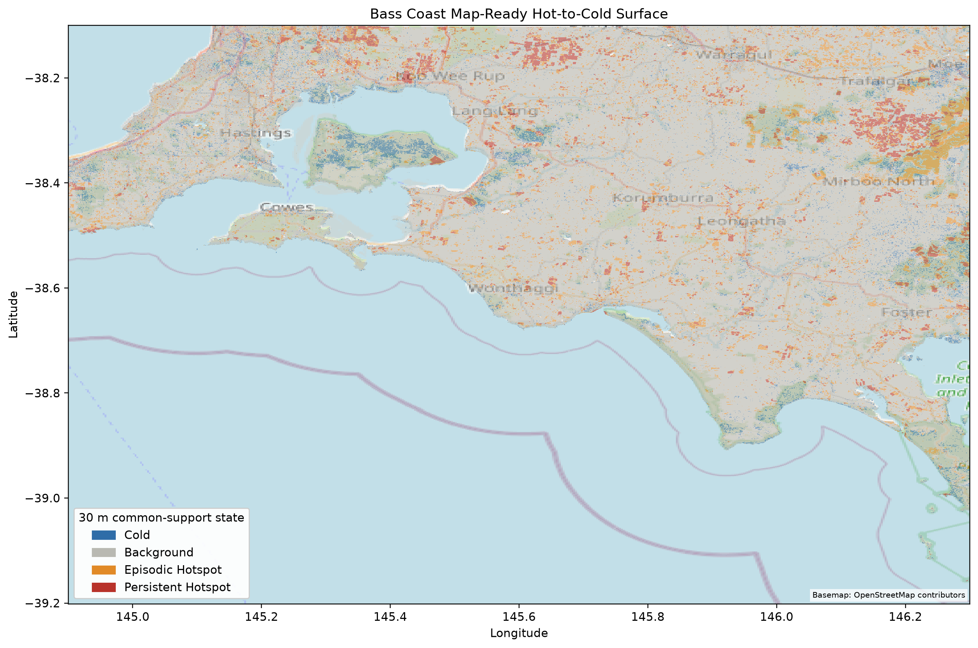
STUDY AREA
Bass Coast is the first proving ground
2017–2024
Eight annual landscape snapshots
10 m
Original embedding grid-cell size
Bass Coast
Case study with a pipeline designed to scale
The map already preserves hot, background and low-change evidence across the study area.
05
Notes:
PURPOSE
Ground the audience in the study area, period and spatial scale.
HOW TO PRESENT
Explain that Bass Coast is the proving ground, using a rectangular study extent that also reaches some surrounding areas. The analysis uses eight annual snapshots from 2017 through 2024. The original Google embedding grid has approximately 10 metre cells. Water was masked during the Earth Engine stage so that the analysis focuses on land.
Point out that the map already contains a range of low-change, episodic and persistent signals, making it useful for method development. Be clear that the current numerical results refer to this study extent, not all of Australia.
KEY TAKEAWAY
Bass Coast is a prototype scale, but the processing choices were designed with national expansion in mind.
TRANSITION
Now introduce the three evidence sources used over this landscape.
SUGGESTED TIME: 60-75 seconds.
[Sources]
- Local: BassCoast_Phase9_Map_Data_Preparation_outputs/figures/phase9_hot_cold_surface.png

Slide 6
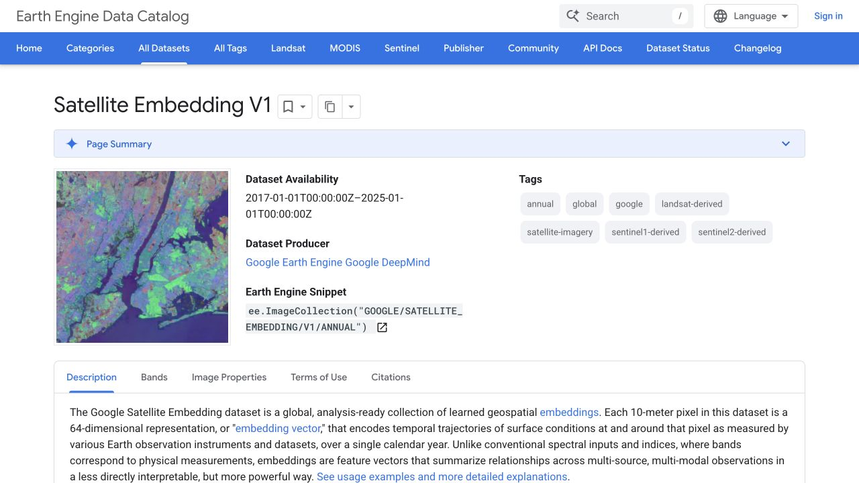
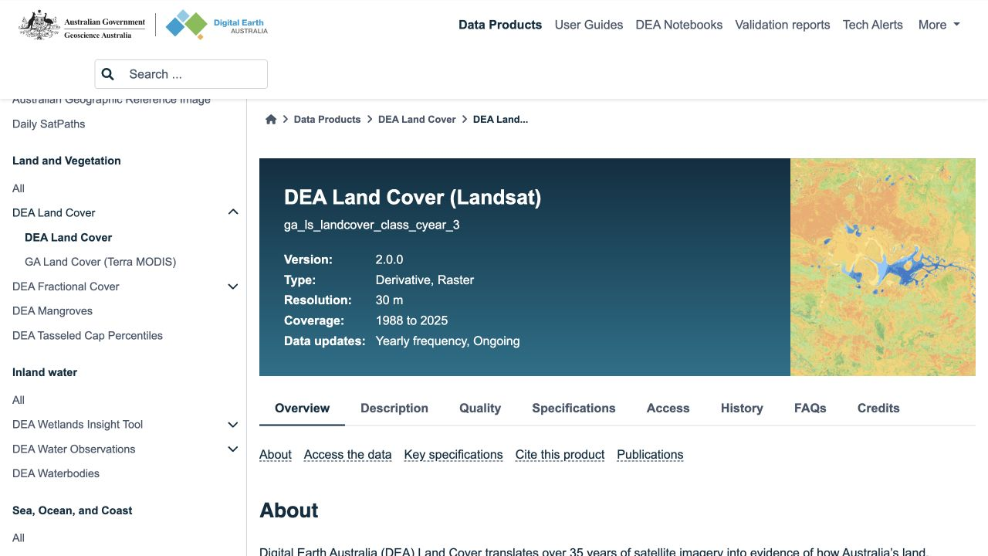
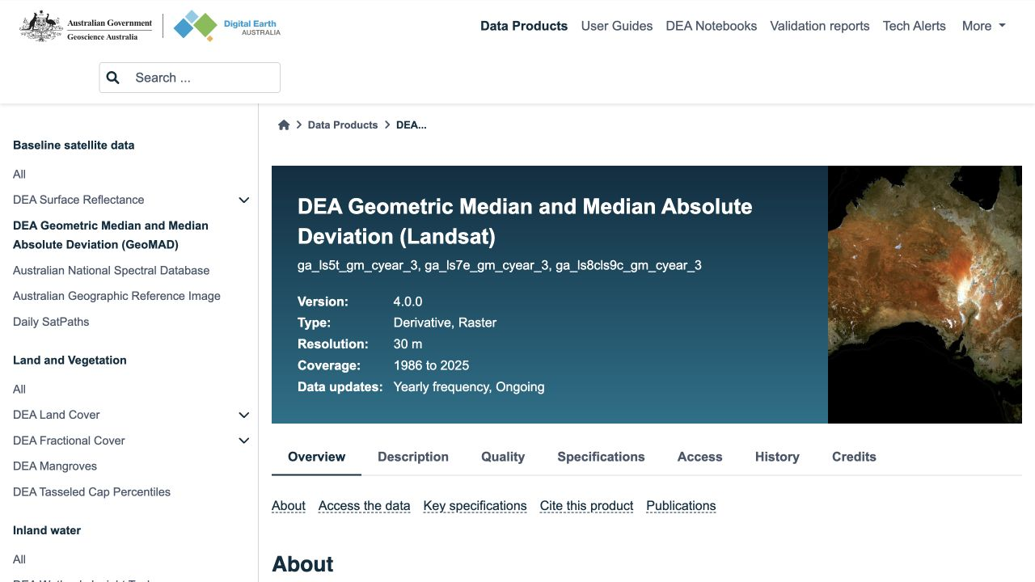
EVIDENCE STACK
Three datasets observe the same landscape differently
Google Satellite Embedding
DEA Land Cover
DEA GeoMAD NDVI
Where and how strongly did the encoded landscape signal change?
What broad land-cover classes and transitions were recorded?
Did vegetation become greener, browner or remain similar?
Detection
Land context
Vegetation response
06
Notes:
PURPOSE
Give the audience a simple mental model for the three datasets before discussing technical details.
HOW TO PRESENT
Use one question for each source. Google Satellite Embedding asks where and how strongly the encoded landscape signal changed. DEA Land Cover asks what broad land-cover classes and transitions were recorded. DEA GeoMAD NDVI asks whether the vegetation signal became greener, browner or stayed similar.
Stress the division of labour: embedding defines the change signal; DEA and NDVI provide supporting context. They are not merged into one accuracy score.
KEY TAKEAWAY
Detection, land context and vegetation response are separate but connected evidence layers.
TRANSITION
The next three slides explain each source in the same order.
SUGGESTED TIME: 75-90 seconds.
[Sources]
- https://developers.google.com/earth-engine/datasets/catalog/GOOGLE_SATELLITE_EMBEDDING_V1_ANNUAL
- https://knowledge.dea.ga.gov.au/data/product/dea-land-cover-landsat/
- https://knowledge.dea.ga.gov.au/data/product/dea-geometric-median-and-median-absolute-deviation-landsat/

Slide 7
DATASET 1
Annual embeddings make landscape signals comparable
One location, one year
[ 0.08, −0.12, 0.21, … , 0.04 ]
64 learned dimensions
10 m annual, analysis-ready representation
Built from multi-source Earth observation data
Consistent embedding space across years
All 64 values work together; individual axes have no simple label
Embedding:
A compact numerical vector that represents learned relationships in satellite observations.
07
Notes:
PURPOSE
Make a 64-dimensional satellite embedding understandable to a first-time audience.
HOW TO PRESENT
Point to the example vector and explain that one location in one year is represented by 64 decimal values. These are learned features derived from satellite observations; they are not random values, but individual dimensions do not have simple labels such as trees or buildings. The full vector works as a compact fingerprint of the observed landscape signal.
The important property is consistency: the vector at the same coordinate can be compared from one year to another. Avoid trying to interpret any individual number in the example.
KEY TAKEAWAY
The embedding is useful because annual landscape fingerprints are directly comparable, not because one dimension has a known physical meaning.
TRANSITION
The embedding finds magnitude; DEA supplies the human-readable land-cover vocabulary.
SUGGESTED TIME: 90 seconds.
[Sources]
- https://developers.google.com/earth-engine/datasets/catalog/GOOGLE_SATELLITE_EMBEDDING_V1_ANNUAL

Slide 8
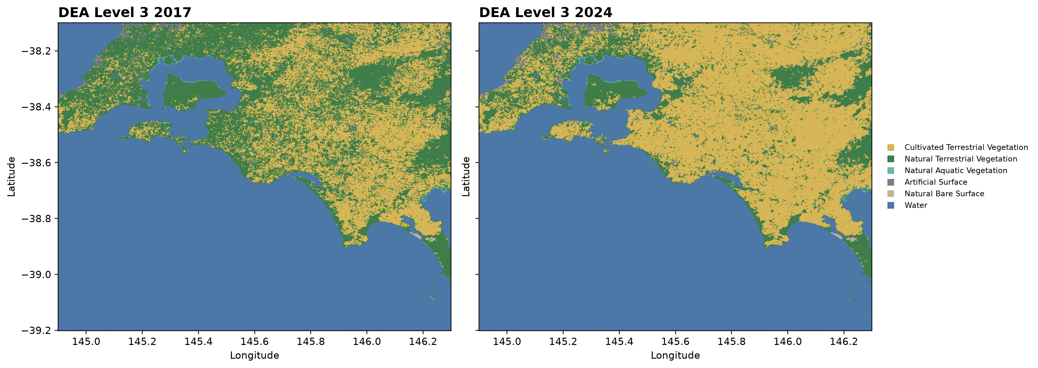
DATASET 2
DEA Land Cover adds categorical context
Level 3
Natural vegetation · cultivated vegetation · artificial surface · bare surface · water
Broad classes
Level 4
Woody or herbaceous vegetation; open or closed cover
More structural detail
DEA Land Cover:
Australia-wide annual land-cover classification derived from Landsat observations.
08
Notes:
PURPOSE
Explain DEA Land Cover Level 3 and Level 4 in plain language.
HOW TO PRESENT
Start with Level 3. It uses broad classes such as natural terrestrial vegetation, cultivated vegetation, artificial surface, bare surface and water. These broad classes are stable enough for summaries and transitions. Level 4 provides more structural detail, for example whether vegetation is woody or herbaceous and whether its cover is open or closed.
Use the 2017 and 2024 maps only to show that the same annual classification framework is available across the study area. Explain that DEA is an annual 30 metre Landsat-derived product for Australia.
INTERPRETATION BOUNDARY
DEA adds descriptive context. A class transition does not, by itself, prove the cause or quality of change.
TRANSITION
Land-cover classes describe what type of surface is dominant; NDVI adds vegetation direction.
SUGGESTED TIME: 90 seconds.
[Sources]
- https://knowledge.dea.ga.gov.au/data/product/dea-land-cover-landsat/
- Local: AusHabitat_Latex/fig12.png

Slide 9
DATASET 3
NDVI adds vegetation direction
NDVI = (NIR − Red) / (NIR + Red)
−1
0
+1
less vegetation signal
stronger greenness signal
Annual 30 m Landsat GeoMAD composite
Signed evidence: greening or browning
Complements an embedding distance that has magnitude but no ecological direction
NDVI:
A spectral index between −1 and +1 that indicates relative vegetation greenness.
09
Notes:
PURPOSE
Explain NDVI without letting the formula dominate the slide.
HOW TO PRESENT
Briefly say that NDVI compares near-infrared and red reflectance. Healthy green vegetation usually reflects more near-infrared light and absorbs more red light, producing a higher NDVI. Values range from minus one to plus one, but they should be interpreted relatively rather than as a universal label for every land-cover type.
The project calculates annual NDVI from the DEA GeoMAD Landsat composite. GeoMAD is a representative, largely cloud-free annual image, not one photograph taken on a single day. NDVI gives a signed direction: greening or browning. Euclidean embedding distance only gives magnitude.
KEY TAKEAWAY
NDVI complements the AI signal; it does not replace it and it is not a land-cover classification.
TRANSITION
With the three sources defined, show how they enter one pipeline.
SUGGESTED TIME: 90 seconds.
[Sources]
- https://knowledge.dea.ga.gov.au/data/product/dea-geometric-median-and-median-absolute-deviation-landsat/

Slide 10
APPROACH
One pipeline connects signals to usable evidence
01
02
03
Annual embeddings
Change rasters
Quality checks + sampling
GEE mosaics and land mask
Endpoint, annual and temporal metrics
Alignment, distributions and behavioural tests
06
05
04
AusHabitat
30 m regions
Evidence context
Interactive filters, histories and maps
Common support and connected areas
Annual DEA classes and NDVI
Each stage leaves an auditable output before the next begins.
10
Notes:
PURPOSE
Provide the roadmap for all remaining method and result slides.
HOW TO PRESENT
Follow the arrows. Annual embeddings and a land mask are prepared in Google Earth Engine. Change rasters are created from endpoint, annual and temporal metrics. Quality checks and sampling verify the data and test category logic. DEA and NDVI then add annual context. The evidence is aligned to a common 30 metre delivery grid and neighbouring cells become regions. AusHabitat exposes the final histories and filters.
Emphasise that each stage leaves an auditable output: rasters, tables, thresholds, region summaries or application data. This is not one opaque end-to-end model.
KEY TAKEAWAY
The pipeline progressively converts an AI signal into evidence people can inspect.
TRANSITION
Begin the method detail with the basic change calculation.
SUGGESTED TIME: 90 seconds.
[Sources]
- Local project pipeline

Slide 11
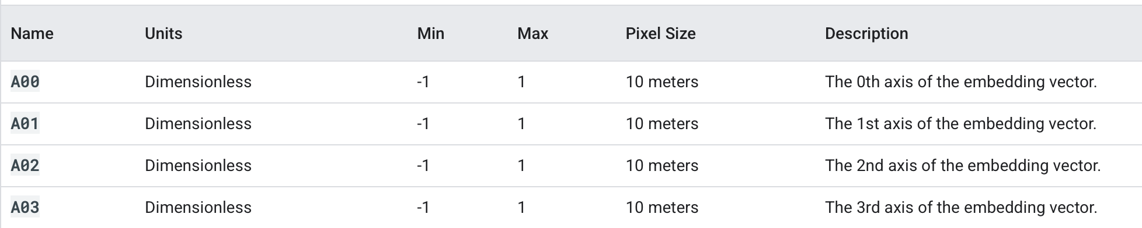
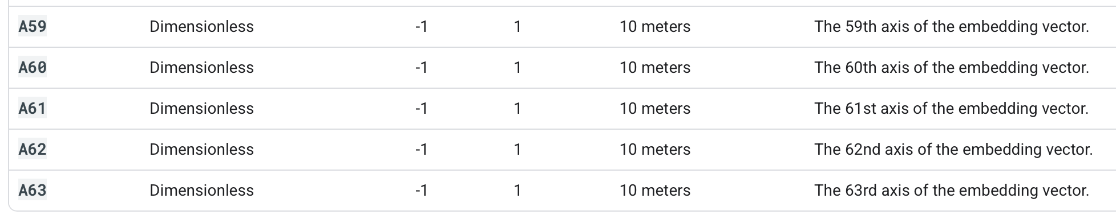
.
.
.
.

Slide 12
METHOD 1
Change begins as distance between annual vectors
2019
d = √Σ(aᵢ − bᵢ)²
2020
v₍₂₀₁₉₎ = [a₀, a₁, …, a₆₃]
v₍₂₀₂₀₎ = [b₀, b₁, …, b₆₃]
Larger distance = stronger change in the encoded landscape signal
Same coordinate
Same coordinate
Distance measures magnitude. It does not tell us whether the change is beneficial, harmful, or caused by a specific event.
Raster:
A geographic grid in which every cell stores a value; here, each location has annual embedding vectors and derived change metrics.
11
Notes:
PURPOSE
Explain exactly what the Euclidean-distance change score means.
HOW TO PRESENT
Point to the 2019 and 2020 vectors. They refer to the same coordinate in two years. Euclidean distance combines the differences across all 64 dimensions into one non-negative number. A larger value means the encoded landscape fingerprint moved further in embedding space.
You do not need to derive the equation line by line. Explain its role: it compresses a 64-dimensional comparison into one change-magnitude score. The annual comparisons use consecutive years, while endpoint change compares 2017 directly with 2024.
INTERPRETATION BOUNDARY
Distance has no ecological sign or cause. It cannot say beneficial, harmful, construction, clearing or restoration without supporting evidence.
TRANSITION
One distance tells how much; seven annual distances show how change unfolded.
SUGGESTED TIME: 90-120 seconds.
[Sources]
- https://developers.google.com/earth-engine/datasets/catalog/GOOGLE_SATELLITE_EMBEDDING_V1_ANNUAL
- Local: AusHabitat_Latex/main.tex

Slide 13
METHOD 1
Seven annual comparisons reveal how change unfolds
Persistence
How many annual distances cross the strong-change threshold?
Variance
Do a few years stand out, or are annual values similar?
Slope
Is change magnitude generally increasing or decreasing?
Maximum year
Illustrative annual sequence
Which annual interval contains the strongest signal?
12
Notes:
PURPOSE
Introduce the temporal metrics that distinguish one-off change from repeated or changing activity.
HOW TO PRESENT
Use the illustrative line from left to right. Persistence counts how many of the seven annual distances exceed the strong-change threshold; the intervals do not need to be consecutive. Variance measures how uneven the seven values are: high variance means some years stand out strongly. Slope is the fitted linear trend through the annual distances: positive means change magnitude generally increases, negative means it generally decreases. Maximum year records the interval with the highest distance.
Also mention cumulative change as the sum of all seven annual distances, although it is not shown in the four callouts.
KEY TAKEAWAY
The same endpoint distance can result from very different annual histories, so temporal metrics add necessary structure.
TRANSITION
Calculating these metrics over very large rasters required a memory-safe workflow.
SUGGESTED TIME: 2 minutes.
[Sources]
- Local: AusHabitat_Latex/main.tex

Slide 14
METHOD 2
Large maps were processed safely, one block at a time
Map processed in small blocks
24 / 24
89,707
Expected rasters loaded and aligned
Stratified sampled points
CRS, transform, dimensions and shape checked against a reference raster
Statistics calculated block by block instead of loading full rasters
Up to 10,000 points sampled within each behavioural category
Fixed random seed made category comparisons reproducible
Read → summarise → release memory → continue
Raster window:
A smaller rectangular block read from a raster so that the entire map can be processed without exhausting memory.
13
Notes:
PURPOSE
Explain the practical processing strategy and why sampling was introduced.
HOW TO PRESENT
Explain the small highlighted block. Instead of loading an entire raster into memory, the code reads one block, calculates summaries, releases it and continues. This still covers the whole raster; windowing is not sampling. The quality check confirmed that all 24 expected rasters shared the same coordinate reference system, transform, dimensions and shape.
Then explain sampling separately. Up to 10,000 points were selected within each of nine behavioural categories using a fixed random seed, producing 89,707 sampled rows. This balanced table was useful for testing methods and detailed point histories.
INTERPRETATION BOUNDARY
Because the sample was stratified by category, it is not a direct estimate of Bass Coast area proportions.
TRANSITION
The next slide shows what those behavioural categories mean.
SUGGESTED TIME: 2 minutes.
[Sources]
- Local: BassCoast_Phase1_Raster_Inspection_outputs
- Local: BassCoast_Phase2_Pixel_Sampling_outputs

Slide 15
METHOD 2
Behavioural categories describe patterns, not causes
Mostly stable
Sudden candidate
Repeated change
Variable / recovery
Low endpoint, no persistent hotspot
One large event, low persistence
Several strong periods
Large swings; lower endpoint
These are temporal archetypes used to organise evidence. They do not automatically mean urbanisation, degradation, agriculture or restoration.
Illustrative sequences
14
Notes:
PURPOSE
Make the rule-based behavioural categories intuitive and prevent causal over-interpretation.
HOW TO PRESENT
Use the four miniature trajectories as archetypes. Mostly stable stays low. A sudden candidate has one large spike but low persistence. Repeated change contains several strong annual periods. Variable or recovery candidates have large swings but a smaller endpoint difference, suggesting that the final state may be closer to the starting state than the intermediate years were.
Explain that the full analysis used nine potentially overlapping categories, including endpoint hotspot, high variance, positive and negative slope, persistence thresholds, sudden candidates and stable controls. A pixel can satisfy more than one rule.
INTERPRETATION BOUNDARY
These labels describe the numerical trajectory. They do not automatically mean urbanisation, degradation, agriculture or restoration.
TRANSITION
Coordinates allow these abstract trajectories to be connected to annual external evidence.
SUGGESTED TIME: 90 seconds.
[Sources]
- Local: BassCoast_Phase2_Pixel_Sampling_outputs
- Local: AusHabitat_Latex/main.tex

Slide 16
METHOD 3
Coordinates connect signals to annual evidence histories
Annual evidence sequence
LATITUDE + LONGITUDE
17
18
19
20
21
22
23
24
REGION SUMMARY
Land-cover transition
Vegetation direction
First change year
Annual history
−38.30, 146.17
.71
.70
.59
.61
.64
.68
.70
.72
same location each year
DEA Level 3
Natural
Cultivated
NDVI values
Illustrative sequence
15
Notes:
PURPOSE
Explain how latitude and longitude connect embedding signals to annual DEA and NDVI histories.
HOW TO PRESENT
Start at the coordinate and move right. The same location is queried or aligned for each year. The coloured sequence represents annual DEA Level 3 classes, while the decimal sequence represents annual NDVI. From these histories, the pipeline derives a broad land-cover transition, vegetation direction, first class-change year and a complete annual record.
Clarify that early exploratory work sampled individual coordinates. The wall-to-wall implementation later used aligned rasters and region summaries, which is more efficient than making millions of separate remote requests.
KEY TAKEAWAY
Coordinates are the join key that connects three independent annual evidence streams.
TRANSITION
Before the evidence can be compared spatially, the 10 metre and 30 metre grids must be reconciled.
SUGGESTED TIME: 90 seconds.
[Sources]
- Local: phase3_dea_landcover_pipeline.py
- Local: phase10_wall_to_wall_context.py

Slide 17
METHOD 4
A common 30 m grid aligns the evidence
Original embedding cells
ALIGNED CONTEXT
0.21
0.24
0.26
COMMON SUPPORT
→
→
Embedding
same grid cell
0.18
0.48
0.52
≈ 30 m
DEA
same grid cell
Mean distance
Hot-cell share
Max persistence
0.16
0.44
0.50
NDVI
same grid cell
3 × 3 cells at 10 m
The original 10 m rasters remain authoritative. The 30 m layer is a common comparison and delivery grid.
16
Notes:
PURPOSE
Resolve the 10 metre embedding versus 30 metre DEA and NDVI scale difference.
HOW TO PRESENT
Explain that a 30 metre context cell covers approximately a 3 by 3 group of 10 metre embedding cells. The project creates a common-support layer that summarises the nine smaller cells using metrics appropriate to the question: mean change distance, the share classified as hot, and maximum persistence.
Be explicit that the original 10 metre rasters are preserved and remain authoritative. The 30 metre grid is an additional comparison and delivery layer; it does not pretend that the embedding was originally measured at 30 metres.
Mention the sensitivity result if asked: the 3 by 3 mean produced essentially the same NDVI association as direct 10 metre point sampling, supporting the alignment choice.
TRANSITION
The common grid is then converted from millions of cells into usable landscape regions.
SUGGESTED TIME: 2 minutes.
[Sources]
- Local: BassCoast_Phase9_Map_Data_Preparation_outputs
- Local: bass-coast-change-map/docs/DATA_BOUNDARIES.md

Slide 18
METHOD 4
Neighbouring cells become interactive landscape regions
30 m change-state cells
CLICKABLE SUMMARY
CONNECTED REGION
Area
Repeated-change share
Strong endpoint share
Annual change series
DEA history
NDVI history
→
One region boundary
→
Area shares retain mixed behaviour inside the region
touching hot cells
Cells are grouped by touching hot/cold state, not by identical annual histories. The region summary preserves that internal variation.
17
Notes:
PURPOSE
Explain why the application displays connected regions instead of millions of individual squares.
HOW TO PRESENT
Begin with the grid. Cells that touch and have the same broad hot or cold state are connected into one region boundary. They do not need identical annual histories. That internal diversity is retained through area shares, such as repeated-change coverage and strong endpoint coverage, plus annual mean change, DEA history and NDVI history.
Explain the trade-off. Grouping greatly reduces rendering and interaction load and presents a landscape feature rather than many adjacent squares. The representative coordinate is less specific than a single 10 metre pixel, but the underlying raster values are not discarded.
KEY TAKEAWAY
Regions are a delivery and interpretation unit, not a claim that every cell behaved identically.
TRANSITION
Before showing aggregate results, examine one real hotspot from end to end.
SUGGESTED TIME: 90-120 seconds.
[Sources]
- Local: BassCoast_Phase9_Map_Data_Preparation_outputs
- Local: bass-coast-change-map/docs/DATA_BOUNDARIES.md

Slide 19
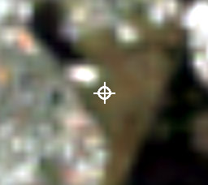
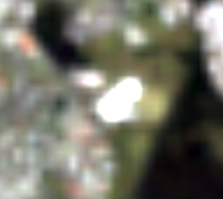
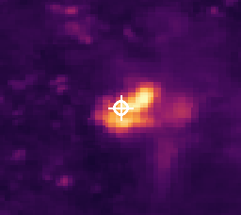
ILLUSTRATIVE CASE
A Wonthaggi hotspot shows the full evidence chain
2017 satellite composite
2024 satellite composite
Embedding endpoint change
Annual AI embedding distance
DEA GeoMAD annual Landsat composites; the white crosshair marks the same coordinate
1.086
2 of 7
Natural → Artificial
0.637 → 0.184
2017–2024 endpoint distance
strong-change intervals
DEA broad class by 2019
annual NDVI, 2017 to 2024
Visible surface change, AI signal, DEA transition and vegetation decline tell a coherent story at this location.
Near McKenzie Street, Wonthaggi. One case demonstrates coherence, not system-wide accuracy.
18
Notes:
PURPOSE
Give the audience one concrete example linking visible change, the embedding signal, DEA Land Cover and NDVI.
HOW TO PRESENT
Locate the white crosshair in all three images. The 2017 and 2024 panels are annual DEA GeoMAD true-colour composites for the same approximately 960 metre extent near McKenzie Street, Wonthaggi. The 2024 image contains a bright artificial feature that was not present in 2017. The third image is the 10 metre 2017-to-2024 endpoint-change raster; brighter colours mean larger embedding distance, and the crosshair lies inside the bright hotspot.
Now read the annual chart. The annual embedding distance exceeded the 0.45 threshold in 2017-2018 and 2018-2019, peaking at 0.834 for 2018-2019. DEA changed from natural vegetation in 2017 to cultivated vegetation in 2018 and artificial surface in 2019, then remained artificial. NDVI fell from 0.637 in 2017 to 0.184 in 2024. Endpoint distance was 1.086.
INTERPRETATION
For this one location, the timing and direction of the independent evidence are coherent with the AI change signal. Present it as an illustrative case, not as proof that every hotspot is correct or that the system identified the exact cause.
TRANSITION
The case study shows one location; the next slides test whether the broader mapped distributions behave sensibly.
SUGGESTED TIME: 2-3 minutes.
[Sources]
- https://knowledge.dea.ga.gov.au/data/product/dea-geometric-median-and-median-absolute-deviation-landsat/
- https://data.dea.ga.gov.au/derivative/ga_ls8cls9c_gm_cyear_3/4-0-0/x58/y27/2017--P1Y/ga_ls8cls9c_gm_cyear_3_x58y27_2017--P1Y_final_nbart_red.tif
- https://data.dea.ga.gov.au/derivative/ga_ls8cls9c_gm_cyear_3/4-0-0/x58/y27/2024--P1Y/ga_ls8cls9c_gm_cyear_3_x58y27_2024--P1Y_final_nbart_red.tif
- Local: GEE_BassCoast_Data/basscoast_endpoint_change_2017_2024.tif
- Local: BassCoast_Phase8_NDVI_Pilot_outputs/basscoast_phase8_annual_ndvi.csv
- Local: merged Phase 3 DEA-enriched review output, review_id 562
- https://nominatim.openstreetmap.org/

Slide 20
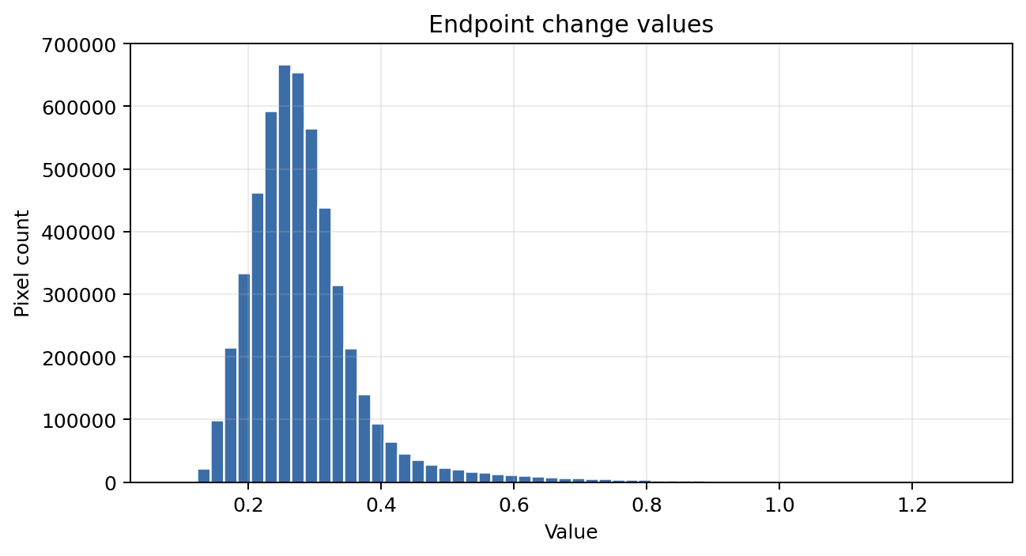
RESULT 1
A small upper tail carries the strongest change
Most pixels
Small upper tail
low to moderate change
strongest landscape-signal change
The right-skewed distribution supports percentile-based hotspot screening.
19
Notes:
PURPOSE
Show why percentile-based endpoint hotspot screening is appropriate.
HOW TO PRESENT
The map shows the 2017-to-2024 endpoint distance across the study area. The histogram shows the same values as a distribution. Most pixels are concentrated at low to moderate change, while a small right-hand tail contains much larger values.
Explain that the endpoint hotspot threshold uses the 95th percentile, approximately 0.445 in the sampling workflow. This selects the strongest 5 percent of valid endpoint-change values relative to this study area. It is not a universal physical threshold for all places and years.
KEY TAKEAWAY
Strong endpoint change is uncommon and spatially concentrated, so percentile screening provides a defensible prioritisation rule.
TRANSITION
Endpoint magnitude alone cannot distinguish repeated change, so the next result examines persistence.
SUGGESTED TIME: 90 seconds.
[Sources]
- Local: AusHabitat_Latex/fig8.png
- Local: AusHabitat_Latex/fig9.png
- Local: BassCoast_Phase2_Pixel_Sampling_outputs/tables/phase2_thresholds.csv

Slide 21
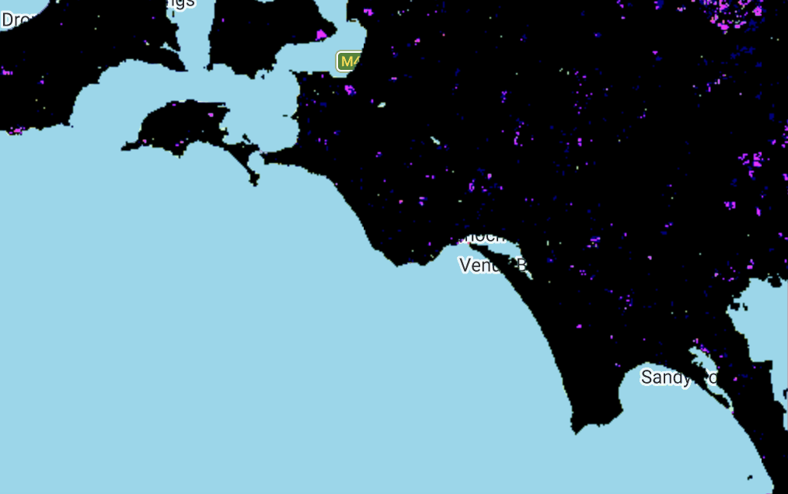
RESULT 2
Repeated change is spatially concentrated
334 km²
Long-term hotspot area
146 km²
Strong change in at least two annual intervals
57 km²
Strong change in at least three annual intervals
As repetition criteria tighten, the footprint shrinks sharply.
20
Notes:
PURPOSE
Show how persistence sharply narrows the footprint of repeated strong change.
HOW TO PRESENT
Define persistence again: the number of annual intervals above the fixed 0.45 strong-change threshold. The intervals do not need to be consecutive. In the initial threshold configuration, the long-term endpoint hotspot covered about 334 square kilometres. Requiring at least two strong annual intervals reduced the footprint to about 146 square kilometres; requiring at least three reduced it to about 57 square kilometres.
Explain what this means operationally. Persistence is a prioritisation tool: it separates one-off start-to-end differences from locations that repeatedly produced strong annual signals.
INTERPRETATION BOUNDARY
Repeated signal does not automatically mean continuous degradation or continuous construction. It only records repeated threshold exceedance.
TRANSITION
The sampled trajectories show why persistence changes the interpretation of similar endpoint scores.
SUGGESTED TIME: 90 seconds.
[Sources]
- Local: AusHabitat_Latex/fig2.png
- Local: AusHabitat_Latex/main.tex

Slide 22
RESULT 3
Embedding-change groups show more DEA class changes
75%
Positive-slope pixels with a DEA broad-class change
versus
30%
Stable controls with a DEA broad-class change
Agreement / enrichment
not model accuracy
22
Notes:
PURPOSE
Explain the strongest DEA enrichment result without calling it model accuracy.
HOW TO PRESENT
Define the calculation carefully. Within each embedding-defined category, a pixel is counted as DEA changed when its 2017-to-2024 Level 3 sequence contains at least one class change. The percentage is the changed count divided by all complete pixels in that category.
Positive-slope and persistent groups show DEA broad-class change rates around 75 and 74 percent, compared with about 30 percent for stable controls. This means change-oriented embedding categories are enriched for independent land-cover change relative to the control group.
INTERPRETATION BOUNDARY
This is not 75 percent embedding accuracy. DEA and the embedding measure different properties, and DEA is not treated as perfect ground truth.
TRANSITION
The result was first observed in the sample, then checked across the complete mapped raster.
SUGGESTED TIME: 2 minutes.
[Sources]
- Local: BassCoast_Phase5_WallToWall_DEA_Summary_outputs/basscoast_phase5_wall_to_wall_category_summary.csv

Slide 23
RESULT 4
The sample and full-area analysis tell the same story
Why sample first?
Faster method testing
Balanced category comparison
Detailed point histories
Fixed-seed reproducibility
Wall-to-wall processing then confirmed the category-level relationship across the full raster stack.
Wall-to-wall:
Processing the complete mapped raster extent rather than estimating area-wide patterns from a sample.
23
Notes:
PURPOSE
Justify the sample-first development strategy and distinguish it from full-area processing.
HOW TO PRESENT
The paired bars compare the 89,707-point stratified sample with the wall-to-wall category summary. The category-level DEA changed shares are very close. Explain why sampling came first: it allowed faster debugging, balanced category comparison, detailed histories and reproducibility. The complete raster analysis then checked that the same category-level relationship appeared across the mapped extent.
INTERPRETATION BOUNDARY
Do not say the sample represented every Bass Coast pixel by area. It was intentionally balanced across behavioural categories. The wall-to-wall run, not the sample, supports complete-area summaries.
KEY TAKEAWAY
Sampling was an efficient method-development step, and full-area processing confirmed that its main comparative result was not a sample artefact.
TRANSITION
DEA adds categorical context; NDVI provides an independent vegetation comparison.
SUGGESTED TIME: 90 seconds.
[Sources]
- Local: AusHabitat_Latex/fig14.png
- Local: BassCoast_Phase5_WallToWall_DEA_Summary_outputs

Slide 24
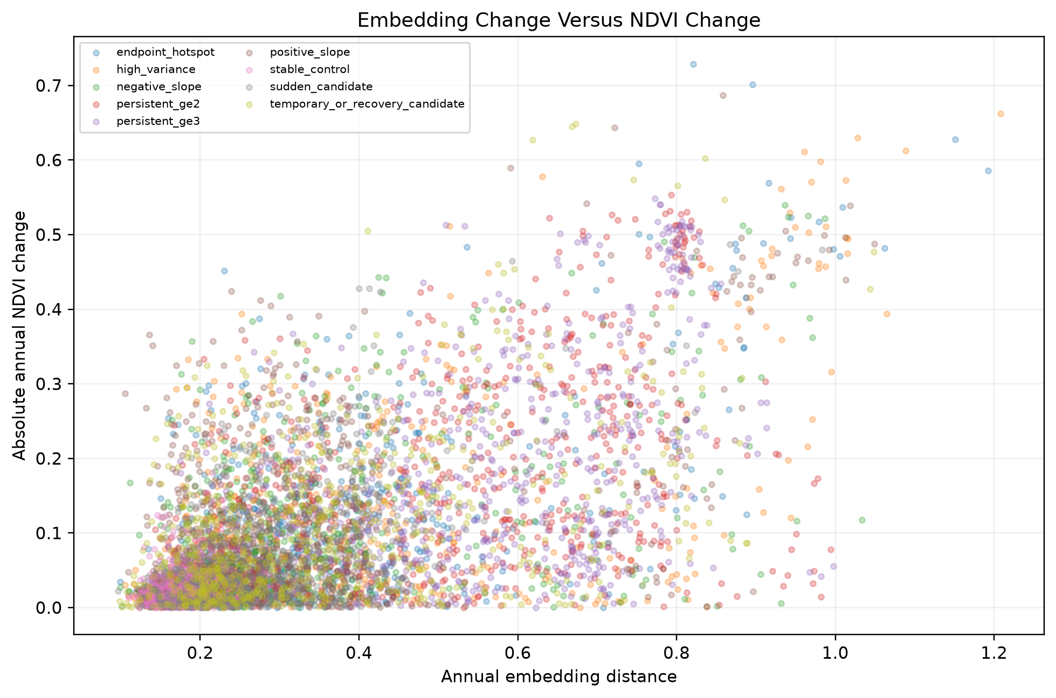
RESULT 5
NDVI adds vegetation context to the embedding signal
0.574
Overall Spearman association
78.1%
Embedding-hotspot intervals also showed a substantial NDVI change
64.4%
Maximum-change timing agreed within one year
Moderate agreement is useful: embeddings respond to more than greenness alone.
24
Notes:
PURPOSE
Present the NDVI comparison as complementary agreement, not a failed attempt at perfect correlation.
HOW TO PRESENT
Spearman correlation of 0.574 means locations with larger embedding changes generally tend to have larger absolute NDVI changes, but the relationship is only moderate. Of 1,563 embedding-hotspot intervals in the 900-point pilot, 1,221, or 78.1 percent, also exceeded the substantial-NDVI-change threshold. The year of maximum embedding change and maximum NDVI change was within one year for 64.4 percent of points.
Explain why perfect agreement is not expected. NDVI responds specifically to vegetation greenness. The embedding can also respond to built surfaces, texture, structure and other non-vegetation changes.
KEY TAKEAWAY
Moderate agreement supports the vegetation relevance of many embedding signals while confirming that the embedding contains broader information than NDVI alone.
TRANSITION
After the pilot, DEA and NDVI context were produced for every interactive region.
SUGGESTED TIME: 2 minutes.
[Sources]
- Local: BassCoast_Phase8_NDVI_Pilot_outputs/basscoast_phase8_ndvi_pilot_report.md
- Local: BassCoast_Phase8_NDVI_Pilot_outputs/figures/phase8_embedding_vs_ndvi_scatter.png

Slide 25
RESULT 6
Wall-to-wall analysis powers the interactive map
191.2M
83.0M
Original raster positions
Valid endpoint values
13,477
307
Interactive change regions
Low-change reference regions
110,272
Region-year context records
Eight annual DEA and NDVI records for every mapped region
Positions include land, water and no-data cells; they are not annual observations.
25
Notes:
PURPOSE
Clarify the scale of the wall-to-wall data and how millions of cells became application-ready records.
HOW TO PRESENT
Separate the denominators. The original raster rectangle contains about 191.2 million grid positions, including land, water and no-data positions. About 83.0 million positions have finite endpoint embedding values after masking and coverage effects. These are spatial positions, not the number of annual records.
For the application, the common-support surface was grouped into 13,477 change regions and 307 low-change reference regions. With eight annual DEA and NDVI records per region, the context table contains 110,272 region-year records.
KEY TAKEAWAY
The wall-to-wall step created complete map coverage, while region grouping produced a dataset small enough for interactive delivery.
TRANSITION
The next slide shows what users can now do with those records.
SUGGESTED TIME: 2 minutes.
[Sources]
- Local: BassCoast_Phase9_Map_Data_Preparation_outputs/basscoast_phase9_map_data_report.md
- Local: BassCoast_Phase10_WallToWall_Context_outputs/basscoast_phase10_report.md

Slide 26
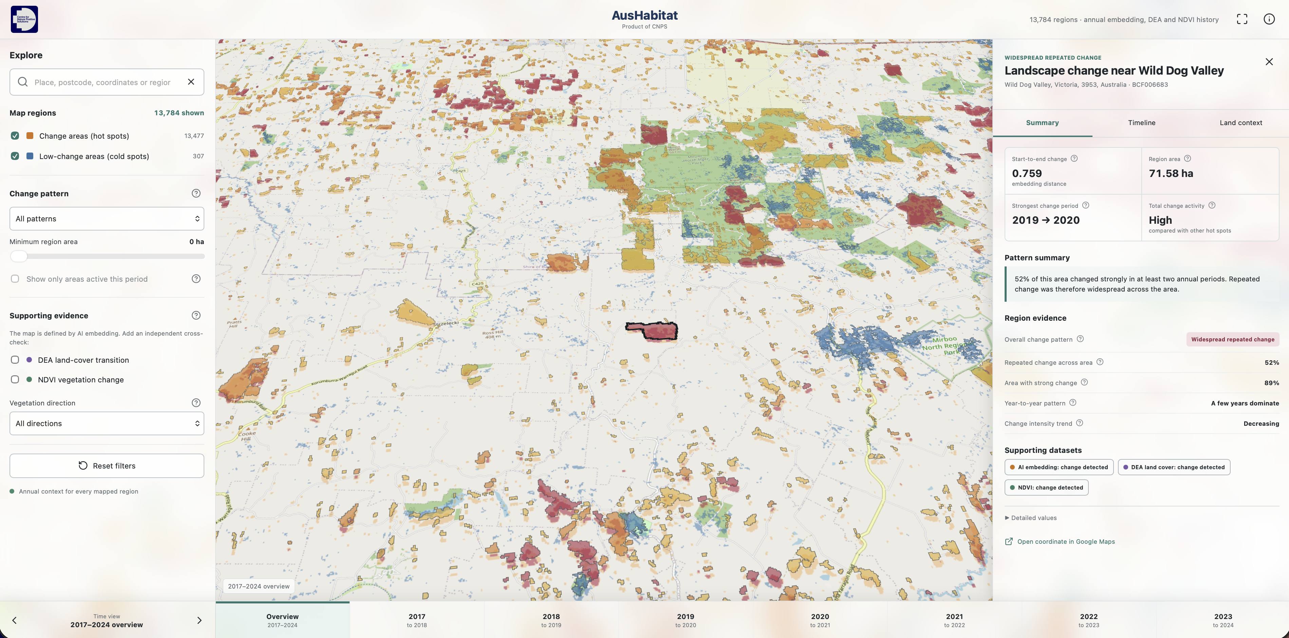

CURRENT PRODUCT
AusHabitat makes the evidence explorable
SCAN FOR LIVE MAP
Search locations
Filter hot and cold regions
Change the annual period
Inspect DEA and NDVI histories
https://thieulong.github.io/SatelliteEmbeddingV1-SpatialAnalysis/
26
Notes:
PURPOSE
Demonstrate the current product and give the audience an opportunity to explore it.
HOW TO PRESENT
Invite the audience to scan the QR code. Explain the interface before starting the live demonstration: the left panel searches and filters hot and low-change regions; the bottom timeline changes the annual interval; the right panel explains a selected region; the Timeline and Land context tabs show annual embedding, DEA and NDVI histories.
Recommended live sequence: reset to Bass Coast; toggle change and low-change regions; select 2018-to-2019; filter for DEA transition or NDVI change; search for region BCF006263; open Summary, Timeline and Land context. Remind the audience that the map is embedding-defined and DEA/NDVI are supporting filters.
FALLBACK
If the network is slow, narrate the screenshot rather than waiting. Keep the demonstration under five minutes.
TRANSITION
After the demonstration, summarise what the current milestone establishes.
SUGGESTED TIME: 4-5 minutes.
[Sources]
- https://thieulong.github.io/SatelliteEmbeddingV1-SpatialAnalysis/
- Basemap: © OpenStreetMap contributors

Slide 27
SYNTHESIS
What this milestone establishes
01
SCALABLE DETECTION
Annual embeddings can identify and characterise strong landscape-signal change across a large raster stack.
02
INDEPENDENT CONTEXT
DEA Land Cover and NDVI add annual categorical and vegetation evidence at every mapped region.
03
USABLE COMMUNICATION
The evidence is packaged into an interactive map that supports search, filtering and historical inspection.
Current boundary: evidence for investigation, not automated causal attribution.
27
Notes:
PURPOSE
Resolve the opening problem with three concrete achievements.
HOW TO PRESENT
First, scalable detection: annual embeddings identify and characterise strong landscape-signal change across a large raster stack. Second, independent context: DEA Land Cover and NDVI add annual categorical and vegetation evidence for every mapped region. Third, usable communication: the evidence is packaged into an interactive map supporting search, filters and historical inspection.
Pause on the boundary at the bottom. The current system supports investigation and prioritisation. It does not automatically attribute ecological cause, benefit or harm.
KEY TAKEAWAY
The milestone is an end-to-end, auditable prototype from AI signal to explorable evidence.
TRANSITION
Close by explaining what must change to move from a Bass Coast prototype to a national service.
SUGGESTED TIME: 90 seconds.
[Sources]
- Local project outputs and public prototype

Slide 28
FUTURE WORK
Next: from Bass Coast prototype to national service
BASS COAST
AUSTRALIA
Working prototype
Cloud delivery
National pipeline
→
Tiled rasters and vector services for heavy load
Automated processing across regions and years
Annual evidence
Interactive regions
Public web map
Accessible products
Richer intelligence
Mobile experience and inclusive interaction
More evidence layers and predictive modelling
The prototype demonstrates the product idea; the next phase is production engineering and national-scale delivery.
28
Notes:
PURPOSE
Close with a credible future direction rather than an unbounded feature list.
HOW TO PRESENT
Start on the left: the current prototype already provides annual evidence, interactive regions and a public web map. The next phase is production engineering. Cloud delivery would use tiled raster and vector services so users do not download all data at once. A national pipeline would automate processing by region and year. Accessible products could include mobile and inclusive interfaces. Richer intelligence could add carefully validated evidence layers and predictive modelling.
Be clear that national scaling requires infrastructure, monitoring, validation and governance; it is not simply a larger map extent.
CLOSING LINE
AusHabitat demonstrates that AI-derived change can be transformed into a transparent evidence workflow that people can inspect, question and eventually scale.
TRANSITION
Move to the closing slide, thank the audience, and invite questions. Keep the three appendix slides available if a technical question arises.
SUGGESTED TIME: 90 seconds.
[Sources]
- Local: bass-coast-change-map/README.md

Slide 29

AUSHABITAT
EXPLORE THE LIVE MAP
Thank you for listening
Questions & discussion
AusHabitat turns annual AI-derived change signals into evidence people can inspect, question and explore.
Scan to open AusHabitat
thieulong.github.io/
SatelliteEmbeddingV1-SpatialAnalysis/
AusHabitat · Bass Coast prototype
29
Notes:
PURPOSE
Close cleanly, reinforce the project in one sentence and create a natural pause for discussion.
HOW TO PRESENT
Thank the audience and pause. Restate the central message: AusHabitat turns annual AI-derived change signals into transparent, inspectable landscape evidence. Invite questions and discussion rather than advancing automatically into the appendix.
Mention that the QR code opens the live Bass Coast prototype. The appendix remains available for questions about metric definitions, thresholds and interpretation boundaries.
SUGGESTED CLOSING LINE
Thank you for listening. I welcome your questions, and you can scan the QR code to explore the current AusHabitat prototype.
SUGGESTED TIME: 30-45 seconds.
[Sources]
- https://thieulong.github.io/SatelliteEmbeddingV1-SpatialAnalysis/
- Local: bass-coast-change-map/public/assets/cnps-logo.jpeg

Slide 30
REFERENCE
Appendix: metric glossary
Endpoint change
Direct embedding distance between the first and last year.
Variance
How uneven the seven annual change values are.
Annual change
Embedding distance between consecutive years.
Slope
Linear trend in annual change magnitude through time.
Cumulative change
Sum of all seven annual distances.
First hotspot year
First interval ending above the annual threshold.
Persistence
Number of annual intervals above the strong-change threshold.
Maximum change year
End year of the strongest annual interval.
30
Notes:
PURPOSE
Use only when the audience asks for precise definitions of the temporal metrics.
HOW TO PRESENT
Endpoint change compares the first and last annual embedding vectors. Annual change compares consecutive years. Cumulative change sums all seven annual distances. Persistence counts threshold exceedances. Variance describes unevenness, slope describes the linear trend, first hotspot year records the first exceedance, and maximum change year records the strongest interval.
Do not present the full glossary during the main talk unless the audience needs it.
[Sources]
- Local: AusHabitat_Latex/main.tex

Slide 31
REFERENCE
Appendix: evidence thresholds
Rule
Threshold
Interpretation
Annual embedding hotspot
distance > 0.45
Fixed strong-change threshold used for persistence.
Endpoint hotspot
endpoint distance ≥ p95 (~0.445)
Top 5% of start-to-end change values.
High variance
variance ≥ p95 (~0.00843)
Most uneven annual trajectories.
Positive / negative slope
top or bottom 5%
Strongest upward or downward change-magnitude trends.
NDVI pilot event
|annual ΔNDVI| ≥ 0.0758
p95 among sampled stable-control intervals.
Application NDVI evidence
|annual ΔNDVI| ≥ 0.0527
p95 among all 307 low-change reference regions.
Pilot and application NDVI thresholds differ because their reference populations differ.
31
Notes:
PURPOSE
Answer questions about thresholds and show that every evidence flag has an explicit rule.
HOW TO PRESENT
Separate fixed and percentile thresholds. Annual embedding hotspots use the fixed 0.45 threshold. Endpoint hotspots and high variance use the upper 5 percent of their study-area distributions. Positive and negative slope categories use the top and bottom 5 percent. The NDVI pilot and application thresholds differ because they use different reference populations: sampled stable-control intervals versus all low-change application regions.
Emphasise that percentile thresholds are relative screening rules and may need recalibration for a new study area or national deployment.
[Sources]
- Local: BassCoast_Phase2_Pixel_Sampling_outputs/tables/phase2_thresholds.csv
- Local: BassCoast_Phase8_NDVI_Pilot_outputs
- Local: BassCoast_Phase10_WallToWall_Context_outputs

Slide 32
REFERENCE
Interpretation boundaries
What it supports
What it does not prove
Embedding distance
Magnitude of encoded change
Ecological improvement, decline or cause
DEA changed share
Independent land-cover agreement / enrichment
Embedding accuracy
NDVI
Vegetation greenness direction
Complete land-cover classification
30 m common grid
Comparable integration and delivery layer
Replacement of the original 10 m rasters
Behavioural category
Rule-based temporal archetype
Definitive ecological process
32
Notes:
PURPOSE
Protect the project from overclaiming during questions and discussion.
HOW TO PRESENT
Read across any row relevant to the question. Embedding distance supports change magnitude, not ecological cause. DEA changed share supports independent land-cover enrichment, not embedding accuracy. NDVI supports greenness direction, not full land-cover classification. The 30 metre grid supports comparable integration and delivery, not replacement of original 10 metre rasters. Behavioural categories support rule-based temporal archetypes, not definitive ecological processes.
Use this slide to answer confidently: the workflow is valuable because it keeps these evidence boundaries explicit.
[Sources]
- Local: AusHabitat_Latex/main.tex
- Local: bass-coast-change-map/docs/DATA_BOUNDARIES.md

