Slide 1
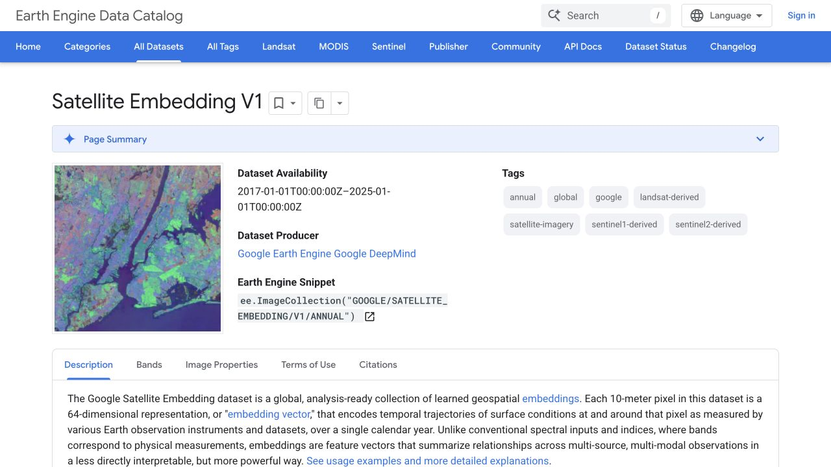
METHOD · OBSERVE
Every 10 m cell becomes an annual landscape fingerprint
One location · one year
[ 0.08, −0.12, 0.21, … , 0.04 ]
64-number landscape fingerprint
The model summarises what it sees in each 10 m cell.
The same cell has a comparable fingerprint each year.
All 64 numbers work together to describe the satellite signal.
We compare fingerprints; individual numbers are not land-cover labels.
Fingerprint:
A compact numerical summary of the satellite signal at one mapped location and one year.
01
Notes:
Purpose: establish the basic unit of the workflow without beginning with equations.
Start with the image on the left: Google provides an annual Satellite Embedding layer. It divides the landscape into 10 metre cells.
At every cell and year, the model stores 64 numbers. Together, those numbers are a learned fingerprint of the satellite-observed landscape signal.
The individual dimensions are not labels such as forest, road or house. Their value is that the full 64-number fingerprint is comparable across space and time.
Key line to say: every place gets one comparable annual fingerprint, so the same place can be tracked through time.
Transition: the next slide shows how two fingerprints become a change score.
[Sources]
- Google Earth Engine Data Catalog, Satellite Embedding V1 Annual: https://developers.google.com/earth-engine/datasets/catalog/GOOGLE_SATELLITE_EMBEDDING_V1_ANNUAL
- Local asset: .tmp/aushabitat_presentation/assets/google_satellite_embedding_catalog.png

Slide 2
METHOD · COMPARE
Comparing the same cell each year creates a change history
2017
CHANGE SCORE
2018
[ 64-number fingerprint ]
[ 64-number fingerprint ]
A larger distance means a stronger change in the encoded landscape signal.
Same mapped location
Same mapped location
Repeat this for seven year-to-year intervals to reveal when change happened — not only how different 2017 and 2024 were.
02
Notes:
Purpose: explain Euclidean distance as a visual comparison, not as a mathematical lecture.
Point to the two boxes. They represent the same coordinate in two consecutive years. Each contains a 64-number fingerprint.
We calculate the straight-line distance between those two fingerprints in the 64-dimensional embedding space. This is Euclidean distance.
A small distance means the encoded satellite signal stayed similar. A large distance means it changed more strongly.
We repeat the calculation for 2017 to 2018, 2018 to 2019, and so on through 2023 to 2024. That gives seven annual change values per cell.
Important limitation: distance measures magnitude only. It does not say whether change was good or bad, nor what caused it.
Transition: once we have seven values, the pattern of that sequence becomes informative.
[Sources]
- Google Satellite Embedding documentation and project implementation: https://developers.google.com/earth-engine/datasets/catalog/GOOGLE_SATELLITE_EMBEDDING_V1_ANNUAL
- Local project methodology: AusHabitat_Latex/main.tex

Slide 3
METHOD · DESCRIBE
The shape of the annual signal shows how change unfolded
Repeated strong change
In how many annual periods was the signal unusually strong?
Year-to-year variation
Was change steady, or concentrated in only a few years?
Change trend
Did annual change intensity generally rise or fall over time?
Strongest period
Illustrative annual change history
Which year-to-year interval contained the largest signal?
03
Notes:
Purpose: turn the seven-number history into four questions a client can understand.
Repeated strong change is the persistence count: how many of the seven annual distances crossed the fixed strong-change threshold of 0.45.
Year-to-year variation is variance. Low variance means the annual scores are relatively similar; high variance means some years stand out strongly from the others.
Change trend is the slope of a straight line fitted through the seven annual scores. A positive slope means change intensity generally increased; a negative slope means it generally declined.
Strongest period is simply the interval with the maximum annual change score.
These are behavioural descriptions. They characterise timing and intensity, but they do not identify a real-world cause by themselves.
Transition: the next slide introduces independent land-cover and vegetation evidence to help interpret the signal.
[Sources]
- Local project methodology and thresholds: AusHabitat_Latex/main.tex
- Local raster outputs: GEE_BassCoast_Data/

Slide 4
METHOD · ADD CONTEXT
Independent evidence helps explain what the AI signal may represent
AI change signal at 10 m
THREE COMPLEMENTARY VIEWS
0.21
0.24
0.26
COMMON COMPARISON AREA
→
→
AI embedding
where & how strongly
0.18
0.48
0.52
≈ 30 m
DEA Land Cover
what broad class
Average AI change
Share of hot cells
Repeated-change evidence
0.16
0.44
0.50
NDVI
greener or browner
3 × 3 original cells
The original 10 m evidence is preserved. The 30 m layer provides a shared area for fair comparison with DEA and NDVI.
04
Notes:
Purpose: show that the external datasets complement the AI signal rather than replacing it.
The embedding evidence begins at 10 metre resolution. DEA Land Cover and the annual DEA GeoMAD data used for NDVI are approximately 30 metres.
For comparison, nine 10 metre embedding cells are summarised into the corresponding 30 metre area. We retain useful statistics such as mean change, hot-cell share and repeated-change evidence.
DEA Land Cover supplies broad and detailed annual land-cover classes. NDVI supplies an annual vegetation-greenness value from minus one to one.
The three sources answer different questions: AI indicates where and how strongly the encoded landscape changed; DEA describes broad land-cover context; NDVI indicates vegetation direction.
The 30 metre alignment does not erase the original 10 metre raster. The web layer is an aligned summary designed for comparison and interaction.
[Sources]
- DEA Land Cover: https://knowledge.dea.ga.gov.au/data/product/dea-land-cover-landsat/
- DEA GeoMAD: https://knowledge.dea.ga.gov.au/data/product/dea-geometric-median-and-median-absolute-deviation-landsat/
- Local implementation and outputs: phase3_dea_landcover_pipeline.py and BassCoast_Phase8_NDVI_Pilot_outputs/

Slide 5
METHOD · PREPARE THE MAP
Touching changed cells become one practical map region
Neighbouring 30 m change cells
WHAT A USER CAN INSPECT
ONE REGION TO INVESTIGATE
Location and area
Strongest change period
Annual AI history
Land-cover history
Vegetation history
→
One connected boundary
→
Percentages preserve variation inside the region
cells that touch
Grouping reduces map clutter without discarding the cell evidence. Cells are joined when they touch and share the same hot- or low-change state.
05
Notes:
Purpose: explain why the application shows regions instead of millions of small squares.
After alignment to 30 metre cells, neighbouring cells are connected when they touch and have the same map state: change region or low-change reference.
This is a connected-components grouping step. It produces one boundary that corresponds more closely to a practical landscape area than a collection of tiny squares.
Cells inside a region do not need identical annual histories. The region preserves variation using measures such as the share of area showing repeated change or strong endpoint change.
The trade-off is that the region boundary is a communication and interaction layer, not a claim that every square metre inside behaved identically.
Transition: the Wonthaggi case shows how the separate evidence sources read together at one location.
[Sources]
- Local map-preparation implementation and outputs: BassCoast_Phase9_Map_Data_Preparation_outputs/
- Local web application: bass-coast-change-map/

Slide 6
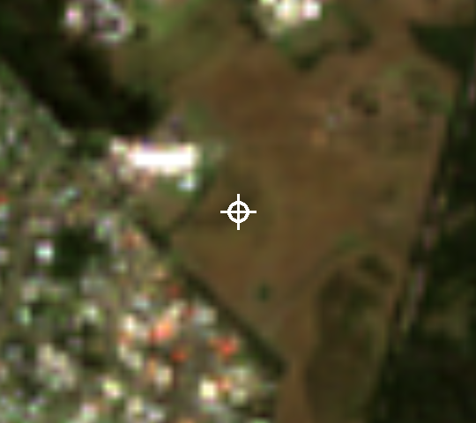
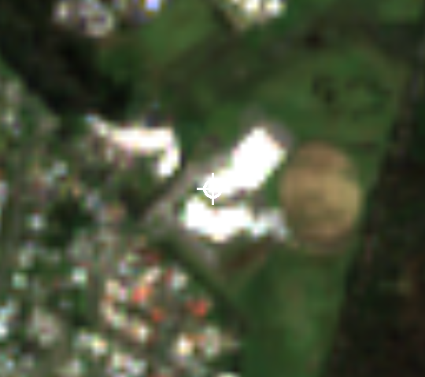
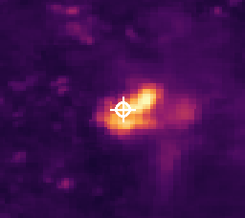
RESULT · WONTHAGGI CASE
At Wonthaggi, independent evidence aligns with the AI signal
9 Mar 2017 · Sentinel-2 (10 m)
3 Oct 2024 · Sentinel-2 (10 m)
AI start-to-end change map
Annual AI change score
Same 640 m area; the white crosshair marks the same coordinate in both public Sentinel-2 scenes
1.086
2 of 7
Natural → Artificial
0.637 → 0.184
2017–2024 AI distance
strong-change periods
DEA broad class by 2019
annual NDVI, 2017 to 2024
Visible construction, a Natural → Artificial transition and vegetation decline align with the AI hotspot at this location.
Near McKenzie Street, Wonthaggi. One case shows evidence coherence, not system-wide model accuracy.
06
Notes:
Purpose: provide a concrete, visually legible example of the complete evidence chain.
The two left images are public, date-specific Sentinel-2 Level-2A true-colour scenes at 10 metre resolution. They show the same 640 metre area and exact crosshair coordinate on 9 March 2017 and 3 October 2024.
The visible surface changes substantially between the dates. The AI endpoint distance at this location is 1.086, and two of the seven annual intervals crossed the strong-change threshold.
DEA Land Cover changed from Natural to Artificial by 2019. Annual NDVI fell from 0.637 in 2017 to 0.184 in 2024, which is consistent with a loss of vegetation greenness.
The sources are independent and are not expected to match perfectly. Here, however, the visible image, embedding signal, land-cover transition and NDVI direction tell a coherent story.
If asked about the broader result: in the sampled comparison, approximately 75 percent of positive-slope pixels showed at least one DEA broad-class change, compared with about 30 percent of stable controls. That is enrichment or agreement evidence, not an accuracy score.
Do not imply that the 2025 Sentinel image was part of the quantitative analysis. The current analytical period ends in 2024.
[Sources]
- Sentinel-2 Cloud-Optimized GeoTIFF open data: https://registry.opendata.aws/sentinel-2-l2a-cogs/
- Element84 Earth Search STAC: https://earth-search.aws.element84.com/v1
- 2017 scene: S2A_55HCT_20170309_0_L2A, captured 2017-03-09
- 2024 scene: S2B_55HCT_20241003_0_L2A, captured 2024-10-03
- Local analysis evidence: .tmp/aushabitat_presentation/assets/hotspot_candidates/candidate_562_endpoint_change.png and merged Phase 3 / Phase 8 outputs

Slide 7
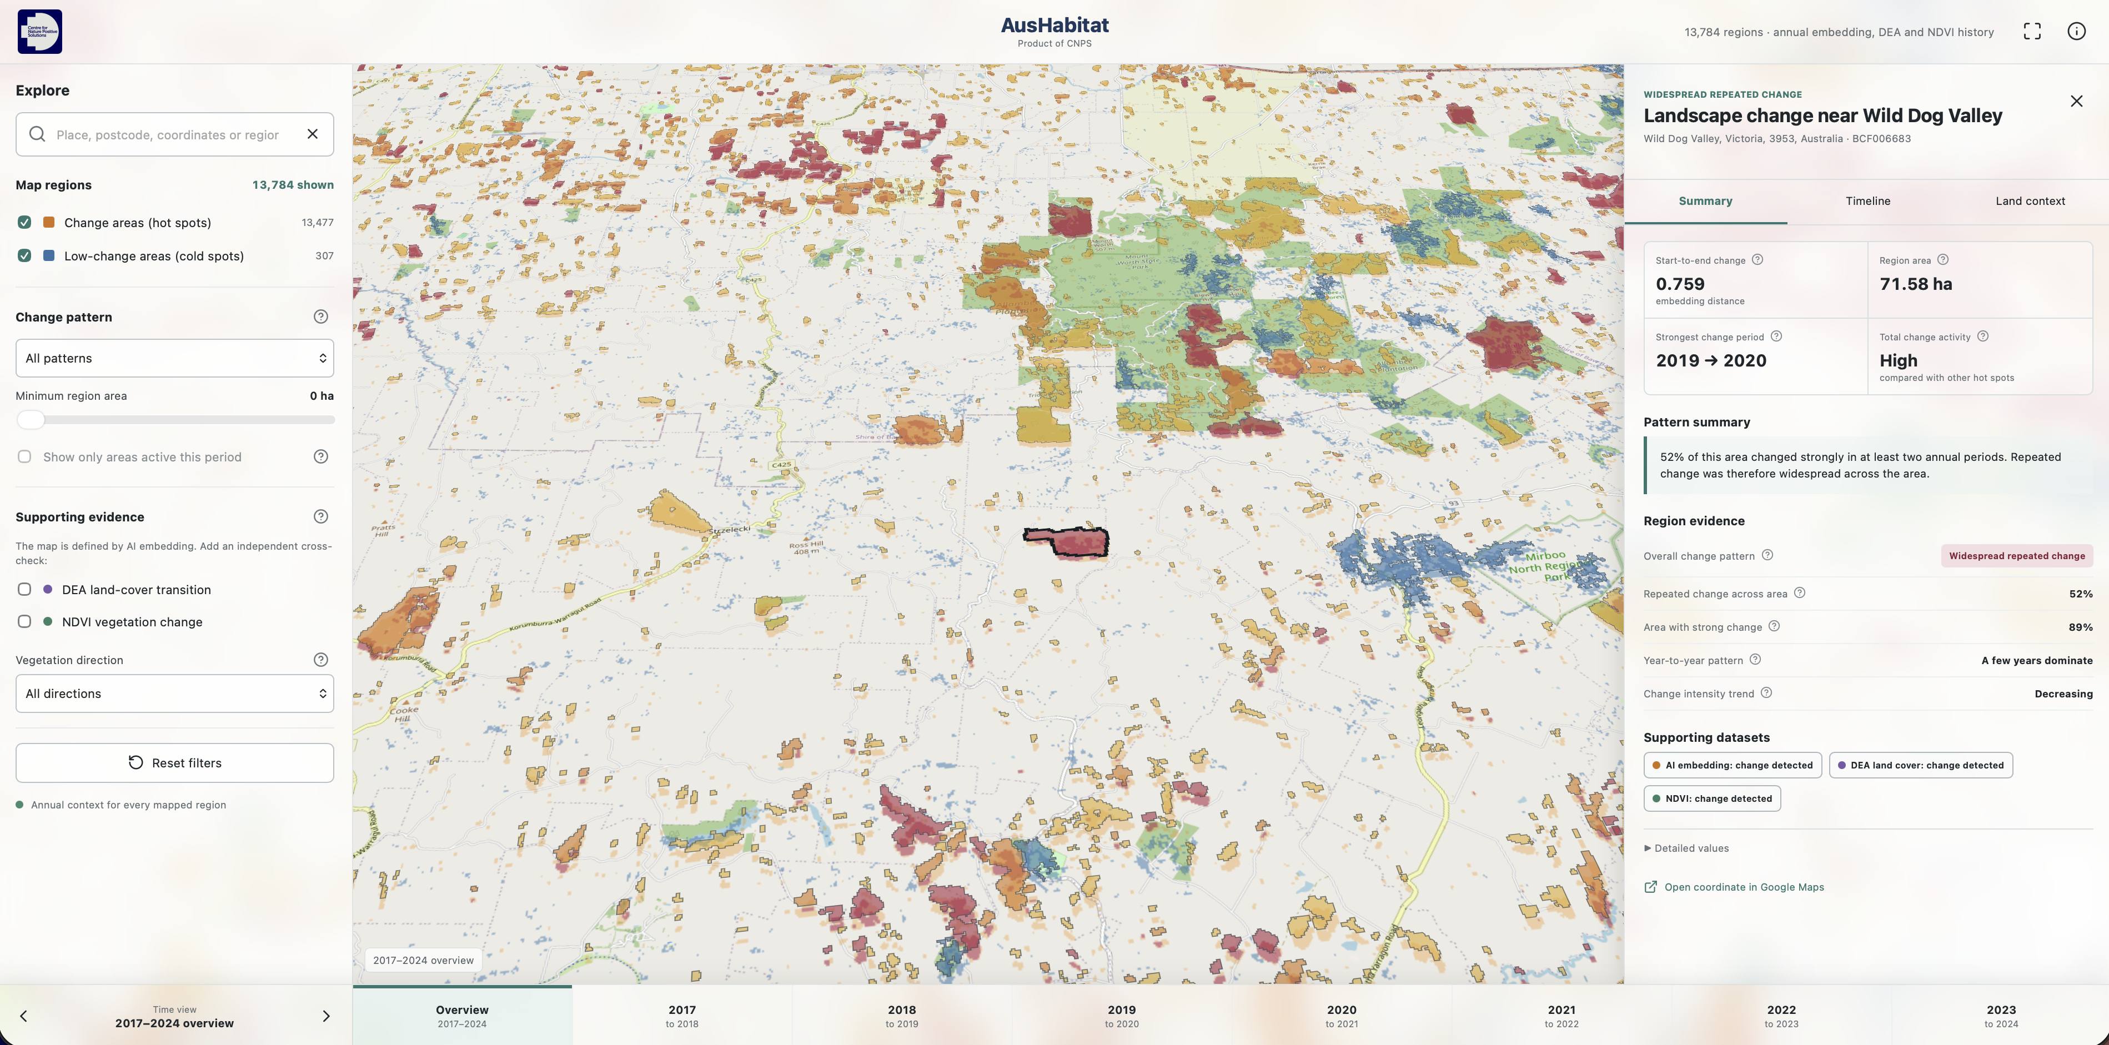

CURRENT PROGRESS
The Bass Coast prototype makes the evidence explorable
SCAN TO OPEN THE LIVE MAP
Search a place or region
Filter change and low-change areas
Move through annual periods
Inspect AI, land cover and NDVI together
thieulong.github.io/SatelliteEmbeddingV1-SpatialAnalysis/
07
Notes:
Purpose: finish your segment on the working milestone, not on a future-work promise.
The current Bass Coast prototype converts the analysis into an interactive evidence portal.
A user can search for a place, filter change and low-change regions, select an annual period, and inspect AI change, DEA land-cover history and NDVI together.
The app currently contains 13,784 interactive regions: 13,477 change regions and 307 low-change reference regions. Each region has annual context from 2017 through 2024.
Invite the client to scan the QR code. If the live demonstration is available, open one change region and move between Summary, Timeline and Land context.
Close your section with one sentence: the milestone is an end-to-end Bass Coast system that moves from annual satellite fingerprints to a client-facing map with independent land and vegetation evidence.
[Sources]
- Live prototype: https://thieulong.github.io/SatelliteEmbeddingV1-SpatialAnalysis/
- Local application source and generated data: bass-coast-change-map/

