Slide 1
Volatility Forecasting SP500 using GARCH from Bayesian Approach

Slide 2
Why do we want to forecast volatiltiy of the stock market?
Risk management
Portfolio Optimization
To estimate the return volatility of stocks, bonds, and other investment assets
Many other financial activities
What good is a Volatility model ?

Slide 3
Investigative Questions
How will a single variable time series improve our prior beliefs that stocks have
What will be the forecasted returns of the SP500 stock on the subsequent day not in the model?

Slide 4
Prerequisites ( What is SDE and why is it important? )
A stochastic process $(S_{t})_{t≥0}$ is a GBM(Geometric Brownian Motion) if it is the following stochastic differential equation (SDE) of the form:
$$dS_{t}=μS_{t} dt+σS_{t} dW_{t}$$
$(W_{t})_{t≥0}$ is a Standard Brownian Motion.
Black-Scholes, an asset pricing model, follows this model.
Non-trivial introduction to SDE in Finance

Slide 5
Interpretation of GBM on Black-Scholes model
$$dS_{t}=μS_{t} dt+σS_{t} dW_{t}$$
t = time of the year(in days)
$S_{t}$ = price of the underlying asset at time t
$S_{0}$ = price of the underlying asset at time t=0
$μ$ = drift rate (i.e. expected return) of the asset at time t
$σ$ = volatility of the asset

Slide 6
Problems with Black-Scholes
Assumes stock prices to follow lognormal distribution at all times
No considerations of dividend payout
Assumes constant return rate $μ$
Assumes constant volatility

Slide 7
How do we fix constant volatility of Black Scholes?
GARCH (A time series model) introduced by Engle (1982) and Bollerslev
$$y_{t}∼N(0,σ_{t}^{2})$$
$$σ_{t}^{2}=α_{0}+α_{1}y_{t−1}^{2}+βσ_{t−1}^{2}$$
$σ_{t}$ = Volatility at time t
$y_{t−1}$ = log of the return at time t-1. (i.e. ln())
other models to consider: Student’s t-distribution and General Error Distribution

Slide 8
Parameters of GARCH
Error parameter: α1 is a measurement of how the model reacts to volatility. Larger α1 value implies the more sensitive the model is to large drops/rises.
Lag parameter: β is a measurement of how long the volatility is going to be. For example, the larger β value implies it is going to take longer for the current volatility trend to die out.
Volatility Persistence parameter: α1+β is a measurement of how fast the current shock to volatility will die away, or the conditional volatility converges to the long-term average.

Slide 9
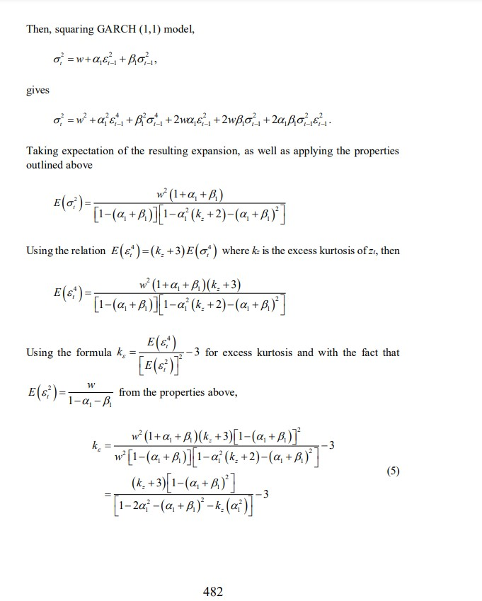
Parameters of GARCH Part 2
GARCH model Estimates

Slide 10
Libraries
library(rstan) library(ggplot2) library(plotly) library(dplyr) library(broom) library(quantmod) library(matrixStats)
rstan (R interface of stan library for Bayesian modeling)
ggplot2 (R visualization library)
plotly (Interactive visualiztion using ggplot2)
quantmod (Library to download historical market data)
broom (Convert objects to “Tidy tibbles”)

Slide 11
Data
Using financial time series data
Dataset includes SP500 daily return series that extends from 2020-01-01 to 2020-09-02
Source of data: finance.yahoo.com

Slide 12
Libraries(Cont)
rstan_options(auto_write = TRUE) options(mc.cores = parallel::detectCores()) #getSymbols("^GSPC",from = "2007-01-01",) GSPC <- readRDS("GSPC.rds") SP500 <- GSPC$GSPC.Adjusted qqnorm(SP500) qqline(SP500, col="blue")

Slide 13
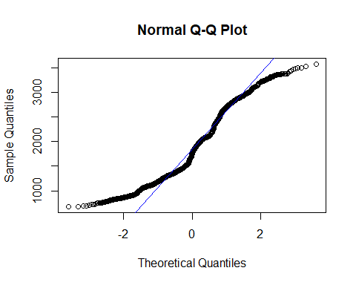

Slide 14
hist(SP500)

Slide 15
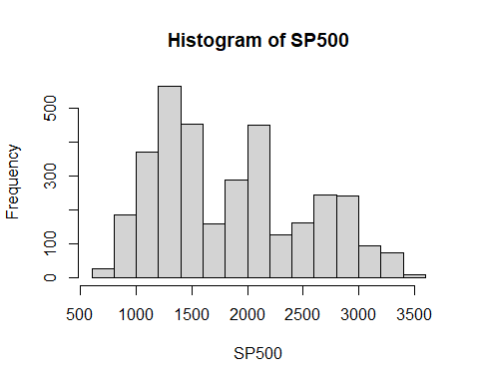

Slide 16
#Use logarithmic formulas to calculated SP 500 return series SP500Ret <- diff(log(SP500), lag = 1) SP500Ret[is.na(SP500Ret)] <- 0 colnames(SP500Ret) <- c('LogReturn') #Visualizing Cleaned Data qqnorm(SP500Ret, main = "QQ Norm: SP500Ret Applied Logarithmic") qqline(SP500Ret, col="blue")

Slide 17
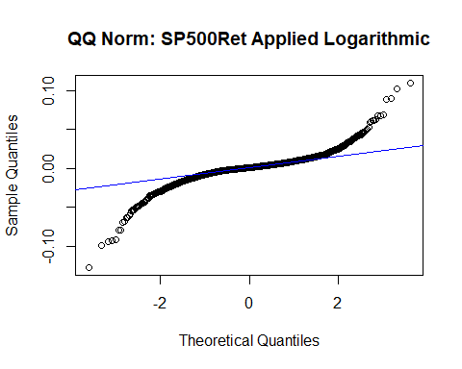

Slide 18
hist(SP500Ret, main = "Histogram: SP500Ret Applied Logarithmic")

Slide 19
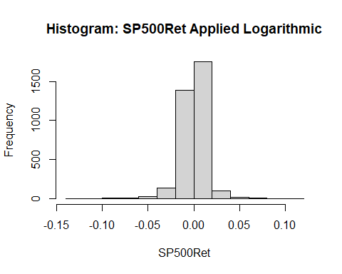

Slide 20
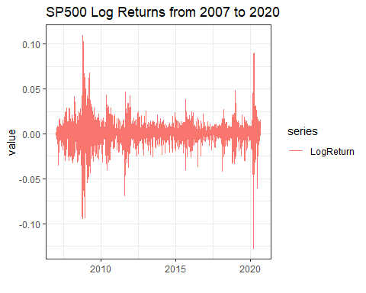
Log-Return time series data of SP500(2007 to current)

Slide 21
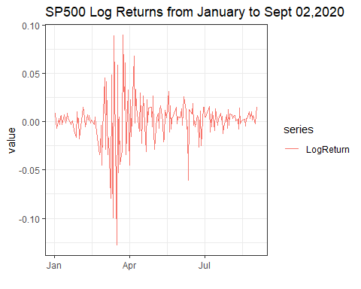
Log-Return of SP500 in 2020

Slide 22

Bayesian GARCH Model
Density Function of Prior and Log Likehood of Residuals

Slide 23
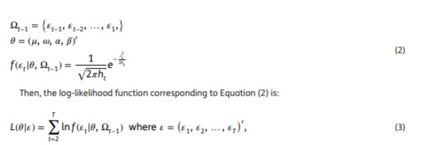
Density Function of Prior and Log Likehood of Residuals

Slide 24
Distinguishing dataset
estimate parameters of models using data from 2020-01-01 to 2020-09-02
having the majority of the data to estimate parameters of models, we anticipate a rise in the MAE while making forecasts

Slide 25
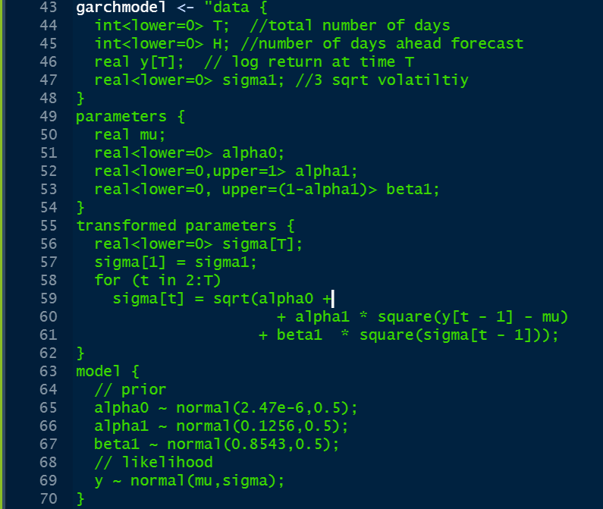
Bayesian GARCH Model Part 2
GARCH model Estimates

Slide 26
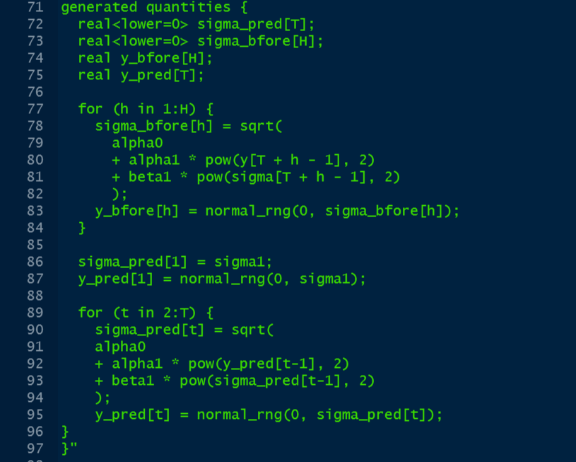
Bayesian GARCH Model Part 3
GARCH model Estimates

Slide 27
Where do these prior values come from?
GARCH Option Pricing Models and the Variance Risk Premium
From frequentist GARCH model
Recorded until Janurary 2020 (Before March Crash)
Lower parameters’ values
Our Bayesian GARCH model dates to Sept 02, 2020. (Including March Crash and Recovery )

Slide 28
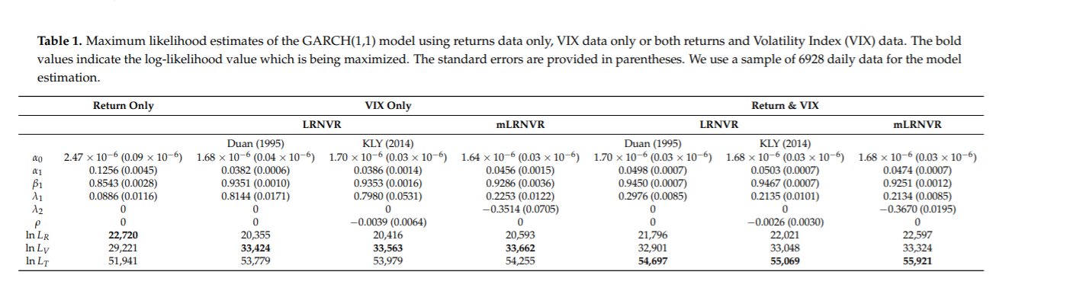
Prior Parameters’ Values

Slide 29
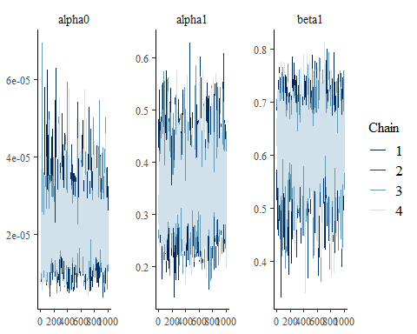
Posterior Parameters’ Traceplot

Slide 30
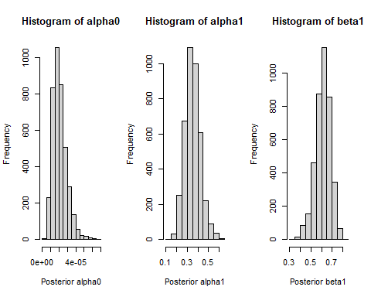
Posterior Distributions

Slide 31
Posterior Summary
## alpha0 alpha1 beta1 ## mean 2.072051e-05 3.519393e-01 6.131612e-01 ## se_mean 2.106029e-07 1.896601e-03 1.830959e-03 ## sd 8.381670e-06 7.161450e-02 7.113440e-02 ## 2.5% 8.281651e-06 2.227734e-01 4.505177e-01 ## 25% 1.466584e-05 3.030523e-01 5.688719e-01 ## 50% 1.940786e-05 3.471646e-01 6.183098e-01 ## 75% 2.527523e-05 3.969862e-01 6.618935e-01 ## 97.5% 4.028629e-05 5.118434e-01 7.407573e-01 ## n_eff 1.583917e+03 1.425772e+03 1.509393e+03 ## Rhat 1.000606e+00 1.001803e+00 1.001561e+00

Slide 32
Prior vs Posterior (What does the difference mean? )
## Priors Posteriors ## alpha0 2.470e-06 1.940786e-05 ## alpha1 1.256e-01 3.471646e-01 ## beta1 8.543e-01 6.183098e-01

Slide 33
One day ahead forecast
Over 170 days(to Sept 02,2020 included), the model suggests us that the median volatility and log return will be 0.014268 and -1.91021 e-07.
The model forecasts that the volatility and log return of Sept 03 will be 0.0121 and -4.27969734 e-05.
Forecasts that the volatility will be lower than average, the return will be same as the investment.
To confirm this, we will need hypothesis testing.

Slide 34
MAE, Error Analysis
# Error analysis mypred <- colMedians(ypred) mytrue <- as.vector(SP500Ret2020) mae <- median(abs(mypred-mytrue)) mae
## [1] 0.008580951
We have log return as training data.
Using the model, we generate a distribution of 4000 samples for each day in the model, totaling 170 days.
Take the median of the distribution for each day.

Slide 35
Posterior Analysis
the error parameter is estimated at 3.514761e-01 much higher indicating an increased sensitivity to large drops/ rise
the lag parameter is estimated at 6.134901e-01 slightly higher indicating a longer duration of volatility
the rate of convergence paramter is 0.9649662
MAE: subsequently is 0.00837064

Slide 36
Conclusions to Investigative Questions
The single variable time series data can use the GARCH model to effectively analyze parameters a0, a1, and b1.
After 170 days, the forecasted SP500 value is 0.0121

Slide 37
Final Remarks
Prior is 2020 historical data until February (Excluding March crash)
Posterior is 2020 historical data (including March crash and May recovery) until Sept 3rd,2020.
Larger Posterior alpha1 implies the model is now sensitive to large drops/rise in asset price
Smaller Posterior beta1 implies current volatility is short-lived (Note the Market is still rising sharp)
Previously the model doesn’t include March crash data, hence smaller alpha and larger beta values. (In other words, prior was an optimistic model)

Slide 38
References
Stan Development Team. 2018. Stan Modeling Language Users Guide and Reference Manual, Version 2.18.0. http://mc-stan.org
Engle, R. F., & Patton, A. J. (2007). What good is a volatility model? In Forecasting Volatility in the Financial Markets (pp. 47–63). Elsevier. https://doi.org/10.1016/b978-075066942-9.50004-2
Zhang, W., & Zhang, J. E. (2020). GARCH Option Pricing Models and the Variance Risk Premium. Journal of Risk and Financial Management, 13(3), 51. https://doi.org/10.3390/jrfm13030051

Slide 39
References
Bollerslev, Tim. 1986. “Generalized Autoregressive Conditional Heteroskedasticity.”

