Slide 1
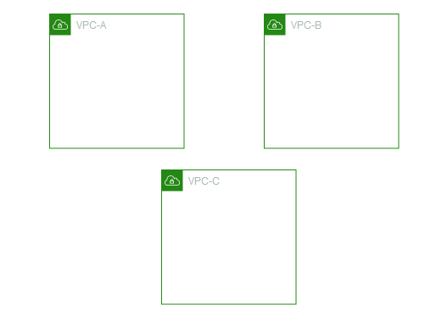

1st Create VPC
Created by Y-Technologies

Slide 2
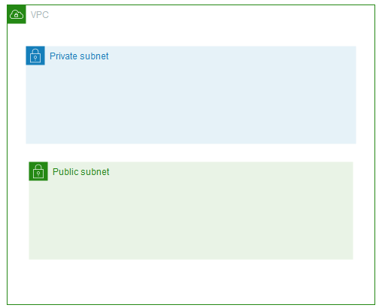
2nd Create Subnet on each VPC
Created by Y-Technologies

Slide 3
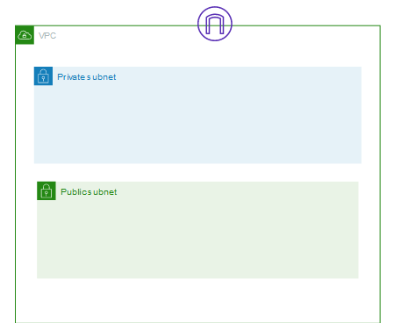
3rd Create Internet Gateway and Attach VPC
Created by Y-Technologies

Slide 4
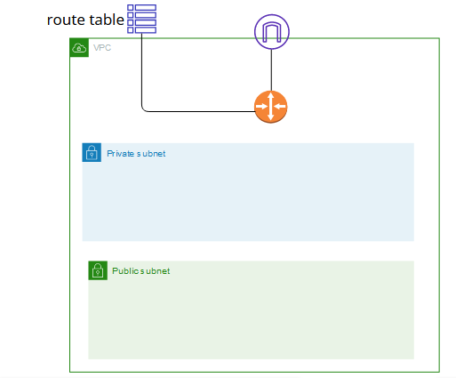
4th Create Route Table
Created by Y-Technologies

Slide 5
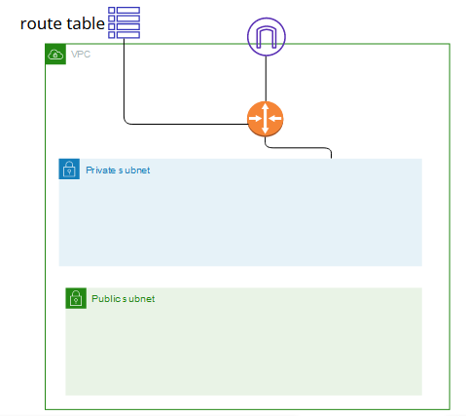
5th Attach the Route Table to Public Subnet
Created by Y-Technologies

Slide 6
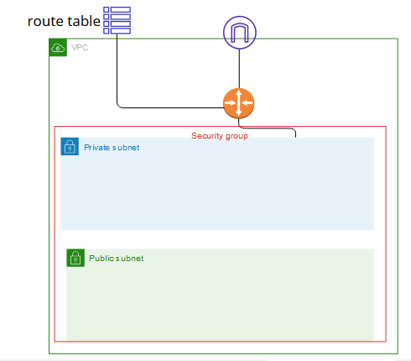
6th Create Security Group
Created by Y-Technologies

Slide 7

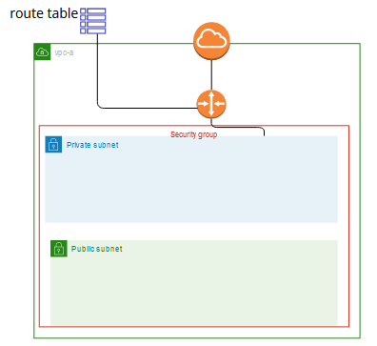
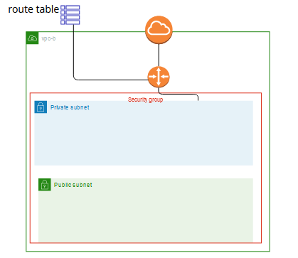
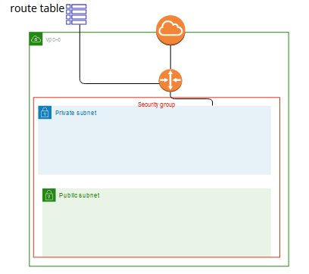

Final Topology
Created by Y-Technologies

