Slide 1
Event sourcing
What/why/how
Notes:
Ervaring polsen
Eventstore
Cosmos db

Slide 2
What?
A pattern for storing data as events in an append-only log
Preferably using a Document DB instead of a Relational DB
Notes:
append-only example: bank account + transactions made. Tranferred the wrong amount? Ask the recipient to return some of the money

Slide 3
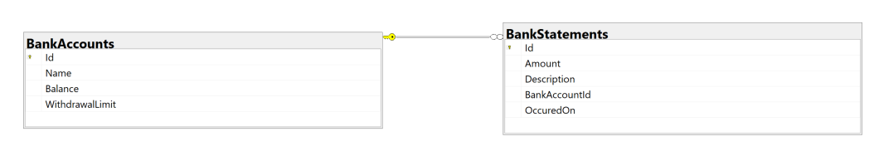
Traditional approach

Slide 4
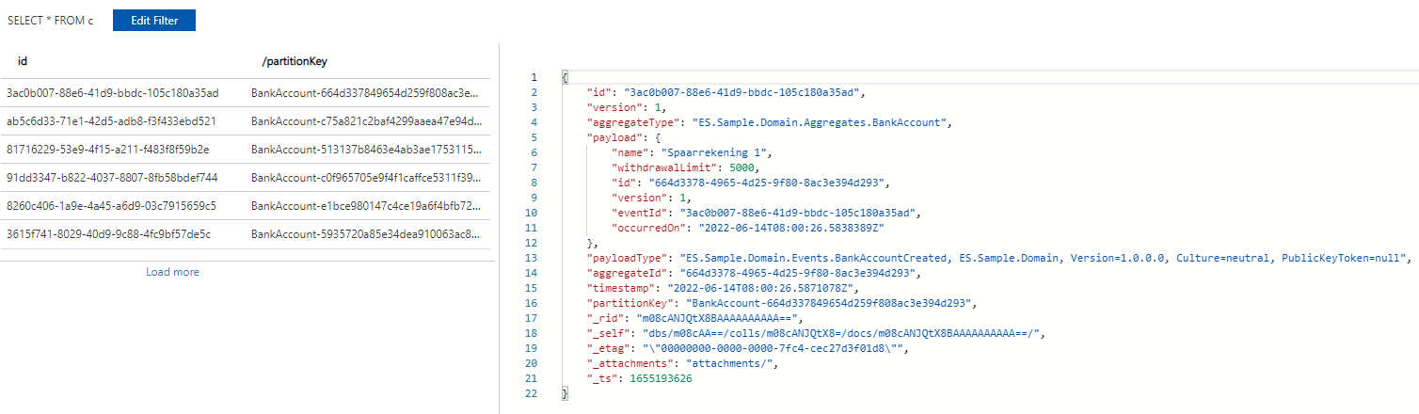
Event sourcing approach
Notes:
Stores a list of events in the order they have been recorded

Slide 5
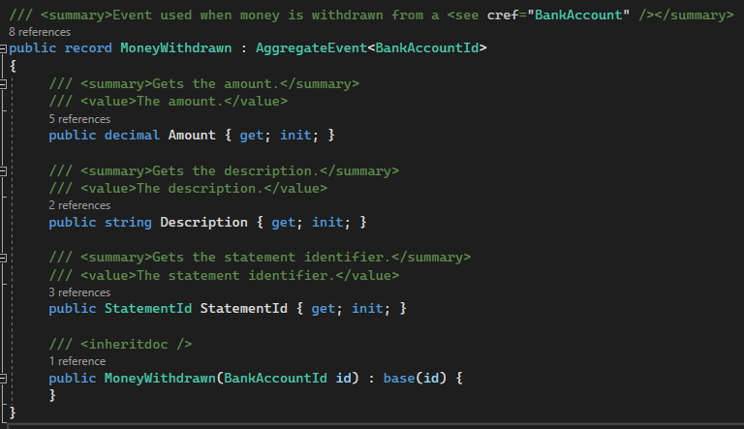
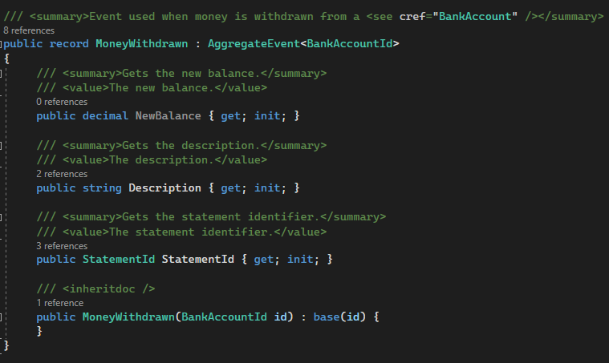

What?
An event represents a fact that took place within your application
Notes:
The design of an event is crucial within an event sourced project. Because once an event has been written, it will exist forever.
An event needs to contain enough context to replay event

Slide 6
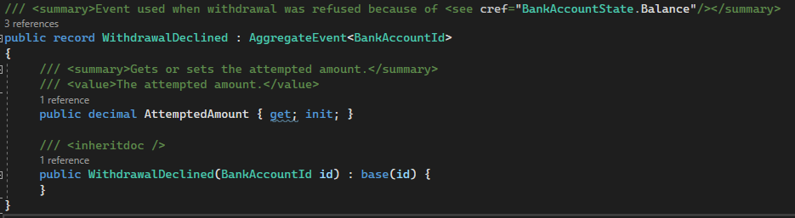
What?
An event doesn’t have to change state!
Notes:
An event can also represent something that a user tried to do but failed. It doesn’t necessarily have to alter the aggregate state.

Slide 7
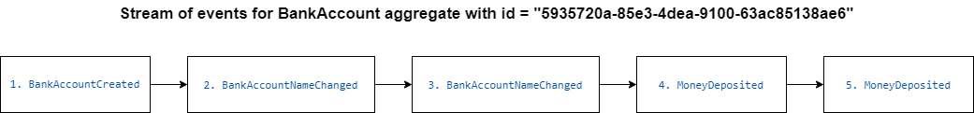
What?
An aggregate’s current state can be created by replaying all the events in order of occurrence.
Notes:
The sum of the events = the current state. Order = order of writing
Replaying the events recreates the current state.

Slide 8
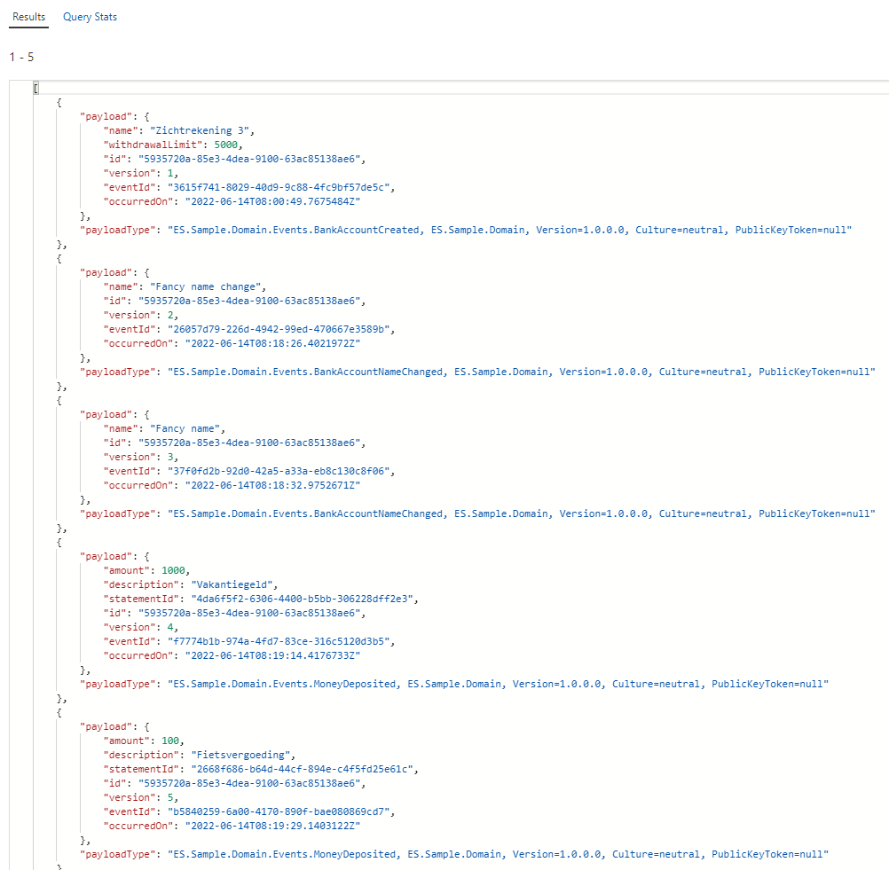
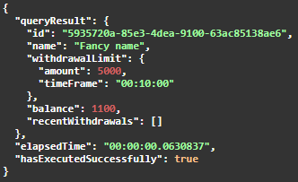
Notes:
Explain events and how state is the result

Slide 9
Why?
Great for auditing
Storing information & context that is incredibly valuable to the business
Optimizing applications both on read & write side
Notes:
Added benefit: the possibility to create new projections on data from the past

Slide 10
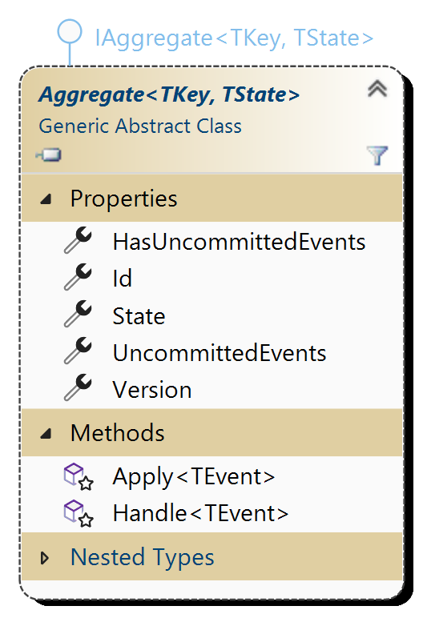
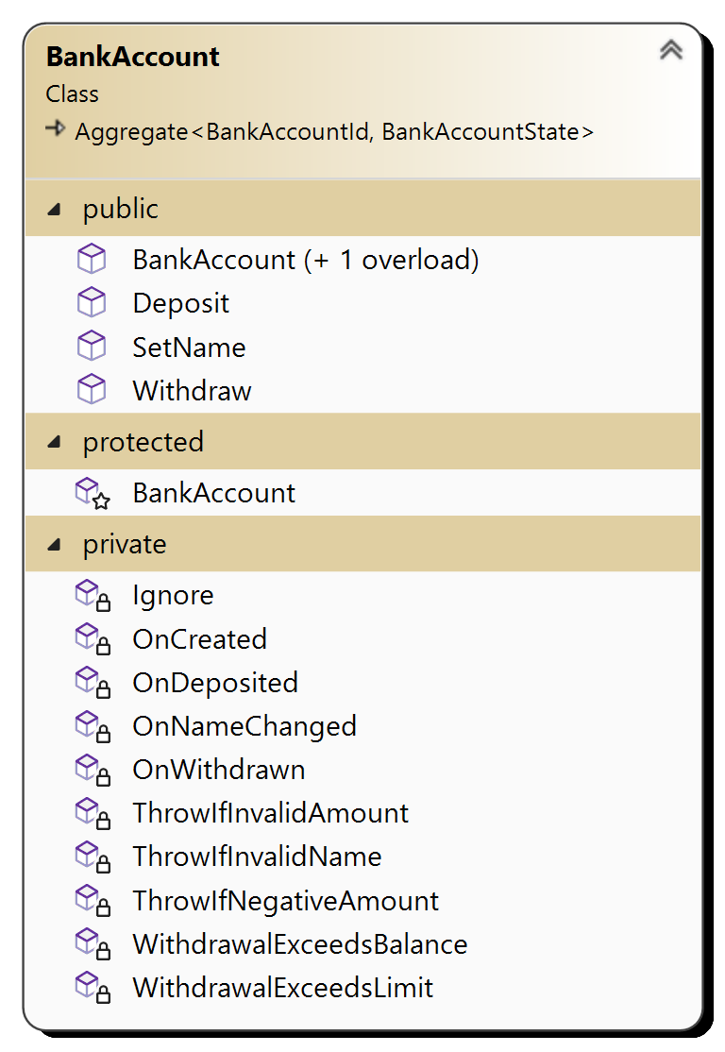
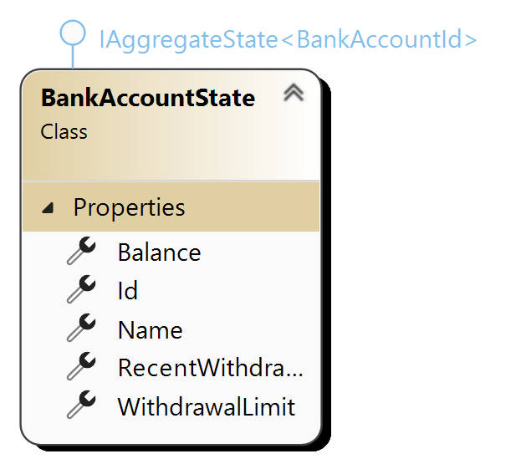
How: Aggregates
Notes:
Aggregate aka Aggregate Root aka Entity : used to execute commands against, validate business logic and create events

Slide 11
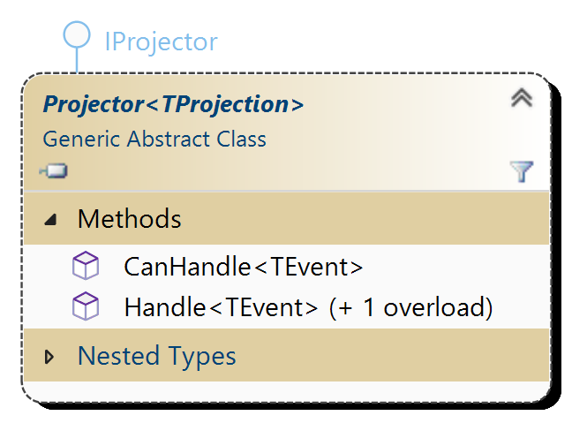
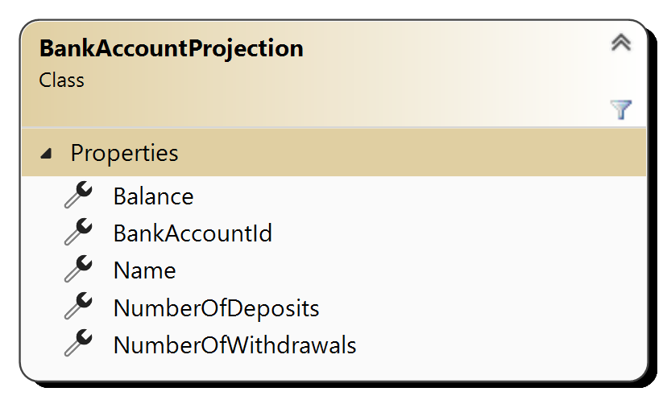
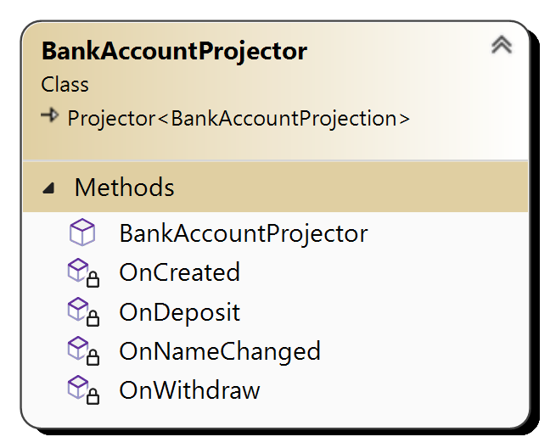
How: Projections
Notes:
Projections aka Materialized Views: for easy & fast read access, can be rebuilt etc.
Cosmos db changefeed as trigger, events are provided in sequence of writing

Slide 12
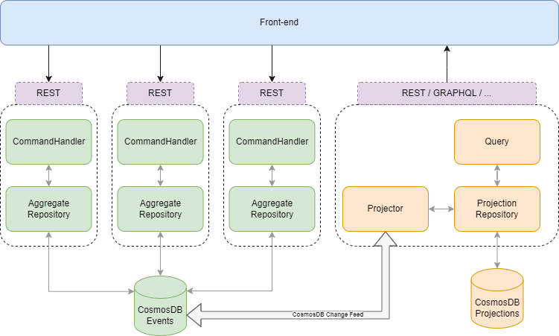
Notes:
PUT PATCH POST DELETE
Vs
GET

Slide 13
Disclaimer
Event Sourcing is not always the best option
Notes:
Very specific use-cases can be found high auditability, etc.

Slide 14
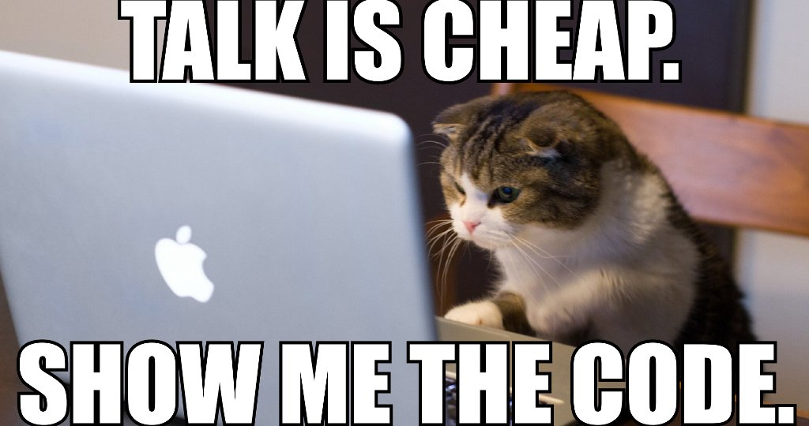
CODE

Slide 15
Get the CODE
https://github.com/thijscornelis/es-lightning-talk.git

Slide 16
Lightning Talks – CEO Edition 2
Save the date: 18/10/2022
Location: TBD
Talks:
Stijn Dhondt: Het maken van een low code front-end ervaring in Angular 2+
TBD
TBD
TBD

Slide 17
Thanks for listening!

