Slide 1
Event sourcing
What/why/how

Slide 2
Disclaimer
Event Sourcing is not always the best option
Notes:
Very specific use-cases can be found high auditability, etc.

Slide 3
What?
A pattern for storing data (!= state) as events in an append-only log
An event represents a fact that took place within your business
An aggregate’s current state can be created by replaying all the events in order of occurrence.
Notes:
append-only example: bank account + transactions made. Tranferred the wrong amount? Ask the recipient to return some of the money
fact can also be something that a user tried to do, but failed

Slide 4
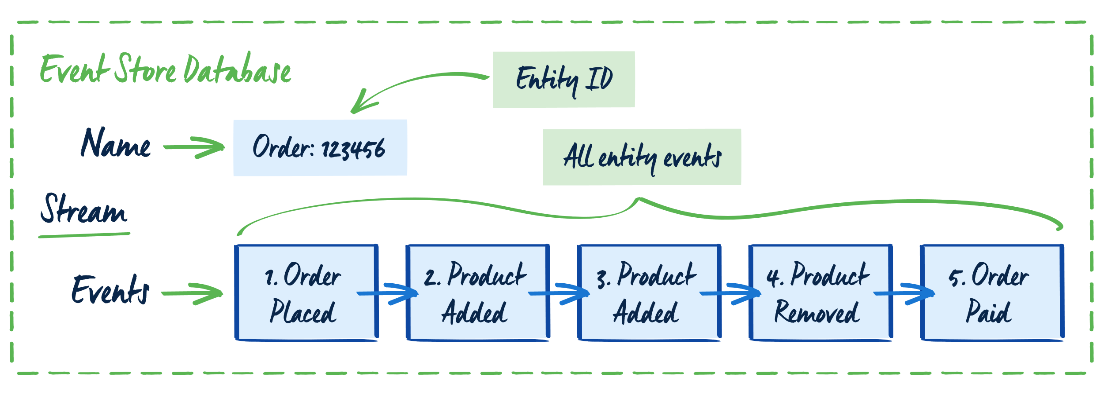
https://www.eventstore.com/event-sourcing

Slide 5
why
Great for auditing
Storing information & context that is incredibly valuable to the business
Optimizing applications both on read & write side
Notes:
Added benefit: the possibility to create materialized views on data from the past

Slide 6
How
Aggregates
Projections
Commands & Queries
(Actors/Subscriptions)
Notes:
Aggregate aka Aggregate Root aka Entity : used to execute commands against, validate business logic and create events
Projections aka Materialized Views: for easy & fast read access, can be rebuilt etc.
Actors aka Subscriptions: reacting on events that happened, excluded from replay scenario’s

Slide 7
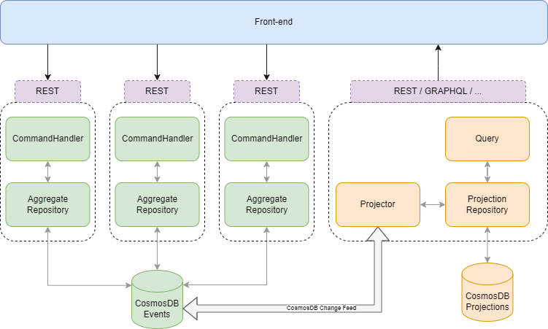

Slide 8

CODE

