Slide 1
Raytracing
drop_table groups

Slide 2
Members
Maarten van Beek, 4107780
Thomas van Helden, 4106725
Berend Ottervanger, 4082427
Felix Akkermans, 4103440
Calvin Wong Loi Sing, 4076699
Petri Rohenkohl, 4087631
Thijs Boumans, 4214854
Jeroen Roosen, 1327739

Slide 3
Overview
Features and work distribution
Picture
Flow of the program
Post processor
Unfinished features
Conclusion
Questions

Slide 4
Features achieved
Shading
Anti-Aliassing through super sampling
Soft shadows
Raytraced reflection and refraction
Bounding box optimization
Post processing
Multi-threaded rendering
Dev/Debug tools

Slide 5
Unfinished features
KD tree optimization
Spheroid shape class
Mass texture import from blender
Triangle intersection
Depth of Field

Slide 6
Distribution of work – achieved features
Generic shading process
Maarten
BlinnPhong shading
Maarten, Thijs, Thomas
Anti-Aliasing by super sampling
Maarten
Soft Shadows (area based directional light)
Thijs

Slide 7
Distribution of work – achieved features
Raytraced reflection
Maarten
Raytraced refraction
Maarten, Berend
Bitmap textures onto spheres
Maarten
Optimization bounding box
Felix

Slide 8
Distribution of work – achieved features
Post processing filters
Thijs
Scene datastructures
Maarten
General structure
Thomas, Thijs
Multi-threading
Felix

Slide 9
Distribution of work – achieved features
Dev-Debug tools (render progress indicator)
Felix

Slide 10
Distribution of work – Not achieved
KD-tree optimization
Jeroen, Maarten
Spheroid shapes
Berend
Textures mapped onto geometry
Thomas
Triangle intersection
Petri, Felix
Depth of Field
Jeroen, Berend

Slide 11
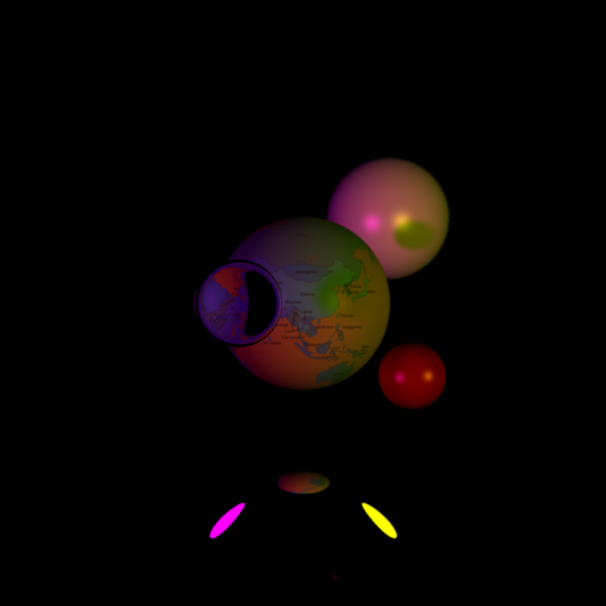

Slide 12
Flow of program

Slide 13
Postproccessors
Chose for non photo realistic
Oil painting
Chalk drawing

Slide 14
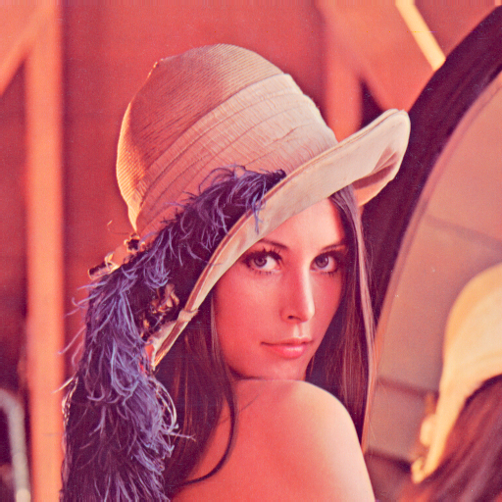
Chalk drawing - original

Slide 15
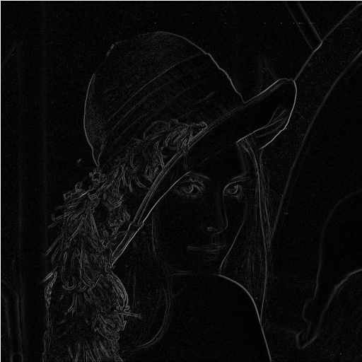
Chalk drawing - processed

Slide 16
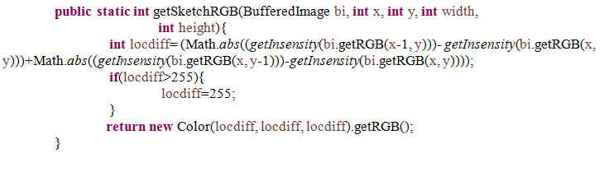
Chalk drawing - code

Slide 17
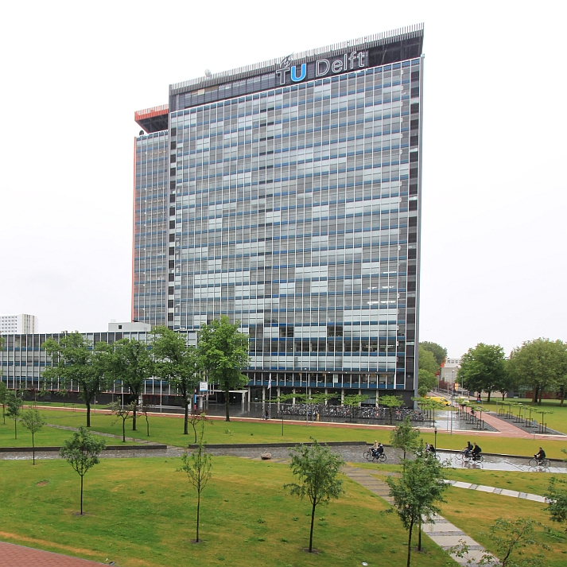
Oil drawing - original

Slide 18

Oil drawing - processed

Slide 19
Oil drawing - method
for each pixel calculate intensity of all surrounding pixels
Group intensity's together in groups
Then calculate average colour of dominant intensity
Set pixels to the average colours

Slide 20
On rendering

Slide 21
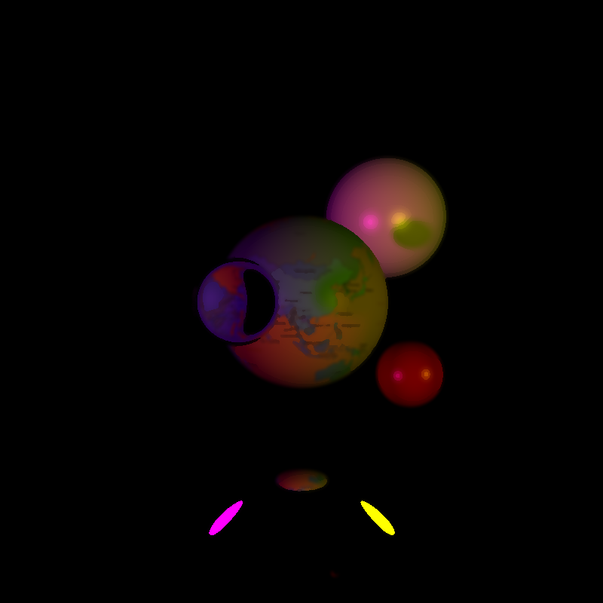
On rendering

Slide 22
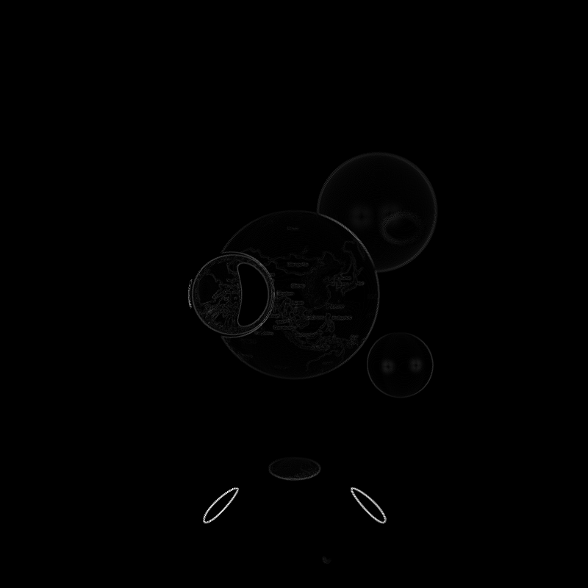
On rendering

Slide 23
Unfinished features – KD tree
Tree building worked
Bounding boxes worked
Combining the two was problematic
Segmentation faults
Time pressure

Slide 24
Unfinished features – Spheroid class
Worked but insignificantly tested, so we didnt add it to the final version
Again time....

Slide 25
Unfinished features – Textures from Blender
Manual oading textures worked
Loading textures from MTL didn’t
Files did not pick up on filenames

Slide 26
Unfinished features – Triangle intersection
Basic funtion
Worked at the start
Later changes caused problems
Edges of objects became noisy
Under certain angles things weren’t displayed

Slide 27
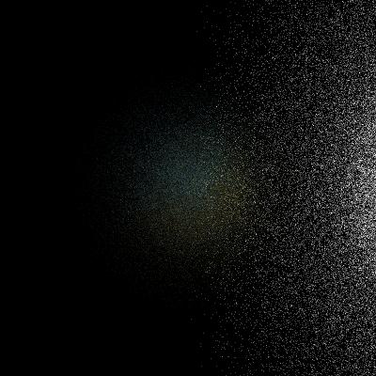
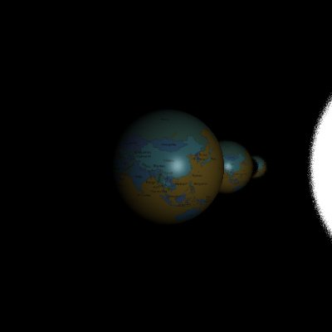
Depth of Field
Aperture too large
Bugs: Rays didn’t shoot to focal point
Once fixed, focal point wasn’t focussed

Slide 28
Conclusion
Some unfinished features
Fancy post processor
Clear structure and flow of program
Awesome picture
Plenty of work done

Slide 29
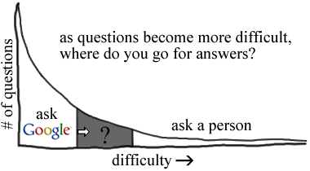
Elmar style slide

