Slide 1
Smart Distribution Systems Exercise session 2

Slide 2
Outline
Neural networks
Training-, validation- and test-set
Exploration
Neural network architecture
Feature selection
Forecasting competition
Report

Slide 3
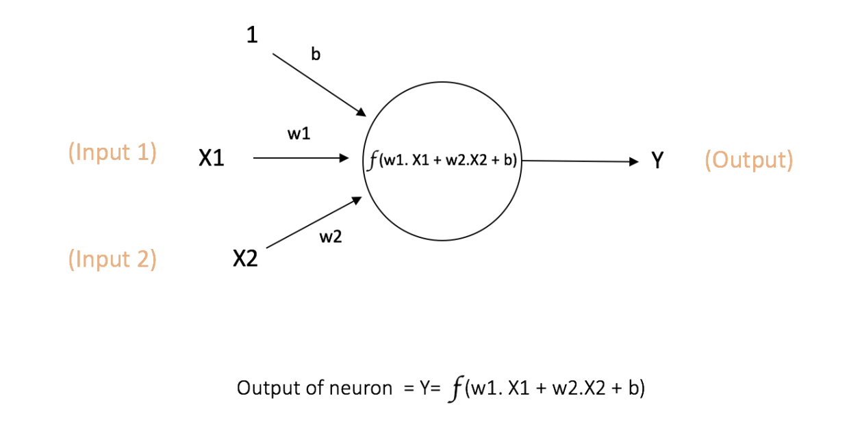
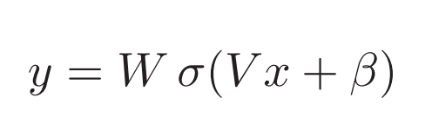
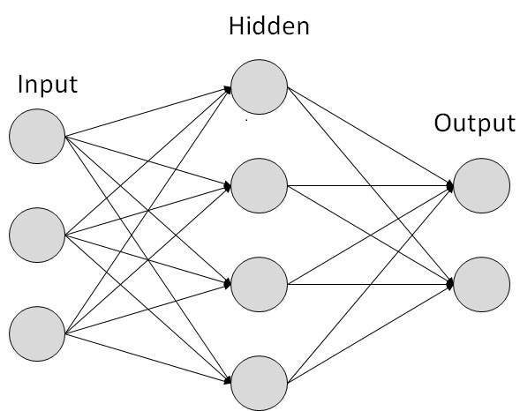
Neural networks

Slide 4
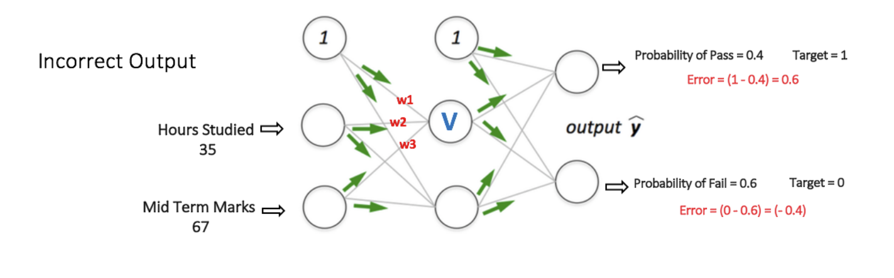
Neural networks – feed forward

Slide 5
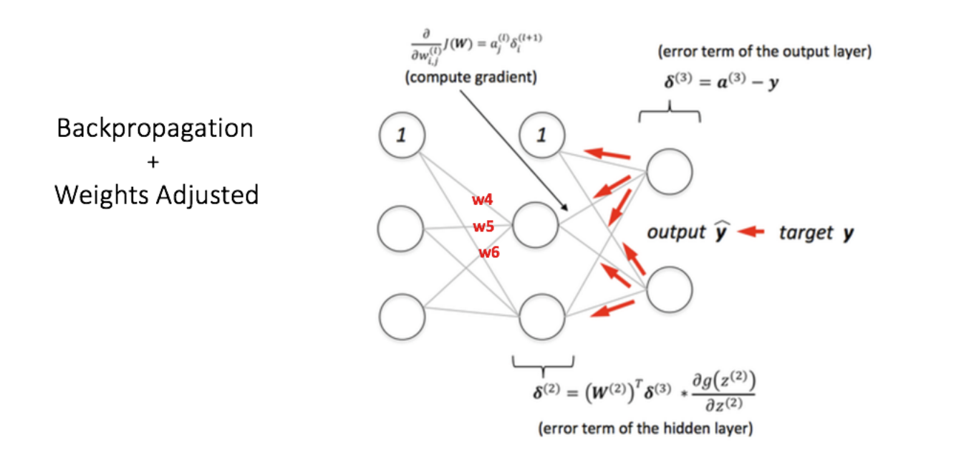
Neural networks - backpropagation

Slide 6
Gradient descent
This means we have a regular optimization problem in the weight-space
Solve with gradient descent
https://towardsdatascience.com/improving-vanilla-gradient-descent-f9d91031ab1d

Slide 7
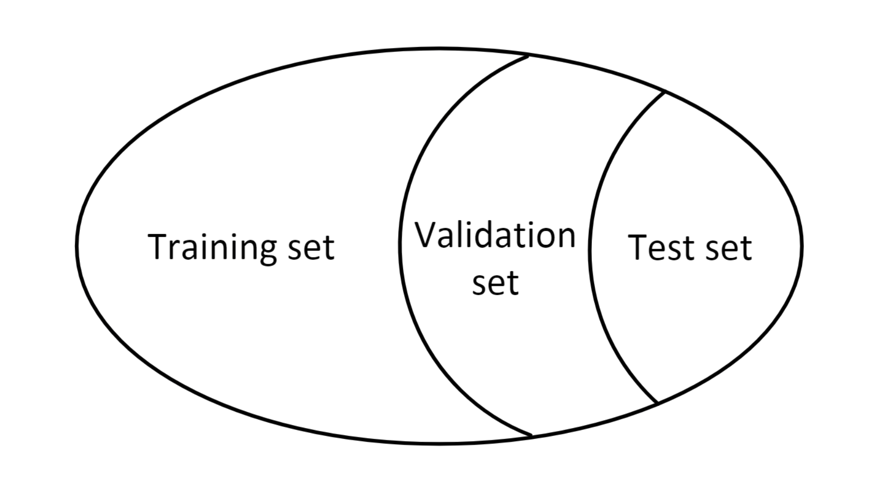
Training-, validation & test-set
Training set: learning set of nn parameters
Validation set: optimizing nn hyperparameters
Test set: evaluate nn performance

Slide 8
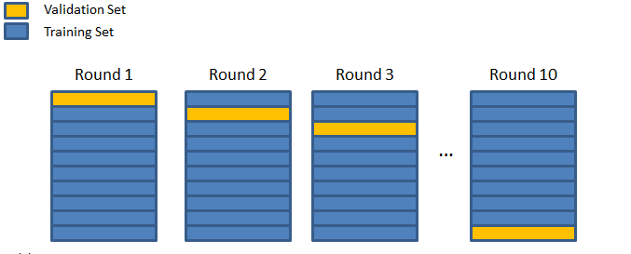
Cross-validation

Slide 9
Data set exploration
First! Explore problem and data sets
What do we need to forecast?
What factors influence the to be predicted value?
Do we have data for them?
What does the data look like?
Is there seasonality?
Is there a trend?
How about outliers?

Slide 10
Neural network architecture
Which architectures are we going to consider?
How many hidden layers? How many neurons?
Which activation function performs best?
How many outputs?
Test based on validation set
For example: 24 nn’s for 24 forecasts, or 24 outputs?
Test multiple times!
Performance depends on (random) initialization.

Slide 11
Feature selection
Which features can influence the performance?
Day of the week
Previous prices
How many previous hours?
Maybe only same day of previous week?
Current running average?
Solar and wind production?
Day-ahead prices of France, Germany, … ?
Does normalization of features (and output) help?
Selecting relevant features can make a big difference!

Slide 12
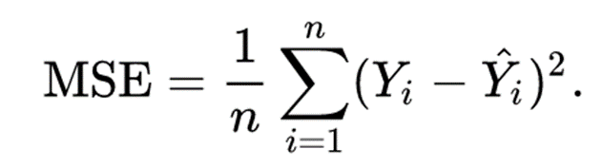
Forecasting competition (1)
Create a neural network to forecast day-ahead electricity prices
As good as possible
Evaluation is based on the Mean Squared Error:
Predict the belpex prices for 3 (random & unknown) days in 2018.
Available data: the same as in the csv files of this exercise session
PV forecast
Wind forecast
Belpex
Only of the previous 7 days

Slide 13
Forecasting competition (2)
Create a predictions.csv file with 3*24 rows, each row should contain the forecast for that hour. (3 predicted days)
=> 1 column + 72 rows!
MSE calculation is automated -> you will not appear in the ranking
Write a report of max. 5 pages (including plots) with the results of your work
Add plots, performance metrics (table), explanation of feature selection and network architecture selection.
Deadline: 26 April 2019, at 5 pm
Upload on Toledo

