Slide 1
Smart Distribution Systems Exercise session 1
Mahtab Kaffash – mahtab.kaffash@kuleuven.be
Thijs Peirelinck – thijs.peirelinck@kuleuven.be

Slide 2
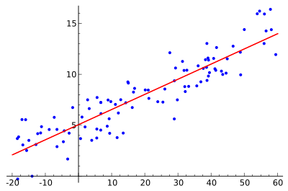
Regression
Statistical model
Estimating relationships among variables
Dependent variable
Independent variables
Linear regression
Non-linear regression

Slide 3
Artificial Neural Networks
Computing system capable of massive data processing and knoweldge representation
Universal approximation theorem: "the standard multilayer feed-forward network with a single hidden layer, which contains finite number of hidden neurons, is a universal approximator among continuous functions on compact subsets of Rn, under mild assumptions on the activation function."

Slide 4
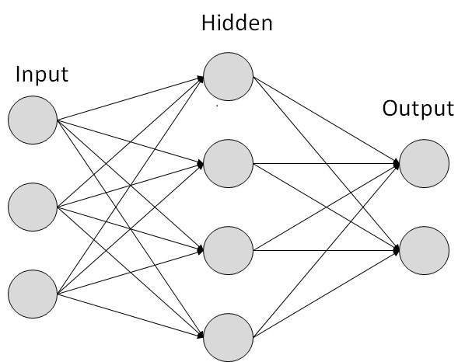
Artificial Neural Networks - Structure
Organized in layers: neurons, inputs, outputs and activation function
Number of neurons in output layer = number of outputs
Used in optimization, control and forecasting

Slide 5
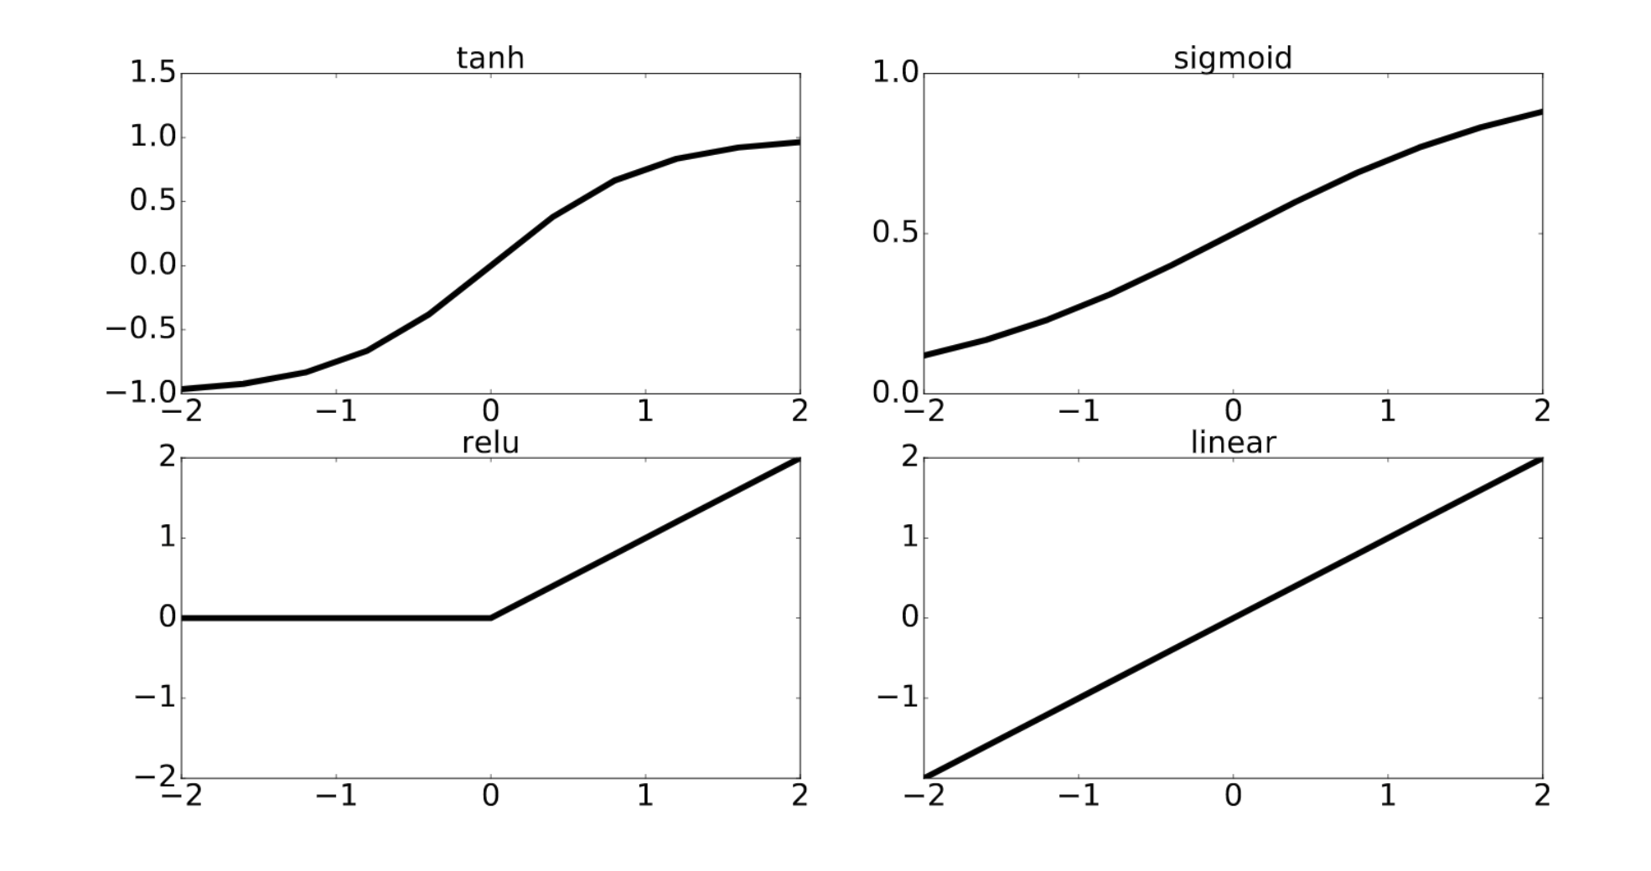
Artificial Neural Networks – Activation functions

Slide 6





Set-up Machine Learning Environment
Download and install Anaconda (Use Python 3.6!)
Install deep learning libraries
More info on Toledo

Slide 7
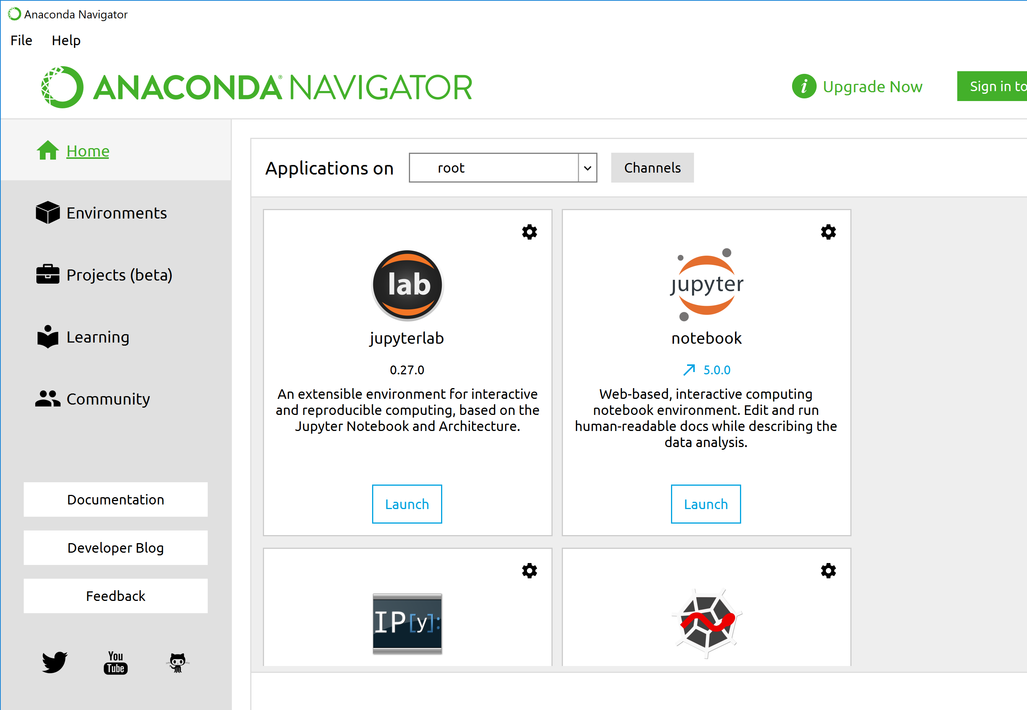
Anaconda navigator

Slide 8
Get started
Download the exercises on Toledo
Open Anaconda / Anaconda Prompt
Activate environment (info on Toledo)
Launch jupyter lab (in correct environment)
Launch exercise_session_1.ipynb
Read all information (go to provided links with additional information) and complete the exercises.

Slide 9
Documentation
Numpy: https://docs.scipy.org/doc/
Pandas: https://pandas.pydata.org/pandas-docs/stable/
Scikit-learn: http://scikit-learn.org/stable/documentation.html
Keras: https://keras.io/

Slide 10
Lab session tasks
Linear regression
Generating data
Plotting
Non-linear regression: kernel regression
Non-linear regression: neural networks
Overfitting
Regularization: early-stopping
Importing real data: DataFetcher

Slide 11
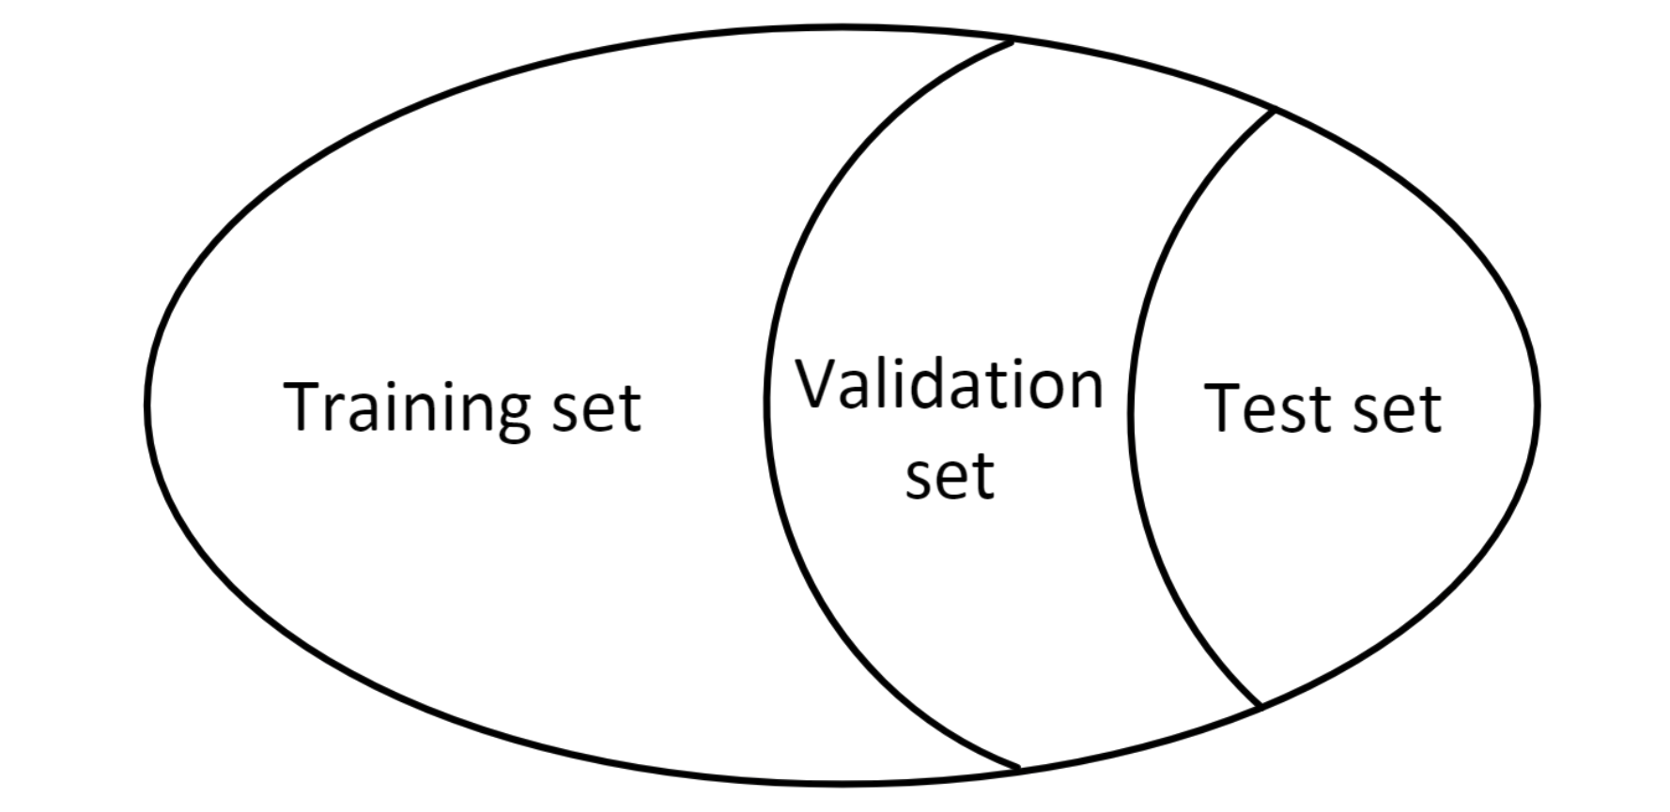
Data set
Training set: for training/learning network parameters
Validation set: tuning hyperparameters: number of hidden layers/neurons
Test set: to evaluate final network performance

Slide 12
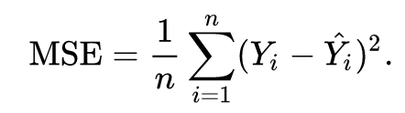
Next exercise session - competition
Create a neural network to forecast day-ahead electricity prices
Try to have a good prediction:
Gain insight in data and preproces inputs
Use additional (relevant) features (use DataFetcher as an example)
Tune network architecture
Submit your results
See which team did best!
Evaluation is based on the Mean Squared Error

Slide 13
Next exercise session - final report
Create a predictions.csv file with 24 rows, each row should contain the forecast for that hour. Predict the belpex prices for ??.
Write a report of max. 5 pages (including plots) with the results of your work
The data you used and the preprocessing you performed.
The architecture of the neural network and the reason why you chose this architecture (explain the experiments you performed to make your decision).
The final results and performance of the model, e.g. what is the test-set performance.
Deadline: TBA

