Slide 1
IBM GROUP 5 CLOUD COMPUTING
DISASTER RECOVERY WITH IBM CLOUD VIRTUAL SERVICES

Slide 2
INTRODUCTION
In this project we are going to see about the problem definition and design thinking.
PROBLEM DEFINITION: In problem definition we are going to see about the disaster recovery, objective to safeguard the plan for disaster, planning for disaster recovery and strategies.
DESIGN THINKING: In design thinking we are going to see about Disaster recovery strategy, Backup configuration, Replication set up, Recovery set up, Recovery tesing, Business continuity.

Slide 3
PROBLEM DEFINITION
Disaster Recovery Plan
Objective
Planning Set Up
Project Definitions

Slide 4
Disaster recovery plan with IBM cloud virtual services
When dealing with improved resilience, it important to make some distinctions between high availability (HA) and disaster recovery(DR).
HA is mainly about keeping the service available to the users when ordinary activities are performed on the system like deploying updates, rebooting the hosting virtual machines, applying security patches to the hosting OS, and so on.
For our purposes, high availability within a single cloud region (MZR can be achieved by eliminating single points of failure. For more information on HA, see Considerations for high availability.
HA usually doesn’t deal with major unplanned or planned issues, such as complete site loss because of major power outages, earthquakes, severe hardware failures, full site connectivity loss, and more.
In such cases, if the service must meet strict Service Level Objectives (SLO), you should make the whole application stack (infrastructure, services, and application components) redundant by deploying it in at least two different cloud regions. This is typically defined as a DR architecture.

Slide 5
OBJECTIVE
The objective of a DR plan is to ensure that an organization can respond to a disaster or other emergency that affects information systems –and minimize the effect on business operations. Kyndryl has a template for producing a basic DR plan. The following are the suggested steps as found in the DR template. Once you have prepared the information, it is recommended that you store the document in a safe, accessible location off site.
Major goals: The first step is to broadly outline the major goals of a disaster recovery plan.
Personnel: Record your data processing personnel. Include a copy of the organization chart with your plan.
Application profile: List applications and whether they are critical and if they are a fixed asset.
Inventory profile: List the manufacturer, model, serial number, cost and whether each item is owned or leased.

Slide 6
PLANNING SET UP FOR DISASTER RECOVERY
Even a minor outage can put you at a competitive disadvantage. Be ready with a business continuity plan that includes cloud backup and disaster recovery for your critical IT systems - without the expense of secondary infrastructure. Take advantage of built-in IBM Cloud geographic resiliency and security, mitigate the risk of downtime and protect sensitive data with IBM's cloud disaster recovery solutions.
In the protection phase, you deploy all the required technologies to create a DR solution and start the data replication process.
Deploy the DR site and network interconnect.
In this step, you create the DR receiving site. You must have active storage to store all the replicated data and an active system that is running and receiving hypervisors. The storage must also have space to accommodate DR testing and to sustain the full production for longer period in an emergency.
The setup must have a network design that enables these activities:
Management flows (LAN)
Replication flows from the primary site (normal operations)
DR test flows from primary site (LAN) and external/WAN
Emergency network (from external/WAN)
Replication flows to the primary site (replication while operating in an emergency) or to a new DR site

Slide 7
PLANNING SET UP FOR DISASTER RECOVERY
Install Zerto.
After you install the DR environment on the target site and hypervisor is active and usable, install Zerto on both the primary and DR site.
On the primary site, Zerto requires a VM (Zerto Virtual Manager – ZVM) to be installed on the source site and a Virtual Replication Agent (VRA) to be installed on each hypervisor that is running VMs to be protected.
On the DR site, Zerto requires a secondary VM (Zerto Virtual Manager – ZVM) and a Virtual Replication Agent (VRA) to be installed on each hypervisor that is receiving data from the source site.
Start to protect the site.
After Zerto is installed, configure the entire protection and DR process through ZVM portal. In this process, you identify the source VMs to protect, the consistency groups (Virtual Protection Groups – VPGs), and the sequence to reprovision and restart the DR VMs.

Slide 8
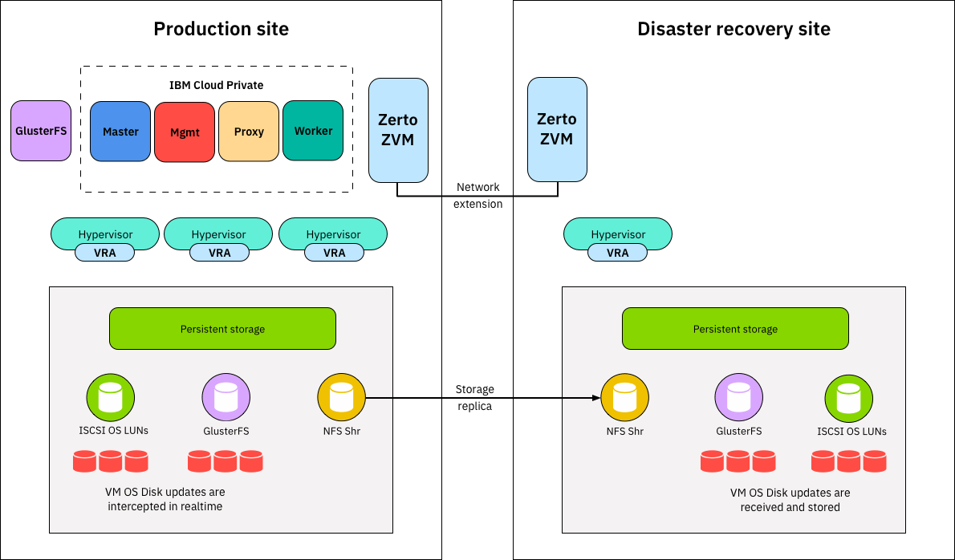
PLANNING SET UP FOR DISASTER RECOVERY

Slide 9
What is a disaster recovery plan (DRP)?
A disaster recovery plan (DRP) is a documented, structured approach that describes how an organization can quickly resume work after an unplanned incident. A DRP is an essential part of a business continuity plan (BCP). It is applied to the aspects of an organization that depend on a functioning information technology (IT) infrastructure. A DRP aims to help an organization resolve data loss and recover system functionality so that it can perform in the aftermath of an incident, even if it operates at a minimal level.
The plan consists of steps to minimize the effects of a disaster so the organization can continue to operate or quickly resume mission-critical functions. Typically, a DRP involves an analysis of business processes and continuity needs. Before generating a detailed plan, an organization often performs a business impact analysis (BIA) and risk analysis (RA), and it establishes recovery objectives.

Slide 10
Recovery plan considerations
When disaster strikes, the recovery strategy should start at the business level to determine which applications are most important to running the organization. The recovery time objective (RTO) describes the amount of time critical applications can be down, typically measured in hours, minutes or seconds.
The recovery point objective (RPO) describes the age of files that must be recovered from data backup storage for normal operations to resume.

Slide 11
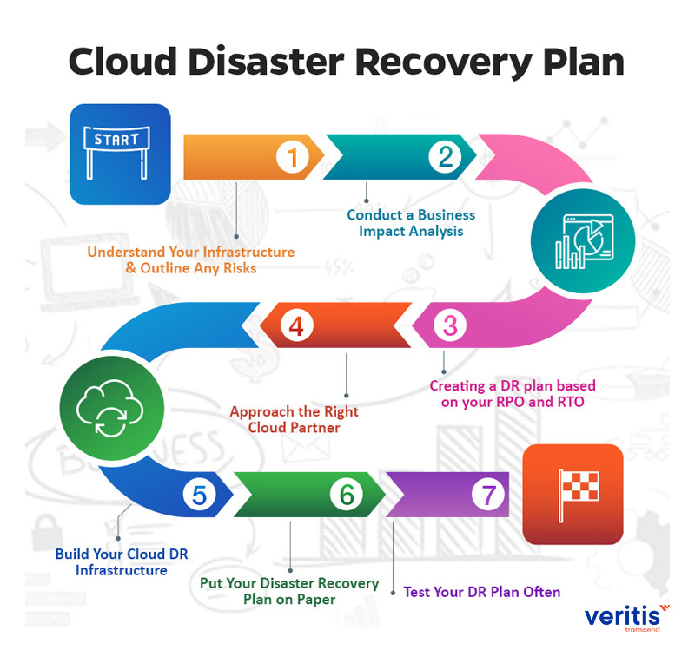

Slide 12
DESIGN THINKING
Disaster Recovery Strategy
Backup Configuration
Replication Setup
Recovery Testing
Business Continuity

Slide 13
Disaster Recovery Strategy
The Disaster Recovery Plan Document The outcome of the disaster recovery planning process is the disaster recovery plan document. During an emergency, this document will be the primary source of information for disaster recovery procedures.
Document Contents The disaster recovery plan document is the only reliable source of information for the disaster recovery during an emergency. It should be very easily readable, with simple and detailed instructions. Following are some of the contents that need to be in this document.
● Document Information: The document should include information such as the authors/owners with their contact details, revision history and other document details (name, location, version), references, and the audience of the document. In the document revision history, it is good to have a brief description of the changes made in each version. A table of contents is a must for quick reference, and it is highly recommended that the sections be numbered to the lowest possible level for easy reference purpose. It is also good to give an appropriate confidential status for the document as it contains sensitive information.
● Purpose: The purpose of the document must be clearly stated in the introduction, defining the objectives the plan intends to achieve.
● Scope: The scope of the plan defines the circumstances under which the plan is invoked and the length of time the procedures defined in the document are in effect. The different failure conditions that lead to invoking the plan should be clearly listed. For example, a system being down for couple of hours may not result in invoking the plan, but a daylong outage may suffice. Similarly, the conditions at the failed system/facility that warrant the reconstitution phase should also be clearly stated.
● Assumptions: Any conditions the plan assumes to be present for success should be clearly stated. This may involve listing the dependencies of the plan as well. For example, a certain number of trained personnel may be assumed to be available at the disaster recovery facility. Wherever possible, these dependencies must be accompanied with the appropriate contact details

Slide 14
. ● System Description: The description of the disaster recovery system should be simple to understand with appropriate figures, workflow charts, and so on. If necessary the descriptions may reference appendices that give more detail. The functions that need to be revived need to be clearly mentioned.
● Roles and Responsibilities: The roles of the managerial and technical staff and their responsibilities during the activation, execution, and reconstitution phases should be clearly listed. An organization structure diagram showing the reporting relationships is beneficial. Key roles should have primary and alternate personnel assigned.
● Contact Details: Full contact information should be included for all the managerial and technical staff involved in the planning, activation, execution, and reconstitution phases. Contact details both during normal situations and emergency situations should be mentioned. This information is recommended to be added as an appendix to the disaster recovery plan document.
● Activation Procedures: The procedures for notification, damage assessment, and activation planning should be outlined. Any topic that needs to be covered in great detail may be added as an appendix.
● Execution Procedures: The recovery procedure for each of the components the plan covers should be explained step by step in detail. When there are parallel threads of tasks, it is beneficial to have a flow chart diagram to visualize the dependencies of the tasks. The success and failure criteria of each procedure also should be mentioned as well as instructions on further actions in case of both success and failure
. ● Reconstitution Procedures: Similar procedures for the reconstitution of the components should be explained in detail. The success and failure criteria and instructions for further actions in case of success and failure should be given.

Slide 15
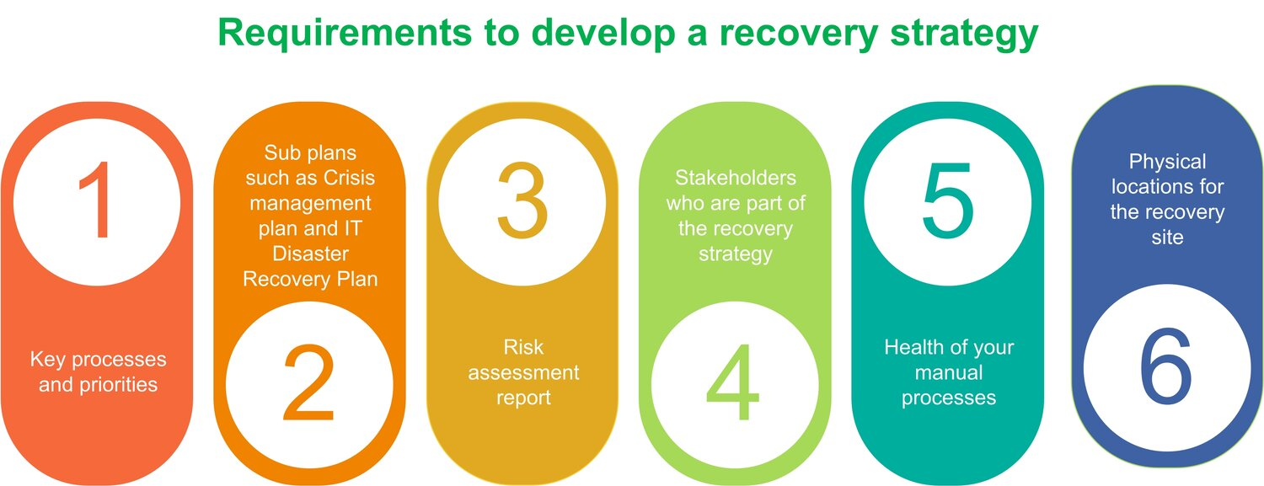

Slide 16
Backup Configuration
Disaster Recovery (DR) Backups are executed using the following phases:
Export During the export phase, the software copies a metadata backup of the CommServe database to the default staging directory that is in software_installation_directory\CommserveDR.
You can specify a local path or a network path as a destination location to export the metadata.
You can set up the following additional export destinations:
Commvault Cloud Services portal
Cloud storage library
Recommended:
You must store the Disaster Recovery (DR) backup in a dedicated network location that is accessible from both the production host and the new server host that is used for recovery.
Do not use a local disk or local clustered disk because it is not safe and recommended.
Use a UNC path to access the network location. Make sure that this dedicated location is not used for any other CommServe task.
Do not use administrative shares as an export location. For example, \\MyServer\E$\.
For a network location that is on a Windows mount path, the software enables ransomware protection by default. For a network location that is on a Linux mount path, you must enable ransomware protection manually.
Do not use the Commvault installation directory as a backup location for DR backups to local disk. By default, the Commvault software enables ransomware protection for DR backup folders on Windows.

Slide 17
Backup
During the backup phase, the metadata available in the staging directory in the CommServe, along with the configured log files, are backed up using the DR storage policy as follows:
A default DR storage policy (CommServeDR) is automatically created when the first library is configured in the CommCell.
By default, the primary copy of the DR storage policy is created as a WORM copy to prevents accidental deletion of data that is not qualified for aging.
A secondary copy for the DR backup data is automatically created when you configure the first tape library. An Auxiliary Copy schedule which runs every 15 minutes is automatically created. If necessary, you can change the frequency of this Auxiliary Copy operation.

Slide 18
Replication SetUp
In this day and age, clients have little patience for any pause in the rendering of services, irrespective of the reason. For example, if you are visiting Company A’s website in search of a particular service, and this service is not available, you are likely to visit a website of a competitor to Company A which can deliver required services in its stead. In today’s feverish world, significant business downtime is highly likely to damage customer loyalty.
In other words, downtime may result in the following:
Loss of profit
Damage to your brand
Problematic relationship with customers and partners
Issues with supply chain
Legal problems, etc.
These results may be due to a lack of availability of business-critical services and data, which is what replication is for — to help you avoid downtime altogether or at least minimize its impact. Disaster recovery (DR) is far from being only about disaster recovery replication, and replication, likewise, is performed not only for disaster recovery, but also for data synchronization, integration, consolidation, and migration.

Slide 19
Recovery Testing
This isn’t as simple as picking one of the methods below. You might need to use all of them. Some cover ensuring that business practices align with the disaster recovery plan, some cover ongoing changes to your systems (or your customer’s systems), and some cover testing the hardware and software by simulating a disaster and restoring a file or system or data center to full functionality.
All of these plans should be reviewed and tests should be ongoing. This doesn’t necessarily mean running through a full plan once a month – you might run through some part of each plan on a weekly basis, a bigger part once a month, and a full test once a year. The important part is to perform disaster recovery testing regularly, and ensure that any additions to the business are reflected in the DR plan.
Walkthrough test
This is a step-by-step review of the plan with the client, reading the plan to ensure that everyone is aware of all the steps and that nothing has been overlooked or added since the last review.
Tabletop test
This kind of test is a ‘what if’ scenario. Lay out a specific kind of disaster, and ask each team member what they would do. A representative of every department should attend, and knowledge of business processes is critical. This may reveal gaps in the plan, which can be addressed before they cause a DR failure.
Technical Tests
Parallel
A parallel test restores a system that hasn’t actually broken down to an alternate location. The real system continues to run and there’s no interruption to business services. This is safe, and not only tests the functionality of backup and restore systems, but can reveal potential problems. An inexpensive way to do this is to run the restore in a virtual machine in the cloud, rather than having to dedicate a physical server somewhere.

Slide 20
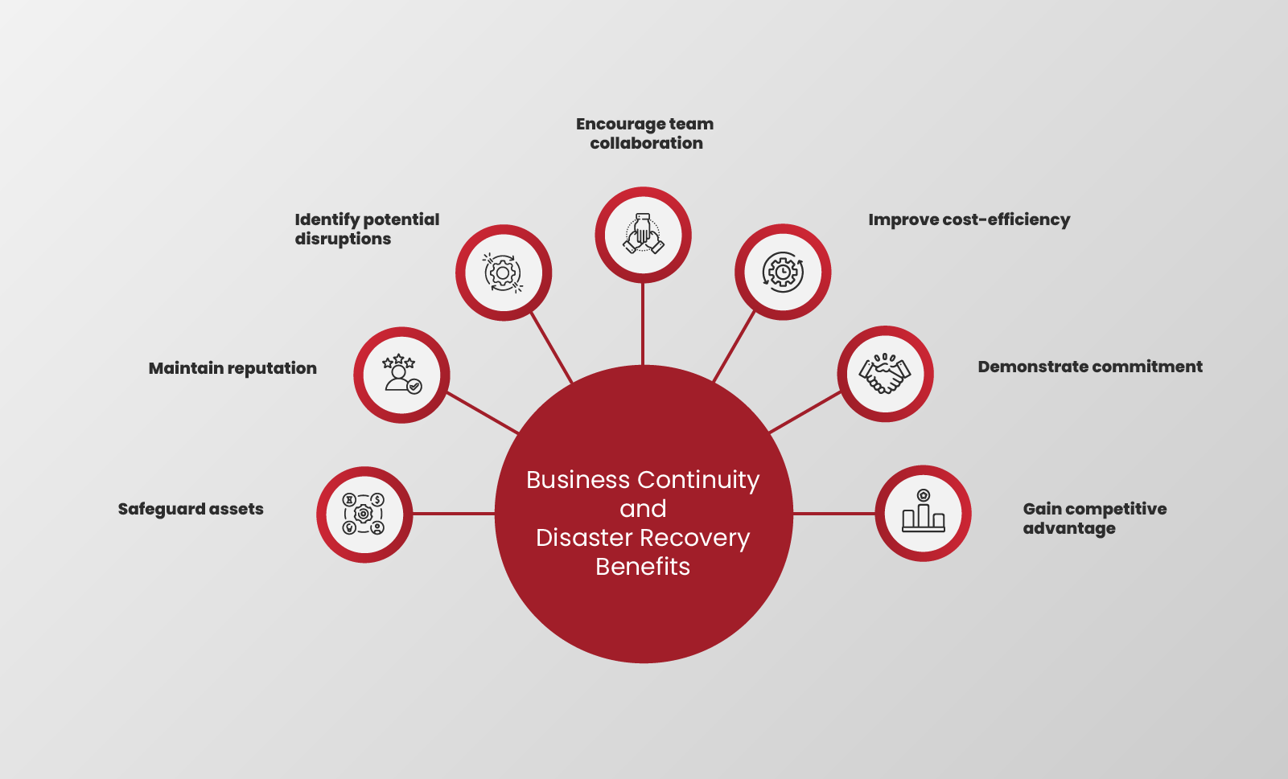
Business Continuity

Slide 21
Conclusion
Disaster recovery planning is an important process for every business to go through. A disaster recovery plan requires identifying threats, setting goals of disaster recovery, researching the best ways to achieve those objectives, and testing the plan.

