Slide 1
IBM GROUP 5 CLOUD COMPUTING phase-2
DISASTER RECOVERY WITH IBM CLOUD VIRTUAL SERVERS

Slide 2
INTRODUCTION
In this project we are going to edit the design into innovation to solve the problem. In Phase 2 we are going to solve the emerging problem that are faced by the disaster systems.
The rise of virtualization as a business tool has revolutionized the way companies operate today. By decoupling data from the underlying physical hardware, businesses are freed from the limitations imposed by a need to keep their data within arm’s reach — it can now be stored anywhere in the world that it makes operational and regulatory sense to do so. However, while data is more mobile than ever, many organizations do not have a comprehensive plan in place for how to recover their data in case of natural disaster, ransomware.
Cybersecurity Ventures predicts cybercrime damages will cost the world $6 trillion annually by 2021, up from $3 trillion in 2015. They also project cybercrime “will be more profitable than the global trade of all major illegal drugs combined.” In such a climate, an attack is not a matter of if, but when.
The secret to recovering from a ransomware breach or other disaster lies in preparation. It is no longer sufficient, or even wise, for an IT manager to cross their fingers and hope that their company won’t be attacked — they must take active, purposeful steps to prepare for the inevitable. In today’s 24x7x365, always-on world, a solid disaster recovery (DR) plan is no longer a “nice to have” — it should be a critical part of every company’s data management strategy.

Slide 3
DISASTER RECOVERY
Don’t be fooled: simple backup is not the same as disaster recovery. Many backup vendors claim to provide DR as part of their solution, but unless they are optimized to provide the fast recovery of all enterprise data and applications, they aren’t enough.
A simple backup app may only update during off-peak times (typically at night) and may store data on legacy media such as tapes in slow-to-access remote locations. If you needed quick access to mission-critical data, such as following a ransomware attack, it could be weeks before you get it.
On the other hand, a backup/restore solution that includes effective DR stores data in one or more separate locations. Most importantly, the enterprise can restore operations quickly and easily, including spinning up VMs off-premises or in the cloud to run applications in order to maintain business continuity.
With a comprehensive DR strategy in place, companies can achieve a recovery point objective (RPO) of less than 24 hours and a recovery time objective (RTO) of mere minutes, restoring any amount of data — from an individual file to a complete virtual machine.

Slide 4
EMERGING METHODS FOR IMPLEMENTING A DR STRATEGY
Historically, on-premises infrastructure was used for backup and disaster recovery, but the cost limited DR to only the most mission critical applications. With the transition to the cloud, these costs have been dramatically reduced allowing more applications to be included in the DR planning.
Effective DR, however, requires remote capabilities, typically leveraging the cloud, and there are a number of ways to make it happen: • Duplicate a primary data center precisely, right down to the last cable. However, managing a secondary data center to ensure proper failover is both time-consuming and costly, particularly for VMware environments. If the secondary location is near the primary data center, it may be affected by the same disaster (e.g., power outage, earthquake, etc.).
• Use an appliance hosted in the cloud such as an Amazon Snow device that can be physically shipped from an Amazon facility for on-premises recovery. This kind of solution is typically marketed for extremely data-intensive analytics use cases.
• Manage self-service recovery using enterprise-owned or -leased infrastructure hosted in the cloud that enables restoring data, applications, or both.
• Engage a disaster recovery as a service (DRaaS) provider. This resembles self-service recovery, but the DRaaS provider eliminates any IT overhead and infrastructure costs. It backs up and restores your company’s operations via a cloud service provider such as AWS

Slide 5
DESIGNING AN EFFECTIVE DR PLAN
While it should be obvious that a comprehensive DR plan is an essential requirement for any modern company, the path toward achieving that goal may not be so clear. To help prepare a DR plan for your company, here are the four essential steps in the process, and tools for helping you get it right:
Step 1: Perform a business impact analysis (BIA) Any comprehensive backup and DR planning process must begin with an accurate assessment of your current virtualized environment.
How much data are you currently managing? Where is it located? How critical is it to your business operations? Once you have completed this step, the vital question becomes: how would a disruption of this data access impact your business? Think in terms of business opportunities lost, time spent restoring files and rebuilding databases, etc. This step is crucial to the process because it will inform every decision you make from here on, including how much you will budget for the solution. Obviously, it makes sense to invest more to protect the data that is vital to your company’s ongoing success.
Step 2: Perform a risk assessment A BIA is essential for looking inward at your business-critical data and the impact on your business of any disruption to it.
A risk assessment, on the other hand, is focused on potential external situations that could negatively impact your business, and the likelihood of such situations occurring. These could include natural disasters (e.g., tornadoes, floods, etc.) as well as man-made events (e.g., power outages, terrorist acts, etc.).
This will allow you to gauge the probability that your DR plan will one day need to be activated. When you’re preparing a risk assessment, be sure to leverage all available records to assess the threat of disaster.

Slide 6
Such sources might include (but are not limited to): Essential requirements for effective DRaaS: Source: GIGAOM Business & Technology Impact Report, Emerging Approaches to Cloud-Native Business Continuity and Disaster Recovery
• SaaS-based
• Cloud-native
• Source-side deduplication
• Separation of data and metadata
• Unified dashboard for management
• Encrypted architecture
• Company records of disruptive events
• Employee recollection of disruptive events
• Local and national media records
• Local libraries
• First-responder organizations
• National Weather Service historical data
• U.S. Geological Survey maps and other documentation
• Experience of key stakeholder organizations

Slide 7
Step 3: Design a risk management strategy Once you have identified the critical elements of your virtualized landscape, the business impact of any disruption to it, and the likelihood of disaster, the question becomes: What can I do to mitigate the damage? This is when you need to decide upon a specific solution for backup and DR of your business-critical data.
Although there are sure to be multiple, possibly contradictory, demands, a few elements that will inform your decision might include the following: • RPO (how much data you can afford to lose)
• RTO (how quickly your business needs to be back in operation) • Data residency laws (where your data can legally be stored) • Budget for implementation These considerations will allow you to calculate the ROI of competing vendors and select the one that best fits your organization’s requirements. As mentioned earlier, utilizing the public cloud for DR can provide savings in all of these areas.
Step 4: Configure and test (and keep testing!) It should be obvious, but you need to know whether your backup and DR solution is configured correctly before you actually have to use it. The only way to achieve that is by regularly testing your DR. A cloud-native backup and DR solution allows you to immediately spin up your virtual machines in the cloud for development testing (dev-test) purposes.
Ensure that your VMs operate as expected and that data has been backed up in compliance with the RPO you have set. Bear in mind that testing is not a “one and done” affair — it should be a regular, and ongoing, part of your work. Set a cadence that makes sense for your organization and stick to it.

Slide 8
What is a disaster recovery plan (DRP)?
A disaster recovery plan (DRP) is a documented, structured approach that describes how an organization can quickly resume work after an unplanned incident. A DRP is an essential part of a business continuity plan (BCP). It is applied to the aspects of an organization that depend on a functioning information technology (IT) infrastructure. A DRP aims to help an organization resolve data loss and recover system functionality so that it can perform in the aftermath of an incident, even if it operates at a minimal level.
The plan consists of steps to minimize the effects of a disaster so the organization can continue to operate or quickly resume mission-critical functions. Typically, a DRP involves an analysis of business processes and continuity needs. Before generating a detailed plan, an organization often performs a business impact analysis (BIA) and risk analysis (RA), and it establishes recovery objectives.

Slide 9
Innovating disaster recovery using virtual cloud servers involves leveraging the flexibility, scalability, and cost-effectiveness of cloud computing to enhance your organization's ability to recover from disasters. Here are some innovative approaches to disaster recovery using virtual cloud servers:
1. **Serverless Computing: - Embrace serverless computing platforms (e.g., AWS Lambda, Azure Functions, Google Cloud Functions) to run critical functions without the need to manage virtual servers. Serverless architectures automatically scale and are highly available.
2. **Cloud-Native Database Replication:**
- Utilize cloud-native database replication features to create real-time backups of your databases in a separate cloud region. This ensures minimal data loss during disasters.
3. **Multi-Cloud Disaster Recovery:**
- Implement disaster recovery across multiple cloud providers to avoid vendor lock-in and increase redundancy. For example, you can use both AWS and Azure for your disaster recovery solutions.
4. **Infrastructure as Code (IaC):**
- Manage your virtual cloud server infrastructure using IaC tools (e.g., Terraform, AWS CloudFormation) to easily replicate and rebuild your environment in case of a disaster.

Slide 10
5. **Distributed Applications and Microservices:**- Design applications using microservices architecture, making it easier to failover individual services to different cloud regions or providers.
6. **Container Orchestration:**
- Use container orchestration platforms like Kubernetes to deploy applications in containers, which can be easily moved and scaled across cloud regions for disaster recovery.
7. **Continuous Data Replication:**
- Implement continuous data replication solutions that can mirror data changes in real-time between primary and secondary cloud regions.
8. **Automated Failover and Scaling:**
- Set up automated failover and scaling policies that can dynamically allocate resources based on demand and automatically redirect traffic during a disaster.
9. **Cloud Automation and Orchestration:**
- Leverage cloud-specific automation and orchestration tools to streamline disaster recovery processes, reducing manual intervention.
10. **Immutable Infrastructure:**
- Adopt an immutable infrastructure approach, where server configurations are never modified but are replaced when changes are needed. This ensures consistency and reproducibility.
11. **Global Load Balancing:**
- Use global load balancers provided by cloud providers to distribute traffic across multiple cloud regions, enabling seamless failover.
12. **Disaster Recovery as Code (DRaC):**
- Define your disaster recovery processes and procedures as code, allowing for version control, automated testing, and easier updates.

Slide 11
13. **AI and Machine Learning for Predictive Analysis:**
- Leverage AI and machine learning algorithms to predict potential disasters and automate response actions based on real-time data.
14. **Security Automation:**
- Implement security automation tools and practices to proactively detect and respond to security threats during and after a disaster.
15. **Cloud-Native Monitoring and Alerting:**
- Utilize cloud-native monitoring and alerting services to gain real-time insights into the health and performance of your virtual servers and applications.
16. **Serverless Disaster Recovery Testing:**
- Automate and script disaster recovery testing in serverless environments to simulate disaster scenarios and validate recovery procedures.
17. **Hybrid Cloud Configurations:**
- Explore hybrid cloud configurations that combine on-premises resources with virtual cloud servers for seamless disaster recovery and resource scaling.

Slide 12
18. **Zero Trust Security Model:**
- Implement a Zero Trust security model, ensuring that trust is never assumed even within cloud environments during disaster recovery.
19. **Blockchain for Data Integrity:**
- Use blockchain technology to maintain data integrity, especially in scenarios where data tampering is a concern.
20. **Edge Computing for Local Resilience:**
- Deploy edge computing resources in disaster-prone areas to maintain local resilience and processing capabilities.
21. **Collaborative Disaster Recovery:**
- Utilize cloud-based collaboration tools to enable remote teams to coordinate and execute disaster recovery plans effectively.

Slide 13
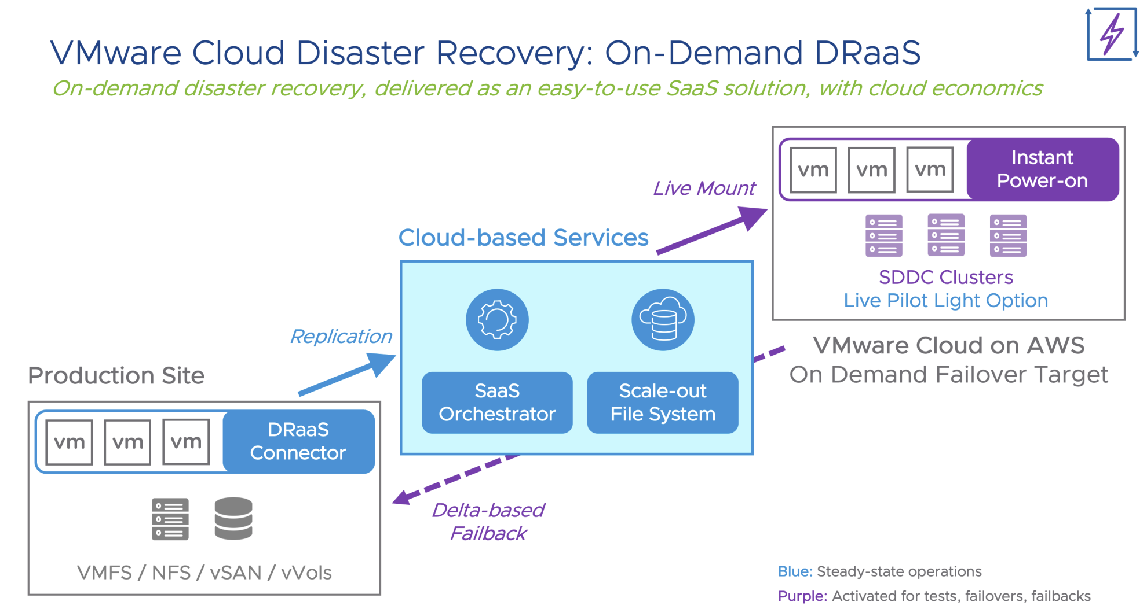

Slide 14
Conclusion
Data recovery of critical data, in case of any catastrophic event is the matter of concern for the companies. To recover your data appropriately, you need an accurate yet convenient disaster recovery plan. Any company must not depend only on remote backup, it should ensure full protection of data. You have to analyze your remote backup system, prioritize your services and conduct a live test to make sure your disaster recovery plan in working. A product of stonefly DR365V provides you with best disaster recovery plan.
It creates 3 redundant copies of your data in the cloud and 6 geo-redundant copies are created in different clouds through geo-replication. Geo-replication can be done from or to on-premises to Public (Microsoft Azure, Amazon (AWS) Private Cloud and Cloud to cloud private or public. Veeam backup engine or StoneFly DR365V offers (RTPOs) of less than 15 minutes for all data and applications. DR365V Veeam Backup appliances are available with combined, high-availability modular, or scale out high-availability modular configurations.

