Slide 1
telecom Customer Churn prediction analysis
Data Science Final Capstone Project
(Springboard Jul 2023 Cohort)
Prepared by : Thant Thiri Myo Kyi
March 2024

Slide 2
Introduction
Problem Statement
To addresses the crucial challenge of developing a predictive model that can forecast the likelihood of customer churn for a telecom company.
By analyzing a multitude of factors—including customer demographics, service usage patterns, and prior churn rates—the model aims to pinpoint customers at a high risk of churning.
The ability to predict which customers are likely to leave enables the company to take strategic and timely actions to increase retention, thereby reducing churn rates and fortifying customer satisfaction and loyalty.
Goal
To construct a dependable and precise predictive model that identifies from its insights which will lead the telecom company's ability to retain customers, leading customers who are potential churn risks.

Slide 3
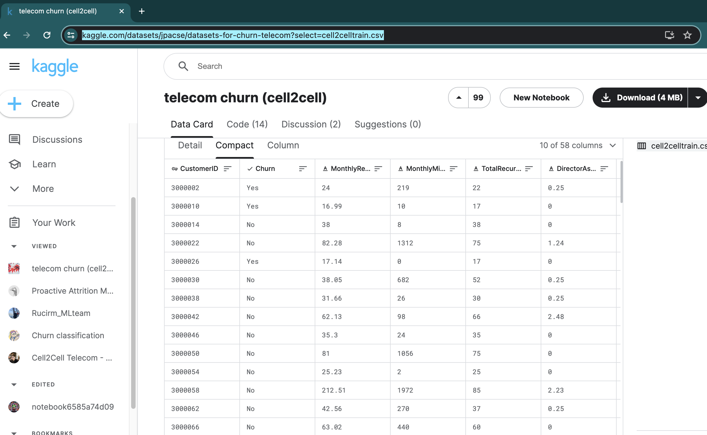
Data Acquisition & Cleaning
Data Collection
Sourced from a Kaggle dataset, the data encompasses records of 51,047 telecom customers, providing a rich foundation for analysis. Variables cover a broad spectrum, including customer demographics, account details, usage metrics, and customer service interactions, encompassing 57 distinct fields ranging from monthly revenue to handset information.
Data Source: https://www.kaggle.com/datasets/jpacse/datasets-for-churn-telecom?select=cell2celltrain.csv

Slide 4
Data Acquisition & Cleaning
Data Wrangling
The initial step involved a rigorous cleaning process to ensure data quality and readiness for subsequent analysis.
Identified and addressed missing data points, with key variables such as AgeHH1, AgeHH2, PercChangeMinutes, and PercChangeRevenues being affected—though these constituted less than 2% of the dataset.
Checked for duplicate records and took appropriate actions to remove redundancies, preserving the integrity of our dataset.
To enhance data granularity, we derived a new categorical feature, 'CityCode', from the Service Area using the first three characters, aligning with the IATA airport coding standard.
Analyzed the distribution of both categorical and numerical columns, identifying and deciding on the best approaches to handle outliers—through methods such as capping, imputation, or adjustments—acknowledging the inherent variability within telecom data due to diverse customer profiles.
The finalized, cleaned dataset consists of 51,047 records and 57 variables, providing a solid base for robust analytical exploration.
Stored the cleansed data in a file named ‘cleaned_data.csv’, ready for deep statistical analysis and predictive modelling in the following phases of the project.

Slide 5
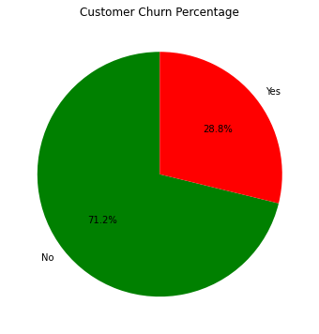
Exploratory Data Analysis (EDA) Overview
Preliminary Data Examination
Initial step in EDA was to examine the churn status across our entire dataset, revealing that 28.8% of customers have churned.
Next step is driving into a variety of variables such as customer demographics, account specifics, and behavior patterns to lay the groundwork for an in-depth analysis.
Customer Analysis
The customer analysis was bifurcated into two key areas to gain a holistic understanding of what influences churn:
Demographic Analysis: Assessed how different customer segments—defined by age, income, marital status, and more—fare in terms of churn likelihood.
Behavioural Analysis: Investigated service usage and customer interaction metrics, aiming to pinpoint behavior patterns that signal a higher propensity for churn.

Slide 6
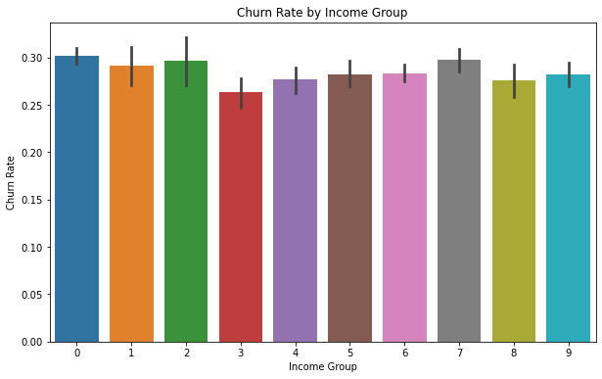
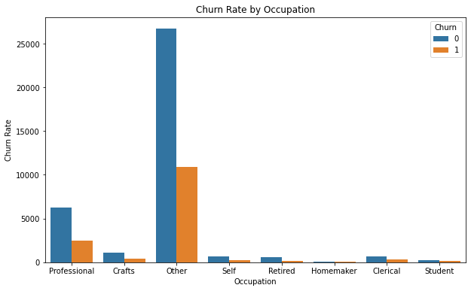
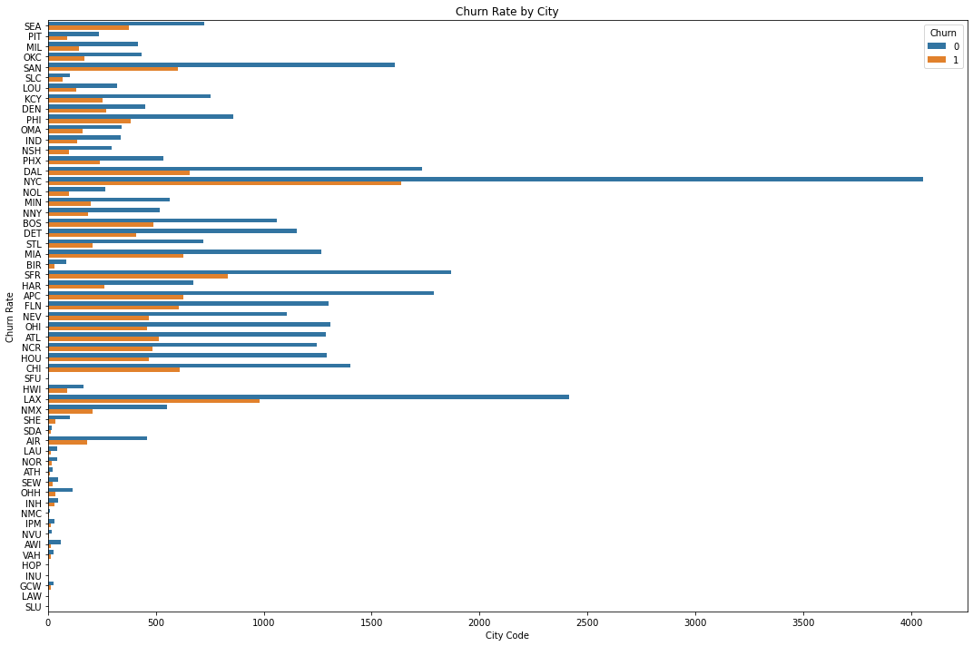
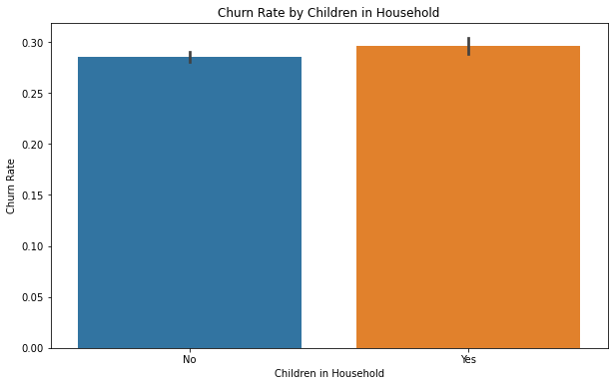
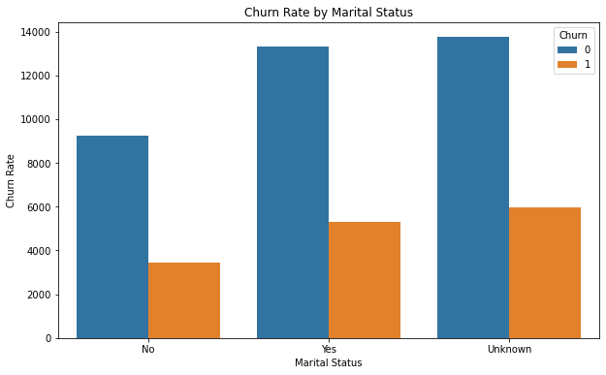
Demographic Analysis
Economic Influence
Analysis of churn across different economic brackets revealed a pattern where customers from specific income and occupation categories displayed higher churn rates.
A trend suggesting that customers with lower income levels were more prone to churn, potentially indicating a sensitivity to pricing and service costs.
Occupation types seem to correlate with churn; certain job categories, perhaps those with more transient lifestyles or erratic service requirements, showed a propensity to switch providers more frequently.
Family Dynamics
Churn rates were notably different among households with and without children, suggesting that family needs play a significant role in retention.
Customers with children in the household had slightly higher churn rates, possibly due to shifting service needs or financial restraints.
Geographic Variance
A significant disparity in churn rates was observed when analyzing the data city-wise.
This variance could point towards external factors such as regional service quality, market competition, or economic conditions influencing customer loyalty.

Slide 7
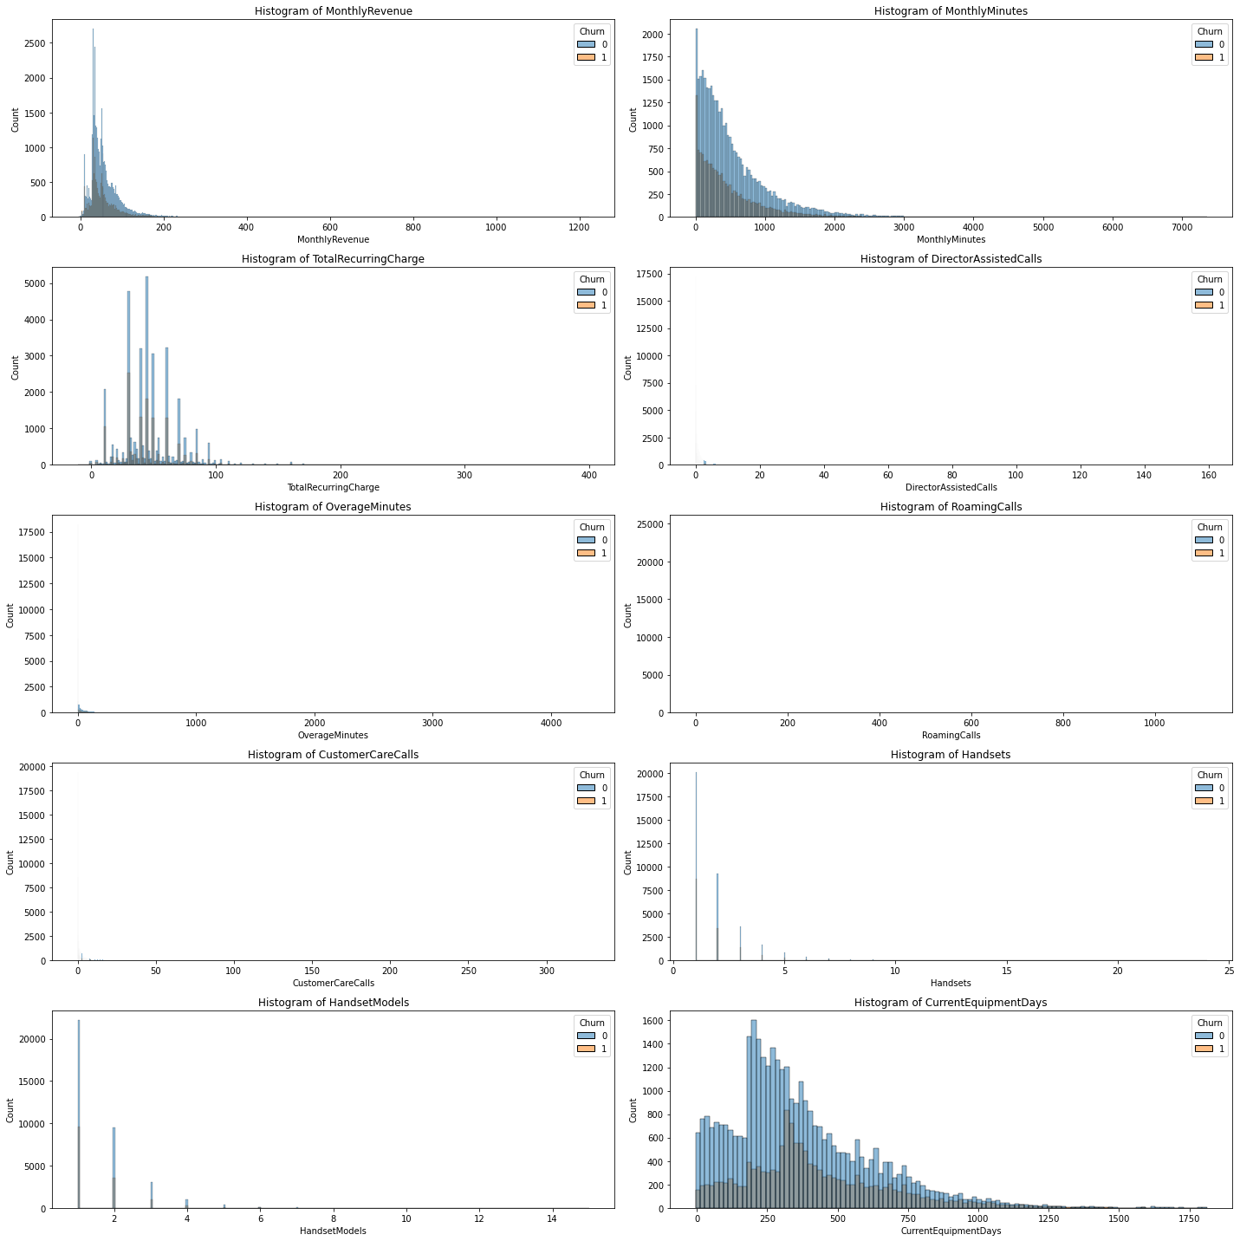
Behavioral Analysis
Service Usage
Customers who eventually churned exhibited lower service usage in terms of both monthly revenue and usage minutes. This suggests that lower engagement with the telecom services may be a precursor to customer departure, highlighting the need for plans that better match customer usage patterns.
A higher incidence of overage minutes among churned customers pointed to a possible mismatch between customer needs and their current plans.
Customer Service Interactions
Churned customers were found to have a higher frequency of director-assisted calls and customer care interactions, implying dissatisfaction or unresolved issues.
The data suggests that addressing service-related concerns promptly and effectively could play a pivotal role in preventing churn.
A proactive customer service approach, focusing on resolving issues before they escalate, could enhance overall customer satisfaction and loyalty.
Equipment and Engagement
The analysis also considered the age of customer handsets and the number of handset models used, uncovering a subtle yet notable correlation with churn rates.
Customers with older or outdated handsets showed a higher tendency to churn, possibly seeking newer technology available with competitors.
Engagement, as indicated by the number of handset models, also correlates with churn, suggesting that customers who are not taking advantage of the full range of services and updates may be at higher risk of churning.

Slide 8
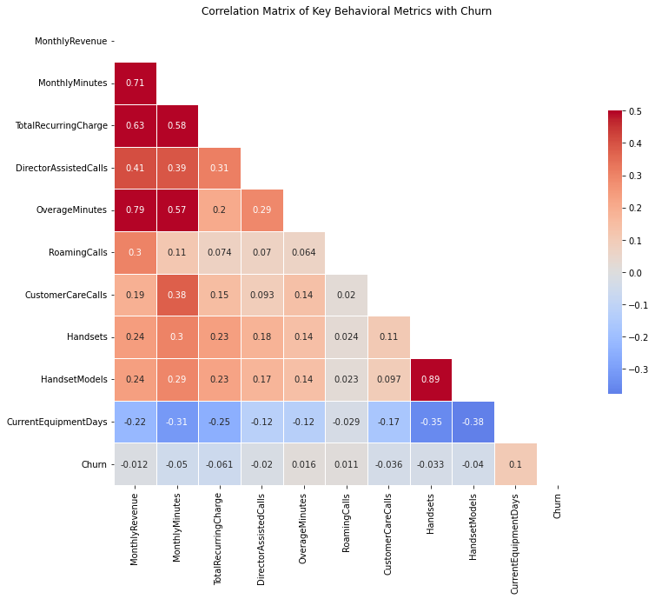
Correlation & Statistical Insights
Statistical Significance
The null hypothesis posited no significant difference between the means of churned and non-churned customers across various metrics.
Results indicated:
A significant difference in the mean monthly revenue and minutes between churned and non-churned customers (p < 0.05), rejecting the null hypothesis.
Customer service interactions, such as the number of director-assisted calls, were significantly higher in churned customers (p < 0.05), further rejecting the null.
Demographic factors like income group and marital status also showed significant differences in churn rates (p < 0.05), while occupation did not (p > 0.05).
These statistically significant differences validate the predictive power of certain behavioural and demographic factors in identifying potential churn.
Correlation Analysis
Correlation matrix serves as a visual representation of the relationships between customer attributes and churn.
While no single factor is a dominant churn predictor, a combination of several weakly correlated factors may cumulatively have a strong influence.
Variables such as monthly minutes, customer service calls, and overage charges, though weakly correlated individually, together paint a compelling picture of potential churn risk.

Slide 9
Preparing for Predictive Modelling
Refined Dataset
Based on our exploratory data analysis (EDA), we streamlined the dataset to concentrate on variables with significant relevance to churn. This refined dataset includes:
CustomerID: For tracking and analysis.
Churn: The target variable we aim to predict.
Service Usage Metrics: MonthlyRevenue, MonthlyMinutes, and TotalRecurringCharge.
Customer Interaction: DirectorAssistedCalls, CustomerCareCalls.
Usage Patterns: OverageMinutes, RoamingCalls.
Demographics: IncomeGroup, MaritalStatus, Occupation, CityCode, ChildrenInHH.
This selection is driven by our goal to create a predictive model that is both accurate and insightful, focusing on the variables most indicative of churn behavior.
EDA Summary
Demographic Trends: Certain demographics, including income group, marital status, and the presence of children, have a pronounced impact on churn rates.
Service Usage and Interaction: There's a clear link between service usage patterns (such as monthly minutes and revenue) and churn, with higher incidences of churn among customers exhibiting lower usage or higher levels of service-related issues.
Geographic Variance: Churn rates vary significantly across different geographic regions, suggesting the influence of local competition and market saturation.
The insights derived from the EDA emphasize the multifaceted nature of customer churn, informing our approach to predictive modeling by highlighting the importance of considering a broad range of factors.

Slide 10
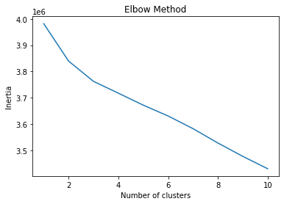
Pre-processing for Model Training
Customer Segmentation
K-Means Clustering: To better understand our customer base, we employed K-Means clustering, a method that groups customers into clusters based on similarities in their data.
Process & Outcome: Relevant features such as service usage metrics and demographic information for the clustering process. Using the elbow method, the optimal number of clusters can be determined. This resulted in distinct customer segments, each with unique characteristics that inform tailored retention strategies.
Feature Engineering
Encoding Categorical Variables: Applied one-hot encoding to transform categorical data (e.g., CityCode, MaritalStatus) into numerical formats for machine learning models.
Refinement and Selection: Removed redundant variables, focused on variables most predictive of churn. Created new features to better capture customer behavior and service usage.
Preparing Dataset Split: Training and Testing Sets: Data split into an 80% training set and a 20% testing set to accurately evaluate model performance.

Slide 11
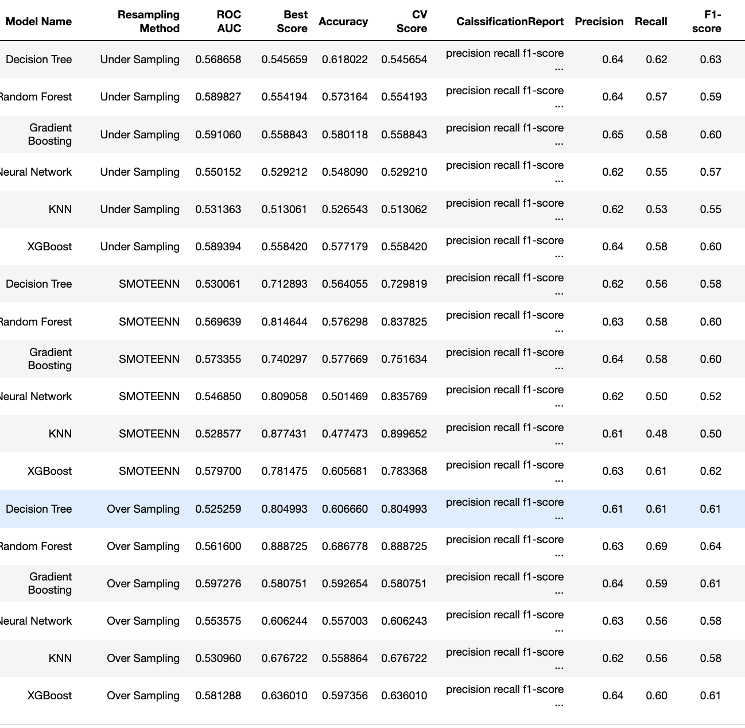
Modelling
Model Selection
Evaluated several machine learning models with Hyper-parameter Tuning to determine the most effective approach for predicting customer churn, including:
Decision Trees
Random Forest
Gradient Boosting
Neural Networks
K-Nearest Neighbors (KNN)
XGBoost
Resampling Techniques: Given the imbalance in our dataset between churned and non-churned customers, we applied resampling techniques like SMOTE (Synthetic Minority Over-sampling Technique) and random under-sampling to balance the classes. This approach improves model sensitivity to churn by ensuring that the minority class is adequately represented.

Slide 12
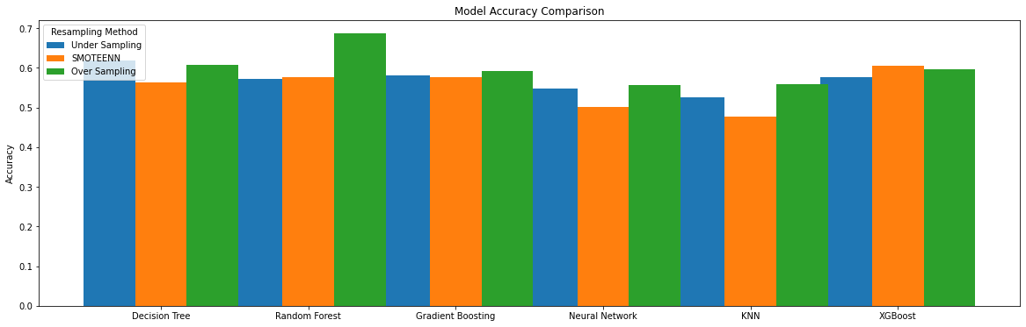
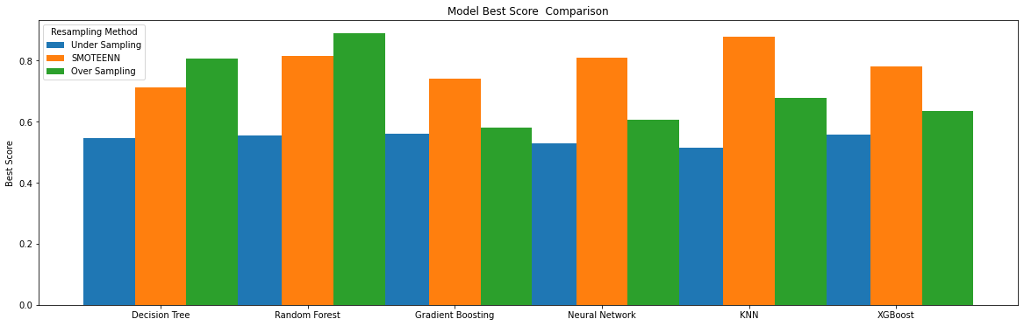
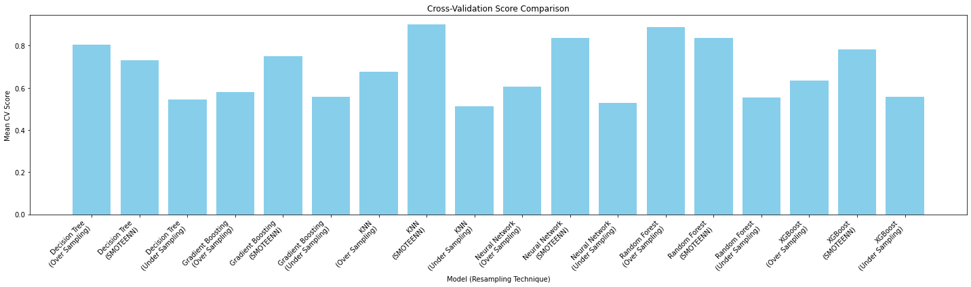
Model Evaluation
Evaluation Metrics: We assessed model performance using several key metrics, including accuracy, precision, recall, F1-score, and the area under the ROC curve (AUC). These metrics provide a comprehensive view of model effectiveness, particularly in predicting churn accurately.
Final Model Selection: Based on our evaluation criteria, the Random Forest Classifier, augmented with hyper-parameter tuning and oversampling techniques, emerged as the final model. This model demonstrated a strong balance between accuracy and generalizability, as evidenced by its performance metrics:
High accuracy in distinguishing between churned and non-churned customers.
A commendable AUC score, indicating excellent model sensitivity and specificity.
The selection was grounded in the model's ability to deliver robust predictions while managing the complexities of our churn prediction task.

Slide 13
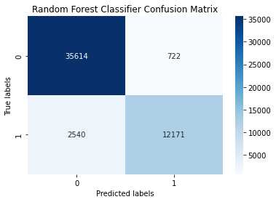
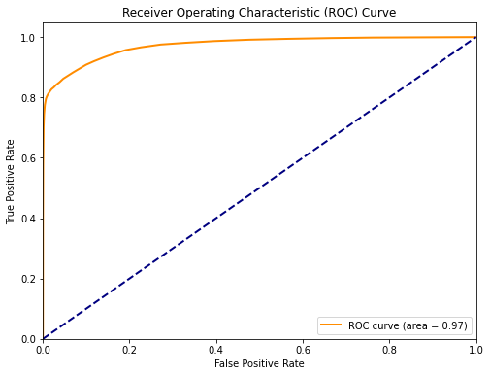
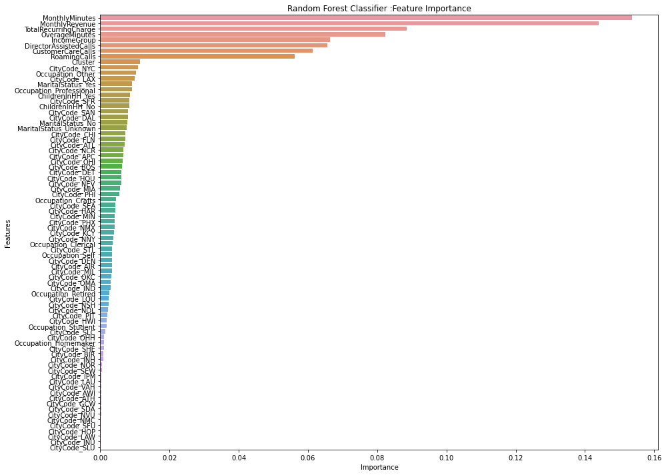
Prediction OUtCOME
The final model, the Random Forest Classifier, showcased impressive predictive outcomes, underlining its effectiveness in identifying potential churn customers.
Model Accuracy: Demonstrated a high level of accuracy in classifying customers, ensuring reliable churn predictions.
ROC AUC Score: Achieved an AUC score near 0.97, indicating exceptional model performance in distinguishing between churned and non-churned customers. A score closer to 1 signifies a high true positive rate and a low false positive rate.
Feature Importance: Analysis revealed that service usage metrics (e.g., MonthlyMinutes, MonthlyRevenue) and customer interaction variables (e.g., CustomerCareCalls) were among the most significant predictors of churn. This insight directs focus towards critical areas for intervention to reduce churn.

Slide 14
Risk Segmentation
Leveraging the predictive model, the customer base into distinct risk categories, enabling targeted retention strategies tailored to each group's likelihood of churn:
Low Risk (Probability of Churn < 30%): For customers with the lowest likelihood of churning, maintain satisfaction through regular service quality checks and personalized offers.
Medium Risk (Probability of Churn between 30% and 70%): Customers in this segment require more direct engagement strategies, such as personalized communication highlighting new features or loyalty programs that address their specific usage patterns.
High Risk (Probability of Churn > 70%): For those at highest risk, deploy intensive retention efforts, including special discounts, proactive customer service outreach, and customized plans designed to address their reasons for potential churn.
By implementing these targeted strategies based on churn risk segmentation, we can more effectively allocate resources to retain customers and ultimately reduce overall churn rates.

Slide 15
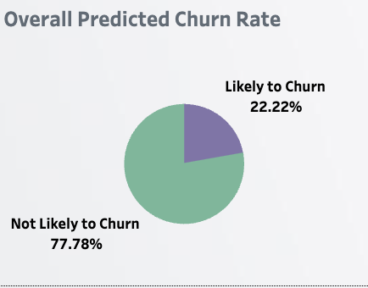
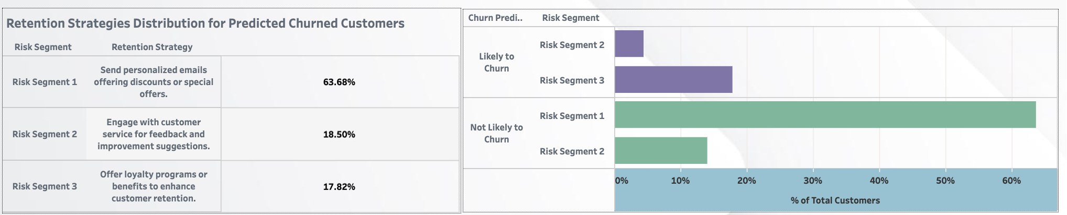
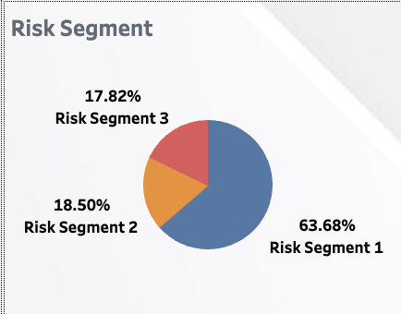
Data Visualization
A series of compelling visualizations are designed using the prediction model data . Each graph illustrate key aspects of customer behavior, churn risk, and the impact of retention strategies. These visual insights are crucial for understanding the dynamics of customer churn and guiding strategic decisions.
https://public.tableau.com/app/profile/thant.thiri.kyi/viz/TelecomChurn_17094319695010/Story1
Churn Overview:
About 22% of customers are likely to stop using our services (churn).
Retention Strategies:
For low risk (Segment 1), sending personalized emails with deals.
For medium risk (Segment 2), asking for feedback and suggestions.
For high risk (Segment 3), offering loyalty programs.
By comparing churn rates or customer satisfaction scores prior to and following the implementation of strategies, we can visually assess the impact of our actions.
Churn Risk Segments:
Majority, nearly 64%, are in the low-risk group (Risk Segment 1).
About 19% are in the high-risk group (Risk Segment 3).

Slide 16
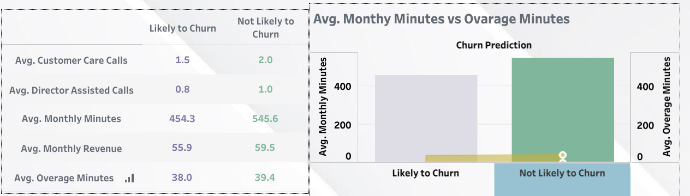
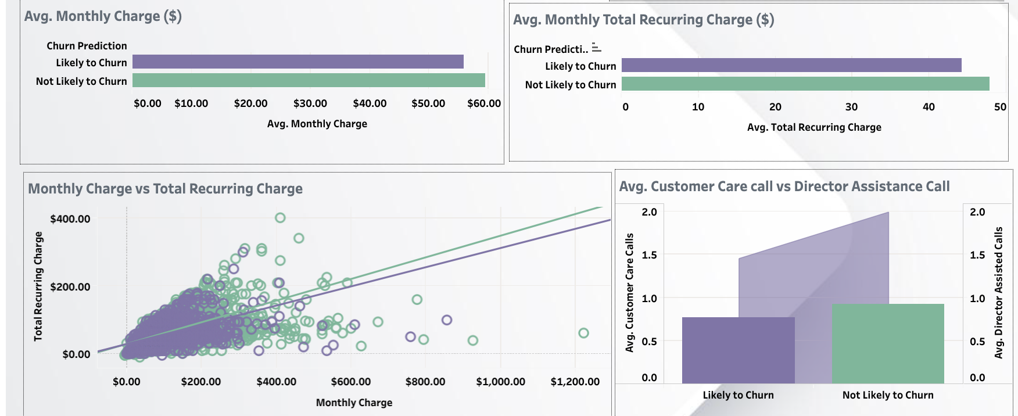
Data Visualization
Churn by Behavior:
Customers likely to churn make fewer customer care calls and have fewer director-assisted calls compared to others.
On average, they use more minutes and have higher monthly overages.
Churn by Charges:
Higher total recurring charges link to a higher chance of churn.

Slide 17
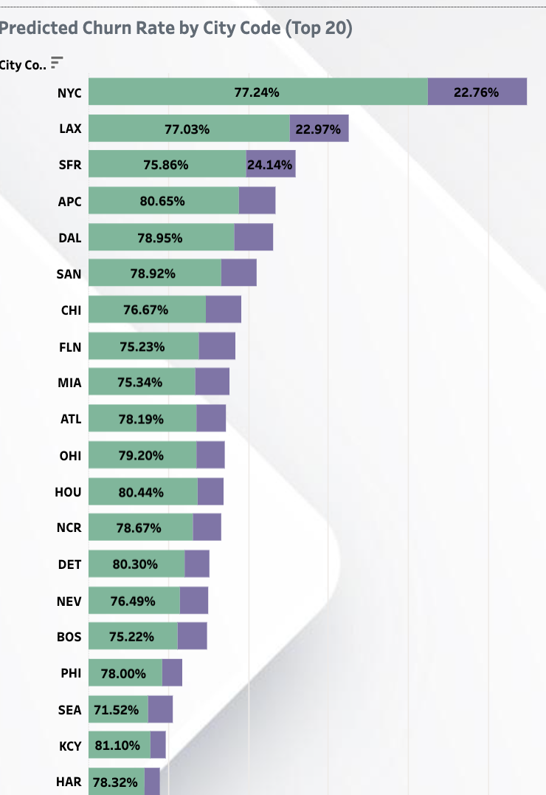
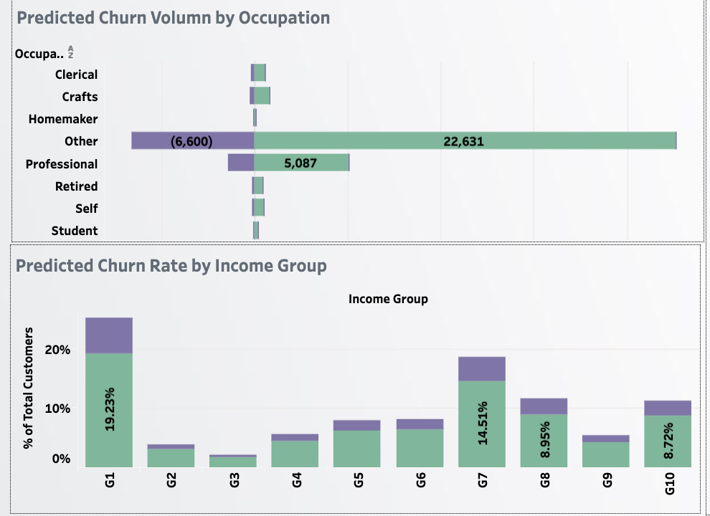
Data Visualization
Churn by Demographics:
Churn does not vary significantly with marital status or children in the household.
The professional group has the highest number of customers likely to churn.
Churn by Location:
City code 'KC' shows the highest likelihood of churn, over 81%.
Income and Churn:
Lower-income groups show a higher rate of churn, especially the lowest income group at nearly 20%.

Slide 18
Conclusion
Future Work - Continual Improvement Process
Ongoing Model Evaluation and Updates: Emphasize the necessity of regularly assessing the model's performance over time, incorporating new data, and adjusting to changes in customer behavior and market conditions.
Feedback Loops: Establish mechanisms for capturing the outcomes of retention strategies, allowing for data-driven refinements to both the predictive model and the strategies themselves.
A/B Testing of Strategies: Implement systematic testing of different retention interventions to quantitatively measure their effectiveness, informing more strategic deployment of retention efforts.
Strategic Importance of Adaptability
Adapting to Market Dynamics: Acknowledge the rapidly changing telecom landscape and the importance of agility in both analytical approaches and customer engagement strategies.
Leveraging Insights for Competitive Advantage: Utilize the insights gained from predictive modeling and data analysis to not only reduce churn but also to enhance overall customer experience, driving competitive differentiation.
Conclusion
The journey into predictive modeling and churn analysis marks the beginning, not the endpoint, of our efforts to understand and mitigate customer churn. The path forward involves continuous exploration, learning, and adaptation, ensuring our strategies remain effective and our customers stay engaged and loyal.

Slide 19
Q & A
Thank you

